Slide 2
Outline
The Four Financial Statements
  The Balance Sheet
  The Income Statement
  The Cash Flow Statement
  The Statement of Shareholders’ Equity
The Articulation of the Financial Statements

Slide 3
The Big Picture
The financial statements are the lens on the business. They draw a picture in two ways:
  The way that the component parts of the statements fit together
sketches out the picture
  The numbers reported within each component fills out the sketch
Accounting equations describe how the components fit together.

Slide 4
The Four Financial Statements
The Balance Sheet
The Income Statement
The Cash Flow Statement
The Statement of Shareholders’ Equity

Slide 5
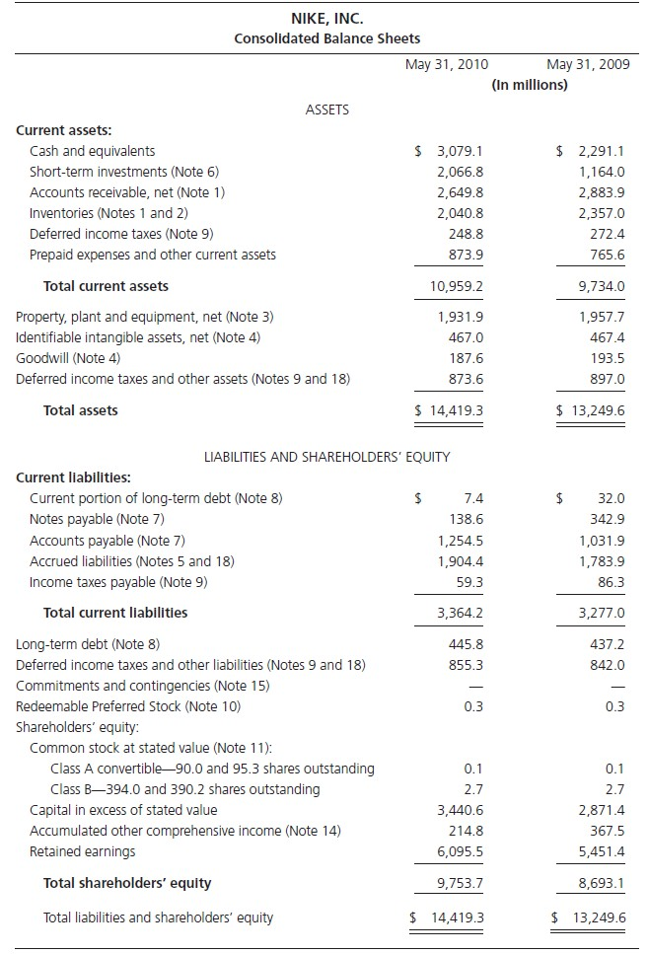
The Balance Sheet: Nike, Inc., 2010
A “snapshot of a firm’s
financial position”

Slide 6
The Balance Sheet: Nike, Inc., 2010
Assets – investments that are expected to generate payoffs
Liabilities – claims to the payoffs by claimants other than owners
Shareholders’ equity –
the claim by the owners
Residual claim on the assets after subtracting liability claims

Slide 7
How Balance Sheet Components Fit Together
Assets = Liabilities + Shareholders’ Equity
Or:
Shareholders’ Equity = Assets – Liabilities
Compare to:
Value of Equity = Value of Firm – Value of Debt

Slide 8
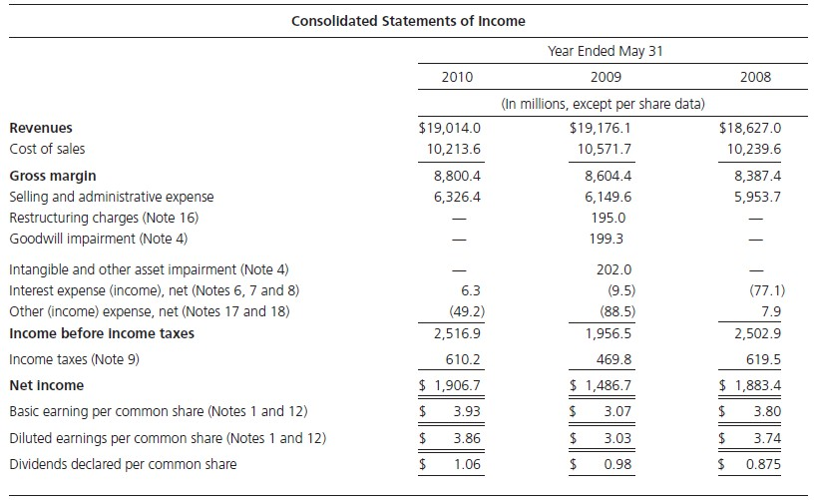
The Income Statement: Nike, Inc., 2010
Shows the firm’s revenues & expenses during a particular period;
how shareholders’
equity ↑ or ↓ as a result
of business activities

Slide 9
The Income Statement: Nike, Inc., 2010
The “bottom line” measure of value added to shareholders’ equity
Net Income = Revenues - Expenses

Slide 10
The Income Statement: Nike, Inc., 2010
Net income (NI) available to common shareholders / weighted-avg. of common shares outstanding during the year

Slide 11
The Income Statement: Nike, Inc., 2010
NI / total common shares would be outstanding if holders of contingent claims were to exercise their options and hold common shares

Slide 12
The Components of the Income Statement
Net Revenue – Cost of Goods Sold = Gross Margin
Gross Margin – Operating Expenses = Operating Income
Operating Income – Interest Expense + Interest Income = Income before
Taxes
Income before Taxes – Income Taxes = Income after Taxes and before
Extraordinary Items
Income before Extraordinary Items + Extraordinary Items = Net Income
Net Income – Preferred Dividends = Net Income Available to Common Operating income is sometimes called earnings before interest and taxes
(ebit)

Slide 13
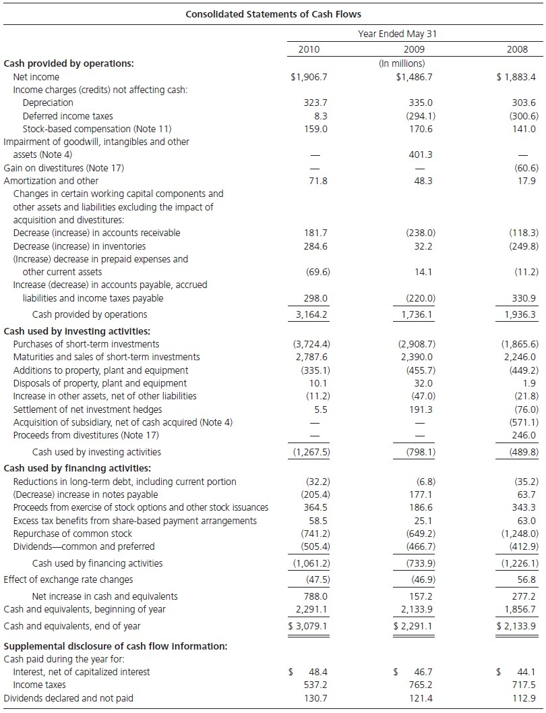
The Cash Flow Statement : Nike, Inc., 2010
Describes how the firm generated and used cash during the period; reflects the firm's liquidity

Slide 14
The Cash Flow Statement : Nike, Inc., 2010
Cash generated from selling products, net of cash used up in doing so
Cash spent on purchasing assets – cash received from selling assets
Cash raised from & disbursed to debt & equity claimants

Slide 15
The Cash Flow Statement : Nike, Inc., 2010
Change in Cash=
Cash from Operations + Cash from Investments
+ Cash from Financing

Slide 16
The Components of the Cash Flow Statement
Change in Cash = Cash from Operations
+ Cash from Investing
+ Cash from Financing

Slide 17
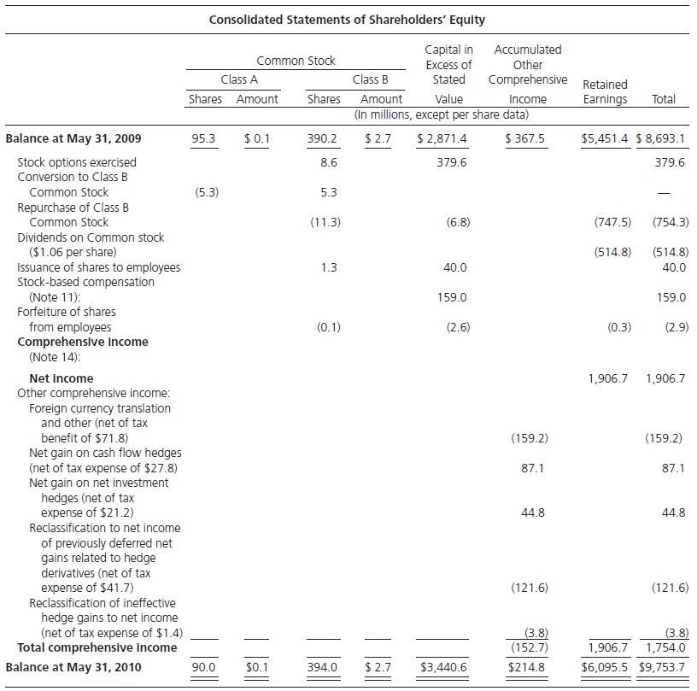
The Statement of Shareholders’ Equity:
Nike, Inc., 2010
Starts with beginning- of-period equity in the BS and ends with end- of-period equity; explains how the equity changed over the period

Slide 18
The Statement of Shareholders’ Equity:
Nike, Inc., 2010
Net Payout = Stock Repurchases + Dividends – Proceeds from Share Issues
Comprehensive Income =
Net Income + Other Comprehensive Income
Ending Equity = Beginning Equity + Total (Comprehensive) Income –
Net Payout to Shareholders

Slide 19
The Components of the Equity Statement
The Stocks and Flow Equation:
Ending equity =
Beginning equity + Total (comprehensive) income
– Net payout to shareholders
Comprehensive income =
Net income + Other comprehensive income
Net payout to shareholders =
Dividends + Share repurchases – Share issues

Slide 20



















The Articulation of the Financial Statements: How They Fit Together
Beginning stocks
Flows
Ending stocks
Cash Flow Statement
Cash from operations Cash from investing Cash from financing
Beginning Balance Sheet
Ending Balance Sheet
Cash
Net change in cash
Cash
Other Assets +
+ Other Assets
Statement of Shareholders’ Equity
Total Assets
Total Assets
- Liabilities
Investment and disinvestment by owners
- Liabilities
Net income and other comprehensive income
Owners’ equity
Net change in owners’ equity
Owners’ equity
Income Statement
Revenues Expenses
Net income

Slide 21
A Summary of the Accounting Relations
How Parts of the Financial Statements Fit Together
The Balance Sheet
Assets
Liabilities
= Shareholders' Equity
The Income Statement
Net Revenue
Cost of Goods Sold
= Gross Margin
Operating Expenses
= Operating Income before Taxes (EBIT)
Net Interest Expense
= Income Before Taxes
Income Taxes
= Income After Tax and before Extraordinary Items
+ Extraordinary Items
= Net Income
Preferred Dividends
= Net Income Available to Common
Cash Flow Statement (and the Articulation of the Balance Sheet and Cash Flow Statement)
Cash Flow from Operations
+ Cash Flow from Investing
+ Cash Flow from Financing
= Change in Cash
Statement of Shareholders' Equity (and the Articulation of the Balance Sheet and Income Statement)
Dividends
Net Income + Share Repurchases Beginning Equity + Other Comprehensive Income = Total Payout
+ Comprehensive Income ←⎯⎯ = Comprehensive Income − Share Issues
Net Payout to Shareholders ←⎯⎯⎯⎯⎯⎯⎯⎯⎯⎯⎯⎯⎯⎯⎯ = Net Payout
= Ending Equity

Slide 22
Intrinsic Value and Book Value
Intrinsic Premium:
  Intrinsic Value of Equity – Book Value of Equity
Market Premium:
  Market Value of Equity – Book Value of Equity
Intrinsic Price-to-Book Ratio:
  Intrinsic Value of Equity
Book Value of Equity
Price-to-Book Ratio:
  Market Value of Equity
Book Value of Equity

Slide 23
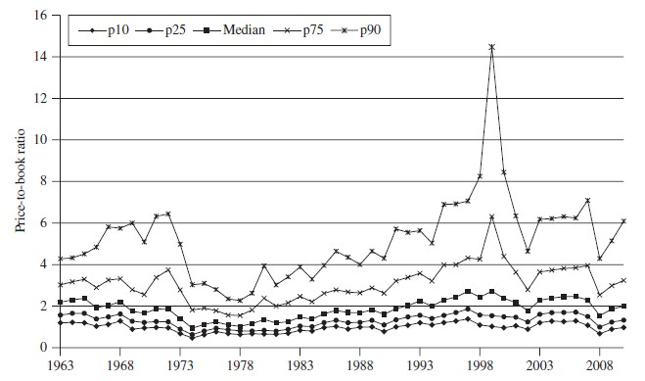
Percentiles of P/B Ratios for U.S. Firms, 1963-2010

Slide 24
Measuring Value Added
Shareholder value added is the change in shareholders’ wealth during a period：
Value added = Ending Value – Beginning Value + Dividend
Stock Return = P_{t} – P_{t-1} + d_{t}
(The stock return is sometimes referred to as Market Value Added)
Accounting value added = Ending book value – Beginning
book value + Net payout
=Comprehensive earnings

Slide 25
Principles of Earnings Measurement
Recognize value added only when you have a customer
  Revenue recognition principles Add value when it has been earned (usually when a sale is made).
  Matching principle
Match expenses against revenue for which they are incurred.
Accounting value added (earnings) = Revenue – Expenses

Slide 26
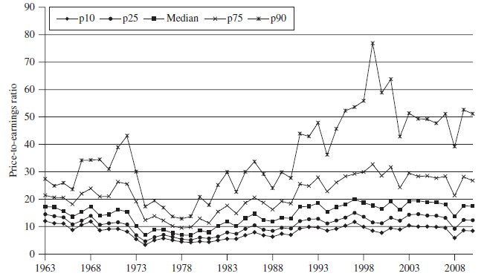
Percentiles of P/E Ratios for U.S. Firms, 1963-2010

Slide 27
Guiding Principles for Recognizing Accounting Value Added
The Fundamentalist Creed
Don’t mix what you know with speculation
The Accountant’s Restatement of the Creed (The
Reliability Criterion)
Accounting numbers should be based on objective
evidence, free of opinion and bias

