Slide 1

How Financial Statements Are Used in Valuation

Slide 2


Outline
Simple Valuation Schemes
Method of Comparables
Screening on Multiples
Asset-Based Valuation
The Process of Fundamental Analysis
The Architecture of Fundamental Analysis: The Valuation Model
Terminal Investments
Going-Concern Investments
The Question for Forecasting: What Creates Value in a Firm

Slide 3

The Big Picture for This Chapter
Understand the Difference Between:
Simple Valuation Schemes
Stock Screening, and
Fully Fledged Fundamental Analysis
Understand how the financial statements are used in each of these types of analysis
Understand how formal fundamental analysis is done
Understand what generates value in a business:
Operating Activities?
Investment Activities?
Financing Activities?

Slide 4

Simple (and Cheap) Schemes for Valuation
Fundamental analysis is detailed and costly.
Simple approaches minimize information analysis (and thus the cost). But they lose precision.
Simple methods:
  Method of Comparables
  Screening on Multiples
  Asset-Based Valuation

Slide 5

The Method of Comparables: Comps
Identify comparable firms that have similar operations to the firm whose value is in question (the “target”).
Identify measures for the comparable firms in their financial statements – earnings, book value, sales, cash flow – and calculate multiples of those measures at which the firms trade.
Apply these multiples to the corresponding measures for
the target to get that firm’s value.

Slide 6
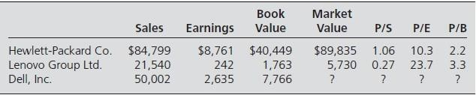
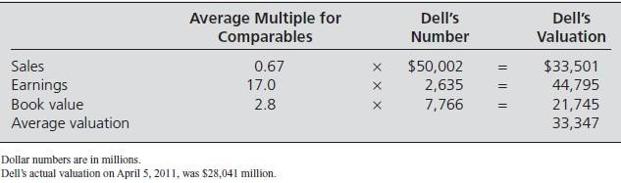
The Method of Comparables: Hewlett Packard, Lenovo, and Dell 2011

Slide 7

How Cheap is this Method?
Conceptual Problems:
  Circular reasoning: Price is ascertained from price (of the comps)
  Violates the tenet: “When calculating value to challenge price,
don’t put price into the calculation”
  If the market is efficient for the comparable companies....Why is it not for the target company ?
Implementation Problems:
  Finding the comparables that match precisely
  Different accounting methods for comps and target
  Different prices from different multiples
  What about negative denominators?
Applications:
  IPOs; firms that are not traded (to approximate price, not value)

Slide 8
Unlevered (or Enterprise) Multiples (that are Unaffected by the Financing of Operations)
Leverage Adjustments:
_{Unlevered Price/Sales Ratio =} 𝑀𝑎𝑟𝑘𝑒𝑡 𝑉𝑎𝑙𝑢𝑒 𝑜𝑓 𝐸𝑞𝑢𝑖𝑡𝑦+𝑁𝑒𝑡 𝐷𝑒𝑏𝑡
𝑆𝑎𝑙𝑒𝑠
_{Unlevered Price/EBIT=} 𝑀𝑎𝑟𝑘𝑒𝑡 𝑉𝑎𝑙𝑢𝑒 𝑜𝑓 𝐸𝑞𝑢𝑖𝑡𝑦+𝑁𝑒𝑡 𝐷𝑒𝑏𝑡
𝐸𝐵𝐼𝑇
_{Enterprise P/B =} 𝑀𝑎𝑟𝑘𝑒𝑡 𝑉𝑎𝑙𝑢𝑒 𝑜𝑓 𝐸𝑞𝑢𝑖𝑡𝑦+𝑁𝑒𝑡 𝐷𝑒𝑏𝑡
𝐵𝑜𝑜𝑘 𝑉𝑎𝑙𝑢𝑒 𝑜𝑓 𝐸𝑞𝑢𝑖𝑡𝑦+𝑁𝑒𝑡 𝐷𝑒𝑏𝑡
  EBIT: earnings before interest and taxes.
  Net debt: total debt obligations less any interest-bearing securities
that the firm may hold as assets.
  Typically the book value (BV) of net debt is an approximation of its market value (MV).

Slide 9

Unlevered (or Enterprise) Multiples (that are Unaffected by the Financing of Operations)
Leverage Adjustments:
_{Unlevered Price/Sales Ratio =} 𝑀𝑎𝑟𝑘𝑒𝑡 𝑉𝑎𝑙𝑢𝑒 𝑜𝑓 𝐸𝑞𝑢𝑖𝑡𝑦+𝑁𝑒𝑡 𝐷𝑒𝑏𝑡
𝑆𝑎𝑙𝑒𝑠
Beware of Price/Sales ratios:
Sales are necessary to add value, but NOT sufficient.
P/S = (P/E) *(E/S), where E/S is the profit margin ratio, i.e. the fraction of each $ of sales that ends up in earnings.
The “profitability of sales” must be understood in evaluating the P/S ratio.
Growth in earnings (from sales) is what is important, and thus the
focus should be earnings growth and the P/E ratio….

Slide 10

Unlevered (or Enterprise) Multiples (that are Unaffected by the Financing of Operations)
Accounting Adjustments:
_{Unlevered Price/EBITDA =} 𝑀𝑎𝑟𝑘𝑒𝑡 𝑉𝑎𝑙𝑢𝑒 𝑜𝑓 𝐸𝑞𝑢𝑖𝑡𝑦+𝑁𝑒𝑡 𝐷𝑒𝑏𝑡
𝐸𝐵𝐼𝑇𝐷𝐴
  EBITDA: earnings before interest, taxes, depreciation, and
amortization

Slide 11

Unlevered (or Enterprise) Multiples (that are Unaffected by the Financing of Operations)
Accounting Adjustments:
_{Unlevered Price/EBITDA =} 𝑀𝑎𝑟𝑘𝑒𝑡 𝑉𝑎𝑙𝑢𝑒 𝑜𝑓 𝐸𝑞𝑢𝑖𝑡𝑦+𝑁𝑒𝑡 𝐷𝑒𝑏𝑡
𝐸𝐵𝐼𝑇𝐷𝐴
Beware of Price/EBITD ratios:
Taxes have to be paid (but excluded in EBITDA), so taxes must be taken into account in the earnings you are buying.
Depreciation is a real cost (e.g. plants wear out and must be replaced).
Amortization expense can be real cost also (e.g. copyrights & patents
expire, goodwill can decline in value)
Pricing a firm without considering plant, copyright, and patent expenses pretends one can run a business without these expenses….

Slide 12
Variations of the P/E Ratio
Trailing & rolling P/E ratios:
Trailing P/E =
𝑃𝑟𝑖𝑐𝑒 𝑝𝑒𝑟 𝑠ℎ𝑎𝑟𝑒
𝑀𝑜𝑠𝑡 𝑟𝑒𝑐𝑒𝑛𝑡 𝑎𝑛𝑛𝑢𝑎𝑙 𝐸𝑃𝑆
Rolling P/E =
𝑃𝑟𝑖𝑐𝑒 𝑝𝑒𝑟 𝑠ℎ𝑎𝑟𝑒
𝑆 𝑢 𝑚 𝑜𝑓 𝐸𝑃𝑆 𝑓𝑜𝑟 𝑚𝑜𝑠𝑡 𝑟𝑒𝑐𝑒𝑛𝑡 𝑓𝑜𝑢𝑟 𝑞𝑢𝑎𝑟𝑡𝑒𝑟𝑠

Slide 13
Variations of the P/E Ratio
Dividend-Adjusted P/E ratios:
In calculating trailing (& rolling) P/E ratios, price should be adjusted for dividends that have been paid:
Dividend-adjusted trailing P/E = ^{𝑃𝑟𝑖𝑐𝑒 𝑝𝑒𝑟 𝑠ℎ𝑎𝑟𝑒+𝐴𝑛𝑛𝑢𝑎𝑙 𝐷𝑃𝑆}
𝐸 𝑃 𝑆
Rationale: Dividends affect prices but not past (trailing) earnings.

Slide 14
Variations of the P/E Ratio
Forward (leading) P/E ratios:
Forward or leading P/E =
𝑃𝑟𝑖𝑐𝑒 𝑝𝑒𝑟 𝑠ℎ𝑎𝑟𝑒
𝐹𝑜𝑟𝑒𝑐𝑎𝑠𝑡 𝑜𝑓 𝑛𝑒𝑥𝑡 𝑦𝑒𝑎𝑟′𝑠 𝐸𝑃𝑆
The dividend adjustment does NOT apply to forward (leading) P/E ratios.
If a dividend is paid out now, it will affect future (forward) earnings. Dividends affect future earnings but not pastearnings.

Slide 15

Screening Analysis
Technical Screens: identify positions based on trading indicators
  Price screens
  Small stock screens
  Neglected stocks screens
  Seasonal screens
  Momentum screens
  Insider trading screens
Fundamental Screens: identify positions based on fundamental indicators of the firm’s operations relative to price
  Price/Earnings (P/E) ratios
  Market/Book Value (P/B) ratios
  Price/Cash Flow (P/CFO) ratios
  Price/Dividend (P/D) ratios
Any combination of these methods is possible

Slide 16

How Multiple Screening Works
Identify a multiple on which to screen stocks.
Rank stocks on that multiple, from highest to lowest.
Buy stocks with the lowest multiples and (short) sell stocks with the highest multiples.

Slide 17
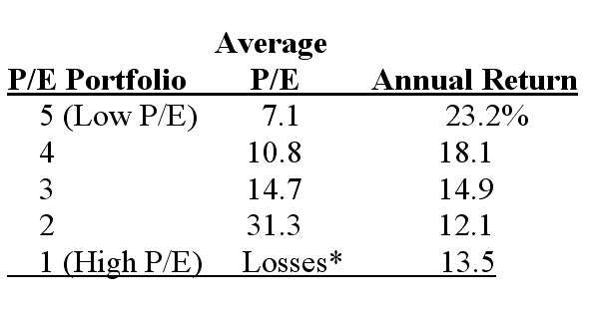

Fundamental Screening: Returns to P/E Screen (1963-2006)

Slide 18
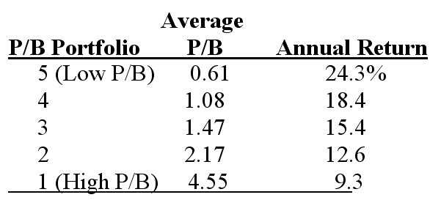

Fundamental Screening: Returns to P/B Screening (1963-2006)

Slide 19
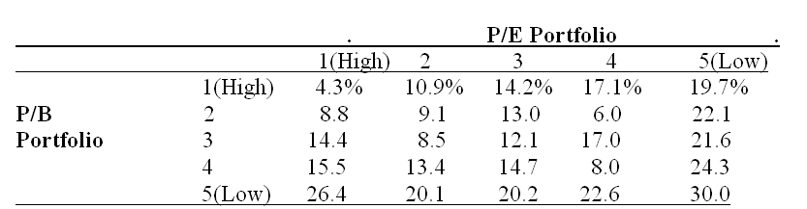
Two-way Screening:
Returns to Screening on Both P/E and P/B (1963-2006)

Slide 20

Problems with Screening
You could be loading up on a risk factor:
  You need a risk model
You are in danger of trading with someone who knows more than you
  You need a model that anticipates future payoffs
You are trading on a small amount of information;
Ignore information at your peril.

Slide 21
Asset Based Valuation
Values the firm’s assets and then subtracts the value of debt:
VE = V^{F} − V^{D}
0 0 0
The balance sheet does this calculation, but imperfectly.
Problems with this approach:
  Getting the value of operating assets when there is no market for
them
  Identifying value in use for a particular firm
  Getting the value of intangible assets (brand names, R&D)
  Getting the value of “synergies” of assets being used together
Applications:
  “Asset-base” firms such as oil and gas and mineral products
  Calculating liquidation values

Slide 22







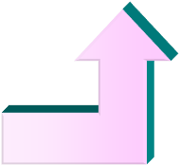



The Process of Fundamental Analysis
Step 5 - Trading on the Valuation
Outside Investor
Compare Value with Price to BUY, SELL, or HOLD
Inside Investor
Compare Value with Cost to ACCEPT or REJECT Strategy
Step 4 - Convert Forecasts
to a Valuation
Step 3 - Forecasting Payoffs
Measuring ValueAdded
Forecasting ValueAdded
Step 2 - AnalyzingInformation
In Financial Statements
Outside of Financial Statements
Step 1 - Knowing the Business
The Products
The Knowledge Base
The Competition
The Regulatory Constraints
The Management
Strategy

Slide 23








How Financial Statements are Used in Fundamental Analysis
Current Financial Statements
Financial Statements
Year 1
Financial Statements
Year 2
Financial Statements
Year 3
Forecasts
Other Information
Valuation of
Equity
Convert forecasts to a valuation

Slide 24















Payoffs to Investing: Terminal Investments and Going-Concern Investments
For a terminal investment
I₀
Initial investment
Investment horizon: T
1
2
3
T-1
T
The first investment is for a terminal investment; the second is for a going- concern investment in a stock.
The investments are made at time zero and held for T periods when they terminate or are liquidated.
0
I
CF₁ CF₂ CF₃
Cash flows
For a going concern investment in equity
o
CF_{T}
^{CF}T-1
Terminal cash flow
P₀
Initial price
1
Investment horizon When stock is sold
2
3
T-1
T
For terminal investment,
I₀= amount invested at time zero
CF = cash flows received from the investment
0
d₁
d₂
d₃
^{d}T-1
For investment in equity,
^{P0}= price paid for the share at time zero
d = dividend received while holding the stock
^{P}T= price received from selling the share at time T.
P_{T} +d_{T}
Dividends
Selling price at T + Dividend (if sold at T)

Slide 25

Two Terminal Investments: A Bond and a Project
A Bond:
Periodic cash coupon Cash at redemption Purchase price
100
100
100
100
100
1000
(1079.85)
Time, t
0
1
2
3
4
5
AProject:
Periodic flow Salvage value
250
120
430
460
460
380
Initial investment
(1200)
Time, t
0
1
2
3
4
5

Slide 26
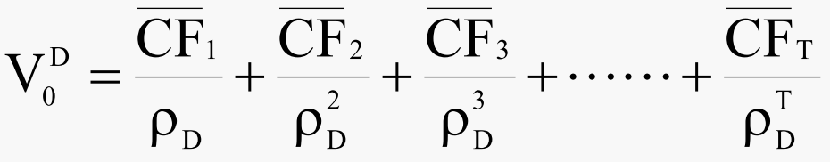
The Valuation Model: Bonds
ρ_{D} is (one plus) the required return on the debt
Required return: 8%
Year | Coupon | Redemp. | Discount | Present Value
1
2
3
4
5
 |  |  | V ^{D} = 0 | 1079.85
Valuation issue: What is the Discount rate ρ_{D ?}

Slide 27
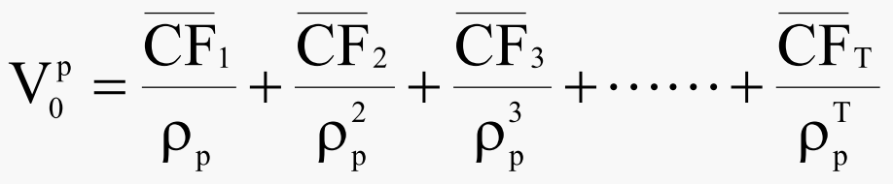

The Valuation Model: A Project
ρ_{P} is (one plus) the required return (hurdle rate) for the project
Required return: 12%
Year Cash Flow Discount Present Value
1
2
3
4
5
V ^{p} = 0 | 1529.49
Valuation Issues:
How are cash flows forecasted? What is the discount rate?

Slide 28

Value Creation: V₀ > I₀
The Bond (no value created):
V₀ = 1,079.85
I₀ = 1,079.85
NPV =
0.00
The Project (value created):
V₀ | = | 1,529.50
I₀ | = | 1,200.00
NPV | = | 329.50

Slide 29
Valuation Models: Going Concerns
AFirm
0
1
2
3
4
5
CF ₁ CF₂ CF₃ CF₄
Equity
CF₅
0
1
2
3
4
5
T
Dividend Flow
d _{T}
TV_{T}
d₁ d₂ d₃ d₄ d₅
The terminal value, TV_{T} is the price payoff, P_{T} when the share is sold
Valuation issues :
The forecast target: dividends, cash flow, earnings?
The time horizon: T = 5, 10,∞? The terminal value?
The discount rate?

Slide 30
Criteria for Practical Valuation
To be practical, we require:
Finite horizon forecasting
  Forecasting over infinite horizons is impractical
Validation
  Whatever we forecast must be observable ex post,
so the forecast can be verified for its accuracy.
Parsimony
  Information gathering & analysis should be straightforward
  The fewer pieces of information, the better

Slide 31

The Question for Forecasting: What Creates Value in a Firm
Equity Financing Activities ?
  Share Issues ?
  Share Repurchases ?
  Dividends ?
Debt Financing Activities ?
Investing and Operating Activities?
Value is created by investing assets in operations to develop products to sell to customers.
Financing activities typically do not create value.

Slide 32
The Question for Forecasting: What Creates Value in a Firm
Equity Financing Activities ?
  Share Issues ?
    In efficient markets, issuing shares at market value does not affect shareholders’ wealth but issuing them at less than market value erodes their wealth.
Example: A firm with 120 million shares outstanding issues 10 million additional shares at the market price of $42 per share. What happens tothe price per share?

Slide 33
The Question for Forecasting: What Creates Value in a Firm
Equity Financing Activities ?
  Share Issues ?
    In efficient markets, issuing shares at market value does not affect shareholders’ wealth but issuing them at less than market value erodes their wealth.
Example (cont.): Suppose the same firm were to issue 10 million shares but at a $32 per share rather than the market price of $42. Has this transaction affected shareholder value?

Slide 34

The Question for Forecasting: What Creates Value in a Firm
Equity Financing Activities ?
  Share Repurchases ?
    In efficient markets, share repurchases at market price do not affect per-share value.
    If the shares are not priced efficiently in the market, managers can make share repurchases when they see that the share price is below intrinsic value.

Slide 35
The Question for Forecasting: What Creates Value in a Firm
Equity Financing Activities ?
  Dividends ?
    Dividend irrelevance concept: shareholders are no better off, cum-dividend.
      If a firm pays $1 of dividends, the shareholders get $1. But there is $1 less in the firm, so the value of the firm drops by $1.
      Shareholders receive $1 of dividends, but they can sell the share for $1 less.
      The dividend payment makes them no better off; it does
not create value.

Slide 36
Valuation Models and Asset Pricing Models
A valuation model is a model for calculating the value of an asset
An asset pricing model is a model to calculate the discount rate in a valuation model
“Asset Pricing Model” is a misnomer: The model does not deliver the asset price

Slide 37
The Required Return
Otherwise known as:
The Discount Rate
The Cost of Capital
Required Return = Risk-Free Rate + Risk Premium
Risk Premium is given by an asset pricing model
For Example: Capital Asset Pricing Model (CAPM):
Required Return = Risk-Free Rate + [Beta × Market Risk Premium]

Slide 38
The CAPM Required Return for Hewlett Packard, 2010
Inputs:
Long-term U.S. Government bond rate: 3.5%
HP Beta: 1.5
Market risk premium: 5%
Required return = 3.5% + [1.5 × 5%]
= 11.0%
How comfortable are you with this calculation? Is a market risk premium of 5% a good guess?

Slide 39
Beware of the Required Return in Valuation
The measure of the required return is imprecise….the market
risk premium is a guess
The required return estimate can affect a valuation considerably
Beware of putting speculation (about the required return) into a valuation.
This is a problem we have to deal with!

