Slide 1

Cash Accounting, Accrual Accounting, and
Discounted Cash Flow Valuation

Slide 2
Outline
The Dividend Discount Model
The Discounted Cash Flow Model
Calculating Free Cash Flow from the Cash Flow Statement Converting Earnings to Free Cash Flow
Earnings and Cash Flows

Slide 3
The Big Picture in This Chapter
A valuation model is a method of accounting for value
Discounted cash flow (DCF) valuation employs cash accounting for valuation
DCF Valuation – and cash accounting for value – does not work
Move to accrual accounting for value in Chapters 5 and 6

Slide 4



A Reminder :Valuation Models for Going Concerns
AFirm
0
1
2
3
4
5
CF ₁ CF₂ CF₃ CF₄
Equity
CF₅
0
1
2
3
4
5
T
Dividend
Flow
d _{T}
TV_{T}
d₁ d₂ d₃ d₄ d₅
The terminal value, TV_{T} is the price payoff, P_{T} when the share issold
Valuation issues :
The forecast target: dividends, cash flow, earnings?
The time horizon: T = 5, 10,∞?
The terminal value?
The discount rate?

Slide 5
The Dividend Discount Model: Forecasting Dividends
Dividend Discount Model (DDM):
𝑑 𝑑
𝑑
𝐸
1 2
3
𝑉 =
+ +
+ ⋯
0
𝜌_{𝐸}
_{𝜌}2 _{𝜌}3
𝐸
𝐸
DDM with a terminal value:
𝑑 𝑑
𝑑
𝑑 𝑃
𝐸
1 2
3
𝑇
𝑇
𝑉 =
+ +
+ ⋯ + +
0
𝜌_{𝐸}
_{𝜌}2 _{𝜌}3 _{𝜌}𝑇 _{𝜌}𝑇
𝐸 𝐸 𝐸 𝐸
A problem: The dividend irrelevance concept
Dividend policy can be arbitrary and not linked to value added
Dividends paid before T reduce P_{T} to leave the present value unaffected
Think of a firm that “pays no dividends”

Slide 6
The Dividend Discount Model: Forecasting Dividends
Dividend Discount Model (DDM):
𝑑 𝑑
𝑑
𝐸
1 2
3
𝑉 =
+ +
+ ⋯
0
𝜌_{𝐸}
_{𝜌}2 _{𝜌}3
𝐸
𝐸
DDM with a terminal value:
𝑑 𝑑
𝑑
𝑑 𝑃
𝐸
1 2
3
𝑇
𝑇
𝑉 =
+ +
+ ⋯ +
+
0
𝜌_{𝐸}
_{𝜌}2 _{𝜌}3
_{𝜌}𝑇 _{𝜌}𝑇
𝐸
𝐸
𝐸
𝐸
The dividend conundrum:
Equity value is based on future dividends, but forecasting dividends over
finite horizons does not give an indication of this value
Conclusion:
Focus on creation of wealth rather than distribution of wealth.

Slide 7

A. Capitalize expected terminal dividends
Terminal Values for the DDM
TV = P =
^{d}T+1
T T
ρ −1
E
B. Capitalize expected terminal dividends with growth
TV_{T} = P_{T} =
^{d}T+1
ρ − g
E
Will it work?

Slide 8
Some Financial Math:
The Value of a Perpetuity and a Perpetuity with Growth
The Value of a Perpetuity
A perpetuity is a constant stream that continues without end. The periodic payoff in the stream is sometimes referred to as an annuity, so a perpetuity is an annuity that continues forever. To value that stream, one capitalizes the constant amount expected. If the dividend expected next year is expected to be a perpetuity, the value of the dividend stream is
Value of a perpetual dividend stream = V ^{E} =
d ₁
0
ρ − 1
E
The Value of a Perpetuity with Growth
If an amount is forecasted to grow at a constant rate, its value can be calculated by capitalizing the amount at the required return adjusted for the growth rate:
Value of a dividend growing at a constant rate = V ^{E} =
d₁
0
ρ − g
E

Slide 9
Dividend Discount Analysis: Advantages and Disadvantages
Advantages
Easy concept: dividends are what shareholders get, so forecast them
Disadvantages
Relevance: dividends payout is not related to value, at least in the short run; dividend forecasts ignore the capital gain component of payoffs.
Predictability: dividends are usually fairly stable in the short run so dividends are easy to forecast (in the short run)
Forecast horizons: typically requires forecasts for long periods; terminal values for shorter periods are hard to calculate with any reliability
When It Works Best
When payout is permanently tied to the value generation in the firm.
For example, when a firm has a fixed payout ratio (dividends/earnings).
Dividends are cash flows paid out of the firm (to shareholders)
Can we focus on cash flows within a firm?

Slide 10









Cash Flows Within a Firm: Free Cash Flow
Free cash flow is cash flow from operations that results from investments minus cash used to make investments.
Cash flow from operations (inflows)
C₁
C₂
C₃
C₄
C₅
Cash investment (outflows)
I₁
I₂
I₃
I₄
I₅
Free cash flow
C₁-I₁
C₂-I₂
C₃-I₃
C₄-I₄
C₅-I₅
Time, t
1
2
3
4
5

Slide 11
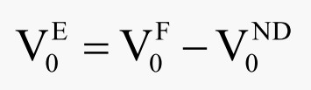
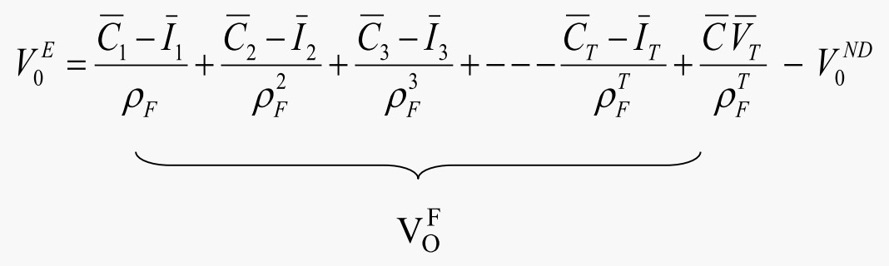

The Discounted Cash Flow (DCF) Model
Cash flow from
operations (inflows) C1
C2
C3
C4
C5 --->
I5 --->
Cash investment (outflows) | I1 | I2 | I3 | I4
Free cash flow | C1 − I1 | C2 − I2 | C3 − I3 | C4 − | I4
C5 − I5 --->
--->
Time, t
1
2
3
4
5

Slide 12

The Continuing Value for the DCF Model
A. Capitalize terminal free cash flow
CV
₌ ^{C}T+1 ^{−I}T+1
T
ρ −1
F
B. Capitalize terminal free cash flow with growth
CV
₌ ^{C}T+1 ^{− I}T+1
T
ρ − g
F
Will it work?

Slide 13

DCF Valuation: The Coca-Cola Company
In millions of dollars except share and per-share numbers. Retuired return for the firm is 9%.
1999
2000
3,657
947
2001
4,097
1,187
2002
4,736
1,167
2003
5,457
906
2004
5,929
618
Cash from operations Cash investments
FCF
Discount rate (1.09)^{t}
Present value of free cash flows
Total present value to 2004 Continuing value (CV)* Present value of CV
Enterprise value
Book value of net debt
Value of equity
4,435
Shares outstanding Value per share
2,472
* Free cash flows are expected to grow at 5% per year after 2004 indefinitely.
Coke's share were traded at $57 at the end of 1999

Slide 14
DCF Valuation: The Coca-Cola Company
In millions of dollars except share and per-share numbers. Required return for the firm is 9%
 | 1999 | 2000 | 2001 | 2002 | 2003 | 2004
Cash from operations |  | 3,657 | 4,097 | 4,736 | 5,457 | 5,929
Cash investments |  | 947 | 1,187 | 1,167 | 906 | 618
Free cash flow |  | 2,710 | 2,910 | 3,569 | 4,551 | 5,311
Discount rate (1.09)^{t} |  | 1.09 | 1.1881 | 1.2950 | 1.4116 | 1.5386
Present value of free cash flows |  | 2,486 | 2,449 | 2,756 | 3,224 | 3,452
Total present value to 2004 | 14,367
Continuing value (CV)* |  |  |  |  |  | 139,414
Present value of CV | 90,611
Enterprise value | 104,978
Book value of net debt | 4,435
Value of equity | 100,543
Shares outstanding | 2,472
Value per share | $40.67
*CV = 5,311 x 1.05 = 139,414
1.09 - 1.05
Present value of CV = 139,414 = 90,611
1.5386

Slide 15
Steps for a DCF Valuation
Here are the steps to follow for a DCF valuation:
Forecast free cash flow to a horizon
Discount the free cash flow to present value
Calculate a continuing value at the horizon with an estimated growth rate
Discount the continuing value to the present
Add 2 and 4
Subtract net debt

Slide 16

Will DCF Valuation Always Work?
A Firm with Negative Free Cash Flows: General Electric Company
In millions of dollars, except per-share amounts.
 | 2000 | 2001 | 2002 | 2003 | 2004
Cash from operations | 30,009 | 39,398 | 34,848 | 36,102 | 36,484
Cash investments | 37,699 | 40,308 | 61,227 | 21,843 | 38,414
Free cash flow | (7,690) | (910) | (26,379) | 14,259 | (1,930)
Earnings | 12,735 | 13,684 | 14,118 | 15,002 | 16,593
Earnings per share (eps) | 1.29 | 1.38 | 1.42 | 1.50 | 1.60
Dividends per share (dps) | 0.57 | 0.66 | 0.73 | 0.77 | 0.82

Slide 17
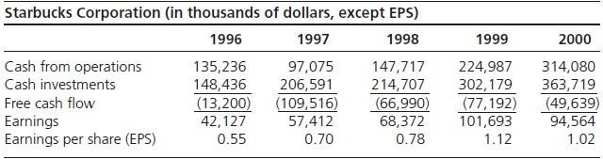

Will DCF Valuation Work for Starbucks?

Slide 18
Will DCF Valuation Work for Wal-Mart Stores?
Wal-Mart Stores, Inc.
(Fiscal years ending January 31. Amounts in millions ofdollars.)
 | 1988 | 1989 |  | 1990 |  | 1991 |  | 1992 |  | 1993 | 1994 | 1995 | 1996
Cash from operations | 536 | 828 |  | 968 |  | 1,422 |  | 1,553 |  | 1,540 | 2,573 | 3,410 | 2,993
Cash investments | 627 | 541 |  | 894 |  | 1,526 |  | 2,150 |  | 3,506 | 4,486 | 3,792 | 3,332
Free cash flow | (91) | 287 |  | 74 |  | (104) |  | (597) |  | (1,966) | (1,913) | (382) | (339)
Dividends per share | 0.03 | 0.04 |  | 0.06 |  | 0.07 |  | 0.09 |  | 0.11 | 0.13 | 0.17 | 0.20
Price per share | 6⅞ | 8½ |  | 10⅝ |  | 16½ |  | 27 |  | 32½ | 26½ | 25⅞ | 24⅜

Slide 19
DCF Valuation and Speculation
Formal valuation aims to reduce our uncertainty about value and
to discipline speculation
The most uncertain (speculative) part of a valuation is the continuing value. So valuation techniques are preferred if they result in a smaller amount of the value attributable to the continuing value
DCF techniques can result in more than 100% of the valuation in the continuing value: See General Electric and Starbucks

Slide 20

Why Free Cash Flow is Not a Value-Added Concept
Cash flow from operations (value added) is reduced by investments (which also add value): investments are treated as value losses
Value received is not matched against value surrendered to generate value
A firm reduces free cash flow by investing and increases free cash flow by reducing investments:
Free cash flow is partially a liquidation concept!!
Note: analysts forecast earnings, not cash flows

Slide 21

Discounted Cash Flow Analysis: Advantages and Disadvantages
Advantages
Disadvantages
Easy concept: cash flows are “real” and easy to think about; they are not affected by accounting rules
Familiarity: is a straight application of familiar net present value techniques
Suspect concept:
  Free cash flow (FCF) does not measure value added
in the short run; value gained is not matched with value given up.
  FCF fails to recognize value generated that does not involve cash flows
  investment is treated as a loss of value
  FCF is partly a liquidation concept; firms increase FCF by cutting back on investments.
Forecast horizons: typically requires forecasts for long periods; terminal values for shorter periods are hard to calculate with any reliability
Not aligned with what people forecast: analysts forecast earnings, not FCF; adjusting earnings forecasts to FCF forecasts requires further forecasting of accruals

Slide 22
Discounted Cash Flow Analysis: Advantages and Disadvantages
When It Works Best
When the investment pattern is such as to produce constant free cash flow or free cash flow growing at a constant rate.

Slide 23
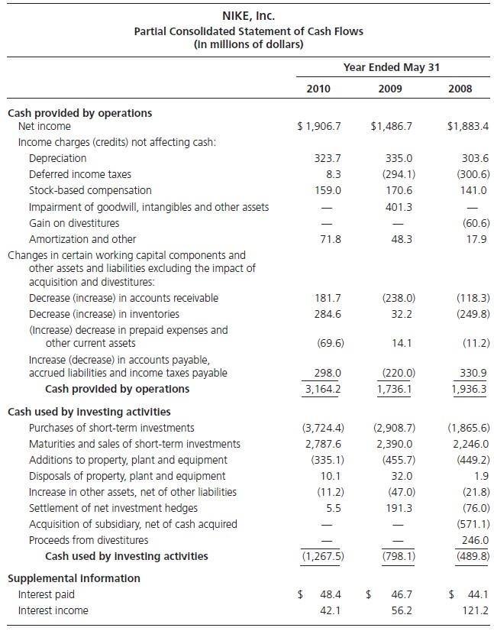

Nike, Inc.: Operating and Investing Cash Flows, 2010

Slide 24
Reported Cash Flow from Operations is Incorrect
Reported cash flows from operations in U.S. cash flow
statements includes interest (a financing cash flow):
Cash Flow from Operations =
Reported Cash Flow from Operations + After-tax Net Interest
Payments
After-tax Net Interest = Net Interest x (1 - tax rate)
Net interest = Interest payments – Interest receipts
Reported cash flow from operations is sometimes referred
to as levered cash flow from operations

Slide 25
Reported Cash Flow in Investing Activities is Incorrect
Reported cash investments include net investments in interest bearing financial assets (excess cash) (which is a financing flow):
Cash investment in operations = Reported cash flow from investing
- Net investment in interest-bearing securities

Slide 26
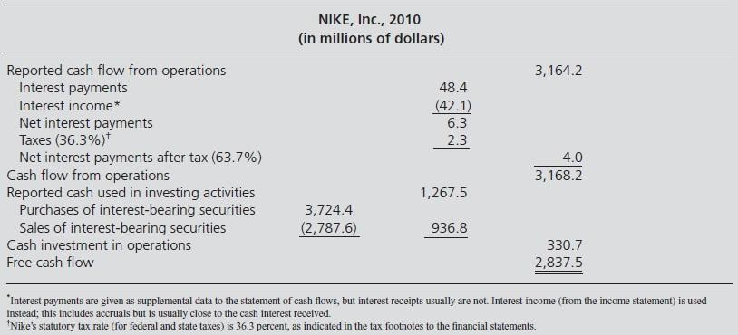

Calculating Free Cash Flow from the Cash Flow Statement: Nike, Inc., 2010

Slide 27
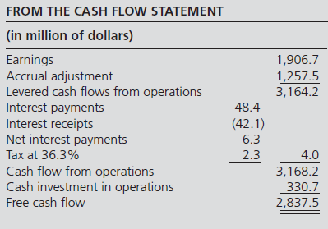

Converting Earnings to Free Cash Flow: Nike, Inc., 2010

Slide 28
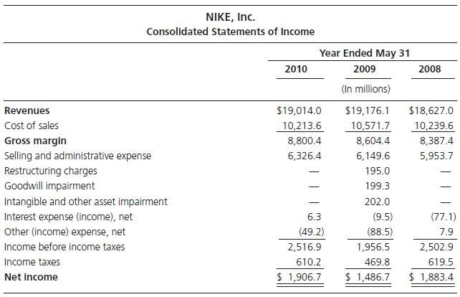

The Income Statement: Nike, Inc.

Slide 29











Features of the Income Statement
Dividends don’t affect income
Investment doesn’t affect income
There is a matching of
Value added (revenues)
Value lost (expenses)
Net value added (net income)
Accruals adjust cash flows
RevenueAccruals
Value added that is not cash flow
Adjustments to cash inflows that are not value added
ExpenseAccruals
Value decreases that are not cash flow
Adjustments to cash outflows that are not value added

Slide 30

Earnings and Cash Flows
Earnings
= Free cash flow – Net cash interest + Investment + Accruals
The earnings calculation adds back investments and puts them back in the balance sheet. It also adds accruals.

Slide 31
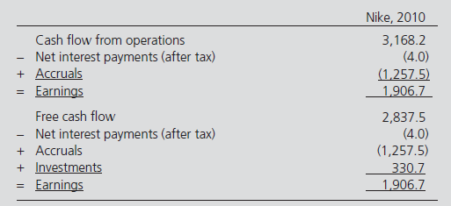
Earnings and Cash Flows: Nike, Inc., 2010

