Slide 2



Outline
Prototype Valuations
  Valuing a One-Period Project
  Valuing a Savings Account
A Model for Anchoring Value on Book Value
Applying the RE Model to Equities
Applying the RE Model to Projects and Strategies
Features of the RE Valuation

Slide 3

The Big Picture for the Chapter
Value = Anchor + Extra Value
The Anchor is Book Value:
Value = Book Value + Extra Value
The Principle for adding extra value to book value:
Add extra value if the rate of return of book value is expected to be greater than the required return

Slide 4
Valuing a One-Period Project (1)
Investment | $400
Required return | 10%
Revenue forecast | $440
Expense forecast | $400
Forecasted earnings $ 40
Residual Earnings₁ = Earnings₁ – (Required Return * Investment₀)
= 40 – (0.10*400)
= 0
This is a zero-RE project.
Value = Book Value + Present Value of Expected Residual Earnings
= 400 + (0/1.10) = 400
This is a zero-NPV project.
DCF Valuation: V = 440 / 1.10 = 400

Slide 5

Valuing a One-Period Project (2)
Investment | $400
Required return | 10%
Revenue forecast | $448
Expense forecast | $400
Forecasted earnings $ 48
Residual Earnings₁ = Earnings₁ – (Required return * Investment₀)
= 48– (0.10*400)
= 8
Value = Book Value + Present Value of Expected Residual Earnings
= 400 + (8/1.10) = 407.27
The project adds value.
DCF Valuation: V = 448 / 1.10 = 407.27

Slide 6
Valuing a Savings Account
Forecasts for a Savings Account with $100 Invested at the End of 2012.
Earning 5% per year. Required return = 5%.
Forecast Year
 | 2012 | 2013 | 2014 | 2015 | 2016 | 2017
Scenario 1: Earnings withdrawn each year (full payout)
Earnings |  | $5 | $5 | $5 | $5 | $5
Dividends |  | 5 | 5 | 5 | 5 | 5
Book Value | $100 | 100 | 100 | 100 | 100 | 100
Residual Earnings |  | 0 | 0 | 0 | 0 | 0
Free Cash Flows |  | 5 | 5 | 5 | 5 | 5
Scenario 2: No withdrawals (zero payout)
Earnings |  | $5 | $5.25 | $5.51 | $5.79 | $6.08
Dividends |  | 0 | 0 | 0 | 0 | 0
Book Value | $100 | 105 | 110.25 | 115.76 | 121.55 | 127.63
Residual Earnings |  | 0 | 0 | 0 | 0 | 0
Free Cash Flows |  | 0 | 0 | 0 | 0 | 0
Value = Book Value + Present Value of Residual Earnings
= 100 + 0
= 100

Slide 7
The Normal Price-to-Book Ratio
Normal P/B = 1.0
(Price = Book Value)
The Normal P/B firm earns an expected rate of return on its book value equal to the required return.
The Normal P/B firm earns expected residual earnings of zero.

Slide 8

Lessons from the Savings Account
An asset is worth a premium or discount to its book value (BV) only if the BV is expected to earn non-zero residual earnings.
Residual earnings techniques recognize that earnings growth does not add value if that growth comes from investment earning at the required return.
Even though an asset does not pay dividends, it can be valued from its BV and earnings forecasts.
The valuation of the savings account does not depend on dividend payout. The two scenarios have different expected dividends, but the same value.
The valuation of a savings account is unrelated to free cash flows: The two accounts have the same value, but different free cash flow.

Slide 9

An Anchoring Principle
If one forecasts that an asset will earn a return on its book value equal to the required return, it must be worth its book value.

Slide 10
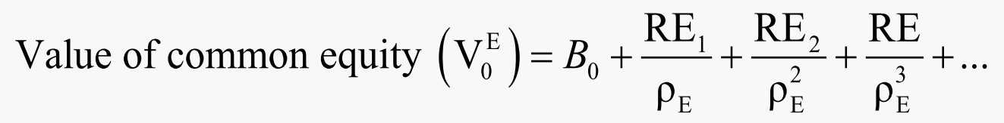

A Model for Anchoring Value on Book Value
The valuation model that captures the extra value for the equity of a going-concern:
where RE is residual earnings for equity:
Residual earnings = comprehensive earnings - (required
return for equity × beginning-of-period book value)
RE_{t} = Earn_{t} − (ρ_{E} −1)B_{t−1}

Slide 11
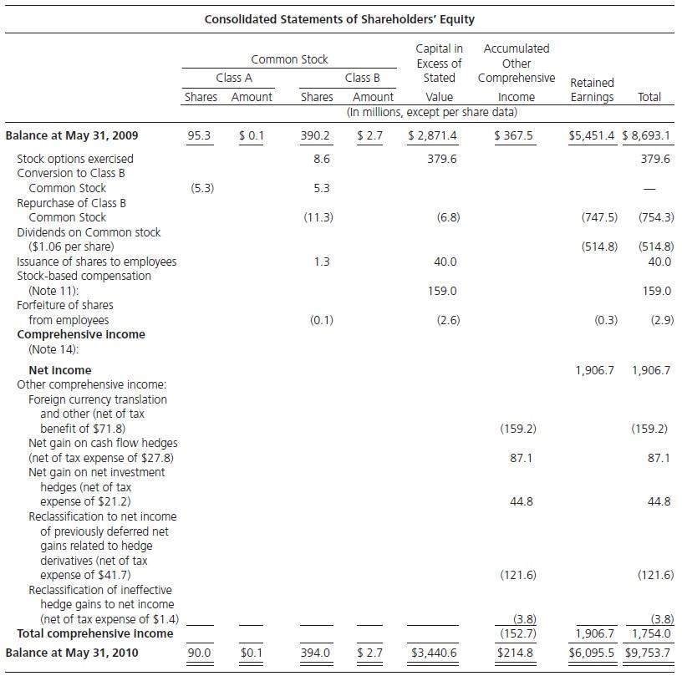

The Statement of Shareholders’ Equity:
Nike, Inc., 2010
Required return: 9%

Slide 12
The Statement of Shareholders’ Equity:
Nike, Inc., 2010
If Nike’s shareholders require a 9% return, then…..
RE₂₀₁₀ = Earn₂₀₁₀ – (ρ_{E} – 1)B₂₀₀₉ = $1,754 – (0.09 × $8,693) =$971.6m

Slide 13
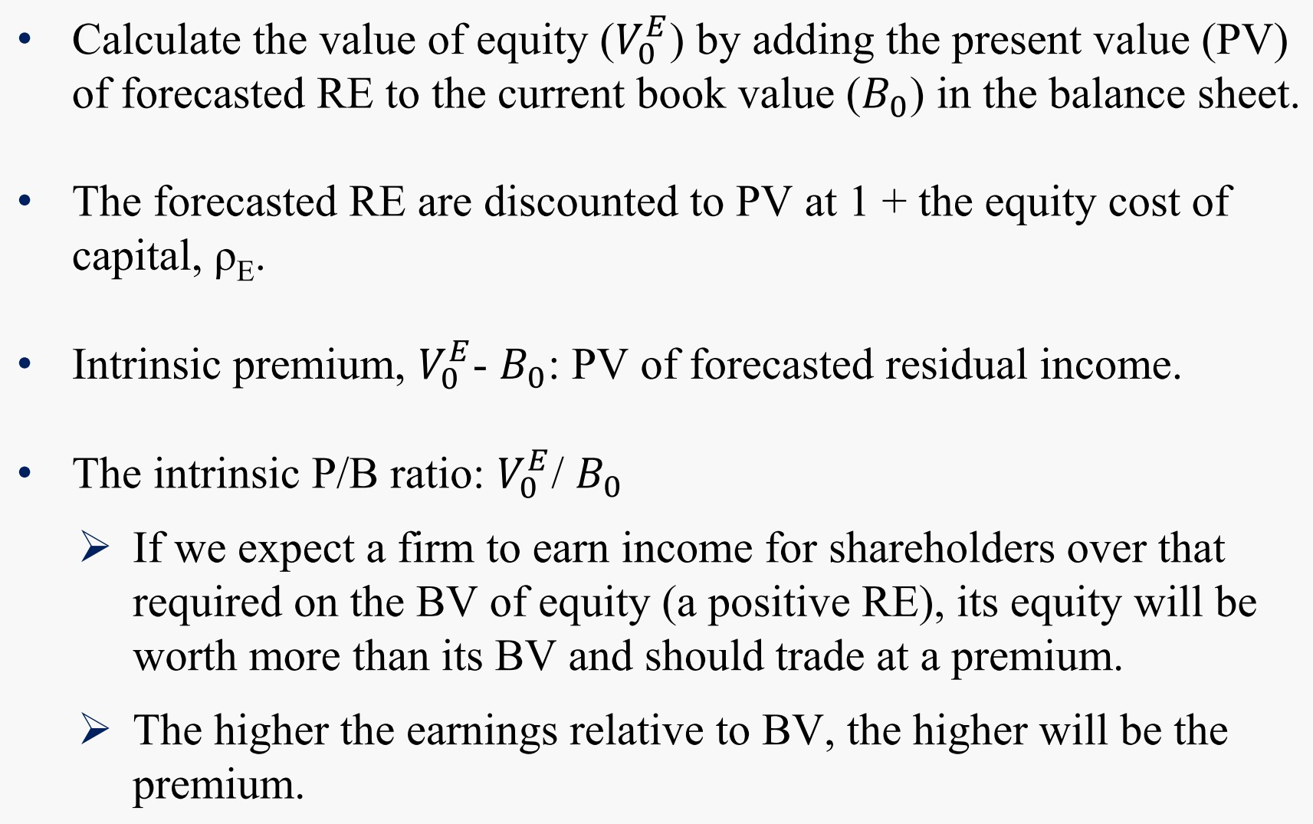

A Model for Anchoring Value on Book Value

Slide 14
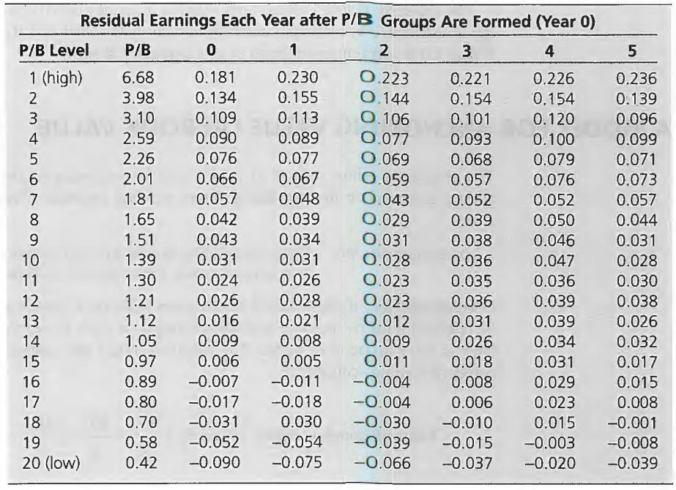
Relation Between P/B Ratios and Subsequent RE, 1965 – 1995, NYSE/AMEX listed firms
High P/B firms yield high RE, on average, and low P/B firms yield low RE.
RE for P/B ratios close to 1 are close to zero.

Slide 15
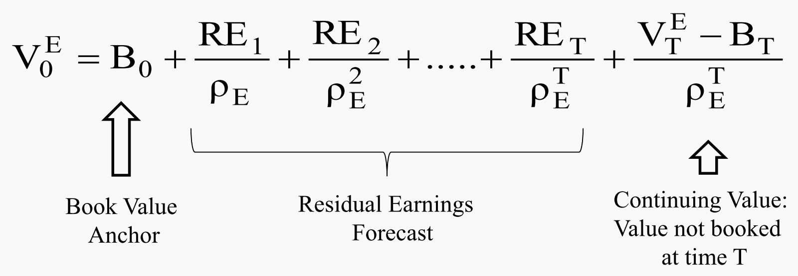

The Model for Finite Forecasting Horizons

Slide 16
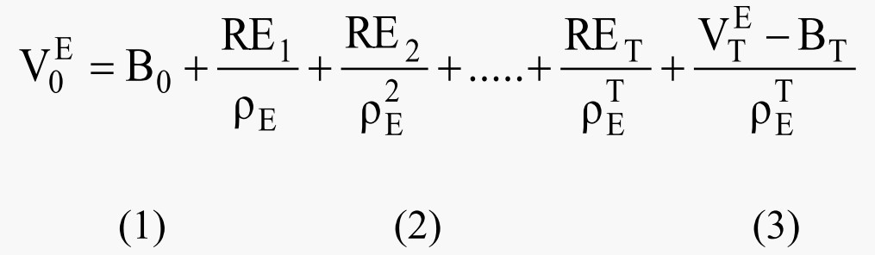

Ingredients of the Model
For finite horizon forecasts we need three ingredients, besides the cost of capital:
The current book value
Forecasts of residual earnings to horizon
Forecasted premium at the horizon – the stock’s expected value relative to book value T periods from now
Component 3 is called the continuing value

Slide 17
Return on Common Shareholders’ Equity (ROCE)
Return on common equity, ROCE, is comprehensive earnings to common earned during a period relative to the BV of net assets put in place at the beginning of the period.
_{ROCE =} Comprehensive earnings to common_{t}
t
Book value
t-1
Comprehensive earnings to common are after preferred dividends
Book value: the BV of common shareholders’equity

Slide 18
Alternative Measure of Residual Earnings
Residual earnings is the rate of return on equity, ROCE, expressed as a dollar excess return on equity rather than a ratio.
For every earnings period t, we can restate residual earnings as:
RE = (ROCE – Required Return on Equity) ×BV of Common Equity
= ROCE Spread × BV of Common Equity
Earn_{t} – (ρ_{E} – 1)B_{t-1} = [ROCE_{t} – (ρ_{E} – 1)]B_{t-1}
where ROCE_{t} = Earn_{t} / B_{t-1} is the rate of return on common equity

Slide 19

The Statement of Shareholders’ Equity:
Nike, Inc., 2010
Required return: 9%

Slide 20
The Statement of Shareholders’ Equity:
Nike, Inc., 2010
ROCE₂₀₁₀ = Earn₂₀₁₀ / B₂₀₀₉ = $1,754 / $8,693 = 20.18%
If Nike’s shareholders require a 9% return, then…..
RE₂₀₁₀ = [ROCE₂₀₁₀ – (ρ_{E} – 1)]B₂₀₁₀ = (0.2018 – 0.09)× $8,693 = $971.6m
Alternatively, recall
RE₂₀₁₀ = Earn₂₀₁₀ – (ρ_{E} – 1)]B₂₀₀₉ = $1,754 – (0.09 × $8,693) =$971.6m

Slide 21

Drivers of Residual Earnings
Two Drivers:
ROCE
  If forecasted ROCE equals the required return, then RE will be zero, and V = B
  If forecasted ROCE is greater than the required return, then V > B
  If forecasted ROCE is less than the required return, then V < B
Growth in book value (net assets) put in place to earn the ROCE
RE will change with ROCE and growth in book value.
Firms increase value by adopting strategies that increase ROCE above the required return (cost of capital) and grow book values (net assets) that can earn at an ROCE above the required return.

Slide 22
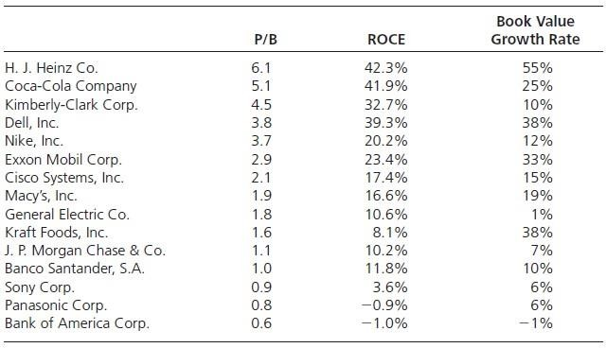

P/B, ROCE and Growth in Book Value
Selected firms ranked by their P/B ratios in 2010, along with the ROCE earned in
2010 & BV growth rates for the year. P/B is related to ROCE and growth in BV.

Slide 23
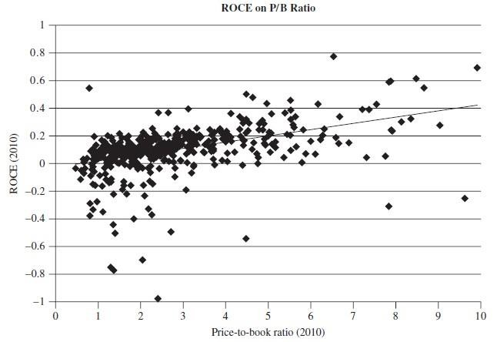
ROCE and P/B Ratios: S&P 500, 2010
This figure plots ROCE in 2010 on P/B ratios at the end of 2010. The line through the dots is the regression line for the relationship between ROCE and P/B: ROCE is positively related to P/B.

Slide 24
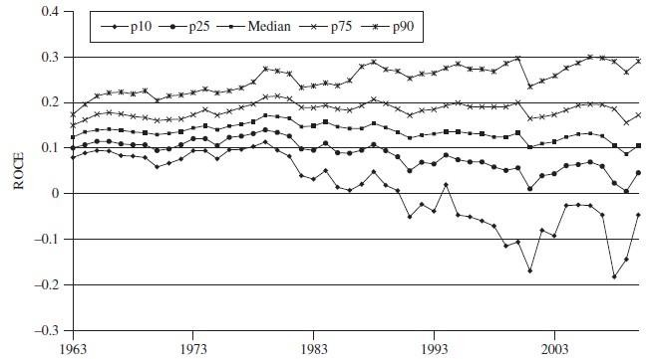
ROCE Over the Years
This figure plots percentiles of ROCE over the years 1963-2010 for U.S. listed firms with market capitalization over $200 million. The median ROCE over all years is 13.7%.

Slide 25

Steps for Applying the Model
Identify the book value in the most recent balance sheet.
Forecast earnings and dividends up to a forecast horizon.
Forecast future book values from current book values and your
forecasts of earnings and dividends.
Calculate future residual earnings from the forecasts of earnings and book values.
Discount the residual earnings to present value.
Calculate a continuing value at the forecast horizon.
Discount the continuing value to the present value.
Add 1, 5, and 7.
E
RE₁ RE ₂ RE _{T} VE − B_{T}
V₀ = B₀ +
+ +.....+ +
T
ρ_{E}
_{ρ}2
_{ρ}T _{ρ}T
E
E E

Slide 26
























How the Residual Earnings Model Works
RE is driven by ROCE and the book value of investments put in place. Valuation involves forecasting future ROCE and the growth in the book value of net assets, discounting the RE that they produce to present value, and adding the current book value.
Current Data
Forecasts
Current year
Year 1 ahead
Year 2 ahead
Year 3 ahead
Current bookvalue
Book value₁
Book value₂
ROCE₁
ROCE₂
ROCE₃
Current book value
Current bookvalue
Residual earnings₁
Residual earnings₂
Residual earnings₃
PV of RE₁
Discount by ρ
PV of RE₂
Discount by ρ²
PV of RE₃
Discount by ρ³

Slide 27


A Simple Demonstration and a Simple Model
In millions of dollars. Required return is 10% per year.
Forecast Year
 | 0 | 1 | 2 | 3 | 4 | 5
Earnings | 12.00 | 12.36 | 12.73 | 13.11 | 13.51 | 13.91
Dividends | 9.09 | 9.36 | 9.64 | 9.93 | 10.23 | 10.53
Book Value | 100.00
RE (10% charge)
RE growth rate
Recall,
Ending Book Value = Beginning Book Value + Comp. Earnings – Net Payout
RE = Comp. Earnings – (Required Return for Equity × Beginning Book Value)

Slide 28
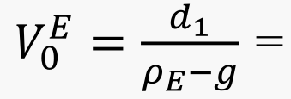
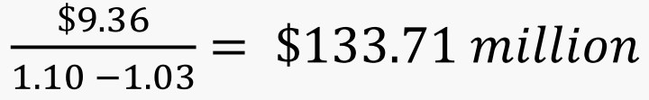
A Simple Demonstration and a Simple Model
In millions of dollars. Required return is 10%.
Forecast Year
 | 0 | 1 | 2 | 3 | 4 | 5
Earnings | 12.00 | 12.36 | 12.73 | 13.11 | 13.51 | 13.91
Dividends | 9.09 | 9.36 | 9.64 | 9.93 | 10.23 | 10.53
Book Value | 100.00 | 103.00 | 106.09 | 109.27 | 112.55 | 115.93
RE (10% charge) |  | 2.36 | 2.43 | 2.501 | 2.583 | 2.655
RE growth rate |  |  | 0.03 | 0.03 | 0.03 | 0.03
With g = 1.03 and ρ_{E} = 1.10, the valuationis:
The intrinsic price-to-book ratio (P/B) is $133.71 / $100 = 1.34
Dividends are expected to grow at 3% per year, so

Slide 29
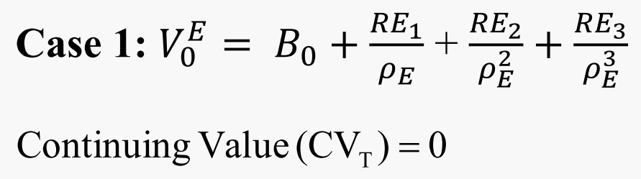
Forecasting Residual Earnings: Flanigan’s Enterprises Inc.
Case 1: Zero RE after the Forecast Horizon
Required rate of return is 9%. RE is expected to be zero after 2003.
Forecast Year 1999 2000 2001 2002 2003
EPS DPS BPS
0.73
0.11
0.80
0.24
0.71
0.25
0.47
0.27
3.58
ROCE
RE (9% charge)
Discount rate (1.09^{t}) Present value of RE
Total present value of RE to 2003 Value per share

Slide 30
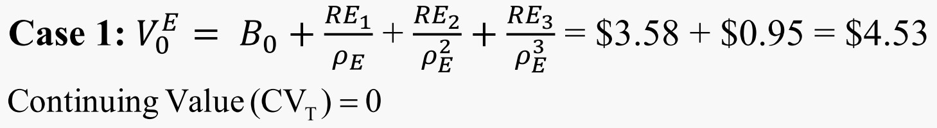
Forecasting Residual Earnings: Flanigan’s Enterprises Inc.
Case 1: Zero RE after the Forecast Horizon
Required rate of return is 9%. RE is expected to be zero after 2003.
Forecast Year
 | 1999 | 2000 | 2001 | 2002 | 2003
EPS |  | 0.73 | 0.80 | 0.71 | 0.47
DPS |  | 0.11 | 0.24 | 0.25 | 0.27
BPS | 3.58 | 4.20 | 4.76 | 5.22 | 5.42
ROCE |  | 20.4% | 19.0% | 14.9% | 9.0%
RE (9% charge) |  | 0.408 | 0.422 | 0.282 | 0.000
Discount rate (1.09^{t}) |  | 1.09 | 1.188 | 1.295 | 1.412
Present value of RE |  | 0.374 | 0.355 | 0.217 | 0.000
Total present value of RE to 2003 | 0.95
Value per share | 4.53
How the forecasts are developed (for 2001)
Forecasting Book Value per share (BPS) |  | Forecasting Residual Earnings
Beginning BPS (a) | 4.20 | Forecasted ROCE (b/a) |  |  | 19.05%
Forecasted EPS (b) | 0.80 | Cost of equity capital |  |  | -9.00%
Forecasted DPS | -0.24 | Excess ROCE (c) |  |  | 10.05%
Ending BPS | 4.76 | RE (a×c) |  |  | 0.422
 |  | Alternatively,
 |  | RE = 0.80 - (0.09 × 4.20) = 0.422

Slide 31
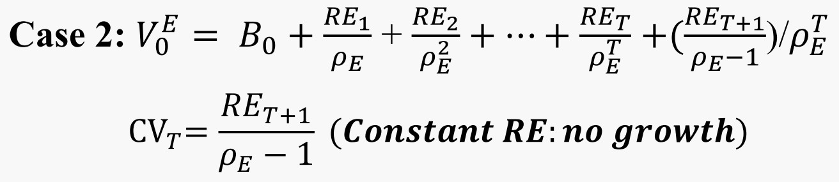
Forecasting Residual Earnings: General Electric
Case 2: Constant RE after the Forecast Horizon
Required rate of return is 10%. RE is expected to be constant, but nonzero after 2003.
Forecast Year
1999 2000 2001 2002 2003 2004
EPS DPS BPS
1.29
0.57
1.38
0.66
1.42
0.73
1.50
0.77
1.60
0.82
4.32
ROCE
RE (10% charge)
Discount rate (1.10^{t})
Present value of RE
Total present value of RE to 2004
Continuing value (CV) Present value of CV Value per share

Slide 32

Forecasting Residual Earnings: General Electric
Case 2: Constant RE after the Forecast Horizon
Required rate of return is 10%. RE is expected to be constant, but nonzero after 2003.
Forecast Year
 | 1999 | 2000 | 2001 | 2002 | 2003 | 2004
EPS |  | 1.29 | 1.38 | 1.42 | 1.50 | 1.60
DPS |  | 0.57 | 0.66 | 0.73 | 0.77 | 0.82
BPS | 4.32 | 5.04 | 5.76 | 6.45 | 7.18 | 7.96
ROCE |  | 29.9% | 27.4% | 24.7% | 23.3% | 22.3%
RE (10% charge) |  | 0.858 | 0.876 | 0.844 | 0.855 | 0.882
Discount rate (1.10^{t}) |  | 1.100 | 1.210 | 1.331 | 1.4641 | 1.611
Present value of RE |  | 0.780 | 0.724 | 0.634 | 0.584 | 0.548
Total present value of RE to 2004 | 3.27
Continuing value (CV) |  |  |  |  |  | 8.82
Present value of CV | 5.48
Value per share | 13.07
The continuing value:
CV₂₀₀₄ = RE₂₀₀₅ / (ρ_{E}-1) = 0.882 / 0.10 = 8.82
Present value of CV = 8.82 / 1.6105 = 5.48

Slide 33
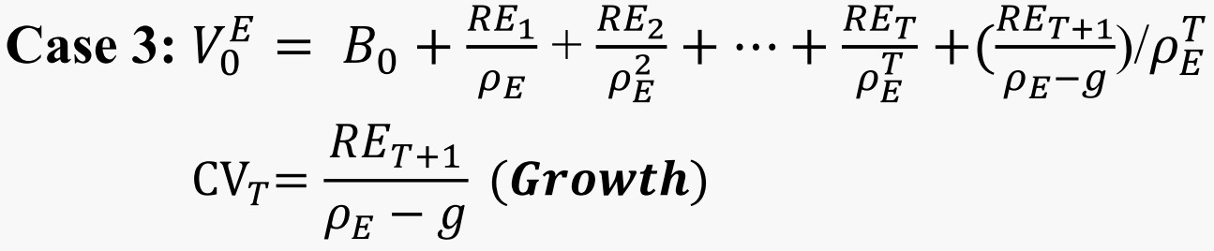
Forecasting Residual Earnings: Nike, Inc.
Case 3: Growing RE after the Forecast Horizon
Required rate of return is 9%. RE is expected to grow at 4.5% rate after 2011.
Forecast Year
2006 2007 2008 2009 2010 2011
EPS DPS BPS
2.96
0.71
3.80
0.88
3.07
0.98
3.93
1.06
4.28
1.20
14.00
ROCE
RE (9% charge)
Discount rate (1.09^{t}) Present value of RE
Total present value of RE to 2011
Continuing value (CV) Present value of CV Value per share

Slide 34

Forecasting Residual Earnings: Nike, Inc.
Case 3: Growing RE after the Forecast Horizon
Required rate of return is 9%. RE is expected to grow at 4.5% rate after 2011.
Forecast Year
 | 2006 | 2007 | 2008 | 2009 | 2010 | 2011
EPS |  | 2.96 | 3.80 | 3.07 | 3.93 | 4.28
DPS |  | 0.71 | 0.88 | 0.98 | 1.06 | 1.20
BPS | 14.00 | 16.25 | 19.17 | 21.26 | 24.13 | 27.21
ROCE |  | 21.1% | 23.4% | 16.0% | 18.5% | 17.7%
RE (9% charge) |  | 1.700 | 2.338 | 1.345 | 2.017 | 2.108
Discount rate (1.09^{t}) |  | 1.090 | 1.188 | 1.295 | 1.412 | 1.539
Present value of RE |  | 1.560 | 1.967 | 1.038 | 1.429 | 1.370
Total present value of RE to 2011 | 7.36
Continuing value (CV) |  |  |  |  |  | 48.96
Present value of CV | 31.82
Value per share | 53.18
The continuing value:
CV₂₀₁₁ = RE₂₀₁₂ / (ρ_{E}-g) = (2.108×1.045) / (1.09-1.045) = 48.96
Present value of CV = 48.96 / 1.539 = 31.82

Slide 35
Continuing Values are Speculative
The continuing value is the most speculative part of the valuation.
Be careful not to add speculation.
Anchor on what you know: Cases 1, 2, and 3 use growth rates in years prior to the continuing value year for an estimate of the long- term growth rate.
Might we also use the historical GDP growth rate (something else we know)? See later.
Financial statement analysis (in Part Two of the book helps in the
determination of the growth rate).

Slide 36
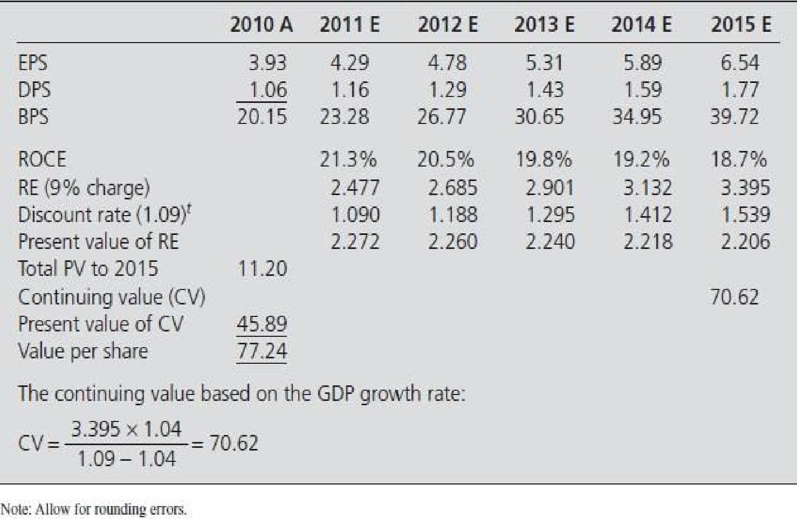

Converting an Analyst’s Forecast to a Valuation: Nike, Inc., 2010
Analyst forecast EPS two years ahead ($.29 for 2011 and $4.78 for 2012) and also forecast a five-year EPS growth rate of 11%. Forecasts for 2013-2015 apply this consensus EPS growth rate to the 2012 estimate. Dividends per share (DPS) are set at the 2010 payout rate of 27% of earnings. Required rate of return is 10%. Yeas labeled A are actual numbers, years labeled E are expected numbers.

Slide 37
Project Evaluation: Residual Earnings Approach
AProject:
Periodic flow
Salvage value
430
460
460
380
250
120
Initial investment
(1200)
Time, t
0
1
2
3
4
5

Slide 38

Project Evaluation: Residual Earnings Approach
Hurdle rate: 12%. The depreciation is calculated using the straight-line method.
Forecast Year
 | 0 | 1 | 2 | 3 | 4 | 5
Revenues |  | $430 | $460 | $460 | $380 | $250
Depreciation |  | 216 | 216 | 216 | 216 | 216
Project income |  | 214 | 244 | 244 | 164 | 34
Book value | $1,200 | 984 | 768 | 552 | 336 | 0
Book rate of return |  | 17.8% | 24.8% | 31.8% | 29.7% | 10.1%
Residual project income (0.12) |  | 70 | 126 | 152 | 98 | (6)
Discount rate (1.12^{t}) |  | 1.120 | 1.254 | 1.405 | 1.574 | 1.762
PV of RE |  | 62.5 | 100.5 | 108.2 | 62.3 | -3.4
Total PV of RE | 330
Value of project | $1,530 |  | Value added = $330
The revenue is from the cash inflow but depreciation has been deducted toget
the net income from the project.
The BV of the project each year is its original cost minus accumulated depreciation, and it follows the following equation:
Book Value_{t} = Book Value_{t-1} + Income_{t} – Cash Flow_{t}
BV₁ = $1,200 +214 – 430 = $984 (The cash flow comes from the revenues.)

Slide 39

Strategy Evaluation: Residual Earnings Approach
Hurdle rate: 12%.
ForecastYear
 | 0 | 1 | 2 | 3 | 4 | 5 | 6 | …...
Residual Earnings Approach
Revenues |  | $430 | $890 | $1,350 | $1,730 | $1,980 | $1,980 | …...
Depreciation |  | 216 | 432 | 648 | 864 | 1,080 | 1,080 | …...
Project income |  | 214 | 458 | 702 | 866 | 900 | 900 | …...
Book value | $1,200 | 2,184 | 2,952 | 3,504 | 3,840 | 3,840 | 3,840 | …...
Book rate of return |  | 17.8% | 21.0% | 23.8% | 24.7% | 23.4% | 23.40%
Residual strategy income (0.12) |  | 70.0 | 195.9 | 347.8 | 445.5 | 439.2 | 439.2 | …...
PV of RE Total PV of RE | 999 | 62.5 | 156.2 | 247.5 | 283.0 | 249.3
Continuing value 439.2/0.12=$3,660
PV of CV | 2,077
Value of strategy Discounted Cash FlowApproach | $4,276
Value added = $3,076
Cash inflow |  | $430 | $890 | $1,350 | $1,730 | $2,100 | $2,100 | …...
Investment | $(1,200) | (1,200) | (1,200) | (1,200) | (1,200) | (1,200) | (1,200) | …...
Free cash flow | (1,200) | (770) | (310) | 150 | 530 | 900 | 900 | …...
PV of FCF Total PV of FCF | 20 | (687.5) | (247.2) | 106.8 | 336.7 | 510.7
Continuing value |  | 900/0.12=$7,500
PV of CV | 4,256
Value of strategy | $4,276 | NPV = $3,076

Slide 40

Advantages and Disadvantages of the Residual Earnings Model
Advantages
Focus on value drivers: focuses on profitability of investment and growth in investment that drive value; directs strategic thinking to these drivers
Incorporates the financial statements: incorporates the value already recognized in the balance sheet (the book value); forecasts value added in the income statement and balance sheet rather than the cash flow statement
Uses accrual accounting: uses the properties of accrual accounting that recognize value added ahead of cash flows, matches value added to value given up and treats investment as an asset rather than a loss of value
Versatility: can be used with a wide variety of
accounting principles (Chapter 17)
Aligned with what people forecast: analysts forecast earnings (from which forecasted residual earnings can be calculated)
Protection: protects from paying too much for
growth
Reduces reliance on speculation: relies less on uncertain continuing values and uncertain long-term growth rates
Disadvantages
Accounting complexity: requires an understanding of how accrual accounting works
Suspect accounting: relies on accounting numbers that can be susceptible (Chapter 18)

Slide 41
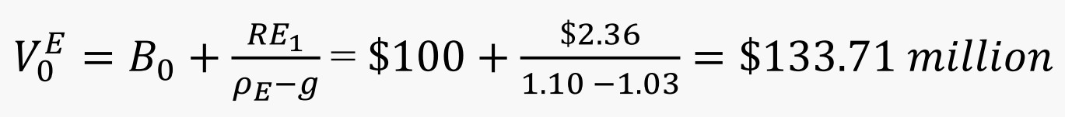
Protection from Paying Too Much for Earnings Generated by Investment
Recall
In millions of dollars. Required return is 10%.
Forecast Year
 | 0 | 1 | 2 | 3 | 4 | 5
Earnings | 12.00 | 12.36 | 12.73 | 13.11 | 13.51 | 13.91
Dividends | 9.09 | 9.36 | 9.64 | 9.93 | 10.23 | 10.53
Book Value | 100.00 | 103.00 | 106.09 | 109.27 | 112.55 | 115.93
RE (10% charge) |  | 2.36 | 2.43 | 2.501 | 2.583 | 2.655
RE growth rate |  |  | 0.03 | 0.03 | 0.03 | 0.03

Slide 42
Protection from Paying Too Much for Earnings Generated by Investment
Same example, except the firm is expected to make a share issue of $50 million
in Year 1, to be invested in assets earning 10% per year.
In millions of dollars. Required return is 10%.
Forecast Year
 | 0 | 1 | 2 | 3 | 4 | 5
Earnings | 12.00 | 12.36 | 17.73 | 18.61 | 19.56 | 20.57
Dividends | 9.09 | (40.64) | 9.64 | 9.93 | 10.23 | 10.53
Book Value | 100.00
RE (10% charge)
RE growth rate

Slide 43
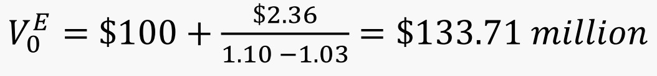


Protection from Paying Too Much for Earnings Generated by Investment
Same example, except the firm is expected to make a share issue of $50 million
in Year 1, to be invested in assets earning 10% per year.
In millions of dollars. Required return is 10%.
Forecast Year
 | 0 | 1 | 2 | 3 | 4 | 5
Earnings | 12.00 | 12.36 | 17.73 | 18.61 | 19.56 | 20.57
Dividends | 9.09 | (40.64) | 9.64 | 9.93 | 10.23 | 10.53
Book Value | 100.00 | 153.00 | 161.09 | 169.77 | 179.10 | 189.14
RE (10% charge) |  | 2.36 | 2.43 | 2.50 | 2.58 | 2.66
RE growth rate |  |  | 3% | 3% | 3% | 3%
The valuation is unchanged:
Beware!
Value is added only if the investment earns over and above its required return.

Slide 44
Protection from Paying Too Much for Earnings Created by the Accounting
Same example, except the firm has written down inventory in Year 0 by $8
million, reducing cost of goods sold in Year 1 by $8 million.
In millions of dollars. Required return is 10%.
Forecast Year
 | 0 | 1 | 2 | 3 | 4 | 5
Earnings | 4.00 | 20.36 | 12.73 | 13.11 | 13.51 | 13.91
Dividends | 9.09 | 9.36 | 9.64 | 9.93 | 10.23 | 10.53
Book Value | 92.00
RE (10% charge)
RE growth rate

Slide 45
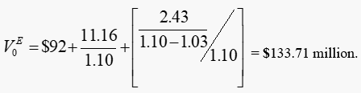


Protection from Paying Too Much for Earnings Created by the Accounting
Same example, except the firm has written down inventory in Year 0 by $8
million, reducing cost of goods sold in Year 1 by $8 million.
In millions of dollars. Required return is 10%.
Forecast Year
 | 0 | 1 | 2 | 3 | 4 | 5
Earnings | 4.00 | 20.36 | 12.73 | 13.11 | 13.51 | 13.91
Dividends | 9.09 | 9.36 | 9.64 | 9.93 | 10.23 | 10.53
Book Value | 92.00 | 103.00 | 106.09 | 109.27 | 112.55 | 115.93
RE (10% charge) |  | 11.16 | 2.43 | 2.50 | 2.58 | 2.66
RE growth rate |  |  |  | 3% | 3% | 3%
The valuation is unchanged:
Beware!
Earnings created by the accounting cannot create value.

Slide 46
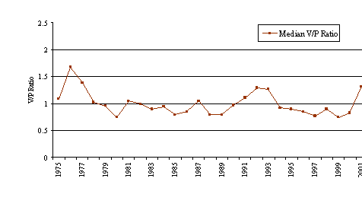
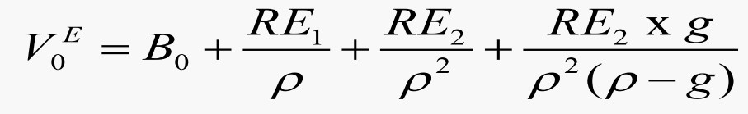

Tracking V/P Ratios: All U.S. Stocks, 1975 - 2001
Inputs:
Analysts’ consensus forecasts Required return = Risk-free rate + 5% g = 4% (average GDP growth rate)

