Slide 1
Valuation and Active Investing

Slide 2
Outline
Common Misconceptions About Valuation
A Reminder: Principles of Fundamental Investing
Reverse Engineering the Growth Rate
Reverse Engineering the Expected Return
Reverse Engineering the S&P 500
Challenging the Price of a Stock

Slide 3
The Big Picture for this Chapter
Don’t take valuation models literally
  Use valuation models to challenge the market
price rather than for calculating intrinsic value
  Use valuation models to convert the market price to a forecast – then challenge that forecast
Investing is not a game against nature, rather a game against other investors
  Therefore, use valuation models to play the game
against other investors

Slide 4
Common Misconceptions About Valuation
The idea of “intrinsic value” is not useful
  Don’t pretend that you can calculate a precise intrinsic value
[The investor] is concerned with the intrinsic value of the security and more particularly with the discovery of the discrepancies between intrinsic value and price. We must recognize, however, that intrinsic value is an elusive concept. In general terms it is understood to be that value which is justified by the facts, e.g., the assets, earnings, dividends, definite prospects – as distinct, let us say, from market quotations established by artificial manipulation or distorted by psychological excesses. But it is a great mistake to imagine that intrinsic value is as definite and as determinable as is the market price.
– Benjamin Graham and David Dodd, Security Analysis (New York: McGraw-Hill Book Company, 1934), p.17.

Slide 5
Common Misconceptions About Valuation
The idea of “intrinsic value” is not useful
  Don’t pretend that you can calculate a precise intrinsic value
We do not know the required return
  Building a required return into a valuation puts speculation into the calculation
We do not know the long-term growth rate
  Building a growth rate into a valuation is speculative
The concept of future prospects and particularly of continued growth in the future invites the application of formulas out of higher mathematics to establish the present value of the favored issue. But the combination of precise formulas with highly imprecise assumptions can be used to establish, or rather justify, practically any value one wishes, however high, for a really outstanding issue.
– Benjamin Graham, The Intelligent Investor, 4th rev. ed. (New York: Harper and Row, 1934), p.315-316.

Slide 6

A Reminder:
Principles of Fundamental Investing
Don’t mix what you know with speculation
Anchor a valuation on what you know rather than speculation
Beware of paying too much for growth
Value = Anchoring value + Extra value
= Value based on what we know + Speculative value

Slide 7


Challenging the Market Price: Reverse Engineering the Growth Rate
The Simple Example of Chapter 5
If price = $133.71, then
Solve for g:
g = 1.03, or a 3% growth rate

Slide 8

Challenging the Market Price: Reverse Engineering the Expected Return
The Simple Example of Chapter 5
If price = $133.71 and one forecasts a growth rate of 3%, then
2.36
P = $133.71 = $100 +
0
ER −1.03
Solve for ER:
ER = 1.10 (a 10% expected return)

Slide 9

A Formula for the Expected Return
The Expected Return is a weighted average of the forward ROCE and growth, where the weights are given by book-to-price (B/P)
Note!
ER is the expected return to buying at the current market price, not the required return

Slide 10
Reverse Engineering the S&P 500, May 2011
Inputs:
Index level: 1357
Book value: 588
P/B: 2.3
B/P: 0.435
Forward Earnings (for the next year) $98.76 Long-term treasury rate: 3.3%
Risk premium: 5.7%
Forward ROCE = 98.76 / 588 = 16.8%
Required Return = 3.3% + 5.7% = 9%

Slide 11




Reverse Engineering the S&P 500, May 2011 (cont.)
1. The implied growth rate:
g = 1.03 (a 3% growth rate)
If one expects REs to grow in the long-run at the historical GDP growth
rate of 4%, the S&P 500 is cheap.
2. The implied expected return:
If one requires a 9% return to invest in the S&P 500, the index is cheap.

Slide 12

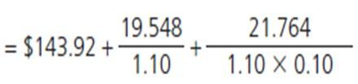
Challenging the Market Price: Google Inc, May 2011
In May 2011, Google, Inc. was trading at $535 per share, or 3.7 times book value of $143.92 per share at the end of its 2010 fiscal year.
Analysts were forecasting a consensus estimate of $33.94 EPS for 2011 and $39.55 for 2012.
Required return 10%.
Value = Value based on what we know + Speculative value
(1) (2)
Value based on what we know is the no-growth valuation based on BV and near-term forecasts
= $143.92 + $215.62 = $359.54
Speculative value is the value from speculating about growth
= Market price – No-growth value
= $535 - $359.54
= $175.46

Slide 13
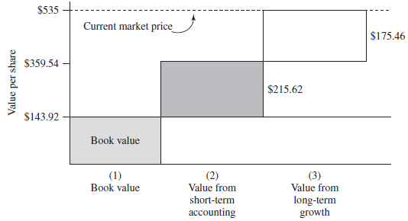
The Building Blocks of the Market: Valuation of Google
Market price = $535 in May 2011
With value set to Google’s market price of $535, we can infer the market’s long- term growth rate: the implied growth rate for Google after 2012 is 4.7% per year.

Slide 14
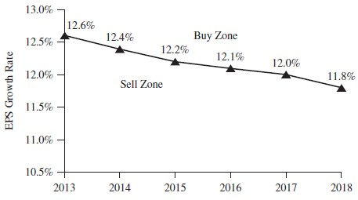
Converting a Residual Earnings Growth Rate to an EPS Growth Rate
Plot of forecasted growth rates:

