Slide 2

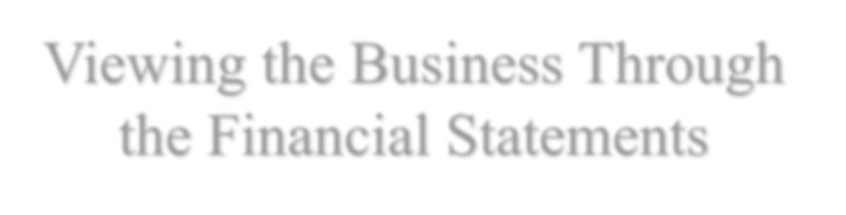


Viewing the Business Through the Financial Statements

Slide 3



Outline
Cash Flows Between the Firm and Claimants in the Capital Market
Business Activities: All Cash Flows
The Reformulated Cash Flow Statements
The Reformulated Balance Sheet
The Reformulated Income Statement
Accounting Relations that Govern Reformulated Statements
Tying it Together: What Generates Value?

Slide 4

The Big Picture for This Chapter
This chapter provides the template for reformulating financialstatements
in a way that readies them for analysis.
Sound financial statement analysis requires
A distinction between the operating and financing aspects ofthe
business
A reformulation of the financial statements into a form thatmakes this distinction clear
A sharper picture of the business is drawn with reformulatedfinancial statements.

Slide 5












Cash Flows Between the Firm and Claimants in the Capital Market
Recall from CH01:
The firm:
The value generator
The investors:
The claimants on value
Cash from loans
Interest and loan repayments
Operating
Activities
Investing
Activities
Financing
Activities
Cash from share issues
Dividends and cash from share repurchases

Slide 6

Cash Flows Between the Firm and Claimants in the Capital Market
The net debt financing flow (F) involves the net CF to bondholders, banks, and other creditors, i.e. cash paid to debtholders in interest and principal repayments – cash paid into the firm from borrowing more from thesecreditors.
The net dividend to shareholders (d) = cash paid in dividends and stock repurchases less cash contributions to the firm from shareholders.
The transactions between the two claimants and the firm are the firm’s financingactivities.
Capital
The Firm Markets
F
Debt Holders or Issuers
Net Financial Assets
d
Share Holders
(NFA)
Financing Activities
Key:
F = net cash flow to debtholders and issuers d = net cash flow to shareholders
NFA = net financial assets = financial assets – financial liabilities

Slide 7
Cash Flows Between the Firm and Claimants in the Capital Market
A firm always begins with cash contributions from shareholders. Cash is a nonproductive asset so, until it is invested in operations, firms invest this cash in bonds or other interest bearing paper and deposits, referred to as financial assets (or marketable securities).
Capital Markets
The Firm
F
Debt Holders or Issuers
Net Financial Assets
d
Share Holders
(NFA)
Financing Activities
Key:
F = net cash flow to debtholders and issuers d = net cash flow to shareholders
NFA = net financial assets = financial assets – financial liabilities

Slide 8
Cash Flows Between the Firm and Claimants in the Capital Market
A firm can be a buyer of debt if it has excess cash or can be an issuer of debt if it needs cash.
Case #1: it holds financial assets; F = cash paid to buy debt assets – cash received in interest and from the sale of the debt.
Case #2: it has financial obligations or financial liabilities; F = cash paid in interest and to redeem debt obligations – cash received in issuing debt.
Capital
The Firm Markets
F
Debt Holders or Issuers
Net Financial Assets
d
Share Holders
(NFA)
Financing Activities
Key:
F = net cash flow to debtholders and issuers d = net cash flow to shareholders
NFA = net financial assets = financial assets – financial liabilities

Slide 9
Cash Flows Between the Firm and Claimants in the Capital Market
Firms often issue debt and hold debt at the same time. Thus they hold both financial assets and financial obligations. The net debtholding is net financial assets, i.e. financial assets – financial obligations.
Correspondingly, the net debt financing flow is the net cash outflow w.r.t. both borrowing and lending.
Capital
The Firm Markets
F
Debt Holders or Issuers
Net Financial Assets
d
Share Holders
(NFA)
Financing Activities
Key:
F = net cash flow to debtholders and issuers d = net cash flow to shareholders
NFA = net financial assets = financial assets – financial liabilities

Slide 10

Business Activities: All Cash Flows
Firms typically are not primarily in the business of buying bonds but hold bonds only temporarily to invest idle cash. They invest in operating assets – land, factories, inventories, etc. – that produce products for sale. This is the firm’s investing activities and the CFs involved are cash investment or CF in investment activities(I).
Note that “investing activities” means investment in operating assets, not financial assets; indeed,
investment in operating assets involves a liquidation of NFA.
The Firm
Capital Markets
F
Debt Holders or Issuers
C
Net Operating Assets
Net Financial Assets
I
d
Share Holders
(NOA)
(NFA)
Operating Activities Financing Activities
F = net cash flow to debtholders and issuers d = net cash flow to shareholders
C = cash flow from operations
I = cash investment
NFA = net financial assets
NOA = net operating assets = operating assets – operating liabilities
Key:

Slide 11

Business Activities: All Cash Flows
The operating assets, set to work, produce net CFs (cash inflows from selling products – cash outflows from paying wages/rent/invoices/…) and this CF is referred to as CF from operations (C). Cash from operations is never “left lying around” but is invested in financial assets to earn interest until needed. When needed, financial assets are liquidated to make cash investment in operations.
Capital
The Firm Markets
F
Debt Holders or Issuers
C
Net Operating Assets
Net Financial Assets
I
d
Share Holders
(NOA)
(NFA)
Operating Activities Financing Activities
F = net cash flow to debtholders and issuers d = net cash flow to shareholders
C = cash flow from operations
I = cash investment
NFA = net financial assets
NOA = net operating assets = operating assets – operating liabilities
Key:

Slide 12

Business Activities: All Cash Flows
Cash generated from operations is invested in net financial assets (that is, it is used to buy financial assets or to reduce financial liabilities). Cash investment in operations is made by reducing net financial assets (i.e., by liquidating financial assets / issuing financial obligations). Cash from operations and cash investment may be negative (such that, e.g., cash can be generated by liquidating an operating asset and
investing the proceeds in a financial asset).
The Firm
Capital Markets
F
Debt Holders or Issuers
C
Net Operating Assets
Net Financial Assets
I
d
Share Holders
(NOA)
(NFA)
Operating Activities Financing Activities
F = net cash flow to debtholders and issuers d = net cash flow to shareholders
C = cash flow from operations
I = cash investment
NFA = net financial assets
NOA = net operating assets = operating assets – operating liabilities
Key:

Slide 13
The Cash Conservation Equation
A fundamental accountingidentity:
C − I ≡ d + F
C | = | Net cash from operations
I | = | Net cash outflow for investing
C - I | = | Free cash flow
d | = | Net dividends (common dividends + share repurchases – share issues)
F | = | Net cash outflow to debtholders and debt issuers (the net cash flow from
 |  | borrowing and lending)
 | = | Net principal payments + net interest paid (i)
CF from operations less cash investment in operation always equals thenet
CFs paid to debtholders (or issuers) and shareholders.
The sources of cash must be equal to its uses.

Slide 14
The Cash Conservation Equation
A fundamental accountingidentity:
C − I ≡ d + F
C | = | Net cash from operations
I | = | Net cash outflow for investing
C - I | = | Free cash flow
d | = | Net dividends (common dividends + share repurchases – share issues)
F | = | Net cash outflow to debtholders and debt issuers (the net cash flow from
 |  | borrowing and lending)
 | = | Net principal payments + net interest paid (i)
If C>I, a pos. FCF is used either to pay net interest and buy bonds (F) or to
pay net dividends (d);
If C<I, a neg. FCF requires that a firm either issue bonds (neg. F) or issue shares (neg. d) to satisfy the cash shortfall.

Slide 15
The Cash Conservation Equation
The treasurer’s rule:
If C – I – i > d: lend or buy down own debt
If C – I – i < d: borrow or reduce lending
If the FCF after making after-tax net interest payment > net dividend that the firm wants to pay, then the firm could use the excess cash to buy others’ bonds or redeem its own debt.
If the FCF after making the net interest payment < dividend payout that the firm wanted to maintain, then the firm need to issue debt or sell off financial assets.

Slide 16
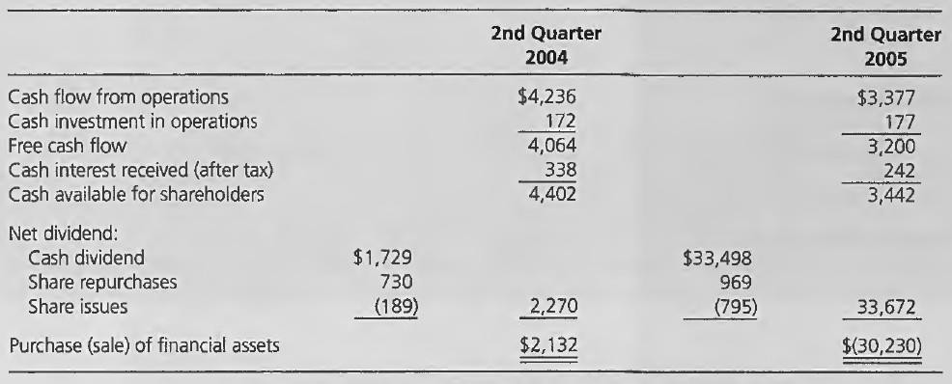

Applying the Treasurer’s Rule: Microsoft
In its 2nd quarter for 2004, Microsoft generated $4,064 million in FCF and received $338 million in interest, net of tax, from short-term (ST) marketable securities it held. It paid a net $2,270 million in cash out to shareholders, leaving $2,132 million with which it purchased ST interest-bearing securities.
In its 2nd quarter for 2005, Microsoft generated $3,200 million in FCF and received $242 million in interest, net of tax, for ST marketable securities it held. In this quarter, the firm paid out a large special net dividend to shareholders of $33,672 million, leaving a cash shortfall. Accordingly, it sold $30,230 million of marketable securities to provide cash for the dividend.

Slide 17
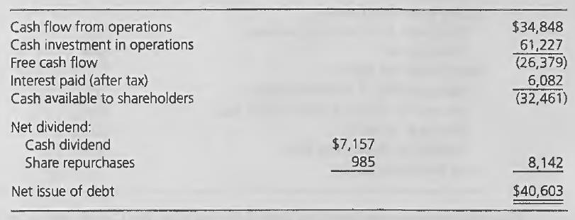
Applying the Treasurer’s Rule: General Electric
During 2002, General Electric generated $34.8 billion in CF from operations but made $61.2 billion further investment in operations, including $7.7 billion of capital exp. on plant, property & equipment, $21.6 billion in acquisitions, and $18.1 billion investment in financing receivables. Accordingly, its FCF was negative to the amount of -$26.4 billion. As it paid out $8.1 billion to shareholders, it had to borrow $40.6 billion to cover this payout, the free cash deficit, and $6.1 billion in interest payments on debt.

Slide 18
Reformulated Statement of Cash Flows C – I = d + F
Cash flows from operations Cash investment
Free cash flow
Equity financing flows:
Dividends and share repurchases XX Share issues (XX)
C (I) C - I
d
Debt financing flows:
Net purchases of financial assets XX Interest on financial assets (XX) Net issue of debt (XX)
Interest on debt XX
F
Total financing flows
d + F

Slide 19
Reformulated Cash Flow Statements: Microsoft
In millions |  | Microsoft |  |  | GE
 |  | Q1, 2004 |  | Q2, 2005 |  | 2002
Cash flow from operations (C) |  | $4,236 |  | $3,377 |  | $34,848
Cash investment (I) |  | (172) |  | (177) |  | (61,227)
Free cash flow (C-I) |  | 4,064 |  | 3,200 |  | (26,379)
Equity financing flows (d):
Dividends and share repurchases | $2,459 |  | $34,467 |  | $8,142
Share issues | (189) | 2,270 | (795) | 33,672 | - | 8,142
Debt financing flows (F):
Net purchase of financial assets |  | 2,132 |  | (30,230) |  | -
Interest on financial assets (after tax) |  | (338) |  | (242) |  | -
Net issue of debt |  | - |  | - |  | (40,603)
Interet paid on debt (after tax) |  |  |  |  |  | 6,082
Total finaning flows (d+F) |  | $4,064 |  | $3,200 |  | $(26,379)

Slide 20
Reformulated Balance Sheet
Assets
Operating assets Financial assets
Total Assets
OA FA
OA + FA
Liabilities and Equity Operating liabilities Financial obligations
Common stockholders’ equity
OL FO CSE
Total
OL + FO + CSE

Slide 21
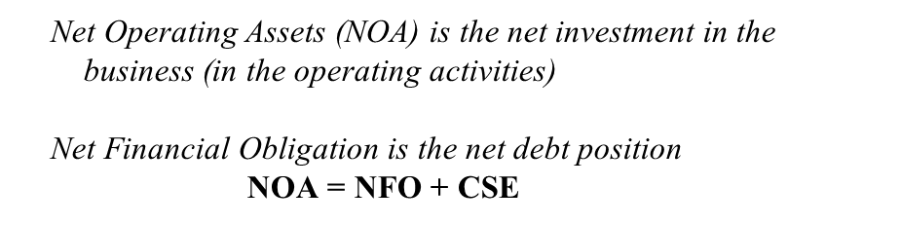

Reformulated Balance Sheet
Operating Assets
Operating assets Operating liabilities
Net operating assets
OA (OL) NOA
Financial Obligations & Owners’ Equity
Financial liabilities Financial assets
Net financial obligations Common equity
FO (FA) NFO CSE
Total NFO & Equity NFO + CSE

Slide 22








Business Activities: All the Stocks & Flows
Product and
input markets
Firms raise cash from capital markets to invest in financial assets which are then turned into operating assets. But they then use the operating assets in operations.
The firm
Capital markets
OR
C
F
Net Operating
Assets (NOA)
Net Financial
Assets (NFA)
OE
I
d
OR-OE=OI
Key:
OI -ΔNOA=C-I
F | = | net cash flow to debtholders and issuers
d | = | net cash flow to shareholders
C | = | cash flow from operations
I | = | cash investment
NFA | = | net financial assets
NOA | = | net operating assets
OR | = | operating revenue
OE | = | operating expense
OI | = | operating income
NFI | = | net financial income
C-I -ΔNFA+NFI=d
Operating
Activities
Financing
Activities

Slide 23

Business Activities: All the Stocks & Flows
Product and
input markets
Financing activities involve trading in capital markets. Operating activities involve trading with customers and suppliers in product andinput markets.
The firm
Capital markets
OR
C
F
Net Operating
Assets (NOA)
Net Financial
Assets (NFA)
OE
I
d
OR-OE=OI
Key:
OI -ΔNOA=C-I
F | = | net cash flow to debtholders and issuers
d | = | net cash flow to shareholders
C | = | cash flow from operations
I | = | cash investment
NFA | = | net financial assets
NOA | = | net operating assets
OR | = | operating revenue
OE | = | operating expense
OI | = | operating income
NFI | = | net financial income
C-I -ΔNFA+NFI=d
Operating
Activities
Financing
Activities

Slide 24

Business Activities: All the Stocks & Flows
Product and
input markets
Net operating assets are employed in operations to generate operating
revenue (by selling goodsand services to customers) and incur operating expenses (by buying inputs fromsuppliers).
∆ indicates changes.
The firm
Capital markets
OR
C
F
Net Operating
Assets (NOA)
Net Financial
Assets (NFA)
OE
I
d
OR-OE=OI
Key:
OI -ΔNOA=C-I
F | = | net cash flow to debtholders and issuers
d | = | net cash flow to shareholders
C | = | cash flow from operations
I | = | cash investment
NFA | = | net financial assets
NOA | = | net operating assets
OR | = | operating revenue
OE | = | operating expense
OI | = | operating income
NFI | = | net financial income
C-I -ΔNFA+NFI=d
Operating
Activities
Financing
Activities

Slide 25

Reformulated Income Statement
The difference between operating revenue and operating expense is called operating income:
OI = O R − OE
Income Statement
Operating income
Operating revenue Operating expense | OR (OE) | OI
Net financial expense Financial expense | FE
Financial revenue | (FI) | (NFE)
Comprehensive income CI
Operating Income (OI) is income from the business (enterprise income)
The net amount of effective interest income (on financial assets) and effective interest expense (on financial obligations) is called net financial income (NFI) or, if interest expense is greater than interest income, net financial expense (NFE).

Slide 26

Free Cash Flows and Dividends: How They are Explained
Free cash flow = Operating income – Change in net operating assets
C - I = OI – ΔNOA
Operations generate operating income, and FCF is the part of this income
remaining after reinvesting some of it in net operating assets.
In a sense, FCF is a dividend from the operations, the cash from operating profits after retaining some of the profits as assets.

Slide 27

Free Cash Flows and Dividends: How They are Explained
Free cash flow = Change in net financial assets – Net financial income
+ Net dividends
C - I = ΔNFA – NFI + d
Free cash flow is used to pay net dividends, with the remainder invested in
net financial assets, along with net financial income.

Slide 28

Free Cash Flows and Dividends: How They are Explained
Free cash flow = Net financial expenses – Change in net financial
obligations + Net dividends
C - I = NFE – ΔNFO + d
If the firm has financial obligations, free cash flow is applied to pay for net
financial expenses, reduce net borrowing, and pay net dividends

Slide 29







Free Cash Flows and Dividends: How They are Explained
Operations yield value (OI)
that is invested in NOA.
Product and input markets
The firm
Capital markets
Excess cash from operations is invested in NFA, which yield net interest income.
OR
C
F
Net Operating
Assets (NOA)
Net Financial
Assets (NFA)
Then these financial assets
are liquidated to pay d.
If operations need cash (neg. FCF), FA are liquidated or FO are created throughborrowing.
OE
I
d
OR-OE=OI
Alternatively, cash is raised from shareholders (neg. d) and temporarily invested in FA until needed to satisfy the neg. FCF.
OI -ΔNOA=C-I
C-I -ΔNFA+NFI=d
Operating Activities
Financing Activities

Slide 30
Free Cash Flows and Dividends: How They are Explained
Net dividends = Free cash flow + Net financial income
– Change in net financial assets
d = (C - I) + NFI – ΔNFA
Dividends are paid out of FCF and interest earned on financial assets and by selling financial assets.
If FCF is insufficient to pay dividends, financial assets are sold (or financial
obligations incurred) to pay the dividend.
If the firm is a net debtor,
Net dividends = Free cash flow – Net financial expenses
+ Change in net financial obligations
d = (C - I) – NFE + ΔNFO
Dividends are generated from FCF after serving interest, but also by increasing
borrowing.

Slide 31
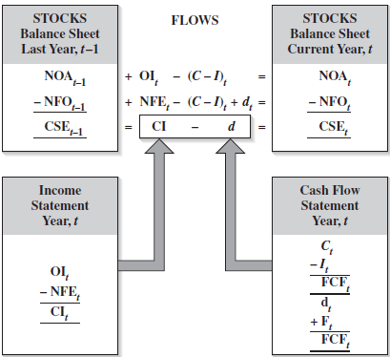

Business Activities and the Financial Statements: The Big Picture
This figure shows how reformulated income statements, balance sheets, and the cash flow statements report the operating and financing activities of a business, and
how the stocks and flows are uncovered in the financial statements. Operating income increases net operating assets and net financial expense increases net financial obligations. Free cash flow is a “dividend” from the operating activities to the financial activities: free cash flow reduces net operating assets and also reduces net financial obligations. Net dividends to shareholders are paid out of net financial obligations.

Slide 32

How the Balance Sheet Evolves Over Time: Operating Activities
The change in Net Operating Assets is given by:
Net operating assets (end) = Net operating assets (beginning)
+ Operating income – Free cash flow
NOA_{t} = NOA_{t-1} + OI_{t} – (C_{t} – I_{t})
Operating income is value added from operations, and that value increases net operating assets.
Free cash flow reduces net operating assets as cash is taken from operationsand invested in net financial assets.

Slide 33
How the Balance Sheet Evolves Over Time: Financing Activities
The change in Net Financing Assets is given by:
Net financial assets (end) = Net financial assets (beginning)
+ Net financial income
+ Free cash flow – Net dividends
NFA_{t} = NFA_{t-1} + NFI_{t} + (C_{t} – I_{t}) – d_{t}
The net financial income earned on net financial assets adds to the assets.
Free cash flow increases the assets (as the cash from operations is invested in financial assets).
The assets are liquidated to pay net dividends.

Slide 34
How the Balance Sheet Evolves Over Time: Financing Activities
If the firm holds net financial obligations rather than net financial assets, thechange
in Net Financing Obligations is given by:
Net financial obligations (end) = Net financial obligations (beginning)
+ Net financial expense
– Free cash flow + Net dividends
NFO_{t} = NFO_{t-1} + NFE_{t} – (C_{t} – I_{t}) + d_{t}
Net financial expenses increase net indebtedness.
Free cash reduces indebtedness, after paying out net dividends from thefree cash flow.

Slide 35
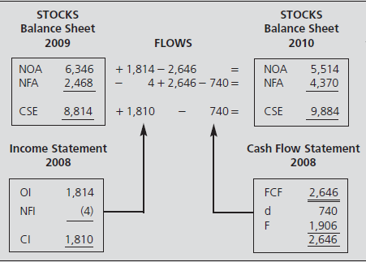

The Reformulated Statements: Nike, Inc., 2010

Slide 36

Free Cash Flow for Nike, Inc., 2010
C - I = OI ‒ΔNOA
= 1,814 ‒ (5,514 – 6,346)
= 2,646
Nike generated $1,814 million in operating income and reduced
its investment in the balance sheet by $832 million, so generated
$2,646 million in free cash flow

Slide 37

Tying it Together: What Generates Value?
From the balance sheet equation
CSE_{t} = NOA _{t} − NFO_{t}
Given the way that NOA and NFO are calculated,
CSE_{t} = NOA_{t−1} + OI_{t} − (C_{t} − I_{t} )− NFO_{t-1} + (C_{t} − I_{t} )− NFE_{t} − d_{t}
= NOA_{t−1} − NFO_{t-1} + OI_{t} − NFE_{t} − d_{t}
= CSE_{t−1} + Earn_{t} − d_{t}
which is the stocks and flows equation.
Free cash flow drops out in this calculation: Free cash flow (C - I) does not add value to shareholders. Free cash flow is a dividend from the operating activities to the financing activities.
The profits from operating activities (OI) and financing activities (NFE), which together give earnings, increase or decrease shareholder wealth.

