Slide 2
Outline
Reformulated Statement of Common Stockholders’ Equity
Reformulation: The Steps
Dirty-Surplus Accounting
Ratio Analysis
Hidden Dirty Surplus

Slide 3
GAAP Statement of Shareholders’ Equity
Opening book value of equity (common, preferred, and noncontrolling equity)
+ Net share transactions with common stockholders
+ Capital contributions (paid in capital from share issues)
Share repurchases (into treasury stock or against paid-in capital)
+ Net share transactions with preferred shareholders
+ Capital contributions (share issues)
Share redemptions
+ Change in retained earnings
+ Net income – including noncontrolling interest income
Common dividends
Preferred dividends
Some share repurchases
+ Accumulated other comprehensive income
+ Earnings restatements due to change in accounting
+ Increase in equity from issuing stock options
Closing book value of equity (common, preferred, and noncontrolling equity)

Slide 4
The Governing Accounting Relation
Book value, beginning of period
+ Comprehensive income
- Net payout to shareholders
= Book value, end of period

Slide 5
Reformulated Statement of Common Stockholders’ Equity
Reformulated Statement of Common Shareholders' Equity
Beginning book value of common equity
+ Net effect of transactions with common shareholders
+ Capital contributions (share issues)
- Share repurchase
- Dividends
= Net cash contribution (negative net dividends)
+ Effect of operations and nonequity financing
+ Net income (from income statement)
+ Other comprehensive income
- Preferred dividends
= Comprehensive income available to common
Closing book value of common equity
Note that preferred equity and noncontrolling interest are taken out of the common shareholders' equity statement (and treated as obligations to others).

Slide 6
Reformulated Statement of Common Stockholders’ Equity
The reformulated statement excludes preferred equity.
The net addition to common equity from transactions with shareholders – the negative net dividend – is separated from the addition to shareholders’ equity that arises from business activities.
The total effect of operations and nonequity financing on the common
shareholders is isolated in comprehensive income:
  Net income (from income statement)
  Other comprehensive income
  Preferred dividends: treated as an “expense” in calculating comprehensive income, as preferred stock is effectively debt from the common shareholders’ perspective.

Slide 7
Reformulation: The Steps
Restate beginning and ending balances for the period for items that are not part of common shareholders’ equity:
  Preferred stock
  Noncontrolling interest reported within equity
+ Dividends payable
Calculate net transactions with shareholders
Cash dividends + share repurchases – share issues
(Cash dividends = Dividends reported – change in dividends payable)
Calculate comprehensive income
= Net income + “Other comprehensive income”
  Earnings from accounting changes
  Preferred dividends
  Noncontrolling interest in earnings
  Hidden dirty-surplus losses

Slide 8
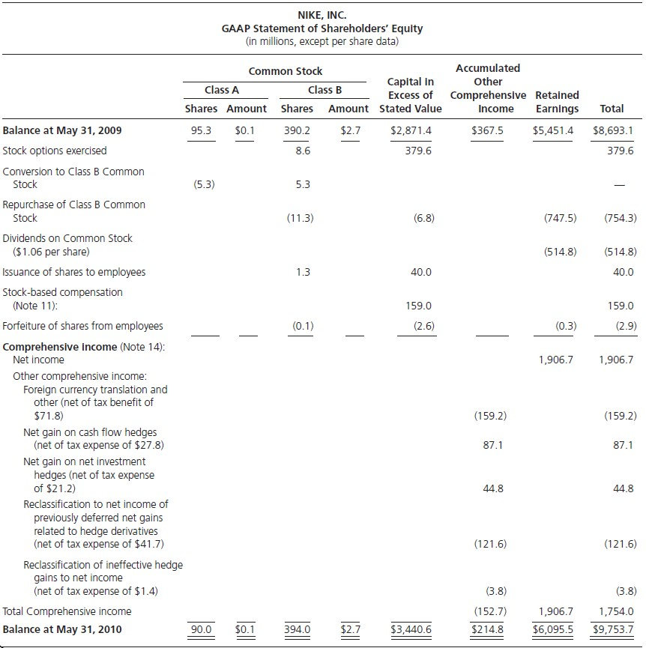
The GAAP Statement: Nike, Inc., 2010
Note: Footenotes to the 10-K indicate Nike had $130.7 million in dividend payable at the end of 2010 and $121.4 million at the end of 2009.

Slide 9
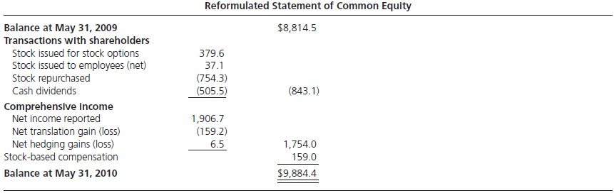
Nike: The Reformulated Statement
Stock-based Compensations is a credit to owners’ equity. This is indeed odd: the shareholders have an obligation to give up value to the option holders (upon exercise of the option), yet GAAP and IFRS treat this an increase in equity! Clearly it is not. It is a liability.
Balance at May 31, 2009 = Reported Balance + Dividends Payable = $8,693.1 + $121.4 = $8,814.5
Balance at May 31, 2010 = Reported Balance + Dividends Payable = $9,753.7 + $130.7 = $9,884.4
Cash dividends = Dividends declared – Change in dividends payable = $514.8 – (130.7 – 121.4) = $505.5

Slide 10
Dirty-Surplus Accounting:
Reporting income items as part of equity rather than in an income statement is known as dirty-surplus accounting. Under dirty-surplus accounting, the income in the income statement is not “clean” (i.e. not complete).
  Dirty-surplus item: an accounting item in shareholders’ equity other than transactions with shareholders or income closed from the income statement.
An equity statement that has no income other than net income from the income statement is a clean-surplus accounting statement.

Slide 11
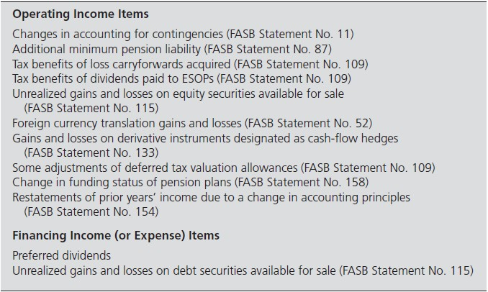
Dirty Surplus Accounting in the US: A Complete List

Slide 12
Dirty-Surplus Accounting: The Most Common Items
Currency translation gains and losses
  The assets and liabilities of majority-owned foreign subsidiaries, measured in the foreign currency, must be consolidated into the statements of a U.S. parent in US$.
  If the exchange rate changes over the reporting period, the value of the assets & liabilities changes in US$. The resulting gain or loss is a translation gain or loss (part of other comprehensive income).
Unrealized gains and losses on securities (debt & equity)
Gains and losses on derivative instruments

Slide 13
Dirty-Surplus Accounting: The Most Common Items
Currency translation gains and losses
Unrealized gains and losses on securities (debt & equity w. less than 20% ownership interest)
  Financial Accounting Standards Board (FASB) Statement No. 115 distinguish three
types of securities:
    Trading securities – mark to fair value; book realized and unrealized gains and losses to income statement.
    Securities available for sale – mark to fair value; book realized (unrealized) gains
and losses to income (equity) statement.
    Securities held to maturity – carry at historical cost; book realized gains and losses to income statement; no unrealized gains and losses are reported.
Gains and losses on derivative instruments

Slide 14
Dirty-Surplus Accounting: The Most Common Items
Currency translation gains and losses
Unrealized gains and losses on securities (debt and equity)
Gains and losses on derivative instruments
  FASB Statement No. 133 requires most derivatives to be marked to fair value on the
BS.
  Fair value hedge – hedge the exposure to changes in the fair value of an existing asset / liability / a firm commitment; the gain/loss from marking the instrument to fair value is recorded as part of net income.
  Cash flow hedge – hedge the exposure to variable CFs from an anticipated future transactions; the gain/loss is recorded to the equity statement, and then removed from the equity statement to net income on the expiration of the hedge.

Slide 15
FASB Statement No. 130
Requires the reporting of comprehensive income in one of three ways
  Within the income statement
  In separate statement
  Within the equity statement
Most firms choose the last alternative
  Effective 2012, only the first two options will be allowed; same with International Financial Reporting Standards (IFRS)

Slide 16
Ratio Analysis
Payout and Retention Ratios
Dividend Payout =
Dividends
Comprehensive Income
_{Total Payout Ratio=} Dividends + Stock Repurchases
Comprehensive Income
Dividends-to-Book Value=
Dividends
Book Value of CSE +Dividends
+Stock Repurchases
Total Payout-to-Book Value=
Dividends+StockRepurchses
Book Value of CSE + Dividends + StockRepurchases
Retention Ratio= Comprehensive Income - Dividends =1- Dividend Payout Ratio
Comprehensive Income

Slide 17
Ratio Analysis (continued)
Shareholder Profitability Ratio
_{ROCE =} Comprehensive Earnings_{t}
t
1
2
(CSE_{t} +CSE_{t-1} )
Growth Ratios
_{Net Investment Rate=} Transactions with shareholders
Beginning Book Value of CSE
_{Growth Rate of CSE=} Change in CSE ₌ Comprehensive Income+Net Transactions with Shareholders Beginning CSE Beginning CSE

Slide 18
Hidden Dirty Surplus
The distinctions between comp. income and transactions with shareholders in the reformulated statement of owners’ equity separates the creation of value from the raising of funds and the distribution of value to shareholders.
The premise is that transactions with shareholders do not create value.
Shareholders lose when shares are issued at less than the market price (e.g.
exercise of options)
This loss, however, is not recorded as expense under GAAP and IFRS.

Slide 19
Hidden Dirty Surplus
What is the nature of this loss?
  If options are part of a compensation package, this loss is an employee
compensation expense.
  If from a conversion of a bond, preferred stock or warrants, the loss is a financing expense.
What is the amount of the loss?
Market price - exercise price

Slide 20
FASB Statement No. 123R
Statement 123R requires an expense to be recognized at option grant date, equal to the value of the option at that date, priced using option-pricing formulas. The compensation is then recognized in the income statement over a service period.
IFRS 2 requires similar treatment (grant-date accounting).
But the granting of options yields an expense only in recognition of possible exercise.
  If the option lapses (because the stock does not go into the money), no expense
is incurred, but the accounting maintains the expense.
  An expense is realized only if the option is exercised.
Exercise-date accounting recognize this expense.
Firms record a tax benefit (for non-qualified options) at exercise date, and credit this to shareholders’ equity.

Slide 21
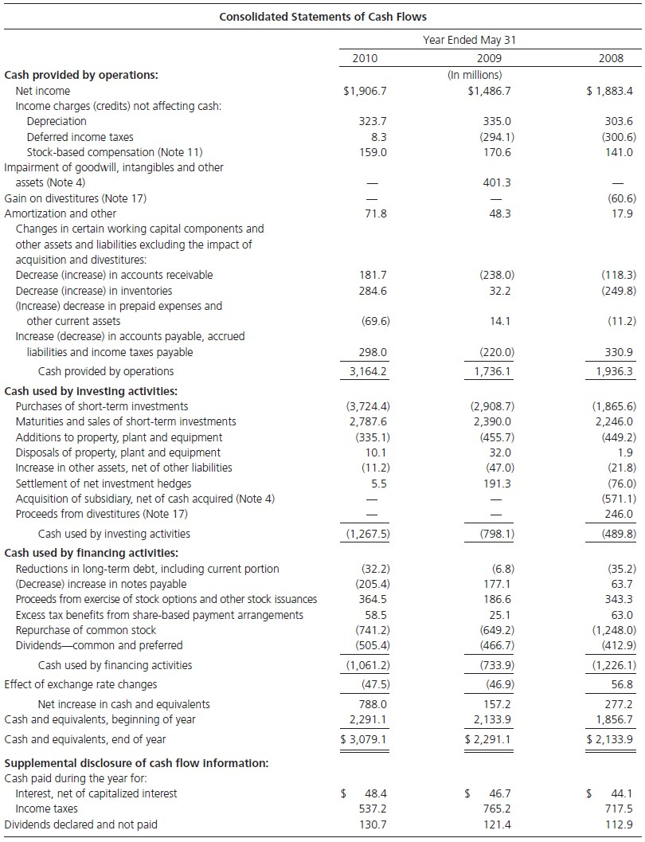



Measuring the Loss from Exercise of Stock Options Method 1 (Nike)
For nonqualifying options – employee stock options that are taxable to the employee on exercise and tax deductible to the issuing corporation.
Stock option loss is implied from the tax benefit from the exercise of options (from financing section of CF statement; sometimes reported separately from equity statement)
Stock option loss | $58.5/0.36 | $161.1
Tax benefit at 36.3% |  | (58.5)
Stock option loss, after tax |  | $102.6
9-23

Slide 22
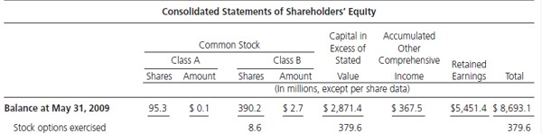
Measuring The Loss from Exercise of Stock Options: Method 2 (Nike)
When tax benefit is not reported, or for incentive options (where there is no tax benefit).
The calculation must estimate the market price at exercise date. Nike’s avg. stock price during 2010 was $64. With 8.6 million options exercised:
Estimate market value of shares issued: 8.6 mill x $64 $ 550.4
Exercise (issue) price, from equity statement Stock option expense, before tax | 321.1* 229.3
Tax benefit at 36.3% | 83.2
Stock option expense, after tax | $ 146.1
* From equity statement ($379.6) less tax benefit of $58.5 that has been added to issue price in equity statement

Slide 23
Should Loss from Exercise of Options be Included in Comprehensive Income?
In principle, YES
But….as grant date expense has already been recorded, we would be double counting to some extent
Two alternatives:
  Unravel GAAP accounting and recognize just the exercise date expense that has not already been recognized in prior years at grant dates (too difficult!)
  Recognize loss on exercise of stock options, but reduce by “stock-based compensation” recognized in the current year.
Alternative 2 is an expediency, though not strictly correct.

Slide 24
Is “Stock-based Compensation” Equity or is it Liability?
It’s a liability! Shareholders have a (contingent) liability to issue stock at less than market price.
Yet GAAP and IFRS treat it as equity
GAAP and IFRS make it look like issuing stock options increases equity. How can “payment” for wages increase equity?
But…unraveling the GAAP accounting is too difficult. So recognize loss on exercise of stock options, but reduce by “stock-based compensation” recognized in the current year…. (as an expediency).

Slide 25
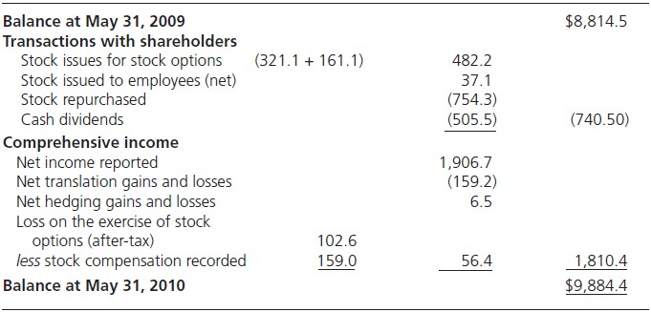
The Reformulated Equity Statement: Including Loss on Exercise of Stock Options
The diff. between market price and exercise price, $161.1 million has been added to share issues to
report them as if they were issued at MV (and thus add no value).
The after-tax loss on exercise of stock options, $102.6 million, has been reduced by the $159 million that has been recognized under grant-date accounting.
Now the reformulated statement records transactions with shareholders at MV with any loss from issuing shares at < MV appropriately recognized in comprehensive income.

Slide 26
The Option Overhang
The option overhang is the value of the options not yet exercised. This (contingent) liability is the estimate of the amount of value that shareholders will give up at exercise date.
A rough estimate of the option overhang:
Market value of stock to be issued
Strike price of options Tax benefit (if any)
Contingent liability for options
XXX XXX XXX XXX

Slide 27
The Option Overhang: Nike Inc.
At the end of 2010, Nike had 36.0 million employee stock options outstanding at a weighted average exercise price of $46.60. Nike’s stock traded at $72.38 at fiscal-year end.
Floor valuation of Nike’s overhang: (In millions)
Market price of shares: 36.0 × $72.38 | $2,606
Exercise price: 36.0 × $46.60 | 1,678
 | 928
Tax benefit (at 36.3%) | 337
Contingent liability | 591
(This is $1.22 per share)

Slide 28
Hidden Losses on Put Options: Dell Inc.
In Dell’s statement of shareholders’ equity for the fiscal year ending Feb 1, 2002 (CH02), the following line item appeared (in millions):
 | Shares | Amount
Repurchase of common shares | 68 | $3,000
Footnotes reveal that Dell was forced to repurchase shares at the strike price of $44 on put options written to investors. (With the share price falling as the stock market bubble burst, Dell was caught as these options went under water.)
Using the avg. price of $24 for 2002 as the market price when the shares were repurchased, the loss from the exercise of put options is:
Market price of shares repurchased | $24 x 68 million | $1,632 million
Amount paid for shares repurchased |  | 3,000
Loss on exercise of put options |  | $1,368 million

Slide 29
Put Option Overhang: Dell
At the end of 2002, Dell had 51 million put options outstanding at a strike price of $45. The market price of the shares was $25.
Estimate of option overhang:
Market price of shares Strike price
Loss per share
$25 45
$20
× 51mill.
$1,020 mill.
Overhang
This overhang is a contingent liability that has not been booked to the balances sheet

Slide 30
Diluted EPS: Does it Deal With the Hidden Expense Problem?
It is tempting to think that one can recognize hidden expenses (and the dilution from shares issues) by using diluted EPS; that is, capture the effect in the denominator rather than the numerator.
This is NOT the case.
Diluted EPS divides earnings by shares outstanding as if all convertible securities
were converted into common (as might happen in the future).
So it divides earnings over both current and future shareholders. However, future shareholders share is future earnings, not current earnings.
Further, the loss from the issue of shares at less than market price is incurred by the current shareholders – in selling an interest in the firm to others; it is not a loss to the future shareholders.
One must recognize the loss to current shareholders (in basic EPS) in selling the firm to new shareholders at less than market value.

Slide 31
Do Share Repurchases Prevent Dilution from Shares Issued Under Stock Option Programs?
Dell, Inc., explains its put option transactions as “part of a share-repurchase program to manage the dilution resulting from shares issued under employee stock plans.”
Buying back shares reduces share outstanding. But does it reverse the dilution? The Answer is NO.
If shares are purchased at fair value, there is no change in the per-share value of the equity; the shareholder does not get extra value to compensate for the loss of value from stock options.
Maintaining constant shares outstanding with share repurchase only gives the
appearance of reversing the dilution.

