Slide 2
Outline
Reformulation of the Balance Sheet
  Issues in Reformulating Balance Sheet
  Strategic Balance Sheet
Reformulation of the Income Statement
  Tax Allocation
  Value Added to Strategic Balance Sheets
Comparative analysis of the Balance Sheet and Income Statement
  Ratio Analysis

Slide 3
The Big Picture for this Chapter
Before statements are analyzed they must be reformulated to “sharpen the lens on the business”
The key to reformulation is the separation of operating and financing activities
  It’s the operating activities that add value in a business, so don’t confuse them with the financing activities
Chapter 8 provides the design

Slide 4
The Standard Balance Sheet
Assets
Current assets:
Cash
Cash equivalents
Short-term investments Deposits and advances
Accounts receivable (less allowances)
Short-term notes receivable Other receivables Inventories
Prepaid expenses
Deferred income taxes (current portion)
Long-term assets:
Long-term debt securities Equity investment at cost Equity investments at market
Equity investments - equity method Property plant and equipment
(less accumulated depreciation)
Land
Buildings
Equipment
Leased assets
Leasehold improvements
Construction in progress
Intangible assets
Patents
Copyrights
Goodwill
Deferred taxes (non-current) Deferred charges
Liabilities and Stockholders’ Equity
Current liabilities:
Accounts payable Accrued expenses
Deferred (unearned) revenues Advances from customers Short-term notes payable Short-term borrowings
Deferred taxes (current portion) Current maturities of long-term debt
Long-term liabilities:
Bank loans Bonds payable
Long-term notes payable Lease obligations
Commitments and contingencies Deferred taxes
Pension liabilities
Post employment liabilities
Redeemable preferred stock
Equity
Preferred equity Common equity
Noncontrolling interest

Slide 5
The Separation of Operating Activities and Financing Activities: the Key Question
Reformulating balance sheets involves distinguish:
  Assets & liabilities that are used in business operations – where the firm makes money.
  Assets & liabilities that are used in financing – to raise cash for operations and disburse / temporarily
store excess cash from operations.
A firm “makes its money” by selling goods and services to customers, so identifying operating assets requires knowledge of goods and services the firm is delivering to customers.
Assets and liabilities with similar names on balance sheets may be financing items for
one firm but operating items for another.
Parallel classification in the income statement (discussed later):
  Operating assets & liabilities generate operating income
  Financial assets & liabilities produce financial income / incur financial expenses

Slide 6
Reformulating the Balance Sheet: The Governing Accounting Relations
Net Operating Assets (NOA) = Operating Assets (OA) – Operating Liabilities (OL)
Net Financial Obligations (NFO) = Financial Obligations (FO) – Financial Assets (FA) Common Shareholders’ Equity (CSE) = NOA – NFO
Reformulated Balance Sheet
OA (OL)
FO (FA) NFO CSE
NFO + CSE
NOA

Slide 7
Typical Financial and Operating Items
Assets
Financial assets:
Cash equivalents
Short-term investments
Short-term notes receivable (?)
Long-term non-marketable debt investments
Long-term marketable debt securities
Operating assets:
all other assets
Liabilities and Stockholders’ Equity
Financial liabilities:
Short-term borrowings
Current maturities of long-term debt
Short-term notes payable (?)
Long-term borrowing (bank loans, bonds, payable, notes payable)
- Lease obligations
- Preferred stock
Operating liabilities:
all other liabilities Noncontrolling interest
Common equity

Slide 8
Issues in Reformulating Balance Sheets
Cash: working cash and excess cash
Short term notes receivable: trade receivables or investment of cash?
Short-term notes payable: trade notes or borrowing?
Finance receivables: an operating asset
Debt investments: financial assets
Short-term equity investments: excess cash or trading securities?
Lease assets: operating assets
Lease liabilities: financial obligation
Deferred tax assets and liabilities: operating
Deferred revenues and accrued expenses: operating
Minority interest: not a financial obligation
For financial firms, many “financial items” are operating assets and liabilities

Slide 9
Issues in Reformulating Balance Sheets
Cash: working cash and excess cash
  Working/Operating cash, which is needed as a buffer to pay bills as they fall due, is an operating asset.
  Interesting-bearing cash equivalents (investment w. <3m maturity) or cash invested in ST securities are financial assets.
Short term notes receivable: trade receivables or investment of cash?
Short-term notes payable: trade notes or borrowing?
Finance receivables: an operating asset
Debt investments: financial assets
Short-term equity investments: excess cash or trading securities?
Lease assets: operating assets
Lease liabilities: financial obligation
Deferred tax assets and liabilities: operating
Deferred revenues and accrued expenses: operating
Minority interest: not a financial obligation
For financial firms, many “financial items” are operating assets and liabilities

Slide 10
Issues in Reformulating Balance Sheets
Cash: working cash and excess cash
Short term notes receivable: trade receivables or investment of cash?
  If the notes are temporary investments of excess cash, treat them as financial assets.
  If they are trade notes (written by customers for goods received in trade), treat them as operating assets.
  Trade notes can be treated as financial assets if they bear the market interest rate.
  If the firm is using credit to attract customers, treat the notes as operating assets
Finance receivables (for financing product sales): an operating asset
Short-term notes payable: trade notes or borrowing?
Debt investments: financial assets
Short-term equity investments: excess cash or trading securities?
Lease assets: operating assets
Lease liabilities: financial obligation
Deferred tax assets and liabilities: operating
Deferred revenues and accrued expenses: operating
Minority interest: not a financial obligation
For financial firms, many “financial items” are operating assets and liabilities

Slide 11
Issues in Reformulating Balance Sheets
Cash: working cash and excess cash
Short term notes receivable: trade receivables or investment of cash?
Finance receivables (for financing product sales): an operating asset
Short-term notes payable: trade notes or borrowing?
  ST notes can be written to generate cash, in which case they are financial obligations.
  Notes also can be written because of trade obligations, e.g. purchase of inventory
    Operating liabilities if they are non-interest bearing, or w. interest rate<market rate for this type of credit;
    Financial liabilities if they are interest bearing at market rates.
Debt investments: financial assets
Short-term equity investments: excess cash or trading securities?
Lease assets: operating assets
Lease liabilities: financial obligation
Deferred tax assets and liabilities: operating
Deferred revenues and accrued expenses: operating
Minority interest: not a financial obligation
For financial firms, many “financial items” are operating assets and liabilities

Slide 12
Issues in Reformulating Balance Sheets
Cash: working cash and excess cash
Short term notes receivable: trade receivables or investment of cash?
Finance receivables (for financing product sales): an operating asset
Short-term notes payable: trade notes or borrowing?
Debt investments: financial assets
  For nonfinancial firms, investments in bonds & other interest-bearing investments are financial assets.
  For banks, debt investments & debt liabilities are operating items.
Short-term equity investments: excess cash or trading securities?
Lease assets: operating assets
Lease liabilities: financial obligation
Deferred tax assets and liabilities: operating
Deferred revenues and accrued expenses: operating
Minority interest: not a financial obligation
For financial firms, many “financial items” are operating assets and liabilities

Slide 13
Issues in Reformulating Balance Sheets
Cash: working cash and excess cash
Short term notes receivable: trade receivables or investment of cash?
Finance receivables (for financing product sales): an operating asset
Short-term notes payable: trade notes or borrowing?
Debt investments: financial assets
Short-term equity investments: excess cash or trading securities?
  If they are part of a trading portfolio, they are operating assets.
  If they are used to temporarily mop up excess cash, they are financial assets.
Lease assets: operating assets
Lease liabilities: financial obligation
Deferred tax assets and liabilities: operating
Deferred revenues and accrued expenses: operating
Minority interest: not a financial obligation
For financial firms, many “financial items” are operating assets and liabilities

Slide 14
Issues in Reformulating Balance Sheets
Cash: working cash and excess cash
Short term notes receivable: trade receivables or investment of cash?
Finance receivables (for financing product sales): an operating asset
Short-term notes payable: trade notes or borrowing?
Debt investments: financial assets
Short-term equity investments: excess cash or trading securities?
Lease assets: operating assets
  Leases that are capitalized and placed on the BS are called capital leases. Capital leases are essentially in- substance purchases granting the firm a right to use the asset for most of its useful life.
Lease liabilities: financial obligation
  The obligation to service the lease is treated as if the firm had purchased the asset and borrowed to finance the purchase: the lease obligation is an effective loan to finance the purchase of the asset.
Deferred tax assets and liabilities: operating
Deferred revenues and accrued expenses: operating
Minority interest: not a financial obligation
For financial firms, many “financial items” are operating assets and liabilities

Slide 15
Issues in Reformulating Balance Sheets
Cash: working cash and excess cash
Short term notes receivable: trade receivables or investment of cash?
Finance receivables (for financing product sales): an operating asset
Short-term notes payable: trade notes or borrowing?
Debt investments: financial assets
Short-term equity investments: excess cash or trading securities?
Lease assets: operating assets
Lease liabilities: financial obligation
Deferred tax assets and liabilities: operating
  Deferred taxes arises almost always from accounting diff. in calculating the operating income component of
taxable income and reported book income. So treat them as operating assets/liabilities.
Deferred revenues and accrued expenses: operating
Minority interest: not a financial obligation
For financial firms, many “financial items” are operating assets and liabilities

Slide 16
Issues in Reformulating Balance Sheets
Cash: working cash and excess cash
Short term notes receivable: trade receivables or investment of cash?
Finance receivables (for financing product sales): an operating asset
Short-term notes payable: trade notes or borrowing?
Debt investments: financial assets
Short-term equity investments: excess cash or trading securities?
Lease assets: operating assets
Lease liabilities: financial obligation
Deferred tax assets and liabilities: operating
Deferred revenues and accrued expenses: operating
  Deferred rev. include receipts from customers that are not yet recognized as revenue (because the firm has not performed on the sale) and obligations to complete performance such as warranties & guaranties.
  Accrued exp. include liabilities to pay for the whole variety of operating expenses (e.g. rent, wages, taxes, etc.)
  But interest payable on financial obligation is a financing item.
Minority interest: not a financial obligation
For financial firms, many “financial items” are operating assets and liabilities

Slide 17
Issues in Reformulating Balance Sheets
Cash: working cash and excess cash
Short term notes receivable: trade receivables or investment of cash?
Finance receivables (for financing product sales): an operating asset
Short-term notes payable: trade notes or borrowing?
Debt investments: financial assets
Short-term equity investments: excess cash or trading securities?
Lease assets: operating assets
Lease liabilities: financial obligation
Deferred tax assets and liabilities: operating
Deferred revenues and accrued expenses: operating
Minority interest: not a financial obligation
  Not an obligation, like debt, that is satisfied with cash from FCF. Rather it is an equity sharing in the results of the consolidated operations.
  The reformulated statement with minority interest has the following form: NOA-NFO = CSE+Minority interest
For financial firms, many “financial items” are operating assets and liabilities

Slide 18
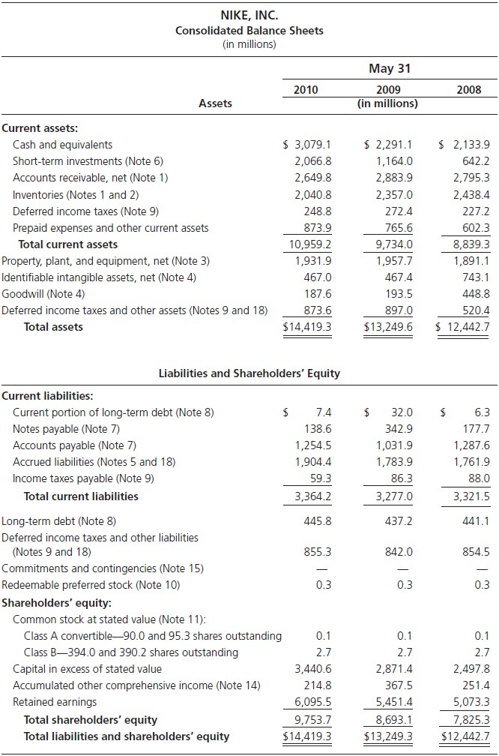
GAAP Balance Sheet: Nike, Inc.

Slide 19
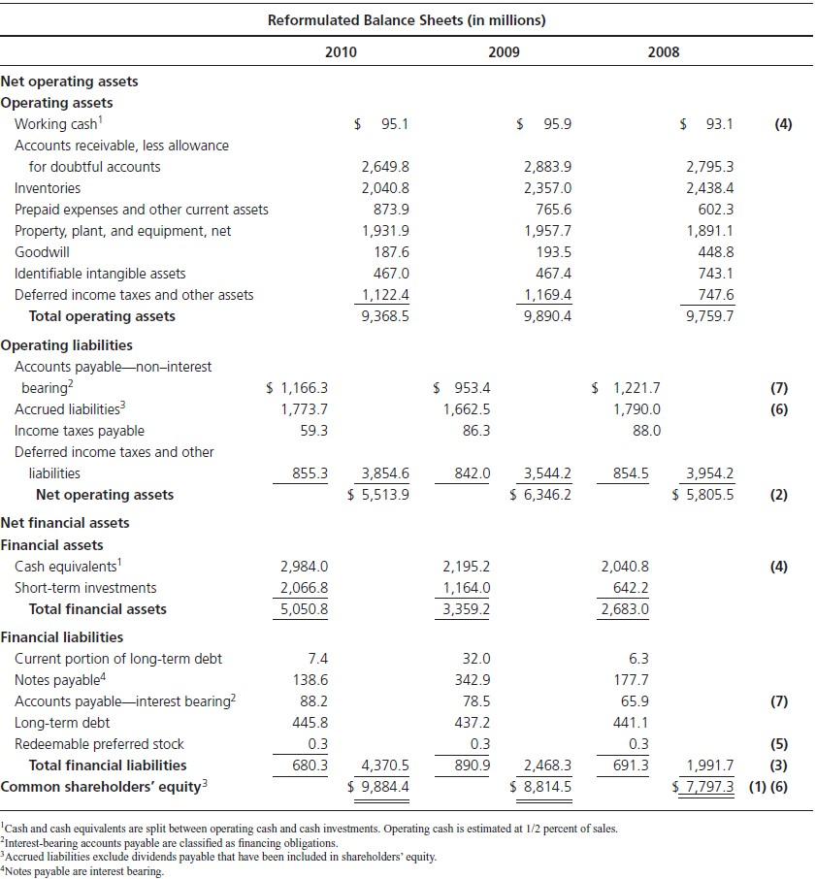
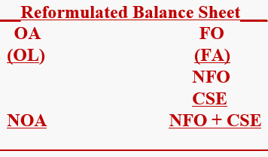
Reformulated Balance Sheet: Nike, Inc.
Common Shareholders’ Equity:
CSE = NOA – NFO
Net Operating Assets: NOA = OA – OL
Net Financial Obligations: NFO
= FO – FA
Cash and cash equivalents have been divided up between operating cash and financial assets. Operating cash has been estimated at 0.5% of sales.
Redeemable preferred stock is a
financial obligation.
Dividends payable is included in shareholders’ equity (see CH 09).

Slide 20
Strategic Balance Sheets
Reformulated balance sheets inform about the firm’s strategy for running the business:
How the firm invests in operations
How the firm relies on operating liabilities
How the firm conducts its financing of the operations
Reformulated statements provide a narrative

Slide 21
Strategic Balance Sheet: Nike Inc.
Nike conducts business by investing shareholders’ equity in NOA + additional inv. in NFA.
The positive NFA reveal Nike’s current financing strategy:
Rather than financing operations through borrowing, Nike does so through equity and indeed is a net lender rather than borrower.
OA list the type of assets that Nike invests in to run the business.
OL indicate how much operating credit suppliers provide to finance those assets.
Due partly to supplier credit, Nike has sig. financial assets that it can payout in div. or share repurchases to shareholders.

Slide 22
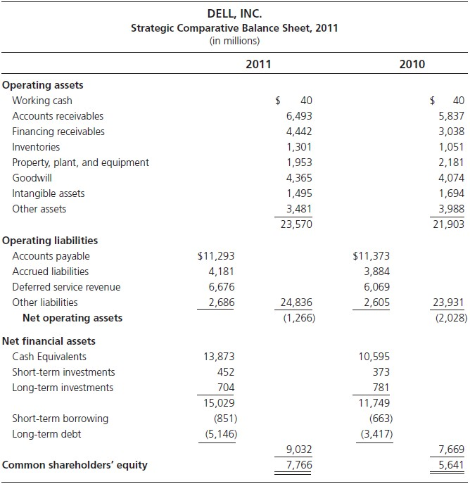
Strategic Balance Sheet: Dell Inc.
Dell has positive NFA (rather than NFO).
Dell has neg. NOA. How can it be? It reflects Dell’s strategy:
Keep OA low with just-in-time inventory;
Require a credit card before shipping retail customer sales (thus keeping accounts receivable low);
Outsource production (↓inv. in
plant & equipment);
Require cash up front for servicing contracts (↑deferred revenues);
Require suppliers to carry Dell’s payables and thus supply operating credit.
In short, the shareholders of Dell are playing a float. That play adds value.

Slide 23
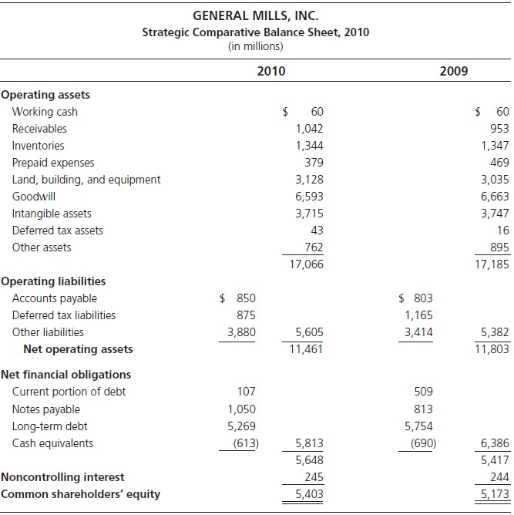
Strategic Balance Sheet: General Mills Inc.
GM is a net debtor with $5.648B in NFO: The financing strategy involves taking on leverage through borrowing.
The firm has $17.066B in OA to finance, with considerable inv. In landing, building, and equipment, acquisition, and intangible assets.
NOA stands at $11.461B, of which about half is financed by borrowing and half by common shareholders + small minority equity interests in subsidiaries.
Note that minority interest in a subsidiary is not a financing obligation but rather an equity share that shares in the subsidiary with the common shareholders at GM.

Slide 24
Strategic Cash
Financial assets (in the form of cash & cash equivalents and ST & LT debt investment) are sometimes just referred to as “cash”.
Why do firms hold cash?
  To grease the working of the operations. This is typically a very small amount of cash, called “working cash”.
  For payout to shareholders in the near future.
  To settle debt in the future.
  For making future investments – capital expenditures or acquisitions.
  As a precaution against a “rainy day”.
  Entrenched managers build excess cash balance (it is said) to spend on empire building and pet projects.

Slide 25
The Income Statement: Typical Items
Net sales (sales minus sales allowances)
+ Other revenue (royalties, rentals, license fees)
Cost of sales
= Gross margin
Marketing and advertising expenses
General expenses
Administrative expenses
± Special items and nonrecurring item s
  Restructuring charges
  Merger expenses
  Gains and losses on asset sales
  Asset impairments
  Litigation settlements
  Environmental remediation
Research and development expense
+ Interest revenue
Interest (expense)
± Realized gains and losses on financial assets
± Unrealized gains and losses on trading securities
+ Share of income of subsidiary
Income taxes
= Income before extraordinary items and discontinued operations
± Discontinued operations
± Extraordinary items
Abnormal gains and losses
= Net income or loss
- Noncontrolling interest
= Net income to shareholders

Slide 26
The Reformulated Income Statement
Income Statement
Operating income Operating revenue Operating expense
O
Net financial expen Financial e Financi
Co
Operating Income (OI) is income from the business (enterprise income)
The net amount of effective interest income (on financial assets) and effective interest expense (on financial obligations) is called net financial income (NFI) or, if interest expense is greater than interest income, net financial expense (NFE).

Slide 27
The Reformulated Income Statement
Operating items are separated from financing items.
Operating income from sales is separated from other operating income.
Tax is allocated to components of the statement, with no allocation to items reported on an after-tax
basis
Reformulated Comprehensive Income Statement
Net sales
Expenses to generate sales
Operating income from sales (before tax)
Tax on operating income from sales
+ Tax as reported
+ Tax benefit from net financial expenses
– Tax allocated to other operating income
Operating income from sales (after tax)
±Other operating income (expense) requiring tax allocation Restructuring charges and asset impairments
Merger expenses
Gains and losses on asset sales
Gains and losses on security transactions
− Tax on other operating income
± After-tax operating items
Equity share in subsidiary income Operating items in extraordinary income Dirty-surplus operating items in Table 8.1 Hidden-dirty surplus operating items
Operating income (after tax)
(continued)

Slide 28
The Reformulated Income Statement (cont.)
- Net financial expenses after tax
+ Interest expense
- Interest revenue
± Realized gains and losses on financial assets
= Net taxable financial expense before tax
+ Tax benefit from net financial expenses
= Net taxable financial expense after tax
± Gains and losses on debt retirement.
± Dirty surplus financial items in Table 8.1
± Hidden dirty surplus financial items
+ Preferred dividends
± Gains and losses on redemption of preferred stock
- Tax benefit from preferred dividends (if any)
- Noncontrolling Interest
= Comprehensive Income to Common

Slide 29
The Allocation of Taxes
In the income statement only one tax number is reported: It must be allocated to the operating and financial components to put both on an after-tax basis
First, calculate the tax benefit (tax shield) provided by deducting interest expense
Tax Benefit = Net Interest Expense × t
where t is the marginal (not effective) tax rate. The statutory rate is usually the marginal rate.
The after-tax net interest expense is:
After-tax Net Interest Expense = Net Interest Expense × (1- t)
From the operating income deduct both the total tax and the tax benefit, to capture what the operating income would have been, after tax, had there been no financing activities.
Tax on Operating Income = Tax Expense as Reported + (Net Interest Expense × t)
To the net financial expense add the tax benefit, because its net effect is attributable to the financing activities.

Slide 30
The Allocation of Taxes
Firms are taxed on a schedule of tax rates, depending on the size of their income. The tax rate used in the calculation (of tax allocation) is the marginal tax rate, the highest rate at which income is taxed, for interest expense reduces taxes at this rate.
The effective tax rate reflects the benefits of tax planning arise from operations:
Effective tax rate for operation
𝑇𝑎𝑥 𝑜𝑛 𝑜𝑝𝑒𝑟𝑎𝑡𝑖𝑛𝑔 𝑖𝑛𝑐𝑜𝑚𝑒
=
𝑂𝑝𝑒𝑟𝑎𝑡𝑖𝑛𝑔 𝑖𝑛𝑐𝑜𝑚𝑒 𝑏𝑒𝑓𝑜𝑟𝑒 𝑡𝑎𝑥, 𝑒𝑞𝑢𝑖𝑡𝑦 𝑖𝑛𝑐𝑜𝑚𝑒, 𝑎𝑛𝑑 𝑒𝑥𝑡𝑟𝑎𝑜𝑟𝑑𝑖𝑛𝑎𝑟𝑦 𝑎𝑛𝑑 𝑑𝑖𝑟𝑡𝑦 − 𝑠𝑢𝑟𝑝𝑙𝑢𝑠 𝑖𝑡𝑚𝑒𝑠

Slide 31
Top-down and Bottom-up Methods for Tax Allocation: Statutory Tax Rate = 35%
GAAP
Income Statement
Revenue
Operating expenses Interest expense Income before tax Income tax expense Net income
Top-down
Tax Allocation
Bottom-up
Tax Allocation
$4,000 (3,400)
(100)
500
(150)
$350
Revenue
Operating expenses Operating income before tax Tax expense:
$4000 (3,400)
600
The top-down approach adjusts the reported tax for which applies to financing activities.
Tax reported
Tax benefit for interest ($100 x 0.35)
Operating income after tax
The bottom-up approach works up
$150
35 (185)
$ 415
from the bottom line, NI, and calculates operating income after-tax as NI adjusted for the after-tax financing component of net income.
Net income Interest expense Tax benefit
Operating income after tax
$350
$100
35 65
$415

Slide 32
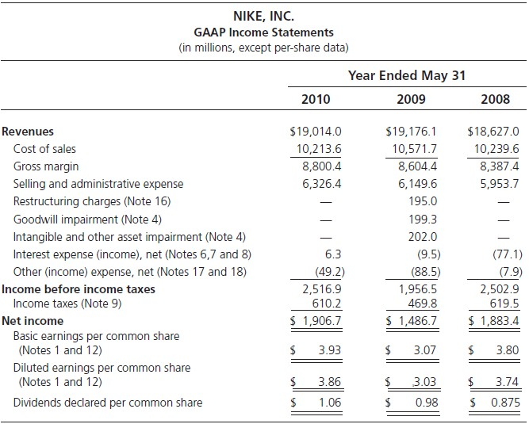
GAAP Income Statement: Nike, Inc.

Slide 33
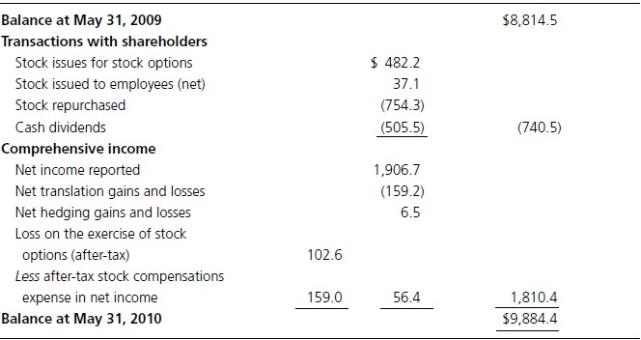
Starting Point for Income Statement Reformulation: Identify Comprehensive Income from Equity Statement
Analysis of the equity statement is a prerequisite for the reformulation of the income statement, for that reformulation identifies dirty-surplus items that have to be brought into the income statement.

Slide 34
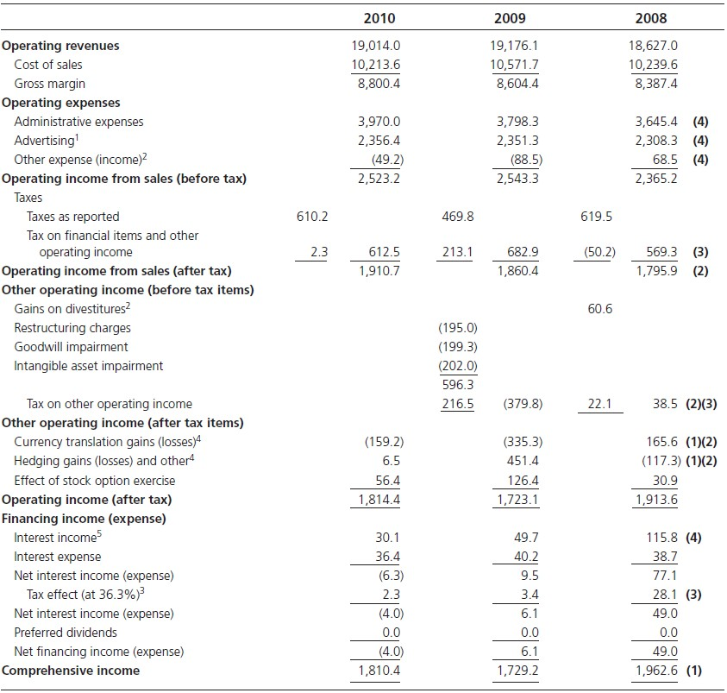
Reformulated Income Statement: Nike, Inc.
(in millions of dollars)
Dirty-surplus items have been brought into the statement so the “bottom line” number is the comp. income.
The reformulation distinguishes operating income that comes from sales from operating income that does not come from sales. This distinction gives a clean measure of the profit margin from sales and of the effective tax rate on operating income. Operating income from items reported net of tax are separately identified.
Taxes have been allocated using federal and state statutory rates (35% fed + 1.3% state) from footnote. Nike’s effective tax rate on OI from sales for 2010: 612.5/2,523.2 = 24.19% <36.3% because operations attract tax concessions.
Detail on expenses has been discovered in the footnotes.

Slide 35
Strategic Income Statements
Reformulated income statements show how the firm’s strategy generates earnings:
How the firm grows earnings through sales growth
How sales are translated into operating income
How the financing strategy affects shareholders
A useful metric: Residual Operating Income (ReOI)
ReOI _{t} = OI_{t} − (ρ −1)NOA_{t-1}
Here, OI is operating income from the reformulated income statement, and
NOA is net operating assets at the beginning of the year.
Value added in operations: How are operations adding value to the book value of operations?

Slide 36
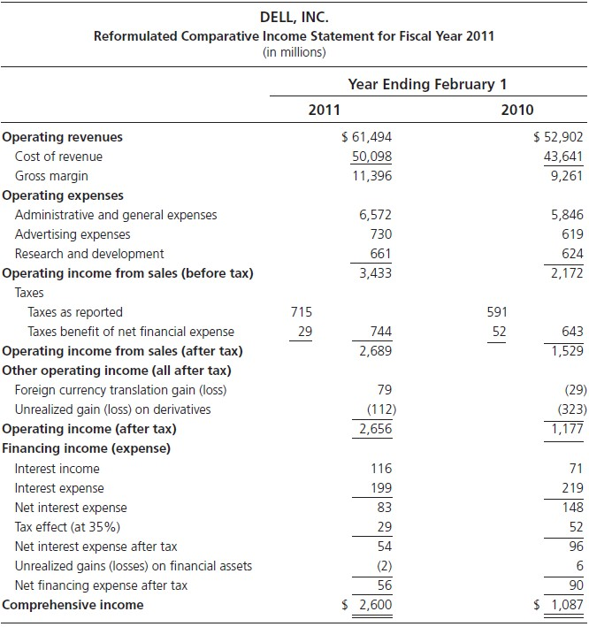
Strategic Income Statement: Dell Inc.

Slide 37
Value Added to Strategic Balance Sheets: Dell Inc.
Dell’s strategic balance reports $9.032 billion in net financial
assets: These add no value
But value is added in the operating activities:
ReOI _{t} = OI_{t} − (ρ −1)NOA_{t-1}
For Dell (with a required return of 9%),
ReOI = $2,656 − (0.09
2011
Dell’s residual income from operations is greater than operating
income: Value from negative net operating assets!

Slide 38
Value Added to Strategic Balance Sheets: Dell Inc.
The negative net operating assets means that Dell effectively runs a float that shareholders can invest elsewhere at 9%, and this value-adding feature is picked up in the residual operating income calculation.
The reformulated statements identify two drivers of residual operating income: Operating income from trading with customers
+
Value of strategically structuring operations to deliver a float
Dell can grow residual operating income (ReOI) by:
  increasing sales & margins to produce OI in the income statement, and
  expanding the float in its management of assets and its relationships with customers and suppliers

Slide 39
Common Size Analysis
Comparison to other firms is called cross-sectional
analysis
Common size analysis gives a ready comparison:
The Income Statement
  Each item/Total revenues
The Balance Sheet
  Operating items/Totals
  Financing items/Totals

Slide 40
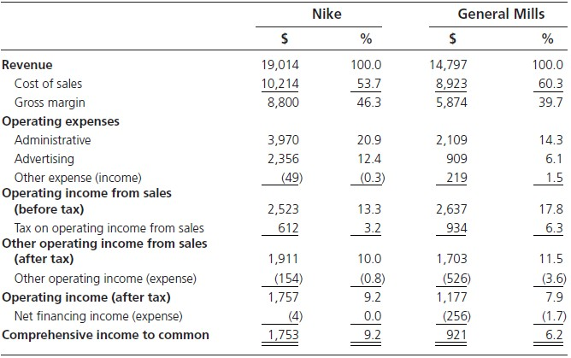
Common Size Analysis:
Nike and General Mills Income Statements

Slide 41
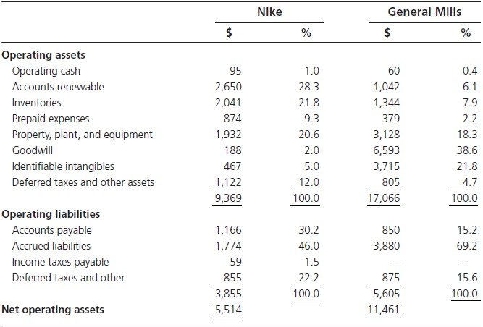
Common Size Analysis:
Nike and General Mills Balance Sheets (Operating Section)

Slide 42
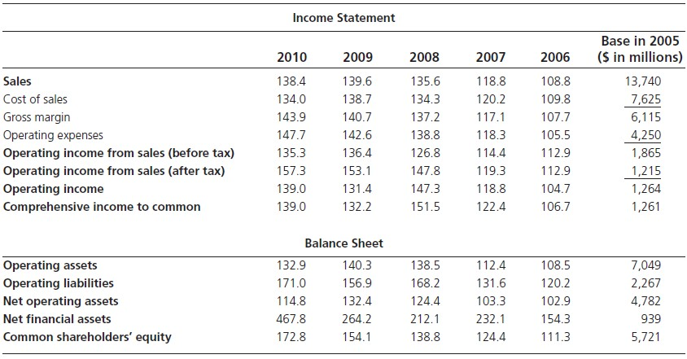
Trend Analysis: Nike, Inc.

Slide 43
Income Statement Ratios
Profit margin ratios
Profit margins are the percentage of sales that yield profits:
Operating Profit Margin (PM) = OI (after tax) / Sales
This profit margin is based on the total OI on the last line of OI before financial item. It can be divided into:
Sales Profit Margin = OI (after tax) from sales / Sales
Other items Profit Margin = OI (after tax) from other items / Sales
These two margins sum to the operating profit margin.
The bottom-line margin ratio is:
Net (comprehensive) income profit margin = Comprehensive income / Sales

Slide 44
Income Statement Ratios
Expense ratios
Expense ratios calculate the % of sales revenue that is absorbed by expenses. They have the
form
Expense ratio = Expense for an activity / Sales
This ratio is calculated for each expense item in operating income from sales, so
1 – Sales Profit Margin = Sum of expense ratios

Slide 45
Balance Sheet Ratios
Composition ratios
The % in common-size balance sheets are composition ratios:
Operating asset composition ratio = Operating asset / Total operating assets Operating liability composition ratio = Operating liability / Total operating liabilities
The ratio for individual items sum to 100% within their category.

Slide 46
Balance Sheet Ratios
Operating liability ratios
The composition of net operating assets can be highlighted by comparing operating liabilities
to net operating assets:
Operating liability leverage (OLLEV) = Operating liabilities / Net operating assets
This ratio indicates how the investment in NOA has been reduced by OL.
It is called a leverage ratio because it can lever up the return on NOA (RNOA) with a lower denominator.
The operating liability composition ratio reveal which liabilities have contributed to the operating liability leverage.

Slide 47
Balance Sheet Ratios
Financial leverage
Financial leverage is the degree to which NOA are financed by common equity.
Recall General Mills has net debt in 2010, while Nike holds net financial assets. The differences are captured by ratios that compare totals for net operating assets and net financial obligations to owners’ equity:
Capitalization ratio = NOA / CSE
Financial leverage ratio (FLEV) = NFO / CSE
It is always the case that
Capitalization ratio – Financial leverage ratio = 1
Either measure can be used as an indication of the degree to which NOA are financed by common equity or net financial debt, but it is usual refer to the financial leverage ratio.

Slide 48


Summary Profitability Ratios
Operating profitability
Return on Net Operating Assets (RNOA), i.e. operating income after tax relative to net
operating assets:
RNOA =
OI_{t}
t
1
2
( NOA_{t} +NOA_{t-1} )
Financial profitability
Net Borrowing Cost (NBC), i.e. net financial expenses after tax relative to net financial obligations:
Return on Net Financial Assets (RNFA), if a firm has NFA (rather than NFO):

Slide 49
Financial Statement Analysis Procedures
Reformulate the statement of stockholders’ equity (Chapter 9)
Calculate comprehensive rate of return on common equity, ROCE, from reformulated statement of common stockholders’ equity (Chapter 9)
Reformulate the balance sheet to distinguish operating and financial assets and obligations (Chapter 10)
Reformulate the income statement and distinguish operating and financing income (Chapter 10)
Compare reformulated balance sheets and income statements with reformulated statements of comparison firms, and over time, with a common size analysis and a trend analysis (Chapter 10)
Calculate balance sheet and income statement ratios (Chapter 10)
Carry out the analysis of ROCE: Chapter 12
Carry out the analysis of growth: Chapter 13

