Slide 2
Outline
The Calculation of Free Cash Flow
Direct and Indirect Calculations of Cash Flow from Operations
Problems with the GAAP Cash Flow Statement
The Reformulated Cash Flow Statement
Cash Flow from Operations

Slide 3
The Big Picture for this Chapter
Once again, appropriate analysis distinguishes operating activities from financing activities
-- free cash flow is the free cash flow from operating activities: the generation of cash flow
-- cash flows to shareholders and net debtholders are financing activities: the disposition of cash flow
GAAP and IFRS confuse the two

Slide 4


Recall Business Activities: All the Stocks & Flows
Product and input markets
Net operating assets are employed in operations to generate operating
revenue (by selling goods and services to customers) and incur operating expenses (by buying inputs from suppliers).
∆ indicates changes.
The firm
Capital markets
OR
C
F
Debtholders
Customers
Net Operating Assets (NOA)
Net Financial Assets (NFA)
or debt
issuers
Suppliers
OE
d
Shareholders
I
OR-OE=OI
Key:
OI -ΔNOA=C-I
F | = | net cash flow to debtholders and issuers
d | = | net cash flow to shareholders
C | = | cash flow from operations
I | = | cash investment
NFA | = | net financial assets
NOA | = | net operating assets
OR | = | operating revenue
OE | = | operating expense
OI | = | operating income
NFI | = | net financial income
C-I -ΔNFA+NFI=d
Operating Activities
Financing Activities

Slide 5
Recall from CH08: How FCF is Explained
Free cash flow = Operating income – Change in net operating assets
C - I = OI – ΔNOA
Operations generate operating income, and FCF is the part of this income remaining after reinvesting some of it in net operating assets.
In a sense, FCF is a dividend from the operations, the cash from operating
profits after retaining some of the profits as assets.
Just as comp. income and changes in the BV of equity explain dividends to shareholders, so comp. operating income and the change in the BV of the net operating assets explain the “dividend” from the operating activities to the financing activities, the FCF.

Slide 6
Recall from CH08: How FCF is Explained
Free cash flow = Change in net financial assets – Net financial income
+ Net dividends
C - I = ΔNFA – NFI + d
Free cash flow is used to pay net dividends, with the remainder invested in
net financial assets, along with net financial income.

Slide 7
Recall from CH08: How FCF is Explained
Free cash flow = Net financial expenses – Change in net financial obligations + Net dividends
C - I = NFE – ΔNFO + d
If the firm has financial obligations, free cash flow is applied to pay for net
financial expenses, reduce net borrowing, and pay net dividends
If minority (noncontrolling) interests are involved, the calculation is
C - I = NFE – ΔNFO + d + Minority interest in income
- ΔMinority interest in the balance sheet

Slide 8
The Calculation of Free Cash Flow
Three methods to calculate FCF:
Use the sources of cash flow equation:
C - I = OI
that is, free cash flow is operating income adjusted for the change in net operating assets
Use the disposition of cash flows equation:
C - I = NFE
that is, free cash flow is net financial expenses, adjusted for the change in net financial obligations, plus dividends to common shareholders.
FCF can also be obtained from the reformulated Statement of Cash Flows.

Slide 9
Calculation of Free Cash Flow: Nike, Inc. (2010)
Method 1: |  | C – I = OI - ΔΝΟΑ
Operating income | 2010 |  | $ 1,814
Net operating assets | 2010 | $ 5,514
Net operating assets | 2009 | 6,346 | 832
Free cash flow | 2010 |  | 2,646
Method 2: |  | C – I = ΔΝFA - NFI + d
Net financial income | 2010 |  | $ 4
Net financial assets | 2010 | 4,370
Net financial assets | 2009 | 2,468 | 1902
Net dividend | 2010 |  | 740
Free cash flow | 2010 |  | $2,646

Slide 10
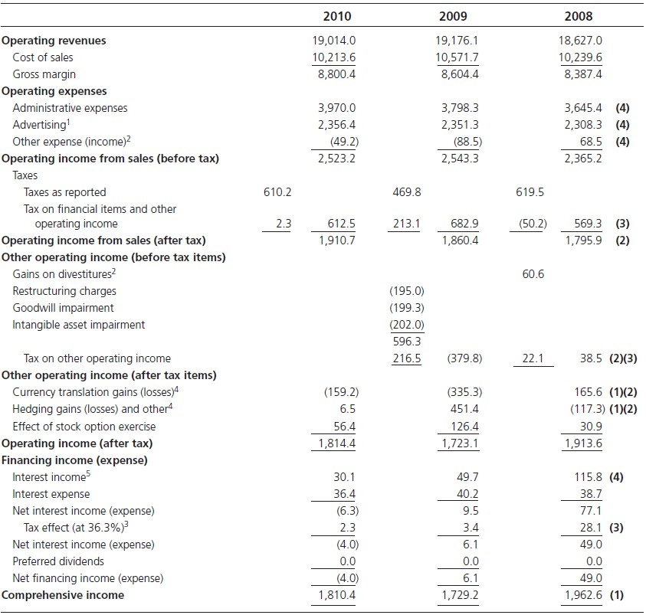
Reformulated Income Statement: Nike, Inc.
(in millions of dollars)

Slide 11
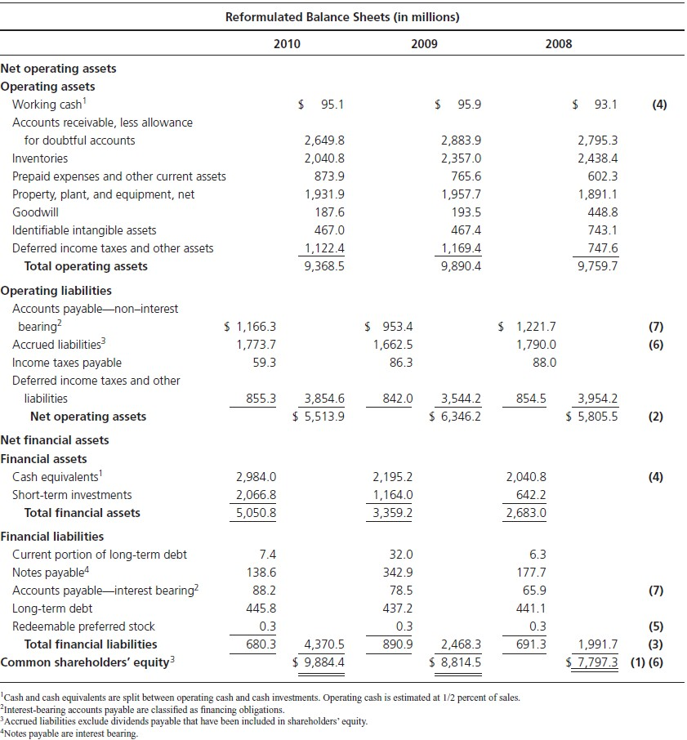
Reformulated Balance Sheet: Nike, Inc.

Slide 12
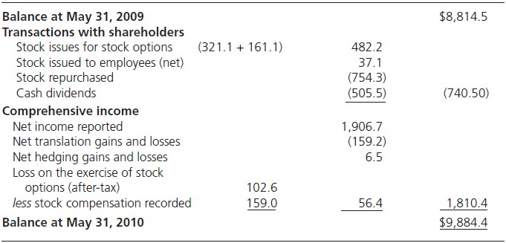
Reformulated Equity Statement: Nike, Inc.

Slide 13
The Standard GAAP Statement of Cash Flows
The statement describes the change in cash and cash equivalents:
“Cash Flow from Operations”
- “Cash Used in Investing Activities”
+ “Cash from Financing Activities”
= Δ in Cash and Cash Equivalents

Slide 14
Indirect Method for Cash Flow from Operations
Net income
+ Accruals
= Cash from operations
Nike’s statement (to follow) employs the indirect method (as do almost all firms):
2010
$ 1,906.7 million
1,257.9
$ 3,164.2
Net income Accruals
Cash provided by operations

Slide 15
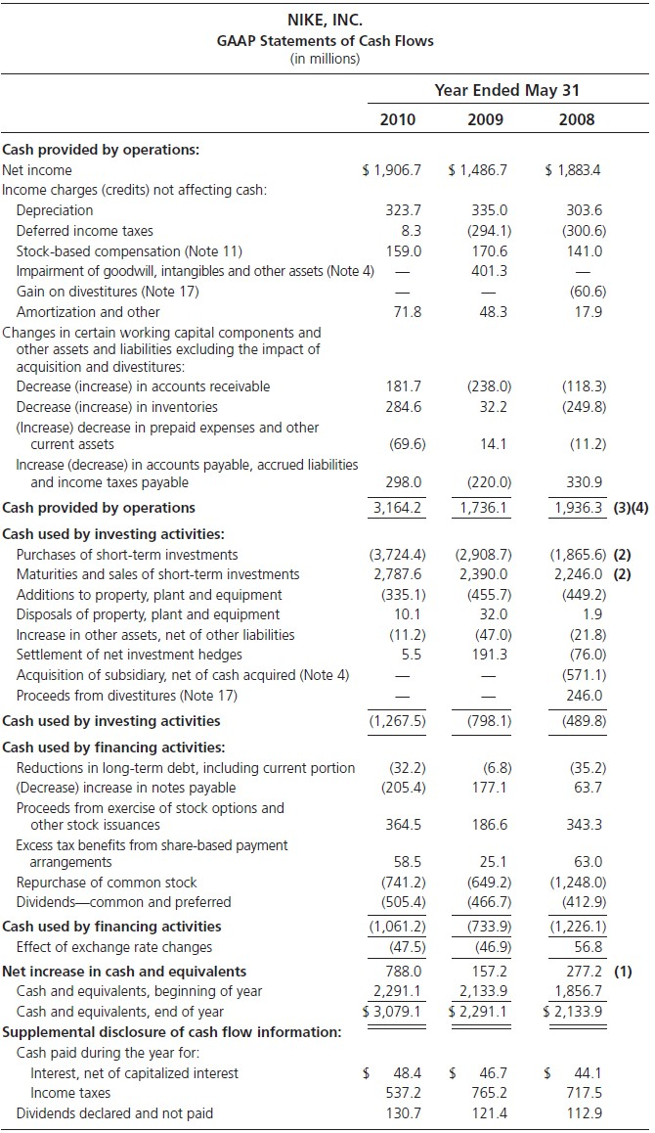
Nike, Inc. Statement of Cash Flows, 2010

Slide 16
Direct Method for Cash from Operations
Cash inflows
- Cash outflows
= Cash from operations
Cash inflows
Cash from sales
Cash from rents
Cash from royalties
Cash from interest received
Cash outflows
Cash paid to suppliers
Cash paid to employees
Cash paid for other operating activities
Cash paid for interest
Cash paid for income taxes

Slide 17
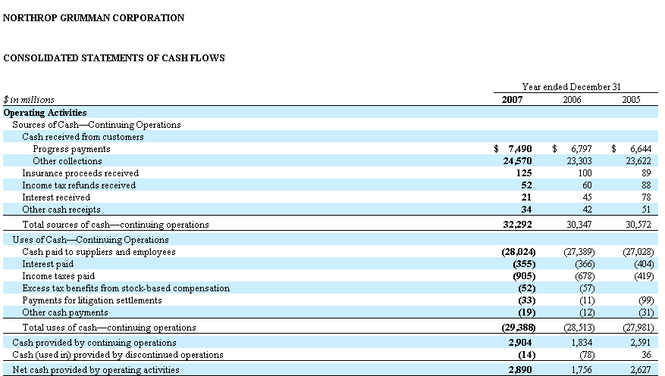
Direct Method for Cash from Operations

Slide 18
Problems with the Standard Statement
1. Change in operating cash (i.e. an investment in operating assets) should be included in the investment section, and the change in cash equivalents (i.e. an investment of excess cash in financial assets) in the financing section

Slide 19

1. Operating Cash and Cash in Financial Assets: Nike
Change in cash and cash equivalents $788.0 million
Increase in operating cash Increase in financial assets
$ (0.8) million
788.8
$ 788.0 million

Slide 20
Problems with the Standard Statement
Transactions in financial assets (FA) are included in the investments section rather than in the financing section
  Nike’s investments in FA are a disposition (NOT a reduction) of FCF.
  If a firm invests its (surplus) FCF from operations in FA, the GAAP classification gives the appearance that the firm is reducing its FCF further.
  Sales of FA to provide cash for operations (or to pay div.) are classified in GAAP statements as ↓ in investment flows rather than financing flows. These sales satisfy a FCF shortfall, they do not create it.
  Nike’s inv. in operations in 2010 is overstated by $936.8 (net purchase of FA).

Slide 21
2. Transactions in Financial Assets: Lucent Technologies
Fiscal Year Ending September
1999 1998 1997
Net income | 4,766 1,035 449
Cash from operating activities | (276) 1,860 2,129
Cash in investing activities:
Capital expenditures | (2,215) | (1,791) | (1,744)
Proceeds from the sale or
disposal of property, plant and equipment | 97 | 57 | 108
Purchases of equity investments | (307) | (212) | (149)
Sales of equity investments | 156 | 71 | 12
Purchases of investment securities | (450) | (1,082) | (483)
Sales or maturity of investment securities | 1,132 | 686 | 356
Dispositions of businesses | 72 | 329 | 181
Acquisitions of businesses - net of cash acquired | (264) | (1,078) | (1,584)
Cash from mergers | 61 | - | -
Other investing activities - net
(69) (80) (68)
Net cash used in investing activities
(1,787) (3,100) (3,371)
Net sales of financial assets | 682 | (396) | (127)
Adjusted cash investment in operations | (2,469) | (2,704) | (3,244)

Slide 22
Problems with the Standard Statement
Interest payments and receipts are included in the operating rather than in the financing section
Tax cash flows are all included in the operating section, and not allocated to operating and financing

Slide 23
3. Net Interest Receipts 4.Taxes on Net Interest Receipts: Nike
In millions
Interest receipts | $42.1
Interest payments | (48.4)
Net interest payments
before tax | 6.3
Tax benefit (at 36.3%) | 2.3
Net interest payments after tax | $ 4.0
Add back to GAAP Cash from Operations

Slide 24
Problems with the Standard Statement
The statement does not incorporate non- cash transactions (e.g. stock-financed acquisition, assets acquired with debt, debt converted to equity, etc.)
  Don’t have a complete picture of firms’ inv. & fin. activities in the GAAP statement.
  Non-cash transactions are often reported in supplemental disclosures
s.t. implicit CFs can be reconstructed.

Slide 25
5. Non-cash Transactions: Nike
At the footnote of its 2000 statement of cash flows, Nike reported the following (in million $):
Assumption of LT debt to acquire property, plant, and equipment
$108.9
This transaction was not reported in the GAAP cash flow statement.
To adjust the statement, add $108.9 million to cash investments and
$108.9 million to issue of debt in financing activities.
The transaction is equivalent to issuing debt for cash, then using the cash to buy property, plant, and equipment.

Slide 26
Recall the Cash Conservation Equation
A fundamental accounting identity:
C − I ≡ d + F
C
I
= Net cash from operations
= Net cash outflow for investing
C – I = Free cash flow
d = Net dividends (common dividends + share repurchases – share issues)
F = Net cash outflow to debtholders and debt issuers (the net cash flow from borrowing and lending)
= Net principal payments + net interest paid (i)
CF from operations less cash investment in operation always equals the net
CFs paid to debtholders (or issuers) and shareholders.
Cash generated must be deposed of; the sources of cash must be equal to its uses.

Slide 27
The Reformulated Cash Flow Statement
Cash flow from Operations
- Cash investments
= Free Cash Flow from Operating Activities
Cash Paid to Shareholders
+ Cash Paid to Debtholders and Issuers
=Cash Paid for Financing Activities
This format follows the cash conservation equation: C – I = d + F

Slide 28
The Reformulated Cash Flow Statement: the Adjustments
GAAP Free Cash Flow
+ Net cash interest outflow (after tax)
+ Investments in financial assets
Sale of financial assets
Noncash investments
Increase in operating cash
= Free Cash Flow
GAAP Financing Flow
+ Net cash interest outflow (after tax)
Noncash financing
+ Purchase of financial assets
Sales of financial assets
+ Increase in cash equivalents
= Financing Cash Flow

Slide 29
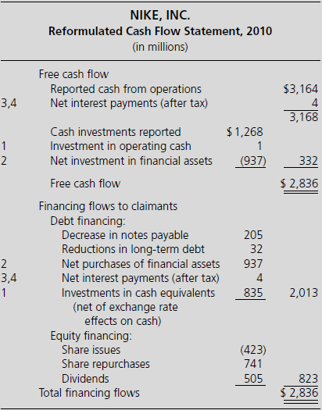
Nike, Inc. Reformulated Cash Flow Statement
Nike had a FCF from operations of
$2,836 million because I < C.
The firm used this cash to pay out a net $823 million to shareholders and $2,013 million in net debt transactions to distribute the cash surplus.

Slide 30
Why Free Cash Flow from Adjusted Cash Flow Statements May not Reconcile to the Methods 1 and 2
“Other assets” and “other liabilities” cannot be identified into operating or financing items appropriately.
Cash dividends in the cash flow statement differ from dividends in the reformulated
equity statement, implying a dividend payable that cannot be discovered.
Cash from share issues in the cash flow statement may differ from share issues in the equity statement. The diff. implies a receivable (for shares issued but not paid for) or a payable that has not been discovered.
Details for adjustments 3,4 and 5 are not available.
GAAP’s treatment of employee stock options (see Chapter 9).
Cash flow numbers of foreign subsidiaries are translated at average exchange rates
whereas balance sheet numbers are translated at end-of-year exchange rates.

