Slide 1
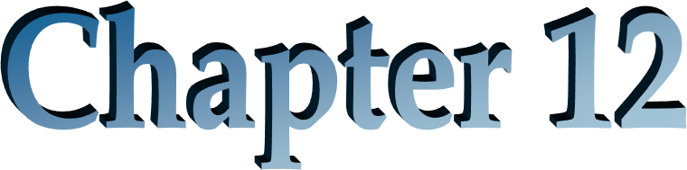


Slide 2
Outline
How ratios aggregate to explain Return on Common Equity
(ROCE)
First Level Breakdown of ROCE: The Effect of Leverage
  Financial Leverage
  Operating Liability Leverage
  Return on Net Operating Assets (RNOA) and Return on Assets (ROA)
Second Level Breakdown of ROCE: Drivers of Operating Profitability
Third Level Breakdown of ROCE:
  Profit Margin Drivers
  Turnover Drivers
  Borrowing Cost Drivers

Slide 3



The Big Picture for this Chapter
Valuation involves forecasting residual earnings and residual earnings growth
So, what drives residual earnings?
ROCE
Growth in Book Value
What drives ROCE?
This Chapter
What drives growth?
Next Chapter

Slide 4
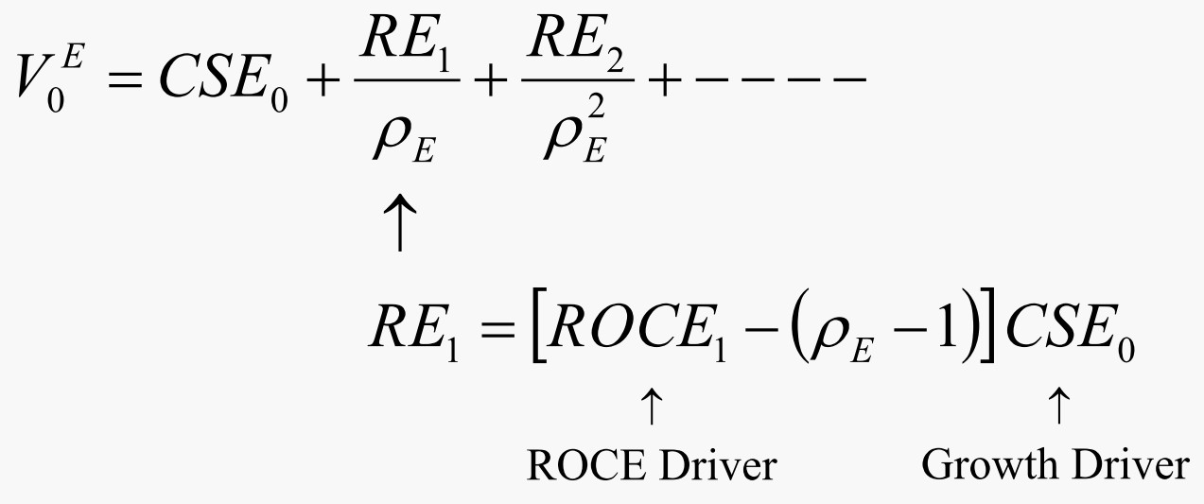
Analysis is the Preamble to Forecasting and Valuation
Analysis establishes where the firm is now
Forecasting asks how it will be different in the future

Slide 5
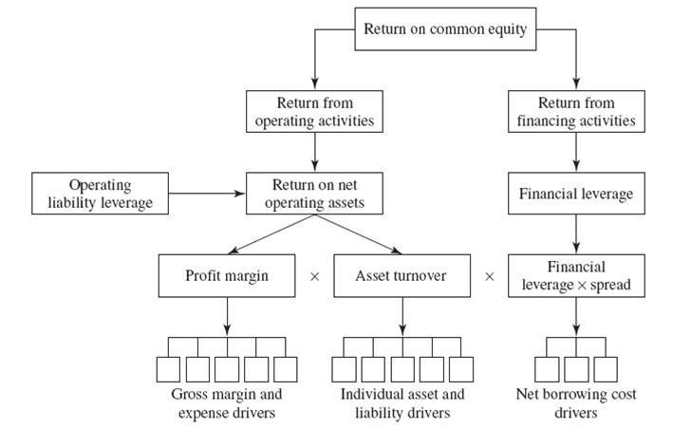
Analyzing ROCE: The Scheme

Slide 6
First Level Breakdown of ROCE: The Analysis of Leverage
The Effects of Leverage:
Financing Leverage
Operating Liability Leverage

Slide 7
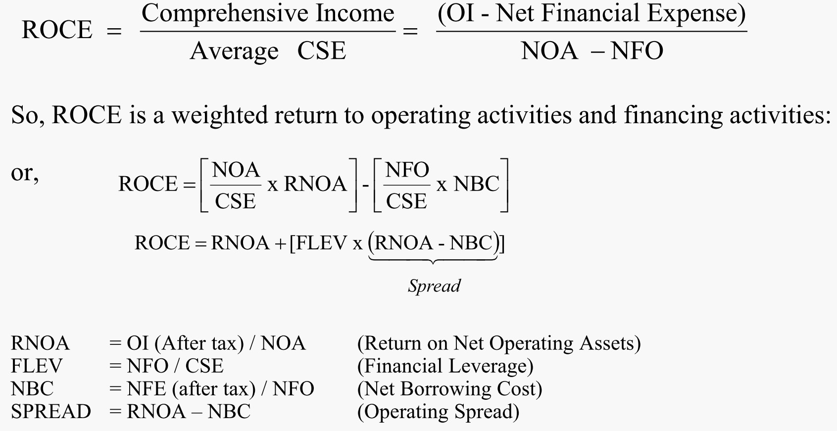

A. Analysis of Financing Leverage (FLEV)

Slide 8

The Financial Leverage Equation
ROCE = RNOA + FLEV × [RNOA – NBC]
The equation says that ROCE is driven by three factors:
1. | Profitability of operations: | RNOA
1. | Financial Leverage: | FLEV = NFO/CSE
3. | Operating Spread: | RNOA – NBC
ROCE is levered up over the return from operations if the firm has financial leverage and the return from operations > the borrowing cost.
The firm earns more on its equity if the net operating assets are financed by net debt, provided those assets earn more than the cost of debt.

Slide 9

How Financial Leverage Explains the Difference Between ROCE and RNOA
8 %
S P R E A D = 6 %
S P R E A D = 4 %
6 %
Difference between ROCE and RNOA
(ROCE-RNOA)
S P R E A D = 2 %
4 %
2 %
S P R E A D = 1 %
S P R E A D = 0 %
0 %
S P R E A D = - 1 %
- 2 %
S P R E A D = - 2 %
- 4 %
0 . 0 0
0 . 2 5
0 . 5 0
0 . 7 5
1 . 0 0
1 . 2 5
1 . 5 0
1 . 7 5
2 . 0 0
F L E V
R O C E = R N O A + [ F L E V x S P R E A D ]

Slide 10
How Financial Leverage Explains the Difference Between ROCE and RNOA
If a firm has zero financial leverage, ROCE = RNOA.
If the firm has financial leverage, the diff. between ROCE and RNOA is determined by the amount of FLEV & SPREAD, i.e. RNOA – after-tax net borrowing cost.
  SPREAD>0: favorable financial leverage / favorable gearing: RNOA is "levered up" or "geared up" to yield a higher ROCE.
  SPREAD<0: unfavorable leverage effect.
Leverage is a component of the risk of equity as well as its
profitability.

Slide 11
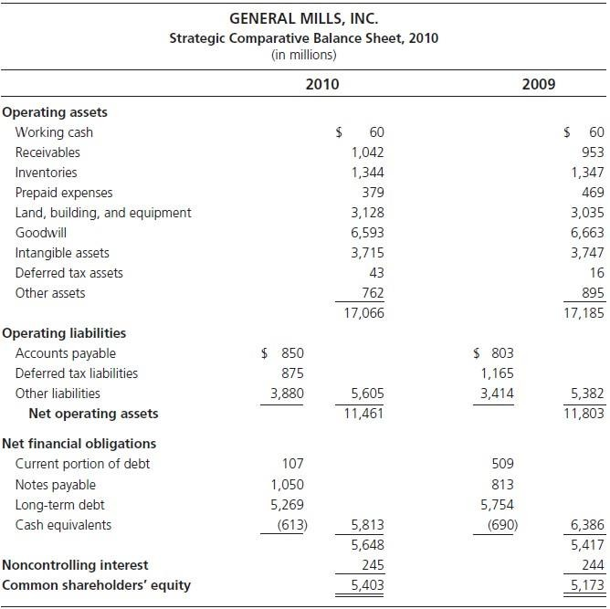

General Mills Inc.: Reformulated Balance Sheet

Slide 12
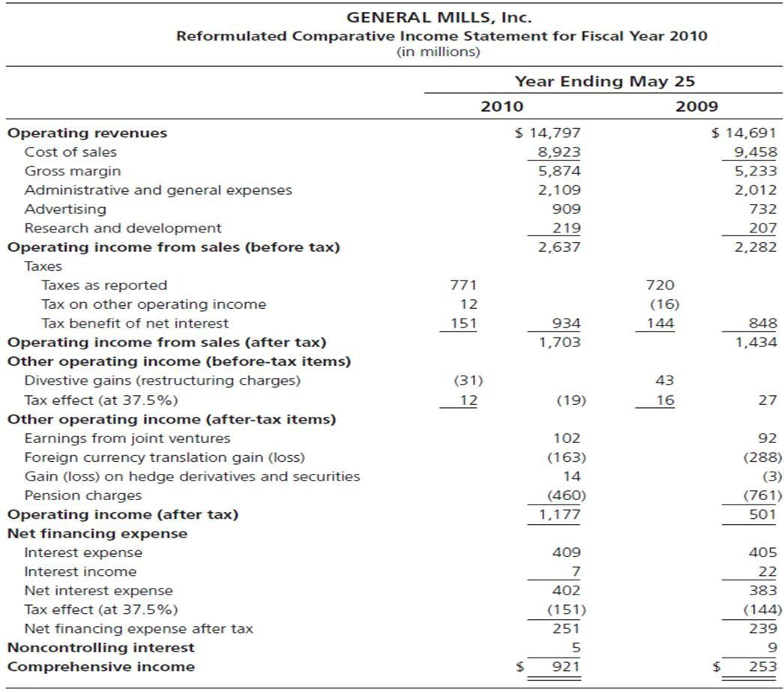
General Mills Inc.: Reformulated Income Statement

Slide 13
Financial Leverage: General Mills Inc., 2010
(In millions of dollars, average for year)
NOA | 11,632 | OI |  | 1,177
NFO | 6,099 | NFE |  | 251
CSE (before MI) | 5,533 | CI |  | 926
FLEV = 6,099/5,533 = 1.102 |  | ROCE | = | 16.7%
 |  | RNOA | = | 10.1%
 |  | NBC | = | 4.1%
ROCE = RNOA + [FLEV × (RNOA – NBC)]
= 10.1% + [1.102 × (10.1% - 4.1%)]
= 16.7%
RNOA is 10.1% but the high financial leverage, combined with a SPREAD over a borrowing cost of 4.1%, yields a much higher ROCE. Beware of firms boasting high ROCE: Is it driven by financial leverage rather than business operations?

Slide 14

General Mills: What If?
What if RNOA fell to 2.0%?
ROCE = 2.0% + [1.102 × (2.0% - 4.1%)]
= -0.3%
Leverage becomes unfavorable!

Slide 15


The Effect of Negative Financial Leverage
If a firm has NFA rather than NFO:
Financial income > financial expense and the firm will have a positive return on financing activities (RNFA) rather than net borrowing costs.
where RNFA = Net financial income/NFA, the return on net financial assets.
Here a positive spread reduces the ROCE:
Some of shareholders' equity is invested in financial assets and if FA earn less
than OA, ROCE < RNOA

Slide 16

The Effect of Negative Financial Leverage: Nike, Inc., 2008
For fiscal 2008, the firm reported an ROCE of 25.9 percent on avg. CSE of
$7.458 billion. But Nike had considerable (avg) FA of $2.086 billion from cash generated from its operations, giving it an avg. financial leverage: -0.280. The firm’s RNFA was 2.3%.
ROCE = RNOA - [NFA/CSE x (RNOA - RNFA)] 25.9% = 35.0% - [0.280 x (35.0% - 2.3%))
The RNOA of 35% ↓ by the lower return on financing activities in the overall
ROCE.

Slide 17

Nike, Inc.: What If?
What if the company used $1.0 billion of its financial assets to pay a special
dividend? What would be the effect on ROCE?
The answer is that with $1.0 billion less in average financial assets and common equity, the average financial leverage would have been -0.168 rather than
-0.280, and the ROCE would have been
29.5% = 35.0% - [0.168 x (35.0% - 2.3%))
Dividends (and stock repurchases) increase ROCE.

Slide 18



The Effect of Negative Financial Leverage: Microsoft Corporation, 1998
For fiscal 1998 Microsoft reported an ROCE of 36.3% on average common equity of $13.702 billion. But Microsoft had no financing debt other than $980 million of convertible preferred stock. And it had considerable financial assets of $11.447 billion from cash generated from its operations. The return on average net financial assets was 8.0% (a significant portion from unrealized gains on financial assets).
The reported ROCE masks the profitability of operations:
ROCE = RNOA − ^{⎡ NFA} x (RNOA − RNFA )⎤
⎢⎣ CSE
⎥⎦
36.3% =179.4% −[0.835 x (179.4% − 8.0%)].
The RNOA of 179.4% is weighted down by return on financing activities in the overall
ROCE.
A What-If Question: Microsoft has regular stock repurchases. In fiscal 1998 the company used $2.796 billion of its financial assets to repurchase stock. What would the ROCE have been had it not undertaken the stock repurchase?

Slide 19
B. The Analysis of Operating Liability Leverage (OLLEV)
Operating liabilities lever the Return on Net Operating Assets
RNOA =
OI
OA - OL
What would be the operating profitability without operating liabilities?
Return on Operating Assets (ROOA)= OI + Implicit Interest (After Tax) .
Operating Assets
where
Implicit Interest on Operating Liabilities (as a benchmark)
= Short-term Borrowing Rate (after tax) x Operating Liabilities
The Effect of Operating Liability Leverage (OLLEV):
RNOA = ROOA + (OLLEV x OLSPREAD)
where Operating Liability Leverage Spread (OLSPREAD):
O L L E V =
OL
NOA
O L S P R E A D = R O O A − Short - term Borrowing Rate (after tax)

Slide 20
B. The Analysis of Operating Liability Leverage (OLLEV)
RNOA = ROOA + (OLLEV x OLSPREAD)
RNOA is driven by the rate of return on operating assets as if there were no operating liability leverage + a leverage premium determined by operating liability leverage & operating liability leverage spread.
The typical OLLEV is about 0.4.
OL reduce NOA → lever RNOA.
Operating liability leverage, like financial leverage, can be unfavorable as well as favorable.

Slide 21
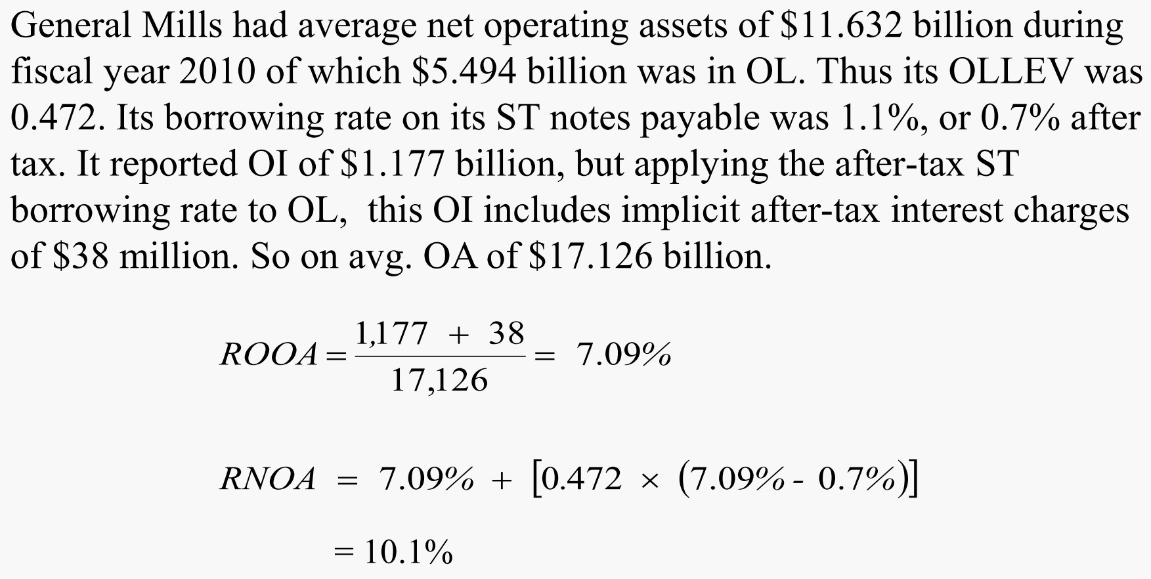

The Effect of Operating Liability Leverage: General Mills, Inc.

Slide 22

The Effect of Operating Liability Leverage: General Mills, Inc.
A What-If Question: What if suppliers were to charge the ST borrowing rate of 1.1% explicitly for the credit supplied in accounts payable? What would be the effect on General Mills value?
Probably none.
The interest would be an additional expense.
But to stay competitive, the supplier would have to reduce prices of goods sold to the firm by a corresponding amount s.t. the total price charged (in implicit plus explicit interest) remains the same.
But supplier markets may not work as competitively as this supposes, so firms can OLLEV if they have power over their suppliers.

Slide 23
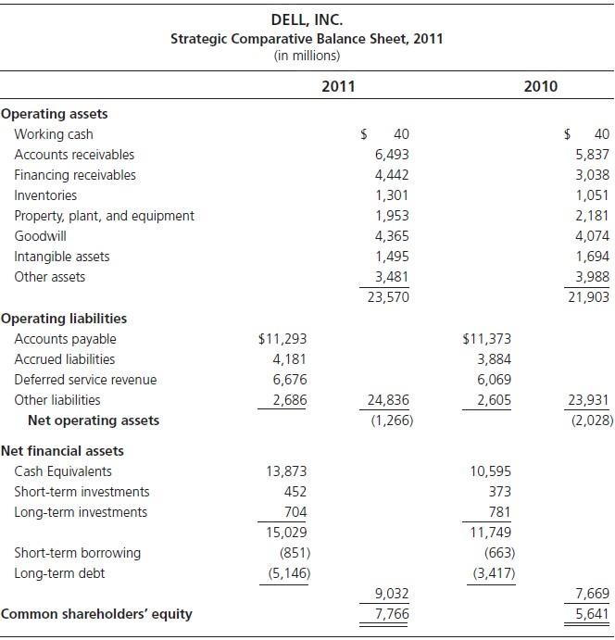
A Case of Extreme Operating Liability Leverage: Dell Inc.
Net Operating Assets (NOA) are negative! Does this leverage add value? Yes!
Residual income from operations = $ 2,656 – (0.09 x -2028) = $2,839 million

Slide 24
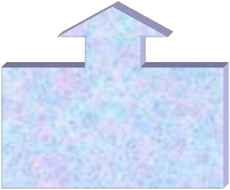
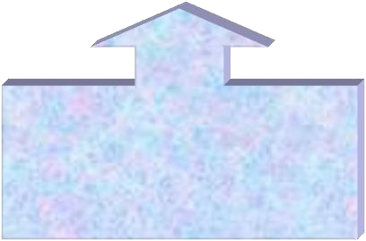
Summing Financial Leverage and Operating Liability Leverage Effects on ROCE
ROCE = ROOA + (RNOA – ROOA) + (ROCE – RNOA)
Return With no leverage
Effect of Operating Liabilities
Effect of Financing Liabilities
For General Mills,
16.7% = 7.1% + (10.1% - 7.1%) + (16.7% - 10.1%)
= 7.1% + 3.0% + 6.6%

Slide 25

Return on Net Operating Assets and Return on Assets
RNOA = ^{OI}
OA − OL
_{ROA =} Net Income + Interest Expense (after tax) + Minority Interest
Total Assets
Problems with ROA:
Mix up financing VS operating activities
  Financial assets in denominator & financial income in numerator
  Mix the return on operations with the (usually lower) return from investing excess cash in FA.
OL not in denominator
  Include the cost of OL in the numerator (in the form of higher input prices as the
price of credit) but exclude the benefit of OLLEV in the base.
NI is not comp. income

Slide 26
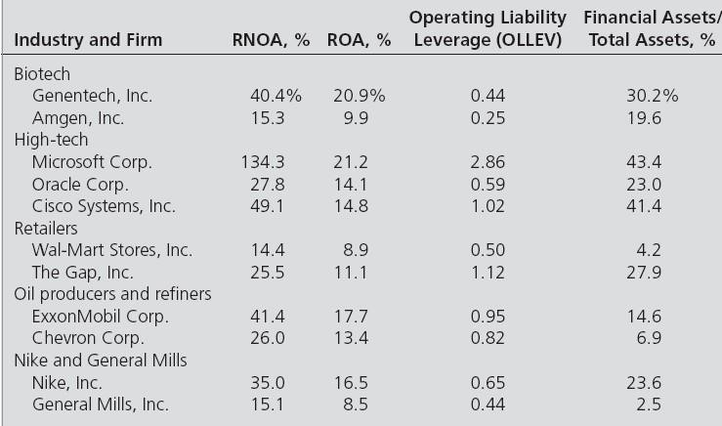
RNOA and ROA for Selected Firms, 2007
Median ROA: 7.1% for U.S firms (1963-2010)
Median RNOA: 10.5% for U.S firms (1963-2010)

Slide 27

FLEV and Debt-to-Equity Ratios
Debt - to - Equity = ^{Total Debt}
Equity
FLEV = ^{NFO}
CSE
Problems with Debt-to-Equity ratio:
Confuses operating liabilities (which create operating liability leverage) with financial liabilities (which create financial leverage)
Does not net out financial liabilities against financial assets.
Median Debt-to-Equity is 1.22 Median FLEV is 0.43

Slide 28
Second-Level Breakdown of ROCE: Drivers of Operating Profitability
ROCE = RNOA + [FLEV x (RNOA - NBC)]
↑
R N O A = PM × ATO
Operating profit margin: the profitability of each $ of sales
PM = OI / Sales
Asset turnover: the ability to generate sales for a given asset base
ATO = Sales / NOA
1/ATO: the amount of NOA used to generate $1 of sales

Slide 29
Second-Level Breakdown of ROCE: Drivers of Operating Profitability
ROCE = RNOA + [FLEV x (RNOA - NBC)]
↑
𝑹𝑵𝑶𝑨 = 𝑷𝑴 × 𝑨𝑻𝑶
This decomposition of operating profitability is known as the DuPont model.
Profitability in operations comes from two sources.
Profitability: ↑of each $ of sales ends up in operating income → ↑ RNOA
Efficiency: ↑ sales are generated from the net operating assets → ↑ RNOA
A firm generates profitability by increasing margins and can lever the margins up by using OA and OL more efficiently to generate sales.

Slide 30
Drivers of Operating Profitability: Nike VS General Mills, 2010
With $1,814 million of operating income and $5,930 million in avg. NOA, Nike generated an RNOA of 30.6% in 2010. With sales revenue of $19,014 million, the OI amounted to an operating profit margin (PM) of 9.54%. The sales yielded an asset turnover (ATO) of 3.21 on the $5,930 million of OA. Thus
RNOA=PM x ATO = 9.54% x 3.21=30.6%.
In 2010, General Mills's sales of $14,797 million earned $1,177 million of OI on $11,632 million of avg. NOA. Thus its RNOA was 10.1%, made up of an operating PM of 7.95% and an asset turnover of 1.27.

Slide 31
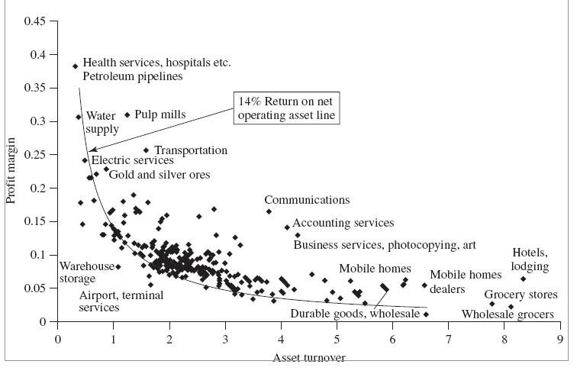
Profit Margin and Asset Turnover Combinations for 238 Industries,
1963-2000

Slide 32
Typical Levels for ROCE, FLEV, OLLEV, RNOA, PM and ATO
 | R O C E ( % ) | F L E V | O L L E V | R N O A ( % ) | P M ( % ) | A T O
P i p e l i n es | 1 7 . 1 | 1 . 0 9 3 | 0 . 1 5 4 | 1 2 . 0 | 2 7 . 8 | 0 . 4 0
T o b a c c o | 1 5 . 8 | 0 . 3 0 7 | 0 . 2 7 2 | 1 4 . 0 | 9 . 3 | 1 . 7 0
R e s t a u r a n t s | 1 5 . 6 | 0 . 3 1 3 | 0 . 3 0 6 | 1 4 . 2 | 5 . 0 | 2 . 8 3
P r i n t i n g a n d p u b l i s h i n g | 1 4 . 6 | 0 . 1 5 4 | 0 . 3 7 4 | 1 3 . 6 | 6 . 5 | 2 . 2 0
B u s i n e s s s e r vi c es | 1 4 . 6 | 0 . 0 5 6 | 0 . 4 8 8 | 1 3 . 5 | 5 . 2 | 2 . 9 5
C h e m i c a l s | 1 4 . 3 | 0 . 1 9 8 | 0 . 3 5 2 | 1 3 . 4 | 7 . 1 | 1 . 9 1
Food s t or es | 1 3 . 8 | 0 . 3 6 4 | 0 . 5 5 9 | 1 2 . 0 | 1 . 7 | 7 . 3 9
T r u c k i n g | 1 3 . 8 | 0 . 6 4 1 | 0 . 4 1 9 | 1 0 . 1 | 3 . 8 | 2 . 8 8
Food p r o d u c t s | 1 3 . 7 | 0 . 4 1 4 | 0 . 3 5 0 | 1 2 . 1 | 4 . 4 | 2 . 7 4
C o m m u n i c a t i o n s | 1 3 . 4 | 0 . 7 4 3 | 0 . 2 8 4 | 9 . 1 | 1 2 . 5 | 0 . 7 6
G e n e r a l s t or es | 1 3 . 2 | 0 . 3 8 9 | 0 . 4 5 7 | 1 1 . 3 | 3 . 5 | 3 . 5 5
P e t r o l e u m r e f i n i n g | 1 2 . 6 | 0 . 3 5 9 | 0 . 4 8 7 | 1 1 . 2 | 6 . 0 | 1 . 9 6
T r a n s p o r t a t i o n e q u i p m e n t | 1 2 . 5 | 0 . 3 6 9 | 0 . 4 2 2 | 1 1 . 2 | 4 . 5 | 2 . 4 7
A i r l i n es | 1 2 . 4 | 0 . 8 4 1 | 0 . 5 1 6 | 9 . 0 | 4 . 3 | 1 . 9 9
Utilities | 1 2 . 4 | 1 . 4 3 4 | 0 . 2 7 2 | 8 . 2 | 1 4 . 5 | 0 . 5 9
W h o l e s a l e r s , non - d u r a b l e goods | 1 2 . 2 | 0 . 5 8 4 | 0 . 4 6 1 | 1 0 . 2 | 2 . 3 | 3 . 7 2
P a p e r p r o d u c t s | 1 1 . 8 | 0 . 4 3 6 | 0 . 2 9 6 | 1 0 . 2 | 5 . 9 | 1 . 7 4
L u m b e r | 1 1 . 7 | 0 . 3 1 2 | 0 . 3 8 4 | 1 0 . 4 | 4 . 0 | 2 . 6 0
A p p a r e l | 1 1 . 6 | 0 . 4 0 8 | 0 . 3 1 7 | 1 0 . 1 | 4 . 0 | 2 . 5 5
H o t e l s | 1 1 . 5 | 1 . 0 5 4 | 0 . 2 0 1 | 8 . 5 | 8 . 2 | 1 . 0 4
S h i p p i n g | 1 1 . 4 | 0 . 7 9 3 | 0 . 2 0 5 | 9 . 1 | 1 2 . 6 | 0 . 6 1
A m u s e m e n t s a n d r e c r e a t i o n | 1 1 . 4 | 0 . 5 9 8 | 0 . 2 0 3 | 1 0 . 1 | 9 . 5 | 1 . 1 0
B u i l d i n g a n d c o n s t r u c t i o n | 1 1 . 4 | 0 . 4 3 9 | 0 . 4 0 9 | 1 0 . 6 | 4 . 5 | 2 . 0 6
W h o l e s a l e r s , d u r a b l e goods | 1 1 . 2 | 0 . 4 4 8 | 0 . 3 5 4 | 9 . 9 | 3 . 4 | 2 . 8 4
T e x t i l e s | 1 0 . 4 | 0 . 4 2 3 | 0 . 2 6 6 | 9 . 3 | 4 . 3 | 2 . 0 9
P r i m a r y me t a l s | 9 . 9 | 0 . 4 2 4 | 0 . 3 3 8 | 9 . 4 | 5 . 0 | 1 . 8 0
O i l a n d g a s e x t r a c t i o n | 9 . 1 | 0 . 3 9 5 | 0 . 2 6 3 | 8 . 3 | 1 3 . 0 | 0 . 5 7
R a i l r o a d s | 7 . 3 | 0 . 5 5 6 | 0 . 3 6 2 | 7 . 1 | 9 . 7 | 0 . 7 8
Source: Standard & Poor’s COMPUSTAT®

Slide 33
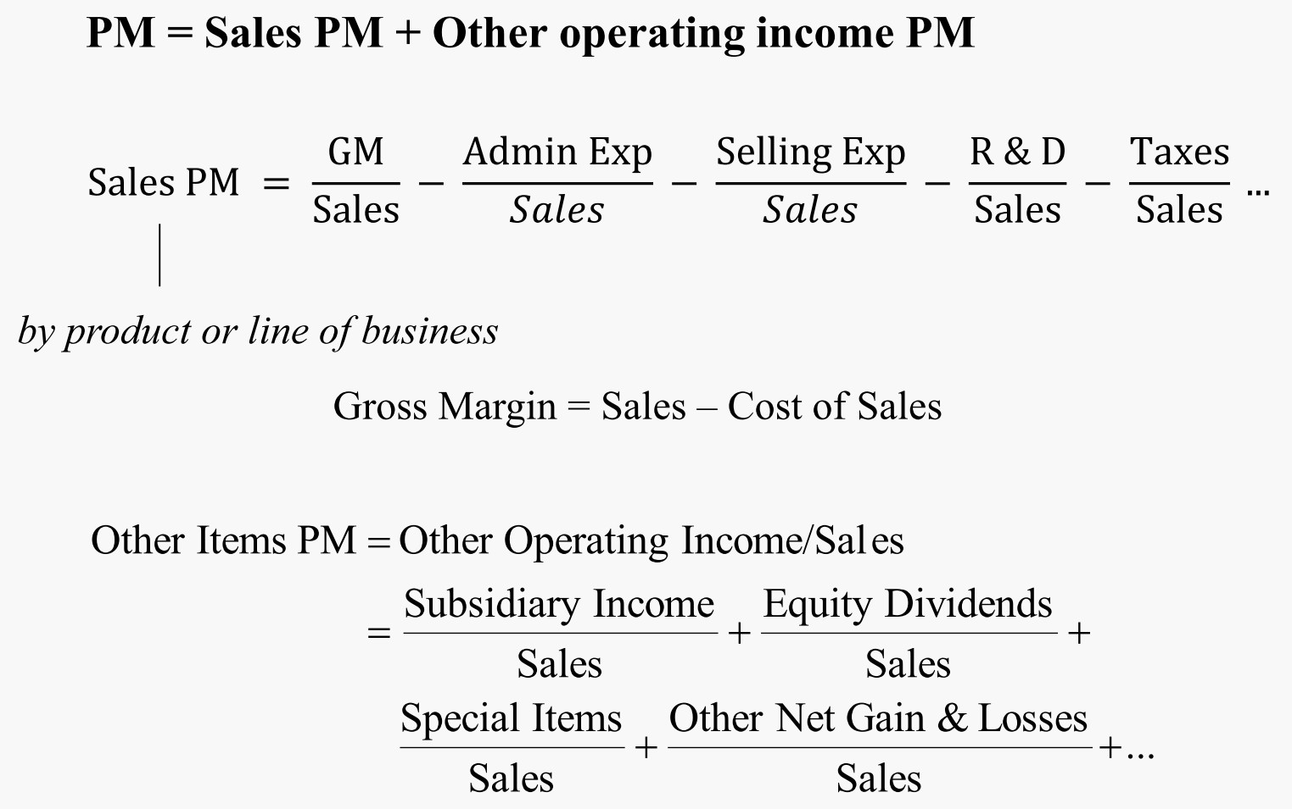

Third-Level Breakdown of ROCE: Profit Margin Drivers

Slide 34
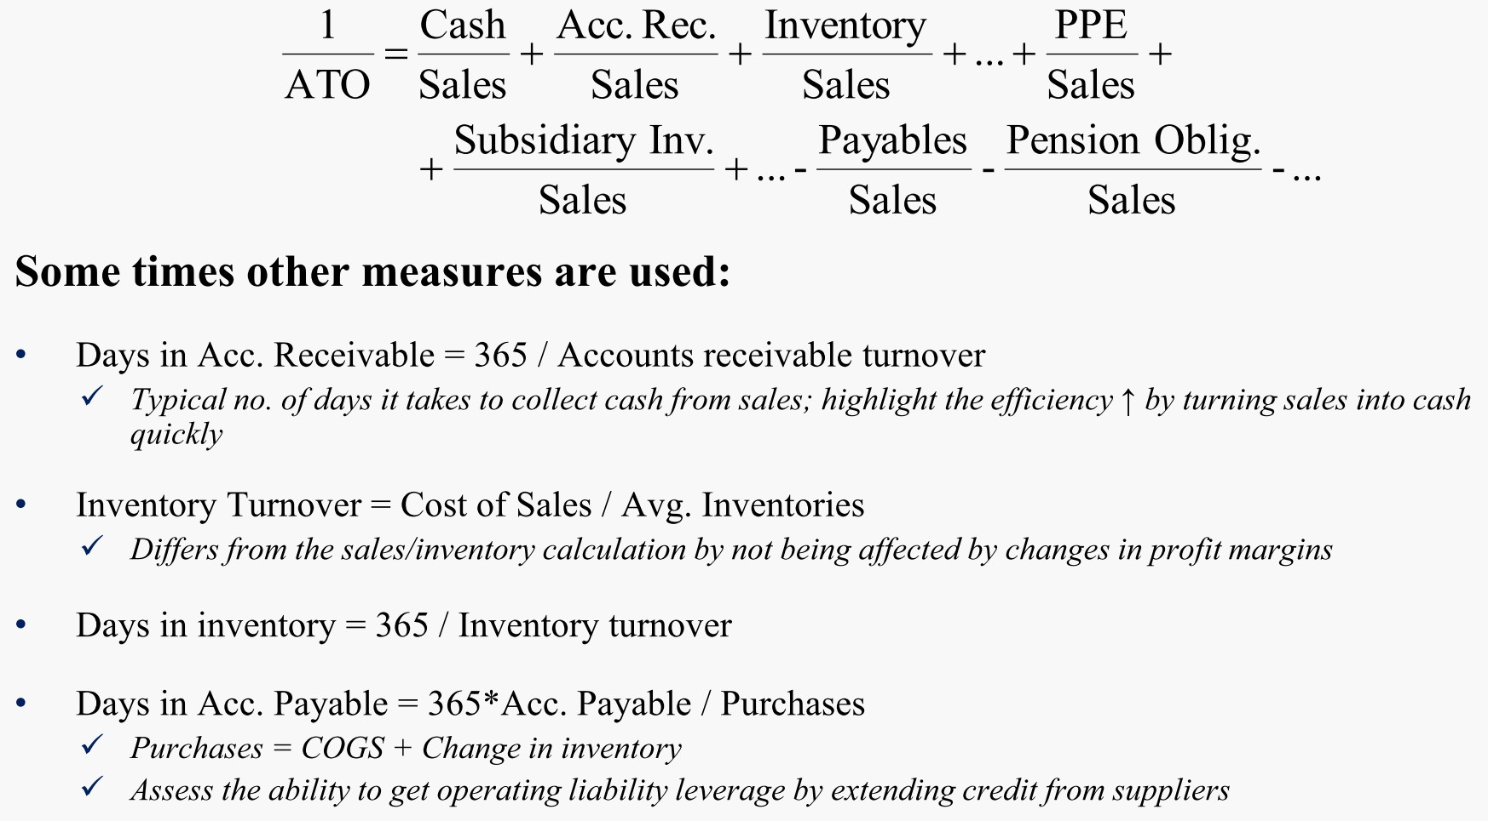

Third-Level Breakdown of ROCE: Asset Turnover Drivers

Slide 35
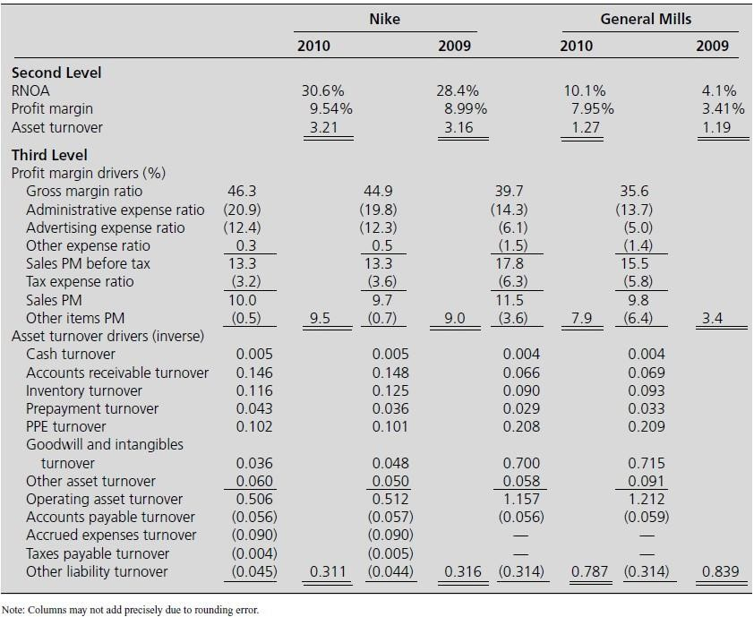

Second and Third-Level Breakdown: Nike and General Mills

Slide 36
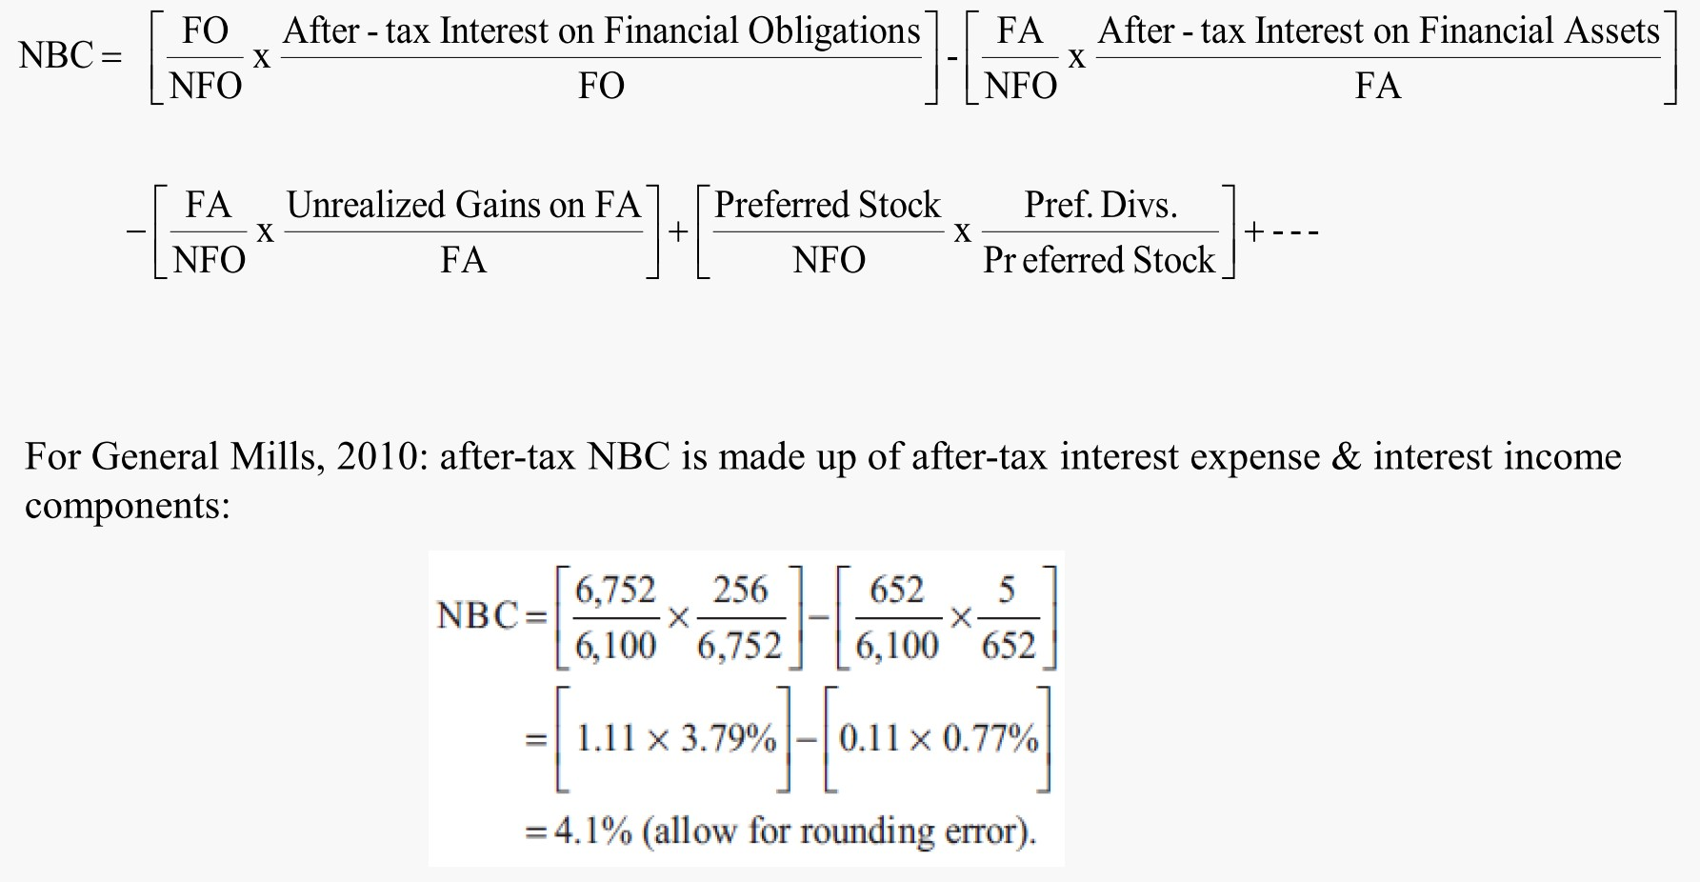

Third-Level Breakdown: Analysis of Net Borrowing Cost

Slide 37
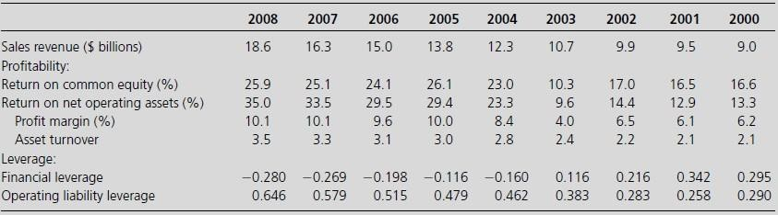

Tracking Profitability for Nike Over Years

