Slide 1
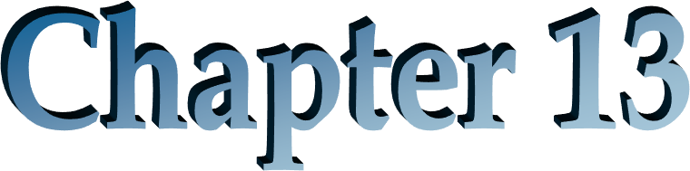
The Analysis of Growth and Sustainable Earnings

Slide 2
Outline
What a growth firm is
Cutting to the Core: Sustainable Earnings
Analysis of Changes in ROCE
Analysis of Growth in Shareholders’ Equity
Using Growth Analysis to Understand P/B and P/E Ratios

Slide 3
The Big Picture for the Chapter
Valuation is based on forecasting residual earnings and residual earnings growth
So, what drives growth?
Understand what growth is, then identify the drivers of growth
Understand that sustainable earnings is the base from which growth can take place, so growth analysis starts with the identification of sustainable earnings

Slide 4
What Is a Growth Company and How Is It Valued?
Growth in sales?
Growth is assets?
Growth in equity?
Growth in earnings?
Does a high P/E ratio indicate a growth company? Does a high P/B ratio indicate a growth company?

Slide 5
Remember the Caveat: Beware of Paying Too Much for Growth
(Chapters 5, 6, and 7)
Firms can grow earnings, but not create value
Earnings growth generated by investment
Earnings growth generated by the accounting
Value-added growth:
Think of growth in residual earnings and abnormal earnings growth
A reminder: abnormal earnings growth (AEG) is equal to growth in residual earnings (ΔRE)

Slide 6
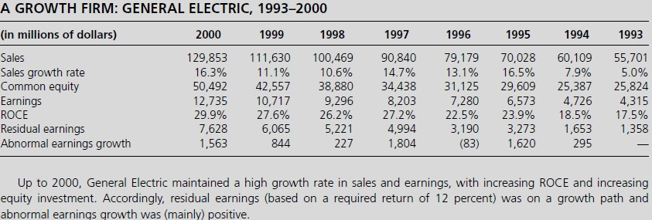
A Growth Company?
General Electric Corp.: 1993-2000

Slide 7
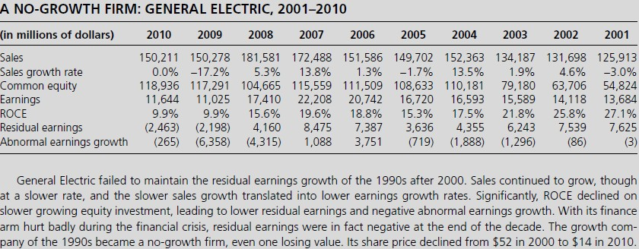
A Growth Company?
General Electric Again.: 2001-2010

Slide 8
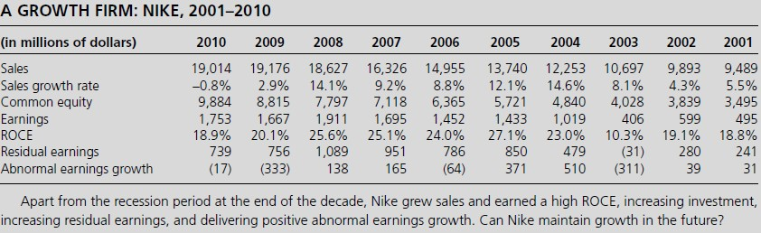
Is Nike a Growth Firm?

Slide 9
The Base for Growth: Sustainable Earnings
Sustainable earnings are earnings that can be repeated (sustained) in the future and which can grow. Otherwise called core earnings / persistent earnings / underlying earnings.
Unsustainable earnings are earnings based on temporary factors. Otherwise
called unusual items / transitory earnings.
Identifying core earnings is sometimes referred to as normalizing earnings:
  Establish "normal" ongoing earnings unaffected by one-time components.
Earnings are composed of OI from the business and NFE, so the exercise amounts to an identification of core operating income and core net borrowing cost.

Slide 10
Cutting to the Core:
Core Earnings (or Sustainable Earnings)
Distinguish core operating income from unusual (transitory) income:
Operating Income = Core OI + Unusual items
Distinguish core income from sales from other core operating income:
Operating Income = Core OI from Sales
+ Core Other OI
+ Unusual items

Slide 11
Reformulating Income Statements to Identify Core and Unusual Items
Reformulated Operating Income Statement: Core and Unusual Items
± Unusual Items
Core Operating Income
Special charges
Special liability accruals
± Nonrecurring items
Asset write-downs
± Changes in estimates
Start-up costs expensed
± Profits and losses from asset sales
Restructuring charges
± Profits and losses from discontinued operations
± Extraordinary operating items
± Accounting changes
± Unrealized gains and losses on equity investments
+ Gains from share issues in subsidiaries
± Currency gains and losses
± Derivative gains and losses (operations)
Core sales revenue
Core cost of sales
= Core gross margin
Core operating expenses
= Core operating income from sales before tax
Tax on core operating income from sales
+ Tax as reported
+ Tax benefit from net financial expenses
  Tax allocated to core other operating income
  Tax allocated to unusual items
= Core operating income from sales
+ Core other operating income
+Equity income in subsidiaries
+Earnings on pension assets
+Other income not from sales
−Tax on core other income
= Core operating income
Tax allocated to unusual items
= Comprehensive Operating Income

Slide 12
Identifying Sustainable Earnings: Items to Consider
Deferred (unearned) revenue
Restructuring charges, asset impairments, special charges
Research and development
Advertising and promotion
Pension expense
Changes in estimates
Realized gains and losses: Cherry Picking
Unrealized gains and losses on equity investments
Unrealized gains and losses from fair value accounting
Income taxes
“Other” income

Slide 13
Watch Deferred Revenue
Firms typically recognize revenue when goods are delivered or services are rendered. In sales contracts that cover several years, revenue from the contract is deferred until the rendering of service and booked as a liability, deferred (unearned) revenue.
Firms may defer revenue into a “cookie jar” and then dip into the cookie jar later when they need more earnings in the income statement.
Microsoft, CF Statement (between NI and CF from Operations)
(in millions) | 2010 | 2009 | 2008
Deferral of unearned revenue | $ 29,374 | $ 24,409 | $ 24,532
Recognition of unearned revenue | (28,813) | (25,426) | (21,944)
“Bleedback” for previously deferred revenue recognized in the current period
Beware if more current revenue was coming from the “bleedback” than was being deferred for.

Slide 14
Watch for Bleed Back of Restructuring and Merger Charges
In moving its business away from computer hardware to a focus on information technology in the early 1990s, IBM wrote off considerable income with restructuring charges in 1991-1993.
Did IBM create earnings with restructuring charges?
Year $billions
1991
1992
1993
3.7
11.6
8.9
Adjustment to NI to calculate CF from operations: Effect of restructuring charges
1994
1995
1996
1997
1998
(2.8)
(2.1)
(1.5)
(0.5)
(0.4)
If IBM had overestimated the restructuring charges in 1991-1993, the diff. between subsequent income and cash from operations could, in part, be due to the reversal of the restructuring charges.
Was IBM bleeding back the earlier restructuring charges to
increase OI?

Slide 15
Analyze R&D
Research and development expenditures on a special project might be considered a one- time expense, but R&D expenditures as part of a continuing R&D program-as is the case for a drug company like Merck & Co.- are persistent.
(In billions of dollars) ₂₀₁₀ |  | 2009 | 2008
Sales | 46.0 | 27.4 | 23.8
R&D | 11.0 | 5.8 | 4.8
R&D-to-Sales | 23.9% | 21.2% | 20.2%
Will Merck's R&D-to-sales in 2010 revert to pre-2010 levels in the future?
Does the 2010 rate indicate that research is becoming less successful in producing new products?

Slide 16
Analyze Marketing Expenditures
THE ANALYSIS OF ADVERTISING COSTS: COCA-COLA
(In billions of dollars) ₂₀₁₀ |  | 2009 | 2008
Revenues | 35.1 | 31.0 | 31.9
Cost of goods sold | 12.7 | 11.1 | 11.4
Gross profit | 22.4 | 19.9 | 20.5
Selling, administrative and general | 14.0 | 11.7 | 12.1
Operating income (before tax) | 8.4 | 8.2 | 8.4
Advertising expenses | 2.9 | 2.8 | 3.0
Advertising expenses/Sales | 8.3% | 9.0% | 9.4%
Marketing is an essential part of brand firms' core strategy. A firm like Coca-Cola spends heavily on advertising to maintain its brand name. A one-time marketing campaign might be a transitory item but repetitive advertising, like Coke's, is persistent.
Is the decline in 2010 temporary? Is it due to ↓ advertising exp. or ↑ sales growth? Is the firm generating more sales from its advertising?

Slide 17
Analyze Pension Costs
International Business Machines (IBM) Components of pension expense, 2001-2004 (In millions of dollars)
 | 2004 | 2003 | 2002 | 2001
Service cost | 1,263 | 1,113 | 1,155 | 1,076
Interest cost | 4,071 | 3,995 | 3,861 | 3,774
Expected return on plan assets | (5,987) | (5,931) | (6,253) | (6,264)
Amortization of transition asset | (82) | (159) | (156) | (153)
Amortization of prior service | 66 | 78 | 89 | 80
cost Actuarial losses (gains) | 764 | 101 | 105 | (24)
Net pension expense | 95 | (803) | (1,199) | (1,511)

Slide 18
Watch the Expected Rate of Return on Pension Plan Assets
In the 1980s, firms were using expected rates of return of about 7%.
In the 1990s, firms were using expected rates of returns of 10-10½%.
Applying a high rate of return to bubble asset prices produces bubble
earnings.
Pricing on the basis of bubble prices perpetuates the bubble
The Pension Pyramid Scheme
(Firms are now using more modest rate: 7½ - 8½%)

Slide 19
Watch for Gains on Pension Fund Assets
General Electric’s expected return on plan assets was $4,327 million in 2001 (22.0% of earnings before tax) against a service cost of $884 million. Its net pension expense was a gain of $2,095 million.
IBM reported an expected return on plan assets of $6,264 million in 2001 (56.0% of
operating income before tax).
Earnings on pension plan assets are earnings from the operation of running a pension fund, not earnings from products and services.
In all cases, list the expected return on plan assets as a separate component of
core income so profit margins can be identified without this component.

Slide 20
Watch Gains and Losses on Sales of Shares
Intel
In its report for its third quarter for 1999, Intel reported net income of $1,458 million, with no indication of unusual items. Its cash flow statement, however, reported $556 million in gains on sales of investments, along with a $161 million loss on retirements of plant, as add backs to net income to calculate cash from operations.
Delta Air Lines
Delta reported operating income (before tax) of $350 million for its September quarter in 1999. However, notes to the report indicated that these earnings included pre-tax gains of $252 million from selling its interest in Singapore Airlines and Priceline.com.
IBM
IBM reported before-tax operating income of $4,085 for its June, 1999 quarter. However, footnotes revealed that this income included a $3,430 million gain from the sale of IBM's Global Network to AT&T. This gain reduced selling, general and administrative expenses in the income statement!

Slide 21
Watch for Cherry Picking
Firms can choose which securities to sell such that
  realized gains are booked to the income statement
  unrealized losses are booked to other comprehensive income
Cherry picking-to sell shares whose prices have appreciated in order to increase income reported in the income statement, while keeping shares whose prices have declined unsold, with the unrealized losses reported in the equity statement.
Beware of firms with large investment portfolios.
Investment portfolios must be evaluated on a comp. income basis s.t. gains,
possibly cherry-picked, are netted against losses for a comp. assessment of portfolio performance.

Slide 22
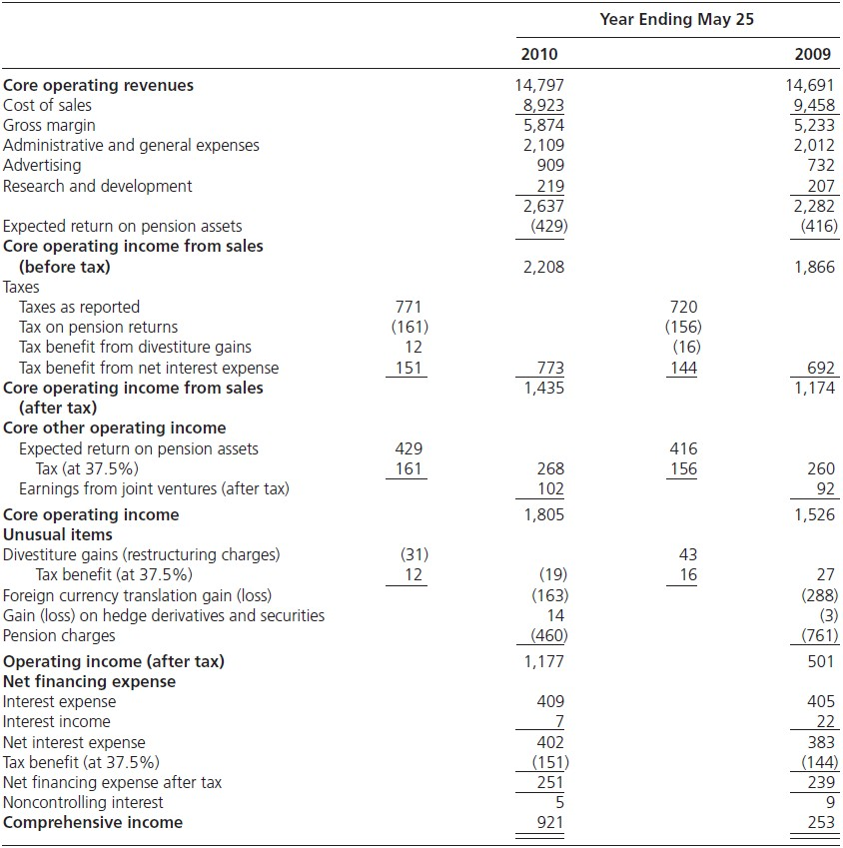
A Reformulated Income Statement Showing Core Income: General Mills

Slide 23
Comprehensive Tax Allocation
GAAP Income Statement
Reformulated Statement
Core revenue
Core operating expense
Core operating income before t Tax:
Tax reported Tax benefit of Tax on
Cor
Revenue Operating expense
Restructuring charge Interest expense Income before tax
Income tax
Net earnings
$ 4,000
(3,400)
(300)
(100)
200
45
$ 155

Slide 24


Analysis of Changes in ROCE
Analyze Changes in Profitability of Operations
Analyze the Effects of Changes in Financing
ROCE = RNOA + [FLEV x SPREAD]
(1)
(2)

Slide 25
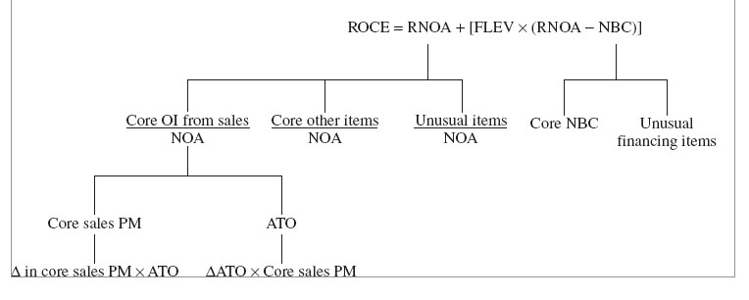
A Road Map

Slide 26
Explaining the Changes in RNOA
Explaining ΔRNOA
1. Distinguish core and transitory components
_{RNOA =} Core OI ₊ UI
NOA NOA
₌ Core OI from Sales ₊ Core Other OI ₊ UI
NOA NOA NOA
Core OI is persistent income from core business
UI is unusual items that are non-recurring, sometimes called transitory items.
All items are after tax

Slide 27
Explaining Changes in RNOA (cont.)
2. Distinguish margin and turnover drivers of core income
_{RNOA =} Core OI from Sales ₊ Core Other OI ₊ UI
NOA NOA
= [Co
where
Core Sales PM = ^{Core OI fr}
ATO =Sales / NOA

Slide 28
Explaining Changes in RNOA (cont.)
Explain changes in profit margins and asset turnovers
Explain changes in Core PM by looking at profit margin drivers
  GM (by segment)
  Selling Expenses / Sales
  Administrative Expenses / Sales
  R&D / Sales
Pay particular attention to GM: per unit sales prices, production costs… Explain changes in ATO by looking at turnovers
  Accounts receivables turnover
  Inventory turnover
  PPE turnover
  Accounts payable turnover
  Operating liability turnover
Also
  Look at operating asset composition ratios
  Look at operating liabilities composition ratios
  Look at OLLEV

Slide 29
Explaining Changes in RNOA: the Calculations
The change in RNOA is explained as:
Change in RNOA =
Change in core sales profit margin at previous asset turnover level
+
Change due
to change in
asset turnover
+
Change due to change in
other core income
+
Change due
to change in unusual
items
ΔRNOA₁ = [ΔCore PM₁ x ATO ]+ [ΔA
(i)
Effect due to change in Profit Margin
(ii)
Effect due to change in Asset Turnover
(iii)
Effect due to Unusual Items this period
Note: (i) is usually more important that (ii)

Slide 30

Analyzing Changes in RNOA: Nike Inc.
1. Effect from changes in core profit margin | 1.11%
2. Effect from changes in ATO | 0.50
3. Effect from unusual items | 0.59
ΔRNOA | 2.20%

Slide 31

Analyzing Changes in RNOA: General Mills
Effect from changes in core profit margin
Effect from changes in ATO
Effect of other operating income
Effect from unusual items
ΔRNOA
2.04%
0.68
0.33
2.9
6.0%

Slide 32
Analyzing Operating Leverage
Changes in core sales PM are determined by how costs change as sales change.
_{Sales PM =} Sales - Variable Cost - Fixed Costs
Sales
₌ Contribution Margin ₋ Fixed Costs Sales Sales
The diff. between sales and variable costs is called the contribution margin - the
amount that contributes to covering fixed costs and providing profits. Also,
Contribution Margin Ratio = 1 - ^{Variable Costs}
Con
This ratio measures the change in income from a change in one dollar of sales

Slide 33
Analyzing Operating Leverage
The sensitivity of income to changes in sales is called the operating leverage. Sometimes measured by the ratio of fixed to variable expenses. Another measure is:
_{OLEV =} Contribution Margin ₌ Contribution Margin Ratio Operating Income Profit Margin
Applying this measure to core operations:
% Change in Core OI = OLEV x % Change in Core Sales

Slide 34
Analysis of Effect of Changes in Financing
ROCE = RNOA + [FLEV x SPREAD]
Effect of Financing
Change in ROCE = Change in RNOA + Change due to change in +
spread at previous level of financial leverage
Change due to change in financial leverage
ΔROCE = ΔRNOA + ΔSPREAD x FLEV
⎡
⎤
⎥⎦
⎡
⎤
+ SPREAD x ΔFLEV
1 1
⎣
0
⎦
⎢⎣
1 1
(i)
Effect of change in operating profitability
(ii)
Effect of change in spread
(iii)
Effect of change in leverage

Slide 35
Effect of Changes in Financing: Reebok Stock Repurchase
In 1996, Reebok borrowed $600 million to repurchase stocks
Summary Reformulated Balance Sheets
(in millions of dollars)
1996
Net operating assets Net financial obligations
Common shareholders' equ ROCE
RNOA
Net borro Fin
11
If financial leverage had been maintained at 1995 level,
ROCE = RNOA + (FLEV x SPREAD)
ROCE₁₉₉₆ = 14.1 + [0.187 x (14.1 - 4.9)]= 15.8%
Explaining ΔROCE:
ΔROCE₁₉₉₆ = - 0.3% = - 2.8% + [- 2.9% x 0.187]+ [0.328 x 9.2%]
= -2.8% - 0.54% + 3.02%

Slide 36
Explaining Changes in the SPREAD
SPREAD = RNOA – NBC
ΔRNOA has been explained Explain Change in NBC:
Distinguish core and unusual borrowing cost
_{NBC =} Core financing exp. ₊ Unusual financing exp.
NFO NFO
Core financing expenses
Change in interest rates (risk free and risk premium)
Change in tax rates (and shield)
Substitution of preferred for debt financing
Unusual financing expenses
Tax effect from unusually high or low taxes (operating losses)
Interest income from tax refunds of prior years
Gains and losses on financial items

Slide 37
Analysis of Growth in Shareholders’ Equity: Road Map
Δ CSE
Δ NOA
Δ NFO
Δ Sales
Δ
1
ATO
Changes in Sales for Business Segments Or Product Lines
Changes in Individual Asset Turnovers
Changes in NFO Components

Slide 38
Analysis of Growth in Common Equity
ΔCSE = ΔNOA - ΔNFO
But, as ATO = ^{Sales} ,
NOA
NOA = Sales x ¹
ATO
ΔCSE= Δ⎛Sales x ^{1 ⎞}- ΔNFO
⎜
ATO ⎟⎟
⎝
⎠
These components of growth in equity investment:
Growth in sales
Change in net operating assets that support each dollar of sales
Change in the amount of net debt that is used to finance the change in net operating assets rather than equity

Slide 39
Preparing Financial Statements for Forecasting
Identify dirty surplus and calculate ROCE from statement of shareholders’
equity
Reformulate balance sheet
Reformulate income statement
Decompose ROCE: Profitability Analysis
Analyze ΔROCE: Sustainability of Earnings
Analyze Growth
Now you are ready to forecast future ROCE and growth and carry out valuations

Slide 40
Using Growth Analysis to Understand P/B and P/E Ratios
How does P/B relate to growth?
How does P/E relate to growth?
How does P/E relate to transitory earnings?

Slide 41
A Reminder: The Benchmark Case of Normal P/B and Normal P/E
Normal P/B Ratio | Normal P/E Ratio
Book values expected to grow at equity cost of capital Residual earnings expected to be zero V ^{E} = C 0 | Earnings expected to grow at equity cost of capital Abnormal earnings growth expected to be zero (Residual earnings expected to be unchanged) Trailing normal P/E: V ^{E} + d _{ρ} 0 0 _{= ρ} E Earn ^{E −1} 0 Forward normal P/E: V ^{E} 1 0 ₌ Earn₁ ρ_{E} −1

Slide 42
A Normal P/E: Whirlpool Corporation
Whirlpool Corp.: Analyst Forecast, December, 1994
 |  | 1993A | 1994A | 1995E | 1996E | 1997E
 | Eps |  | 4.43 | 4.75 | 5.08 | 5.45
 | Dps |  | 1.22 | 1.28 | 1.34 | 1.41
 | Bps | 22.85 | 25.83 | 29.30 | 33.04 | 37.07
 | RE (.10) |  | 2.15 | 2.17 | 2.15 | 2.15
 | ΔRE |  |  | 0.02 | (0.02) | 0.00
 | AEG |  |  | 0.02 | (0.02) | 0.00
Valuation:
E
2.15
V = 25.83 +
= 47.33
0
0.10
VE + 𝑑₀
47.33 + 1.22
0
=
= 11.00
(approx)
𝐸𝑎𝑟𝑛₀
4.43
_{V} E
47.33
0 ₌
= 10.00
Earn₁ 4.75
(approx)
Normal P/E for a 10% cost of capital

Slide 43
P/E Ratios Different from Normal
If earnings are expected to grow faster than the cost of capital (cum-dividend),
P/E > Normal
If earnings are expected to grow slower than the cost of capital (cum-dividend), P/E < Normal
OR
If AEG is forecasted to be positive, P/E > Normal
If AEG is forecasted to be negative, P/E < Normal
OR
If RE is forecasted to increase, P/E > Normal
If RE is forecasted to decrease, P/E <Normal

Slide 44
The P/E Ratio and the P/B Ratio
P/B indicates expected growth in book value
P/E indicates expected growth in earnings
OR
P/B indicates future RE
P/E indicates future changes in RE from current RE

Slide 45


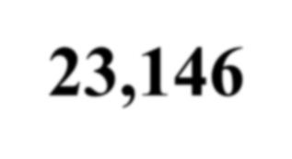
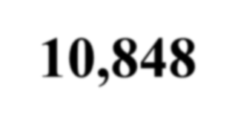


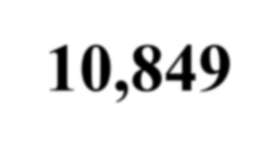
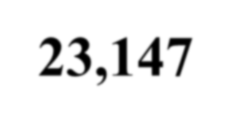
How do Trailing P/E and P/B Articulate?
P/B Ratio High
Low
High
23,146
10,848
P/E Ratio
Low
10,849
23,147
Joint Values of P/E and P/B Ratios; 1963-2001

Slide 46




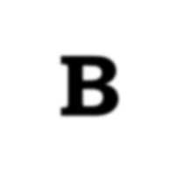




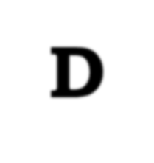

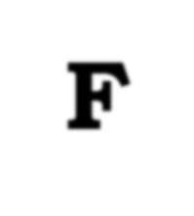



Fill Out the Cells
(this is not TIC-TAC-TOE)
P/B
High Normal Low
High
A | B | C
D | E | F
G | H | I
P/E
Normal
Low
Which cell do growth firms fall in ?

Slide 47

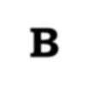

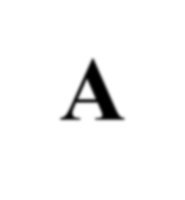
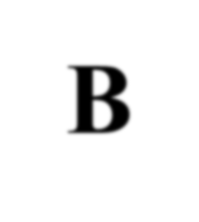
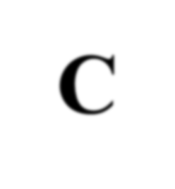

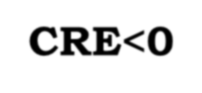


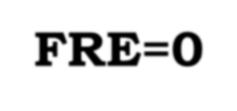
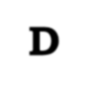

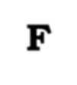
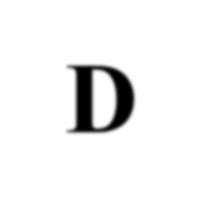
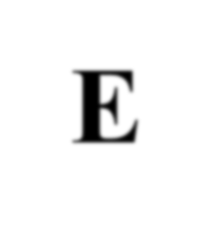

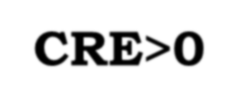

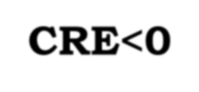
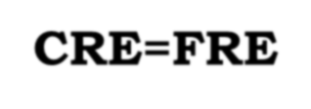

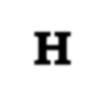

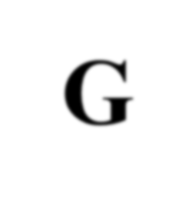
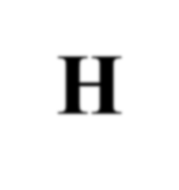
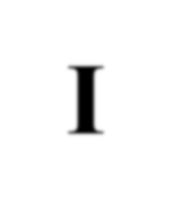


The Solution
P/B Normal
FRE=0
High
FRE>0
Low
FRE<0
High
FRE>CRE
A
B
C
FR_{A}E>0
CR_{B}E<0
FR_{C}E<0
CRE<FRE
FRE=0
CRE<FRE
P/E
Normal
FRE=CRE
D
E
CRE_{E}=FRE=0
F
D
F
CRE>0
CRE<0
CRE=FRE
CRE=FRE
G
H
I
Low
FRE<CRE
FR_{G}E>0
CR_{H}E>0
FR_{I}E<0
CRE>FRE
FRE=0 CRE>FRE
CRE = Current residual earnings
FRE = Expected future residual earnings

Slide 48
What is a Growth Stock?
P/E indicates growth in RE but this could be from a very low base: Firms in cell C can be high P/E firms
Trailing P/E reflects growth and transitory earnings. If earnings are temporarily low, P/E will be high
The Molodovsky Effect:
  Cells B and H are pure Molodovsky effects (i.e. the effect of transitory earnings on the P/E)
  Cells A, C, G and I are mixed growth and Molodovsky effects

Slide 49
P/B is not Growth
P/B is often said to indicate a growth stock But…..
A firm can have a high P/B but zero growth (Cell D)
A firm can have a high P/B and negative growth (Cell G)
A firm can have a low P/B and positive growth (Cell C)
There is much confusion around the notions of value vs. growth in
investing

