Slide 1
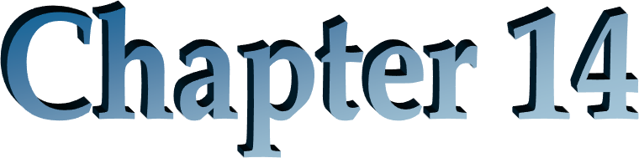
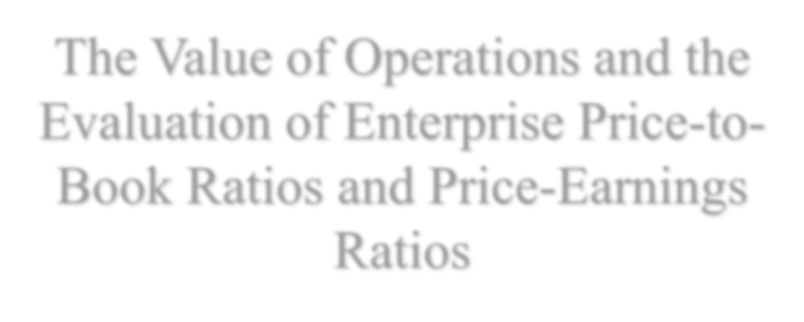
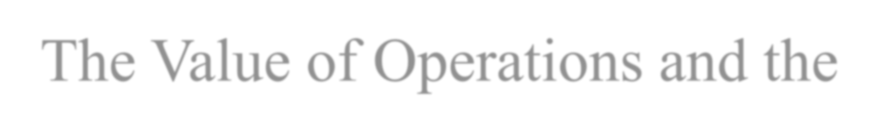
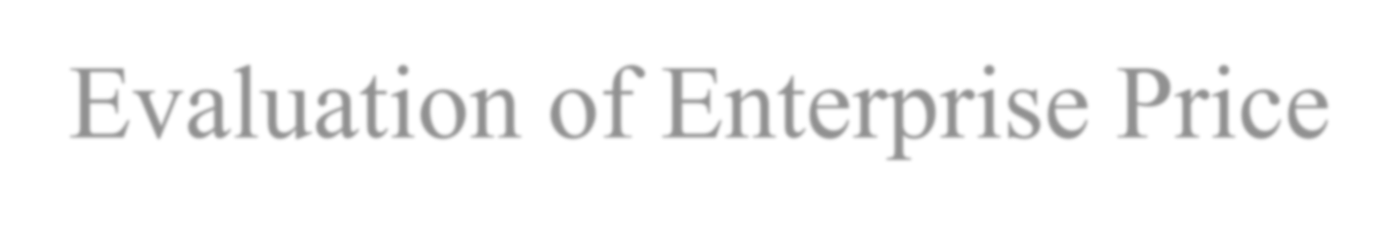
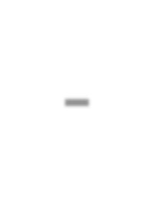
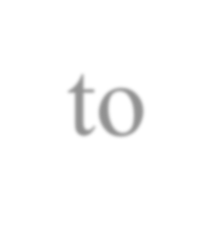
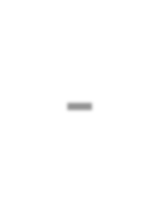
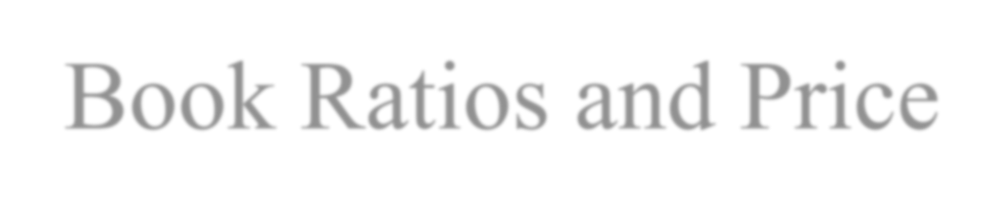

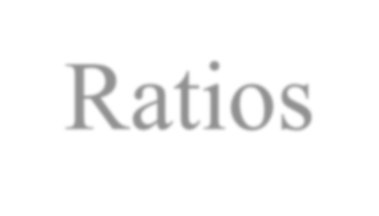
The Value of Operations and the Evaluation of Enterprise Price-to- Book Ratios and Price-Earnings Ratios

Slide 2
Outline
A Modification to the RE Model: Residual Operating Income Model
A Modification to the AEG Model: Abnormal Growth in Operating Income
The Cost of Capital and Valuation
Financing Risk and Return and Value of Equity
Mark-to-Market Accounting: A Tool for Incorporating the Liability for Stock Options in Valuation
Enterprise Multiples

Slide 3
The Big Picture for this Chapter
Net financial obligations are close to their value on the balance sheet.
Financing activities do not add value (usually)
So, valuation focuses on the valuation of operating activities:
Enterprise Valuation
The metrics:
  Residual operating income
  Abnormal operating income growth

Slide 4
A Reminder:
The Residual Earnings Valuation Model
RE₁ ₊ RE ₂
CV_{T}
VE = CSE
+ .... ^{RE T}
0
0
ρ
_{ρ}2
_{ρ}T _{ρ}T
E
E
E
E
The valuation of equity
Forecast future residual income (RE)
Calculate a continuing value
Take present values and add to current book value
Review Chapter 5

Slide 5
Market Value Balance Sheets and Expected Residual Earnings
If the balance sheet is at market value, then
Book value is expected to earn at the required return
Residual earnings is expected to be zero
V₀ = CSE₀ implies forecasted RE = 0 Forecasted RE = 0 implies V₀ = CSE₀

Slide 6
A Modification of the RE Model
RE Model:
VE = CSE +
0
Some assets and liabilities have zero expected RE because they are measured at market value
Modified Model:
VE = CSE + PV of residual ear
0 0
net

Slide 7
Earnings Components and Corresponding Residual Earnings Measures
Focus on:
Residual Operating Income (ReOI)
= OI_{t} − (ρ_{F} −1) NOA_{t−1}

Slide 8
The Value of the NFO and the Value of the NOA
NFO are usually at market value on the balance sheet (or close to it). So residual
earnings from NFO are expected to be zero:
_{V}NFO
= NFO
(usually)
0
0
NOA are not usually at market value in the balance sheet
Value of Operations (Enterprise Value) = BV of NOA + PV of exp. ReOI
ReOI₁ ₊ ReOI ₂ Re
V ^{NOA} = NOA
0
0
CV_{T} = 0
Case 1
CV
₌ Re OI_{T+1}
Case 2
T
ρ − 1
F
CV
₌ Re OI_{T+1}
Case 3
T
ρ − g
F

Slide 9
The Value of the Common Equity
Residual operating income model
_{V}E _{= V}NOA _{− V}NFO 0 0 0
_{V}NOA
⁰ 
ReOI₁
VE = NOA
0
0
ReOI₁
ReOI
VE = CSE
+ ..
0
⁰
NO

Slide 10
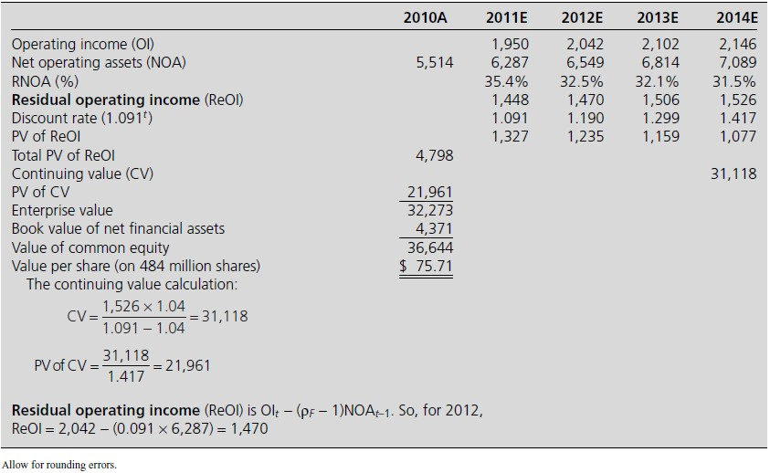
Residual Operating Income Valuation: Nike, Inc.

Slide 11
The Drivers of Residual Operating Income
The Drivers of RE:
RE _{t} = Earn_{t} − (ρ_{E} −1)CSE _{t−1} = [ROCE − ρ
The Drivers of ReOI:
ReOI_{t} = OI_{t} − (ρ_{F} −1) NOA_{t−1} = [RNOA_{t}
(1)
(1) RNOA
− (ρ −1)]NOA
F t−1
(2)
(2) NOA put in place to earn at RNOA

Slide 12
A Reminder:
The Abnormal Earnings Growth Model for Valuing Equity
VE = capitalized [forward earnings + present value of abnormal earnings growth]
0
1
⎡
Earn
₊ AEG ₂
₊ AEG ₃
₊ AEG ₄
⎤
=
_{ρ}2 _{ρ}3
+ ....⎥
ρ −1 ⎢
1
ρ
E
⎢⎣
E
E E
⎥⎦
Abnormal earnings growth _{t} (AEG) = cum-dividend earnings _{t} − normal earnings _{t}
= [earnings _{t} + (ρ_{E} −1)d _{t−1} ]− ρ_{E}earnings _{t−1}
= [G _{t} − ρ_{E} ] x earnings _{t−1}

Slide 13
A Modification to the AEG Model
VE =
Capitalized [forward operating income + present value
of abnormal operating income growth] – net financial obligations
0
1
⎡
OI
₊ AOIG ₂ ₊ AOIG ₃ ₊ AOIG ₄
⎤
VE =
_{ρ}2 _{ρ}3
+ ...⎥ − NFO₀
⎥⎦
0
ρ −1 ⎢
1
ρ
F
⎢⎣
F
F F
Abnormal operating income growth_{t} (AOIG)
= cum-dividend operating income – normal operating income
= [operating income_{t} + (ρ_{F} – 1)FCF_{t-1}] - ρ_{F} operating income_{t-1}
= [G_{t} – ρ_{F}] x operating income_{t-1}
where G_{t} is now “cum-dividend” operating income growth rate
The “dividend” from the operating activities is free cash flow

Slide 14
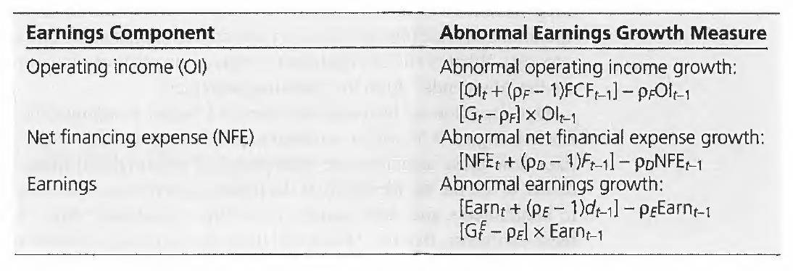
Earnings Components and Corresponding Abnormal Earnings Growth Measures

Slide 15
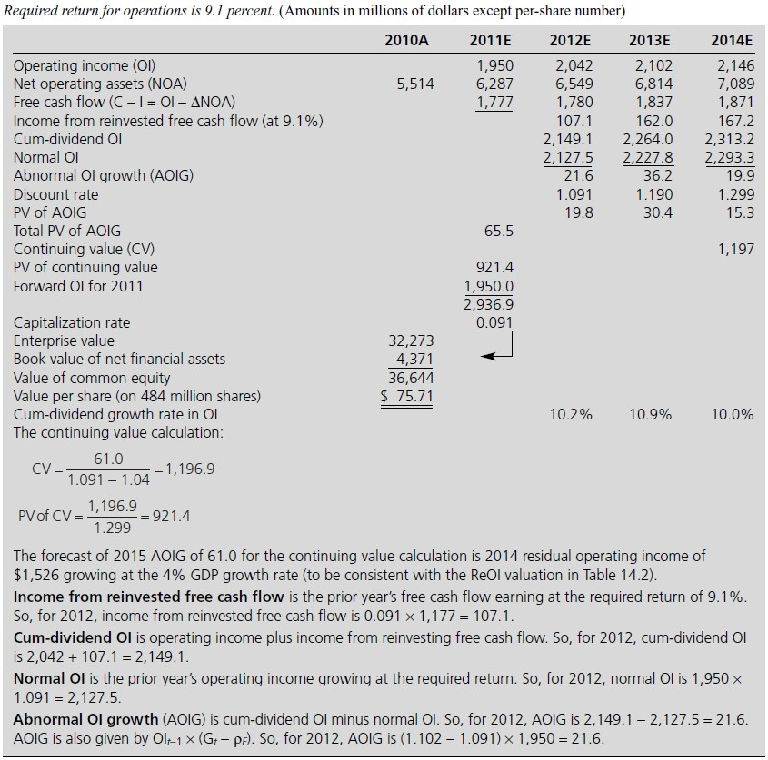
Abnormal OI Growth Valuation: Nike

Slide 16
An Equivalent Form: Easy Method
Just as AEG = ΔRE, so AOIG = ΔReOI
So,
1
₊ ΔReOI ₂ ₊ ΔReOI ₃ ₊ ΔReOI ₄
VE =
⎡OI
+ ...
⎤ − NFO
0
ρ −1 ⎢
1
ρ
_{ρ}2 _{ρ}3 ⎥
0
F
⎣ F F F ⎦
In the ReOI pro forma, just add an extra line for ΔReOI
See how this works for Nike :
AOIG (2012) = 22 = ReOI (2012) - ReOI (2011) = 1,470 -1,448 = 22

Slide 17
The Cost of Capital for Operations
Operations have their own risk, referred to as operational risk
This risk determines the required return (or cost of capital) to invest in the
operations
The required return is called the cost of capital for operations or the cost of capital for the firm: ρ_{F}
It is also called the weighted average cost of capital because
V
E
V
D
ρ =
0
ρ +
0
ρ
F
_{V}F
E
_{V}F
D
0
0

Slide 18
The Effective Cost of Capital for Debt is After Tax
After-Tax Cost of Debt (ρ_{D}) = Nominal Cost of Debt * (1-t)
t is the marginal income tax rate

Slide 19
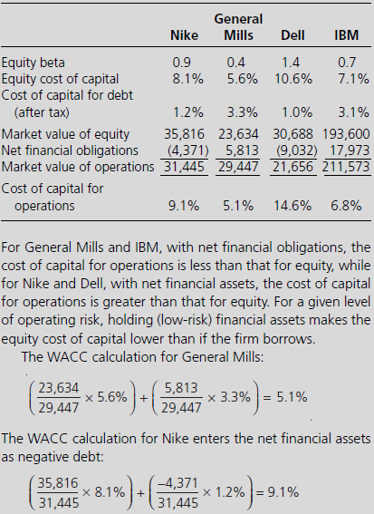
The WACC Calculation: Some Examples
Risk free rate = 3.6% Market risk premium = 5%

Slide 20
The Cost of Equity Capital
The cost of capital for equity is really derived from the cost of capital for operations (not vice versa)
V
F
_{V}D
ρ =
0
ρ
E
or
V
D
(ρ − ρ )
F D
ρ_{E} = ρ_{F} +
0
_{V}E
0
Equity risk has two components
  Operating risk
  Financing risk
    Leverage
    Spread
So, for General Mills, the equity cost of capital is
5.15% + ^{⎡ 5,813} (5.15% - 3.3%) ⎤ = 5.6%
⎢⎣ 29,447
⎥⎦

Slide 21
Financing Risk and Return and Value of Equity
Required Return on Equity:
V
D
(ρ − ρ )
ρ_{E} = ρ_{F} +
0
_{V}E
F
D
0
market leverage
Accounting return on equity
ROCE = RNOA + ^{NFO} (RNOA − NBC)
CSE
book leverage
Leverage increases both accounting return (if SPREAD>0) and required return
What is the net effect of leverage on the present value of RE (and value)?
Financing irrelevance: None

Slide 22
The Effect of Change in Leverage on Equity Value: RE Valuation
ReOI Valuation of a Firm with 9% cost of capital for operations and 5% after-tax cost of debt
0 |  | 1 | 2 3
Net operating assets | 1,300
Net financial obligations | 300
Common shareholders’ equity | 1,000
Operating income |  | 135 | 135 | 135 ---→
Net Financial expense (300 x .05) |  | 15 | 15 | 15 ---→
Earnings |  | 120 | 120 | 120 ---→
Residual operating income, ReOI (.09) |  | 18 | 18 | 18 ---→
PV of ReOI ^{⎛ 18 ⎞}
200
⎜ ⎟
⎝ .09 ⎠
Value of common equity | 1,200
Value per share (on 600 shares) | 2.00

Slide 23
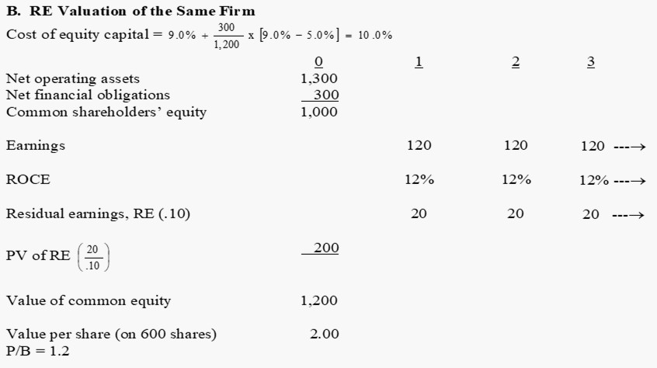
The Effect of Change in Leverage on Equity Value: RE Valuation

Slide 24
Leverage Demonstration in RE Valuation (cont.)
C. RE Valuation for the Same Firm after Debt for Equity Swap
Cost of equity capital = 9% + ⁷⁰⁰ x [9% − 5%] = 12.5%
800
0
1,300
700
600
1
2
Net operating assets
Net financial obligations Common shareholders’ equity
Operating income
Net Financial expense (700 x .05) Earnings
135
ROCE
Residual earnings, RE (.125)
PV of RE ^{⎛ 25 ⎞}
⎜ ⎟
⎝ .125 ⎠
Value of common e
Value per sh P/B = 1.3
Value per share is not affected but P/B increases

Slide 25
Effect of a Stock Repurchase and Debt Issue: Reebok
August, 1996: repurchase of 16.7 million common shares at $36 per share;
$601.2 million borrowed to finance the repurchase
Actual 1996 Balance Sheet with Stock Repurchase Net operating assets 1,135 | “As If” 1996 Balance Sheet without Stock Repurchase 1,135
Net financial obligations 720 | 119
Total equity 415 | 1,016
Minority interest 34 | 34
Common stockholders’ equity 381 | 982
Financial leverage (FLEV) 1.73 | 0.12
(continued)

Slide 26
Effect of a Stock Repurchase and Debt Issue: Reebok (cont.)
Operating income | Pro Forma 1997 Income Statement with Stock Repurchase 187 | “As If” Pro Forma 1997 Income Statement without Stock Repurchase 187
Net financial expense (4% of NFO) | (29) | (5)
Minority interest in earning | (15) | (15)
Earnings forecast | 143 | 167
Shares outstanding (millions) | 55.840 | 72.540
Forecasted eps | 2.56 | 2.30
Forecasts for 1997 − RNOA | 16.5% | 16.5%
SPREAD | 12.5% | 12.5%
ROCE | 37.5% | 17.0%
Note the effect on ROCE

Slide 27
Reebok Stock Repurchase
 | Valuation with Stock Repurchase | “As If” Valuation without Stock Repurcha
Value of NOA | 3,472 | 3,472
Book value of NFO | 720
Value of equity | 2,752
Value of minority interest | 210
Value of common equity Value per share | 2,549
If the 16.7 million shares had been repurchased at $43.33 rather than $36, the comparison is
 | Valuation with Repurchase at $43.33 per share | Valuation without Repurchase
Value of NOA | 3,472 | 3,472
Book value of NFO | 843 | 119
Value of equity | 2,629 | 3,353
Value of minority interest | 210 | 210
Value of common equity | 2,419 | 3,143
Value per share | 43.33 | 43.33

Slide 28
The Effect of Change in Leverage on Equity Value: AEG valuation
0 1 2 3
AOIG Valuation of a Firm with 9% Cost of Capital for Operations and 5% After-Tax Cost of Debt
15 →
Operating income | 135 |  | 135 | 135 →
Net financial expense (300 x 0.05) Earnings | 15 120 |  | 15 120 | 120 →
Eps (on 600 million shares) | 0.20 |  | 0.20 | 0.20 →
Free cash flow (C – I = OI - Δ NOA) | 135 |  | 135 | 135 →
Reinvested free cash flow (at 9%) | 12 |  | 12 12 →
Cum-dividend operating income |  |  | 147 | 147 →
Normal operating income (at 9%) | 147 |  |  | 147 →
Abnormal operating income growth (AOIG) | 0 |  |  | 0 →
135 Value of operations ( ) _{1,500} 0.09
Net financial obligations | 300
Value of equity | 1,200
Value per share (on 600 million shares) | 2.00
2.00
Forward P/E =
= 10
0.20

Slide 29
Leverage Demonstration in AEG Valuation (cont.)
0 1 2 3
AEG Valuation of the Same Firm
Cost of equity capital = 9.0% + ^{⎡ 300} x(9% − 5%)⎤ = 10.0%
⎢1,200
⎥
⎣
⎦
Operating income
Net financial expense (300 x 0.05)
135 →
15 →
0.20 0.20 0.20 →
135 135
15 15
Earnings 120 |  | 120 | 120 →
Eps (on 600 million shares)
Dividend (d = Earn - Δ CSE) Reinvested dividends (at 10%) Cum-dividend earnings Normal earnings (at 10%)
Abnormal earning growth (AEG)
120 120 120 →
12 12 12 →
132 132 132 →
132 132 132 →
0 0 →
Value of Equity (
120
)
1,200
0.10
Value per share (on 600 million shares)
2.00
2.00
Forward P/E=
= 10
0.20

Slide 30
Effect of a Change in Leverage (Cont.)
AEG Valuation of the Same Firm after Debt-for-Equity Swap
⎡ 700
⎤
⎦
Cost of equity capital
= 9% +
⎢
x(9% − 5%)
⎥
= 12.5%
⎣
800
Operating income
135 135 135 →
Net financial expense | (700 x 0.05) | 35 | 35 | 35 →
Earnings |  | 100 | 100 | 100 →
Eps (on 400 million shares) |  | 0.25 | 0.25 0.25 →
Dividends (d = Earn - Δ CSE) |  | 100 | 100 100 →
Reinvested dividends (at 10%) |  |  | 10 10 →
Cum-dividend earnings |  |  | 110 110 →
Normal earnings |  |  | 110 110 →
Abnormal earnings growth (AEG)
0
0 →
Value of equity (
100
)
800
0.125
Value per share (on 400 million shares)
2.00
2.00
Forward P/E =
= 8
0.25
Value per share is not affected but P/E declines

Slide 31
Leverage Creates Earnings Growth but not Value
Before stock repurchase: No Leverage (No div. payout; ρ_{F}=10%)
 | 0 | 1 | 2 | 3 | 4
Net operating assets | 100.00 | 110.00 | 121.00 | 133.10 | 146.41
Common equity | 100.00 | 110.00 | 121.00 | 133.10 | 146.41
Operating income (equals comprehensive income) |  | 10.00 | 11.00 | 12.10 | 13.31
Eps (on 10 million shares) Growth in eps |  | 1.00 | 1.10 10.0% | 1.21 10.0% | 1.33 10.0%
RNOA |  | 10% | 10% | 10% | 10%
ROCE |  | 10% | 10% | 10% | 10%
Residual operating income Free cash flow |  | 0 0 | 0 0 | 0 0 | 0 0
Cum-div OI |  |  | 11.0 | 12.10 | 13.31
Normal OI |  |  | 11.0 | 12.10 | 13.31
Abnormal OI Growth |  |  | 0 | 0 | 0
Value of equity | 100.00
Per-share value of equity (10 million shares) Forward P/E ratio | 10.00 10.0
P/B ratio | 1.0

Slide 32
Leverage Creates Earnings Growth but not Value (cont.)
After stock repurchase: Leverage introduced with 5 million shares repurchased at $10 each, financed by borrowing at 5%. (ρ_{F} =10%)
 | 0 | 1 | 2 | 3 | 4
Net operating assets | 100.00 | 110.00 | 121.00 | 133.10 | 146.41
Net financial obligations | 50.00 | 52.50 | 55.12 | 57.88 | 60.77
Common equity | 50.00 | 57.50 | 65.88 | 75.22 | 85.64
Operating income |  | 10.00 | 11.00 | 12.10 | 13.31
Net financial expense |  | 2.50 | 2.63 | 2.76 | 2.89
Comprehensive income |  | 7.50 | 8.37 | 9.34 | 10.42
Eps (on 5 million shares) |  | 1.50 | 1.68 | 1.87 | 2.08
Growth in eps |  |  | 11.67% | 11.57% | 11.48%
RNOA |  | 10% | 10% | 10% | 10%
ROCE |  | 15.0% | 14.6% | 14.2% | 13.9%
Residual operating income Free cash flow |  | 0 0 | 0 0 | 0 0 | 0 0
Cum-dividend OI |  |  | 11.0 | 12.10 | 13.31
Normal OI |  |  | 11.0 | 12.10 | 13.31
Abnormal OI growth Value of equity | 50.00 |  | 0 | 0 | 0
Per-share value of equity (5 million shares) | 10.00
Forward P/E ratio P/B ratio
6.67
1.00
Value per share is not affected but P/E declines

Slide 33
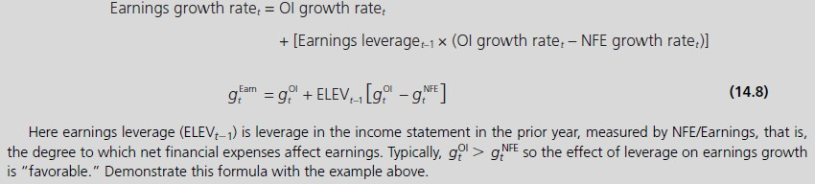
Leverage and Earnings Growth: A Formula

Slide 34
Do Share Repurchases Add Value ?
Share repurchases add to EPS, but do they add value?
Consider:
Buying shares at fair market value cannot add value
See the leverage examples: Share repurchases add to ROCE and to earnings growth but do not add to value
An exception:
Repurchase of shares at less than fair value

Slide 35
Why do Managers Repurchase Shares?
To pay out cash
To reverse dilutive effect of stock options!?
To increase EPS!?
To actively time the market price

Slide 36
IBM: Repurchases, Leverage, and EPS
International Business Machines (IBM)
2000 1999 1998 1997 1996 1995
Share repurchases, net ($ billions) | 6.1 | 6.6 | 6.3 | 6.3 | 5.0 | 4.7
Change in net debt ($ billions) | 2.4 | 1.2 | 4.4 | 4.6 | 0.8 | 2.3
Financial leverage (FLEV) | 1.21 | 1.10 | 1.22 | 0.98 | 0.68 | 0.62
Earnings per share | 4.35 | 4.58 | 4.25 | 3.38 | 3.09 | 2.56
IBM’s EPS growth has been increased by stock repurchases and financial leverage

Slide 37
The Three Caveats
Beware of earnings growth created by investment
Beware of earnings growth created by accounting methods
Beware of earnings growth created by financial leverage

Slide 38
Levered and Unlevered (Enterprise) P/B Ratios
_{V}E _{V}NO
Levered P/B =
0
Unlevered P/
CSE ₀
_{V} NOA _{− V}NFO 0 0
NOA − NFO
Levered P/B =
_{V} NOA
_{⎡ V} NOA
⎤
= ^{0} + FLEV ⎢ ^{0} −1⎥
NOA_{0 ⎢⎣} NOA₀
⎥⎦
FLEV is the financial leverage ratio, NFO/CSE

Slide 39
Levered P/B vs. Financial Leverage
7.0
V^{NOA}/NOA = 3
6.0
V^{NOA}/NOA = 2.5
5.0
Levered P/B (V ^{E} / CSE)
4.0
V^{NOA}/NOA = 2
3.0
V^{NOA}/NOA = 1.5
2.0
1.0
V^{NOA}/NOA = 1
0.0
0.0
0.3
0.5
0.8
1.0
1.3
1.5
1.8
2.0 2.3
V^{NOA}/NOA = 0.5
-1.0
Leverage (NFO/CSE)
_{V}E _{= V}NOA
_{⎡ V}NOA
₋ ⎤
FLEV _{⎢ NOA} 1⎥
CSE NOA
⎣ ⎦

Slide 40
Levered vs. Unlevered P/B
3.0
FLEV = 1.5
2.5
FLEV = 1.0
FLEV = 0.75
2.0
FLEV = 0.5
1.5
FLEV = 0.25
FLEV = 0
Levered P/B (V ^{E} /CSE)
1.0
0.5
0.0
0.0
0.5
1.0
1.5
2.0
-0.5
-1.0
-1.5
Unlevered P/B (V^{NOA}/NOA)
_{V}E _{= V}NOA _{⎡ V}NOA
₋ ⎤
FLEV _{⎢ NOA} 1⎥
CSE NOA
⎣ ⎦

Slide 41
Levered and Unlevered (Enterprise) P/E Ratios
Value of Operations
_{V} NOA
Forward enterprise P/E =
₌ 0
OI_{I}
Forward OI
NFE
ELEV =
Earnings
NBC = net borrowing cost

Slide 42
Levered and Unlevered (Enterprise) P/E Ratios
Trailing enterprise P/E = ^{Value of Operations + FCF}
current OI
_{V}NOA
FCF
₌ 0 0
OI₀
_{⎛ V} E
d
⎞
Levered trailing P/E ⎜⎜ ⁰ ⁰ ⎟⎟
⎝ Earn₀
⎠
_{V} NOA
FCF
_{⎡V} NOA
FCF
1
⎤
= ⁰ ⁰ + ELEV
0 0 ₋
− 1
OI
0 ⎢
OI
NBC
⎥
0
⎣
0
0 ⎦

Slide 43
The Leverage Effects
Simple Forecast | Levered Measure | Unlevered Measure | Relationship
Profitability Cost of Capital P/B Ratio Forward P/E Trailing P/E | ROCE ρ_{E} V0E/CSE 0 _{V}E 0 E VE + d 0 0 Earn ₀ | RNOA ρ_{F} V0^{NOA} /NOA 0 _{V}NOA 0 V ^{NOA} + FCF 0 0 OI₀ | ROCE = RNOA + FLEV[RNOA − NBC] ρ = ρ + ^{VD} [ρ − ρ ] 0 E F _{V}E F D 0 VE ₌ V^{NOA} ₊ NFO ⎡ V^{NOA} ₋ ⎤ CSE NOA CSE ^{⎢ 1⎥} 0 0 0 0 0 0 0 ⎣^{NOA}0 ⎦ _{V}0 _{= V}NOA _{+ ⎛ V}NOA ^{E 0} ELEV ⎜ Earn₁ OI V⁰ + d₀ ₌ V^{NOA} + FCF ₊ ⎛ V^{NOA} + FCF ₋ 1 ₋ ⎞ E 0 0 _{ELEV0 ⎜} 0 0 _{1⎟} Earn ₀ OI₀ ⎜ OI₀ NBC₀ ⎟ ⎝ ⎠

Slide 44
Advantages of Valuing Operations
Financing activities can be ignored for forecasting: focus on operations where the value is generated
Required return does not have to be adjusted as leverage changes

