Slide 1
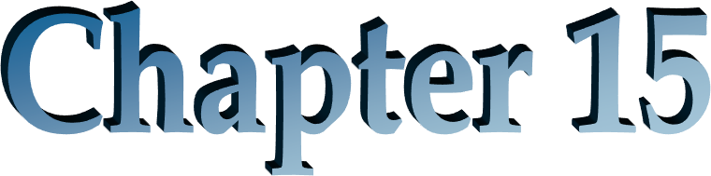
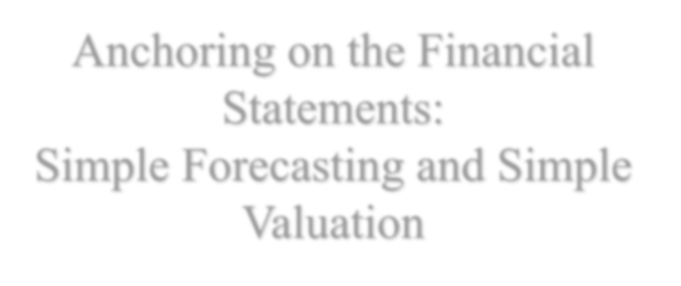
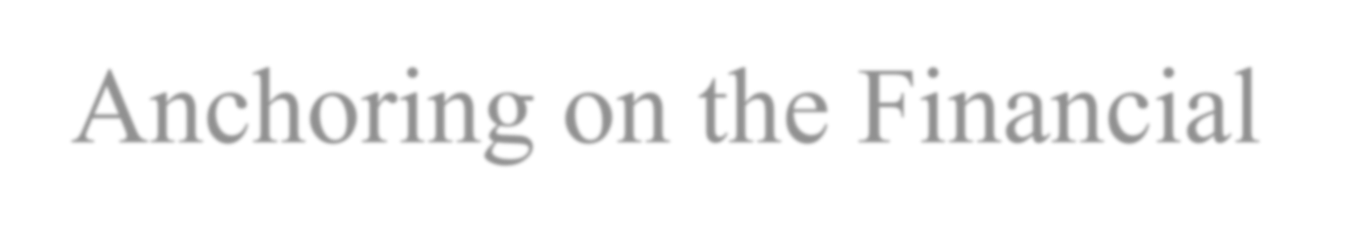
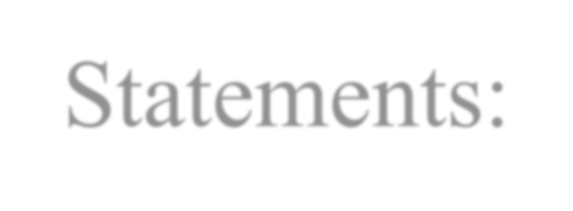
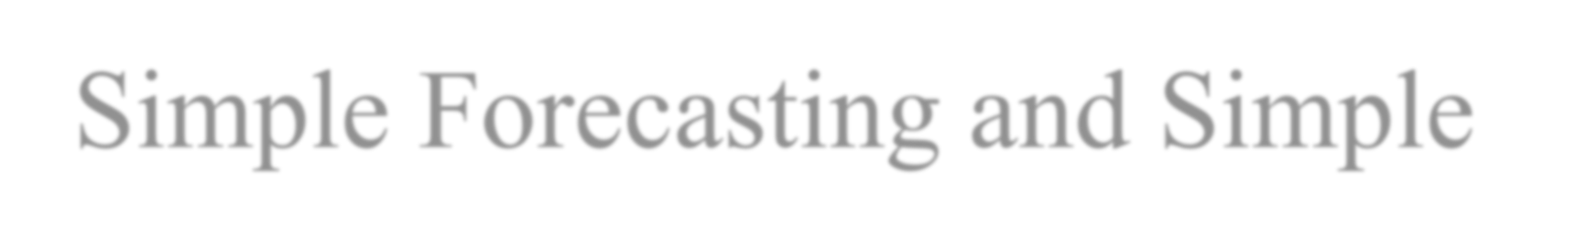
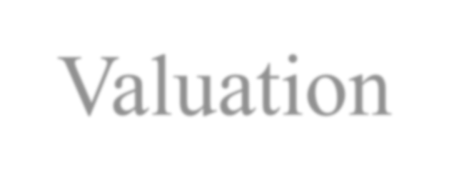
Anchoring on the Financial Statements:
Simple Forecasting and Simple Valuation

Slide 2
Outline
A Simple Valuation Model
The No-Growth Forecast and Valuation
The Growth Forecast and Valuation
Simple Forecasts and Simple Valuations
Simple Valuation as an Analytical Device: Sensitivity Analysis
Reverse Engineering the Forecasted Growth Rate

Slide 3
The Big Picture for this Chapter
The tenet: Anchor valuation on what you know rather than speculation
The financial statements, appropriately formulated and
analyzed, are “what we know”
Therefore, anchor a valuation on what you see in the financial statements before adding speculation
⎡ Value implied by
⎤
⎡Value from ⎤
+
^{Value = ⎢}financial statements⎥
⎣ ⎦
⎢speculation ⎥
⎣ ⎦
This Chapter “Simple Valuation”
Next Chapter “Full pro forma
valuations”

Slide 4

A Simple Valuation Model
We can get the ingredients from the financial statements:
Date 0 items are in the financial statements
Date 1 items can be forecasted from the financial statements
Growth, g, can be forecasted from the financial statements

Slide 5
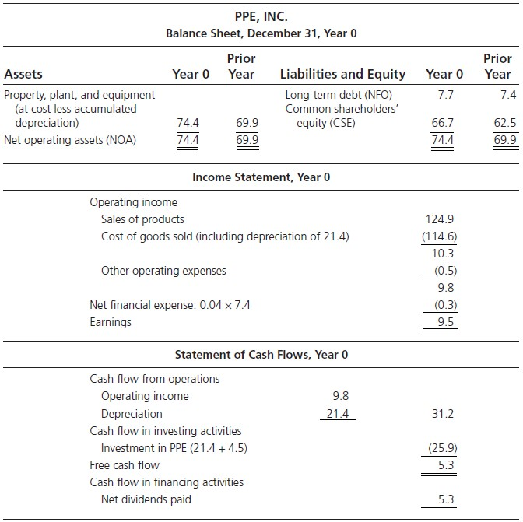
PPE, Inc.: The Financial Statements
Required return for operations = 10% Required return for debt = 4%

Slide 6
The No-growth Forecast
PPE Inc.
Pro Forma Income Statement, Year 1
Operating income: 9.8 + (0.10 x 4.5)
Interest expense: 7.7 × 0.04 Earnings
10.25
0.308
9.942
ReOI0 = (9.8 – (0.10 × 69.9) = 2.81
ReOI1 = 10.25 – (0.10 × 74.4) = 2.81

Slide 7
The No-growth ReOI Valuation
_{V} NOA
Core ReOI ₀
= NOA
0
0
ρ − 1
F
For PPE Inc.,
_{V}NOA
= 74.4 + ^{2.81}
0
0.10
= 102.5
_{V}E _{= V} NOA _{− V}NFO 0 0 0
= 102.5 - 7.7
= 94.8

Slide 8
The No-growth AOIG Valuation
The no-growth enterprise value is also forward operating income capitalized:
𝑉^{𝑁𝑂𝐴}= OI /(ρ -1)
0
1 F
Constant ReOI implies AOIG = 0
Zero AOIG implies a normal enterprise P/E ratio. For PPE Inc.
Forward enterprise P/E = 102.5/10.25 =10
which is normal for a required return of 10%

Slide 9
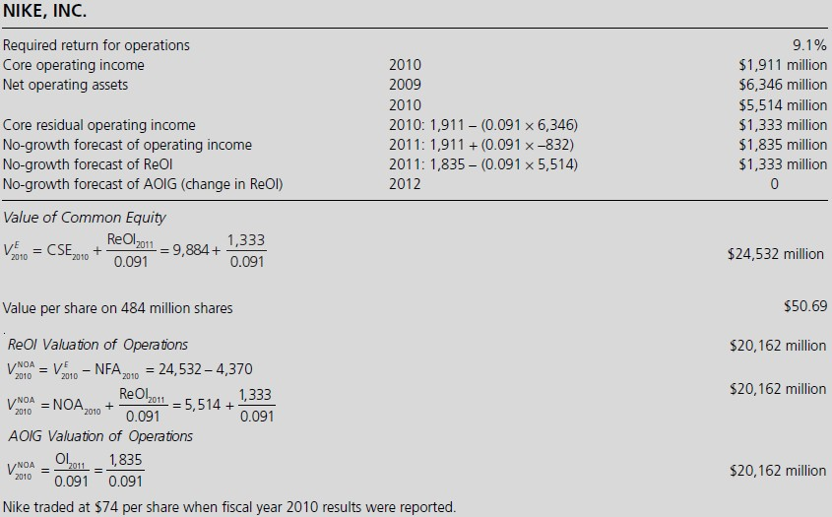
No-growth Valuation: Nike, Inc.

Slide 10
The Growth Forecast
For PPE, Inc. the current core RNOA = 9.8/69.9 = 14.02%
PPE Inc.
Pro Forma Income Statement, Year 1
Operating income: 0.1402 x 74.4 | 10.431
Interest expense: 7.7 x 0.04 | 0.308
Earnings ReOI₁ = 10.431 – (0.10 × 74.4) = 2.991 | 10.123
= (0.1402 – 0.10) × 74.4 = 2.991

Slide 11
The Forecasted Growth Rate
If RNOA₁ = RNOA₀
NOA ₀
Growth Rate in ReOI =
1
NOA₋
1
i.e. the forecasted growth in ReOI for the next year is given by the current growth of NOA. The growth forecast is given by growth in the balance sheet.
For PPE:
g = 74.4/69.9 = 1.0644

Slide 12


The Growth Valuation
Assuming RNOA will be the same as current core RNOA indefinitely but NOA investments will continue to grow at the current rate. ln this case, ReOI will also grow indefinitely at this rate.
Capitalizing the forecast of ReOI for Year 1 as a perpetuity with growth:
where g = NOA₀/NOA₋₁

Slide 13
The Growth Valuation
_{V} NOA
ReOI₁
= NOA
0
0
ρ - g
= 74
_{V}E _{= V} NOA 0 0
NFO
= 158.41− 7.7
= 150.71

Slide 14
The Growth Valuation Restated
_{V} NOA
_{x} Core RNOA ₀ − (g −1)
= NOA
0
0
ρ − g
F
The NOA multiplier (Enterprise P/B ratio)
For PPE Inc., g = 1.0644 (6.44% growth)
_{V} NOA
_{= 74.4 x} 0.1402 − 0.0644
0
1.10 − 1.0644
= 158.41
Enterprise P/B = 2.13

Slide 15
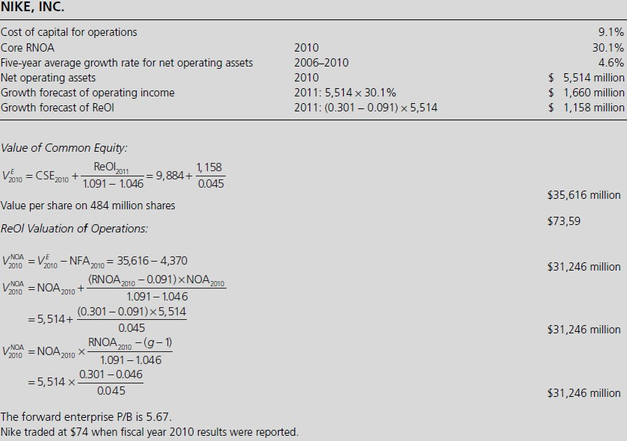
Growth Valuation: Nike, Inc.

Slide 16
The AOIG Growth Valuation
⎡
1 G
V^{NOA} = OI ×
0 1
Growth multiplier Forward Enterprise P/E
G₂ = 1+ Cum-dividend growth rate in OI for two years ahead
g= growth rate in NOA
For PPE Inc.
G = 11.667 10.431 = 1.1185
2
(11.85% growth)
1 ⎡₁ ₊ 1.1185 −1.10⎤
V ^{NOA} = 10.431 x
0
0.10 ⎢⎣ 1.10 −1.0644⎥⎦
= 158.41
Forward Enterprise P/E =15.20

Slide 17
Simple Forecasts and Simple Valuations
Simple Forecast | Simple Valuation of the Equity |  | Simple Valuation of the Operations
ReOI=0 | VE = CSE 0 0 _{V E = CSE +} Core ReOI ₀ ⁰ ⁰ ρ −1 F _{V E = CSE +} [Core RNOA ₀ − (ρ_{F} −1)]NOA₀ |  | _{V}NOA ₌ 0 _{V NOA = NOA +} Core ReOI ₀ ₌ OI 1 ⁰ ⁰ ρ − 1 ρ − 1 F F _{V NOA = NOA +} [Core RNOA ₀ − (ρ_{F} −1)]NOA ₀ ⁰ ⁰ ρ − g F _{= NOA ×} Core RNOA ₀ − [g −1] ⁰ ρ − g F _{= OI ×} 1 ⎡ ₊ G ₂ − ρ_{F} ⎤ ¹ ρ −1 ^{⎢1} ρ − g ⎥ F ⎣ F ⎦
No-
growth
Growth
 | 0 0 | ρ − g
 |  | F
Growth
No-
growth

Slide 18
Weighted-Average Forecasts of Growth
Weighted-average forecast of growth in ReOI:
Forecasted growth rate for ReOI =
(0.70 × Current growth rate for ReOI) + (0.30 × 4%) where 4% is the historical GDP growth rate
For Nike Inc.,
Forecasted NOA growth rate = (0.70 × 4.6%) + (0.30 × 4.0%)
= 4.42%
(This implies a value for Nike of $71.54 per share)
Recognize an historical fact:
Growth rates trend towards the average growth rate for the economy
RNOA tends to decline over time
Investment tends to slow down over time

Slide 19
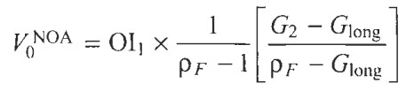
Simple Valuations with Short-Term and Long-Term Growth Rates
The idea that growth rates decline over the long term can also be accommodated
with the abnormal operating income growth (AOIG) model.
G₂ is (1+) the growth rate forecasted for cum-div. operating income two years ahead.
G_{long} is the growth rate for the long term usually set to the GDP growth rate.
The model implies a gradual (geometric) decay of the growth rate over time from the short-term to the long-term rate.

Slide 20
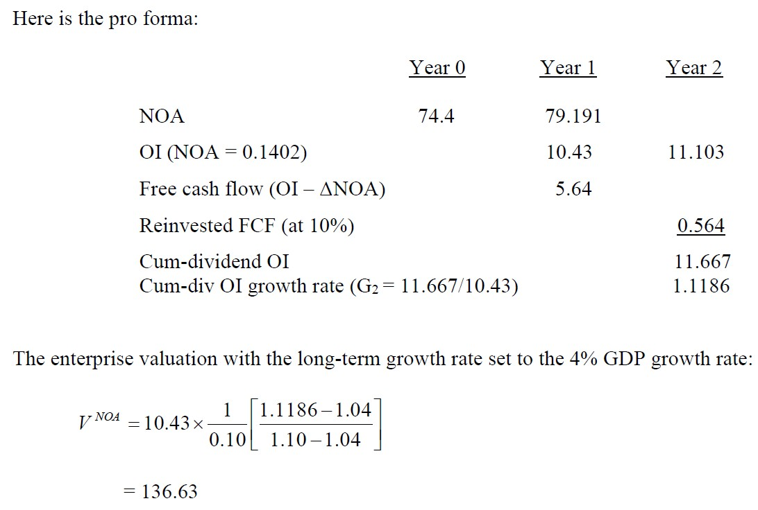
Two-Stage Growth Valuation for PPE

Slide 21
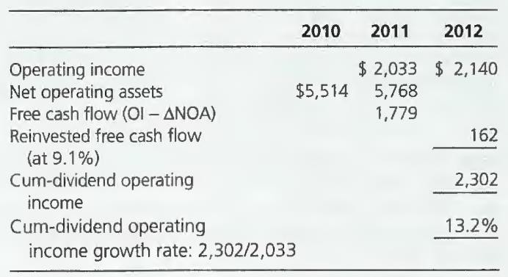
Two-Stage Growth Valuation for Nike, Inc.
In early fiscal year 2011, analysts following Nike were forecasting EPS of
$4.39 for 2011 and $4.64 for 2012, up from $3.93 in 2010. Adjusting for expected net interest income these forecasts translated into operating income forecasts of $2,033 million and $2,140 million. With an expectation of net operating assets in the 2011 balance sheet of $5,768 million, a two-year pro forma is developed as follows:

Slide 22
Two-Stage Growth Valuation for Nike, Inc.
For the valuation: G₂ = 1.132
G_{long} = 1.04 (the GDP growth rate)
ρ_{F} = 1.091
The value of the operation is:
𝑉^{𝑁𝑂𝐴} = 2,033 * 1/0.091 * [(1.132-1.04)/1.091-1.04)]
2010
_{𝑉}𝐸
= 𝑉^{𝑁𝑂𝐴} + NFA = 40,301+4,370 = $44,671
2010 2010
Value per share on 484 million shares: $92.30.
The market price was $74 at the time.
Either the market price is too low, analysts’ forecasts are too optimistic, or the LT growth rate is too high….

Slide 23
Sales Growth Can Replace NOA Growth
1
NOA = Sales ×
ATO
If ATO is constant,
Growth in NOA = Grow
Forecast growth in NOA with forecasted sales growth rate.
Recognize that RNOA = Profit Margin * ATO. If we forecast a constant ATO, we forecast a constant RNOA with forecasted constant margins.
The simple growth valuation usually work best for firms w. constant profit margins & turnovers + steady sales growth, e.g. retailers
Firms change their types of business are not good candidates for a simple
growth valuation.

Slide 24
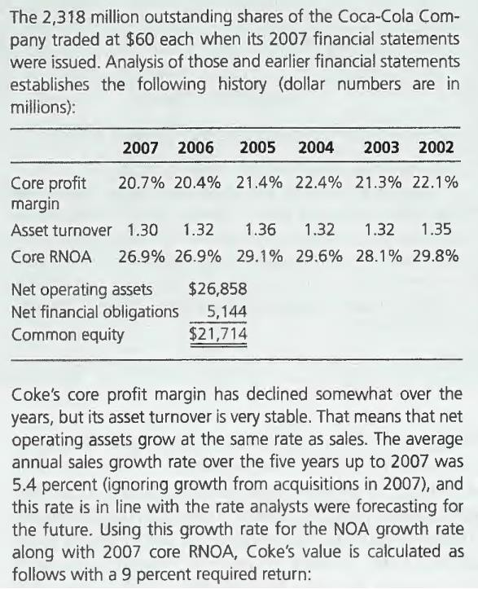
A Simple Valuation Based on Core RNOA and Sales Growth: Coca Cola

Slide 25
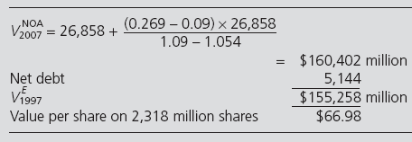
A Simple Valuation Based on Core RNOA and Sales Growth: Coca Cola
Average sales growth rate, 2002-2007 = 5.4%

Slide 26
Enhanced Stock Screening
Rather than screen on P/E or P/B, screen as follows:
Unlever: Use enterprise multiples (and get rid of leverage effects on the ratios)
Reverse engineer to the expected return or the implied growth
rate
Screen on expected returns or implied growth rates

Slide 27
Simple Forecasting as an Analytical Device: Sensitivity Analysis
The simple valuation formulas allow us to enter any values. Accordingly we can entertain what the valuation might be under diff. scenarios for future profitability and growth.
Setting different values for these features is called sensitivity analysis.
This tests how a valuation changes as inputs to a model change, how the valuation is sensitive to alternative forecasts of the future.
The simple valuation model gives the form in which to conduct sensitivity analysis.

Slide 28
Simple Forecasting as an Analytical Device: Sensitivity Analysis
“As If” Questions
Effect of changes in RNOA on forecasts and values
Effect of changes in PM and ATO
Effect of changes in sales growth and in NOA
Effect of leverage on forecasts of net income

Slide 29
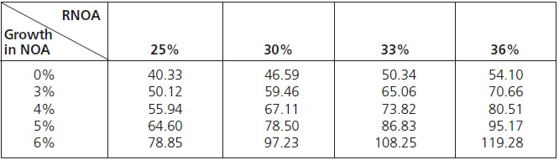
The Valuation Grid: Nike, Inc.
What values are implied by different combinations of RNOA and growth in
NOA?
A Valuation Grid for Nike, 2010:

Slide 30
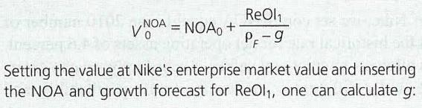
Simple Valuation:
Reverse Engineering the Forecasted Growth Rate for Nike Inc.
Nike share price Shares outstanding Market price of equity Net financial assets
Enterprise market value
= $74
= 484 million
= $35,816
= 4,370
$31,446
^{NOA}2010
Core RNOA₂₀₁₀
= $5,514
= 30.1%
ReOI = (0.301 − 0.091) × 5,514 = $1,158
2011
Enterprise price = 31,446 = 5,514 +
1,158
1.091- g
_{= 5,514 x} 0.301- (g -1)
1.091- g
g = 1.046 (a 4.6% growth rate)

