Slide 1



Slide 2
Outline
Financial Statement Analysis: Focusing the Lens on the Business
  Focus on ReOI and Its Drivers
  Focus on Change
  Focus on Key Drivers
Full-information Forecasting and Pro Forma Analysis
  A Forecasting Template
  Features of the ReOI Valuation Approach
Value Generated in Share Transactions
Financial Statement Indicators and Red Flags
Business Strategy Analysis and Pro Forma Analysis

Slide 3
The Big Picture for this Chapter
Pro forma analysis is the tool to add speculative information to
the simple valuations of Chapter 15
Pro forma analysis involves forecasting the future financial statements
The future financial statements are forecasted by the same
drivers of our financial statement analysis
  Sales growth
  Operating profit margin
  Asset turnovers
These drivers drive residual operating income

Slide 4




Financial Statement Analysis: The Lens on the Business
Economic Factors
The Filter of Financial Statement Analysis
Economic Factors Interpreted as ReOI Drivers

Slide 5
Four Points of Focus
Focus on Residual Operating Income and its Drivers
Focus on Change
Focus on Key Drivers
Focus on Choice versus Conditions

Slide 6
Focus on Residual Operating Income (ReOI)
Two drivers:
Core Oth
RNOA = Core Sales PM × AT
NOA = Sal
The drivers can be captured in one expression for ReOI:
Required return for operations
Re OI = Sales× ⎡Core Sales PM -
⎢⎣
Operational efficiency in using NOA to generate sales relative to the required return for those assets.
Sales generate positive ReOI only if they are turned into positive margins. And sales
generate positive ReOI only if these margins > ATO relative to the required return.

Slide 7
Focus on Change
Establish Typical Driver Pattern for Industry
Modify Typical Driver Pattern for Forecasted Changes for the Industry and the Economy
Discover How a Firm’s Driver Pattern will be Different from the Typical Pattern Remember
Change in RNOA
=
Change in core sales profit margin at previous asset turnover level
+
Change due to change in
asset turnover
+
Change due to change in other core income
+
Change due
to change in unusual items
ΔRNOA₁ = [ΔCore PM₁ x ATO ]+ [ΔA

Slide 8
Driver Patterns: Core RNOA
(All NYSE and AMEX firms, 1964 – 99)
The patterns trace the median drivers over five years for 10 groups formed for diff. levels of the drivers in Year 0. Firms in the upper groups have high drivers in the current year (Year 0) and firms in the lower groups have low drivers in the current year.
0.35
0.3
0.25
0.2
0.15
0.1
0.05
0
-0.05
-0.1
Core RNOA
Year Ahead
The rate of convergence towards common level is referred to as the Fade Rate
Firms with high core RNOA currently (in the upper groups) tend to have ↓ profitability in the
future; firms with low core RNOA (in the lower groups) tend to have ↑ profitability in the future.

Slide 9
Driver Patterns: Core Other Income/NOA
0.06
High core other income tends to ↓ subsequently as % of NOA; low core
other operating income tends to ↑.
0.05
Core Other Income / NOA
0.04
0.03
0.02
0.01
0
-0.01
-0.02
Year Ahead

Slide 10
Driver Patterns: Unusual Items/NOA
0.08
Unusual Items tend to disappear very quickly – as expected for a
transitory item.
0.06
0.04
0.02
0
-0.02
-0.04
-0.06
Unusual Items / NOA
Year Ahead

Slide 11
Driver Change Patterns: Sales Growth Rates
0.6
Sales growth tends to fade quickly: Firms with high sales growth currently have lower sales growth subsequently; firms with low current sales growth have higher sales growth subsequently.
0.5
0.4
0.3
0.2
Sales Growth Rate
0.1
0
-0.1
-0.2
-0.3
t
Year Ahead

Slide 12
Driver Change Patterns: Change in Core Sales PM
0.06
Changes in core sales profit margins tend to fade quickly toward
common levels close to zero.
0.04
0.02
0
-0.02
-0.04
-0.06
-0.08
Change in Core Sales PM
Year Ahead

Slide 13
Driver Change Patterns: Change in ATO
0.8
Changes in asset turnovers tend to revert toward common levels very quickly; large increase in asset turnovers are temporary, as are large decreases in asset turnovers.
0.6
0.4
0.2
0
-0.2
-0.4
-0.6
-0.8
-1
Change in ATO
Year Ahead

Slide 14
Forecasting How a Firm’s Drivers will be Different from the Typical Pattern
The tension between the forces of competition and the firm’s responses to those forces: challenge and counter challenge
Firms challenge other firms:
  Product price reduction
  Product innovation
  Lower production costs
  Imitation of successful firms
  Entering industries where firms are earning abnormal profits
Firms counter challenge:
  Brand creation
  Patent protection
  Managing consumer expectations
  Alliances and agreements with competitors, suppliers and firms with related technology
  Exploiting first-mover advantages
  Mergers
  Creating superior production and marketing technologies
  Creating economies of scale that are difficult to replicate
  Creating a technological standard that consumers and other firms must tie into
  Government protection

Slide 15
Focus on Key Drivers
Some firms have one or two drivers that are key to driving ReOI.
Analysts focus on these key drivers
Industry | Key Economic Factors | Key ReOI Drivers
Airlines | Load factors and fares | Sales and ATO
Automobiles | Model design and production efficiency | Sales and margins
Beverages | Brand management and product innovation | Sales
Cellular Phones | Population covered (POP) and churn rates | Sales and ATO
Commercial Real Estate | Square footage and occupancy rates | Sales and ATO
Computers | Technology path and competition | Sales and margins
Fashion Clothing | Brand management | Sales, advertising
Internet Commerce | Hits per hour | Sales and ATO
Non-fashion clothing | Production efficiency | Margins
Pharmaceuticals | Research and development | Sales
Retail | Retail space and sales per square foot | Sales and ATO

Slide 16
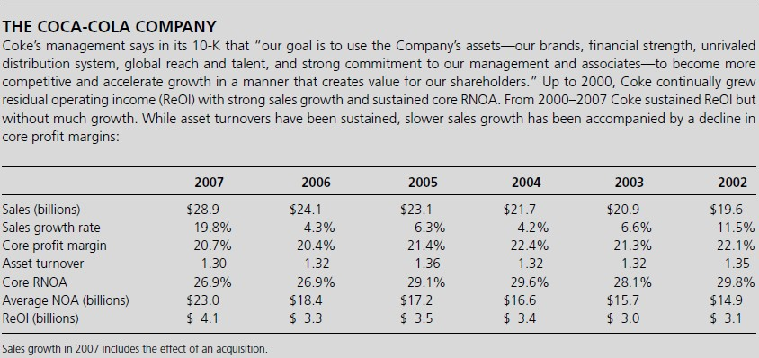
Driver History for a Brand Name Company: Coca-Cola

Slide 17
Full Information Forecasting
Forecast all economic factors and the full set of ReOI drivers
Express forecasts in a set of pro forma financial statements
An Example with PPE Inc. follows

Slide 18
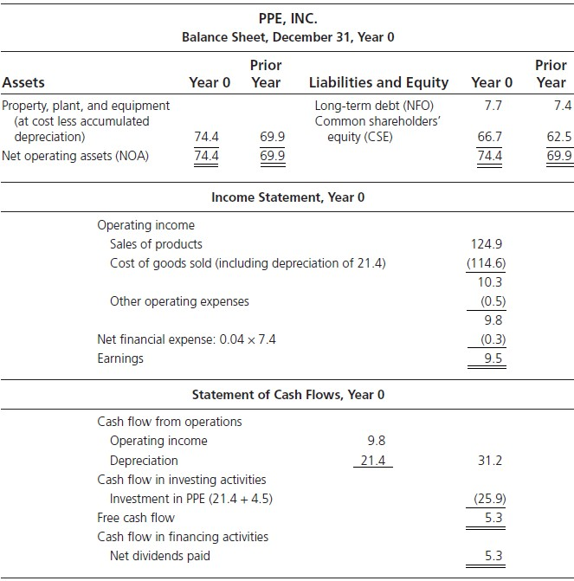
PPE, Inc.: Initializing Financial Statements
Required return for operations = 10% Required return for debt = 4%

Slide 19
Forecasting for PPE Inc.
The forecasts:
Sales are forecasted to grow at 5%
Forecasted Core PM is 7.85%
To produce sales, an investment of NOA of 56.75 cents for each $ of sales will have to be put in place at the beginning of each year => Forecasted ATO is 1.762
With these three forecasts we can value the firm

Slide 20
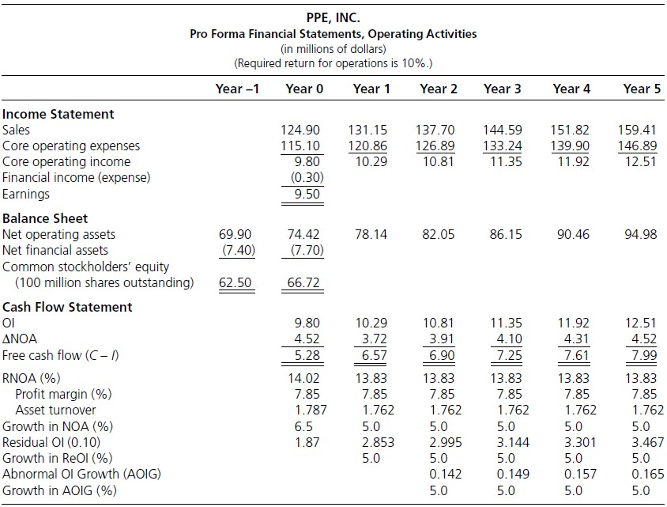
PPE Inc.:
The Pro Forma for Operating Activities
Exp. Sales Growth: 5%
OI = Sales * PM
NOA = Sales / ATO

Slide 21
PPE, Inc.:
The ReOI Valuation
2.853
V ^{NOA} = $ 74.42 +
= $131.48 million
0
1.10 −1.05
= $131.48 million
_{V}F _{=V}NOA 0 0
NFO
= $131.48 - 7.70
= $123.78 million

Slide 22
PPE Inc.
The AOIG Valuation
_{V}E
1
0.142
⎤
=
⎡10.295 +
0
0.10 ⎢⎣
1.10 −1
= $123.7

Slide 23
PPE Inc.
The FCF Valuation from the Pro Forma
_{V}E
₌ FCF₁
NFO
0
ρ − g
0
F
6.574
=
− 7.70
1.10 −1.05
= $123.78 million

Slide 24
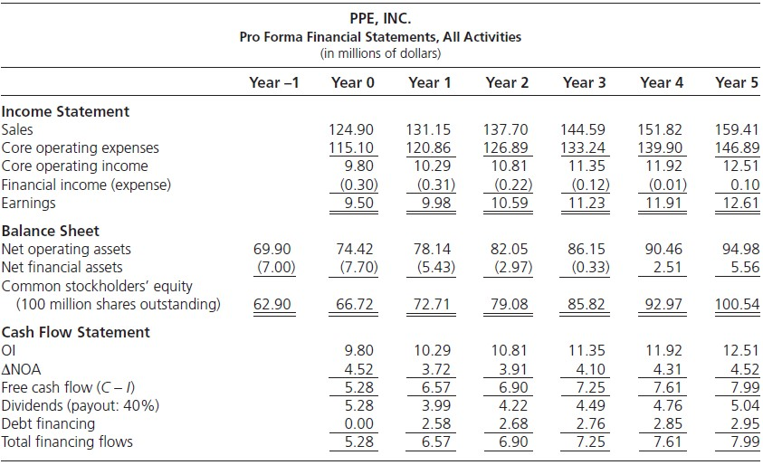
Filling out the Pro Forma Financial Statements
Dividend forecast: Payout will be 40% of Earnings Borrowing cost forecast: Same as present (4%)
NFE_{t} = (ρ −
Earnings = O
ΔNFO_{t} = NFE_{t} + d_{t} − (C − I)_{t}

Slide 25
Full-Information Forecasting: Nike
After reformulating Nike's financial statements for 2004, an analyst prepares a forecast in order to value Nike's shares. With a thorough knowledge of the business, its customers, and the outlook for athletic and fashion footwear, he first prepares a sales forecast. Then, understanding the production process and the components of cost of goods sold, he forecasts how much gross margin will be earned from sales. Adding forecasts of expense ratios-particularly the all-important driver, the advertising-to-sales ratio-he finalizes his pro forma income statements with a forecast of operating income. His forecasted balance sheet models accounts receivable, inventory, PPE, and other net operating assets based on his assessment of turnover ratios for these items. He arrives at the following forecasts:

Slide 26
Full-Information Forecasting: Nike
Income statement forecasts:
Sales for 2005 will be $13,500 million, followed by $14,600 million for
2006. For 2007-2009, sales are expected to grow at a rate of 9% per year.
The gross margin of 42.9% in 2004 is expected to increase to 44.5% in 2005 and 2006 as benefits of off-shore manufacturing are reaped, but decline to 42% in 2007 and subsequently to 41% as labor costs increase and more costly, high-end shoes are brought to market.
Advertising, standing at 11.25% of sales in 2004, will increase to 11.6% of sales to maintain the ambitious sales growth. The recruitment of visible sports stars to promote the brand will also add to advertising costs.
Other before-tax expenses are expected to be 19.6% of sales, the same level as in 2004.
The effective tax rate on operating income will be 34.6%.
No unusual items are expected or their expected value is zero.

Slide 27
Full-Information Forecasting: Nike (cont.)
With these forecasts the analyst developed the following pro forma financial statements and valuation:
Income Statement | 2004A | 2005E | 2006E | 2007E | 2008E | 2009E
Sales | 12,253 | 13,500 | 14,600 | 15,914 | 17,346 | 18,907
Cost of sales | 7,001 | 7,492 | 8,103 | 9,230 | 10,234 | 11,155
Gross margin | 5,252 | 6,008 | 6,497 | 6,684 | 7,112 | 7,752
Advertising | 1,378 | 1,566 | 1,694 | 1,846 | 2,012 | 2,193
Operating expenses | 2,400 | 2,646 | 2,862 | 3,119 | 3,400 | 3,706
Operating income before tax | 1,474 | 1,796 | 1,941 | 1,719 | 1,700 | 1,853
Tax at 34.6 % | 513 | 621 | 672 | 595 | 588 | 641
Operating income after tax | 961 | 1,175 | 1,269 | 1,124 | 1,112 | 1,212
Core profit margin
7.84%
8.69%
8.69%
7.06%
6.41%
6.41%

Slide 28
Full-Information Forecasting: Nike
Balance sheet forecasts:
To maintain sales, the carrying value of inventory will be 12.38 cents per $
of sales (an inventory turnover ratio of 8.08).
Receivables will be 16.5 cents per dollar of sales (a turnover ratio of 6.06).
PPE will fall to 12.8 cents per $ of sales in 2005 and 2006, from the 13.1 cents in 2004, because of more sales from existing plant. However, with new production facilities coming on line--at higher construction costs--to support sales growth, PPE will increase to 13.9 cents for each $ of sales (a turnover ratio of 7.19).
The holdings of all other NOA, dominated by OL, will be -6.0% of sales.
A contingent liability for the option overhang of $452 million is recognized.

Slide 29
Full-Information Forecasting: Nike (cont.)
Balance Sheet
Accounts receivable | 2,120 | 2,228 |  | 2,409 |  | 2,626 |  | 2,862 |  | 3,120
Inventory | 1,634 | 1,671 |  | 1,807 |  | 1,970 |  | 2,147 |  | 2,341
PPE | 1,587 | 1,728 |  | 1,869 |  | 2,212 |  | 2,411 |  | 2,628
Other NOA | (790) | (810) |  | (876) |  | (955) |  | (1,041) |  | (1,134)
Net operating assets | 4,551 | 4,817 |  | 5,209 |  | 5,853 |  | 6,379 |  | 6,955
Asset turnover (ATO) |  | 2.803 |  | 2.803 |  | 2.719 |  | 2.719 |  | 2.719
Operating income |  | 1,175 |  | 1,269 |  | 1,124 |  | 1,112 |  | 1,212
Change in NOA |  | 266 |  | 392 |  | 644 |  | 526 |  | 576
Free cash Flow |  | 909 |  | 877 |  | 480 |  | 586 |  | 636
RNOA (on beginning NOA) |  | 25.82% |  | 26.34% |  | 21.58% |  | 19.00% |  | 19.00%
ReOI (8.6 % required return) |  | 783.6 |  | 854.7 |  | 676.0 |  | 608.6 |  | 663.4
Present Value (PV) of ReOI Total PV to 2009 | 2,851 | 721.5 |  | 724.7 |  | 527.8 |  | 437.5 |  | 439.2
Continuing Value (CV)* | 12,809
Enterprise value | 20,711
Net financial assets | 289
 | 20,500
Option overhang | 452
Value of common equity | 20,048
19,349
Value per share on 263.1 million shares: $76.20
*CV = ^{663.4 x 1.05} = 19,349
1.086 −1.05

Slide 30
A Forecasting Template
Forecast sales
Forecast ATO and calculate NOA
NOA=sales/ATO
Revise sales forecast for asset constraints
Forecast Core PM and calculate Core OI
Core OI = Sales x Core PM
Forecast Other Core OI and total Core OI
Core OI = Core OI from sales + Other Core OI
Forecast unusual operating items
Calculate ReOI and AOIG
  OI_{t} = Core OI_{t} + UI_{t}
  ReOI_{t} = OI_{t} - (ρ_{F} - 1) NOA_{t-1}
  AOIG_{t} = ΔReOI_{t}
Calculate Free Cash Flow
C − I ≡ OI − ΔNOA

Slide 31
A Forecasting Template (cont.)
Forecast net dividend payout
Calculate financial expenses (or income)
NFE_{t} = (ρ_{D} −1)NFO_{t−1}
Update net financing position
ΔNFO_{t} = NFE
Calculate comprehensive earnings
Earnings_{t} = OI_{t} - NFE_{t}
Calculate common stockholders’ equity
CSE_{t} = NOA_{t} - NFO_{t} = CSE_{t-1} + Earnings_{t} - d_{t}
Adjust the valuation for stock option overhang (Chapter 13)
Adjust for any value for noncontrolling interests
Steps 1-6 and step 9 and 10 require forecasting
All other forecasts are calculations from forecasted amounts using accounting relations
Only steps 1-7 are necessary for valuation (without stock options)

Slide 32
Checking Pro Forma Analysis
Make sure CSE reconciliations in Step 13 agree
Check common size analysis against industry norms. Are
differences reasonable?
Watch for financial asset build up. What will the firm do with the build-up?

Slide 33
Features of the ReOI Valuation Approach
It is efficient: forecast five factors
  Sales
  Core PM
  ATO
  Other Core OI
  Unusual Items
Focuses on the part of the business that adds value: the operations
Dividends are irrelevant
Financing is irrelevant
Zero NPV (zero ReOI) investments don’t affect the valuation
Value-generating investments are identified
Avoids problems of the discount rate changing as leverage changes

Slide 34
Financial Statement Indicators
Current RNOA different from the past
Components of RNOA different from the past
  Analyze the determinants of the current ΔRNOA:
ΔRNOA = (ΔCore PM × ATO + Δ
  Δ in Core PM is particularly important
RNOA different from industry mean
  RNOAs tend to revert towards industry averages

Slide 35
Financial Statement Indicators (cont.)
Components of RNOA different from industry mean PM components:
  Cost of sales/Sales
  Advertising/Sales
  G & A expenses/Sales
  R & D /Sales
ATO components
  Inventories/Sales
  Accounts receivables/Sales
  Doubtful debts/Sales
  PPE/Sales
  …
Changes in RNOA components different from industry mean
Changes in capital expenditures different from industry mean Combine investigation with Quality of Earnings Analysis (Chapter 17).

Slide 36
Indicators Outside Financial Statements
Firm specific indicators
  Non-working assets
  Order backlog
  Per-unit sales prices
  R&D success
  Firms’ investment plans
  Change in labor force
  Management discussion and analysis
  Insider trading
  Contingent liabilities (see footnotes)

Slide 37
Red Flag Indicators
Slower sales growth
Declines in order backlog
Increasing Accounts Receivable/Sales
Increasing Inventory/Sales
Deterioration in Gross margin/Sales
Increasing Selling and Administrative Expenses/ Sales
Low effective tax rates
Large non-recurring items
Increases in dilutive securities: executive stock options
Build up of financial assets

Slide 38
Business Strategy and Pro Forma Analysis
The same apparatus serves strategy analysis
Five steps of fundamental analysis are the five steps of strategy analysis
The focus:
  Sales growth
  Operating profit margins
  Asset turnovers
Pro forma financial statement analysis articulates strategy
Beware of unarticulated strategy fads

Slide 39
Scenario Analysis
Re-run the pro forma for different scenarios and estimate value under different scenarios. For example,
--- Alternative sales growth forecasts
--- Alternative profit margin and profit margin fade patterns
--- Alternative asset turnovers
Re-run with different required returns

Slide 40
Risk Analysis
Use scenario analysis to model your uncertainty
Chapter 19 take pro forma analysis to the
analysis of risk

