Slide 2
Outline
Value Creation and the Creation of Residual Earnings
Accounting Methods, P/B ratios, P/E ratios, and the Valuation of Going Concerns
Hidden Reserves and the Creation of Earnings
Valuation Fallacies

Slide 3
The Big Picture for this Chapter
Accounting methods affect accounting numbers and the measures like RNOA and growth
But----
Accounting methods do not affect value
Residual income valuation builds in protection from accounting methods.
Accounting methods do not affect residual income valuation

Slide 4
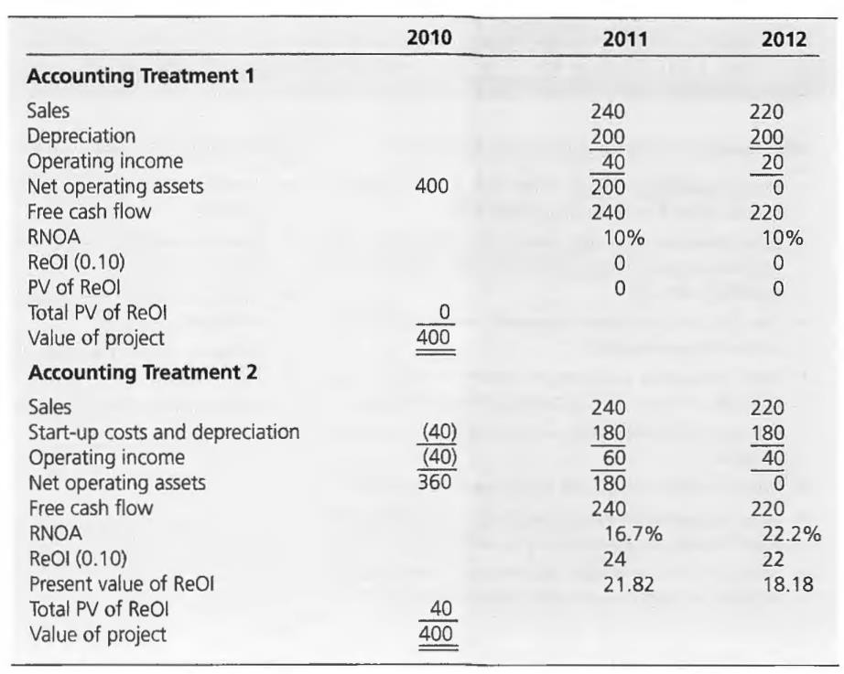
Two Accounting Treatments for a Project
Investment in project
Required return
Project life
$400
10%
2 years

Slide 5
Neutral Accounting, Conservative Accounting, and Liberal Accounting
Neutral (Unbiased or Normal) Accounting: yields expected RNOA equal to the cost of capital when operations add no value
Conservative Accounting: yields expected RNOA greater than the cost
of capital when operations add no value (writing down net assets)
Liberal Accounting: yields expected RNOA less than the cost of capital when operations add no value (writing up net assets)
The funny thing about conservative accounting: it makes firms look more profitable than they are

Slide 6
Projects: Accounting Effects and Valuation Effects
Accounting Effects:
  Residual earnings and RNOA can be created by the accounting
Valuation Effects:
  Residual earnings created by the accounting does not affect the valuation
Distinguish:
  Economic value added
  Accounting value added
Economic value added is measured with residual earnings techniques
irrespective of the accounting: the value conservation principle
Valuations using residual income techniques are not affected by the accounting for current book value.

Slide 7
Going Concerns with Constant Investment: Neutral Accounting
A firm investing $400 each year with no value added: neutral accounting
 | 2010 | 2011 | 2012 | 2013 | 2014
Sales From investments in - 2010 |  | 240 | 220
- 2011 |  |  | 240 | 220
- 2012 |  |  |  | 240 | 220
- 2013 |  |  |  |  | 240
Operating expenses (depreciation) |  | 240 | 460 | 460 | 460
For investments in - 2010 |  | 200 | 200
- 2011 |  |  | 200 | 200
- 2012 |  |  |  | 200 | 200
- 2013 |  |  |  |  | 200
 |  | 200 | 400 | 400 | 400
Operating income |  | 40 | 60 | 60 | 60
Net operating assets For investments in - 2010 | 400 | 200
- 2011 |  | 400 | 200
- 2012 |  |  | 400 | 200
- 2013 |  |  |  | 400 | 200
- 2014 |  |  |  |  | 400
 | 400 | 600 | 600 | 600 | 600

Slide 8
Going Concerns with Constant Investment: Neutral Accounting
A firm investing $400 each year with no value added: neutral accounting
 | 2010 | 2011 | 2012 | 2013 | 2014
Investment | 400 | 400 | 400 | 400 | 400
Free cash flow | (400) | (160) | 60 | 60 | 60
RNOA |  | 10.0% | 10.0% | 10.0% | 10.0%
Profit margin |  | 16.7% | 13.0% | 13.0% | 13.0%
Asset turnover |  | 0.60 | 0.77 | 0.77 | 0.77
Growth in NOA |  | 50% | 0 | 0 | 0
ReOI (.10) |  | 0 | 0 | 0 | 0
AOIG |  |  | 0 | 0 | 0
Value | 400 | 600 | 600 | 600 | 600
Premium | 0 | 0 | 0 | 0 | 0
P/B | 1.0 | 1.0 | 1.0 | 1.0 | 1.0
Trailing P/E |  | 11.0 | 11.0 | 11.0 | 11.0
Forward P/E | 10.0 | 10.0 | 10.0 | 10.0 | 10.0

Slide 9
Valuation: Constant Investment with Neutral Accounting
ReOI Value = 400
(book value)
AOIG Value = 40/0.1
(capitalized forward earnings)
= 400

Slide 10
Going Concerns with Constant Investment: Conservative Accounting
A firm investing $400 each year with no value added: 10% of investment expensed immediately.
 | 2010 | 2011 | 2012 | 2013 | 2014
Sales From investments in - 2010 |  | 240 | 220
- 2011 |  |  | 240 | 220
- 2012 |  |  |  | 240 | 220
- 2013 |  |  |  |  | 240
Operating expenses |  | 240 | 460 | 460 | 460
For investments in - 2010 | 40 | 180 | 180
- 2011 |  | 40 | 180 | 180
- 2012 |  |  | 40 | 180 | 180
- 2013 |  |  |  | 40 | 180
- 2014 |  |  |  |  | 40
 | 40 | 220 | 400 | 400 | 400
Operating income | (40) | 20 | 60 | 60 | 60
Net operating assets For investments in - 2010 | 360 | 180
- 2011 |  | 360 | 180
- 2012 |  |  | 360 | 180
- 2013 |  |  |  | 360 | 180
- 2014 |  |  |  |  | 360
 | 360 | 540 | 540 | 540 | 540

Slide 11
Going Concerns with Constant Investment: Conservative Accounting
A firm investing $400 each year with no value added: 10% of investment expensed immediately.
 | 2010 | 2011 | 2012 | 2013 | 2014
Investment | 400 | 400 | 400 | 400 | 400
Free cash flow | (400) | (160) | 60 | 60 | 60
RNOA |  | 5.6% | 11.1% | 11.1% | 11.1%
Profit margin |  | 8.3% | 13.0% | 13.0% | 13.0%
Asset turnover |  | .67 | .85 | .85 | .85
Growth in NOA |  | 50% | 0% | 0% | 0%
ReOI (.10) |  | (16) | 6 | 6 | 6
AOIG |  |  | 22 | 0 | 0
Value | 400 | 600 | 600 | 600 | 600
Premium |  | 60 | 60 | 60 | 60
P/B | 1.11 | 1.11 | 1.11 | 1.11 | 1.11
Trailing P/E |  | 22.0 | 11.0 | 11.0 | 11.0
Forward P/E | 20.0 | 10.0 | 10.0 | 10.0 | 10.0
P/B ratios are higher - and permanently so - because of the lower BV.
Trailing and forward P/E ratios are affected temporarily (as earnings are transitory) but they are unaffected once the permanent level of investment is reached: Earnings are unaffected by the accounting (as, of course, is value).
The AOIG is expected to be zero, so the P/E ratio remains a normal P/E ratio.

Slide 12
Valuation: Constant Investment with Conservative Accounting
ReOI Value
16
₊ ⎛
6
= 360 -
⎞ /1.10
1.10 ⎜ 0.10 ⎟
⎝ ⎠
= 400
AOIG Value
1
22 ⎤
1.10 ⎥⎦
=
⎡20 +
0.10 ⎢⎣
= 400

Slide 13
Effects of Conservative Accounting: Going Concerns with Constant Investment
Accounting Effects
Operating income is not affected by the accounting once a constant level of investment is reached
NOA are permanently lower with conservative accounting
Conservative accounting increases RNOA and residual income
RNOA and residual operating income are constant for both types of accounting once a constant level of investment is reached; AOIG is thus zero in both cases
Valuation Effects
Value is not affected by the
accounting
Conservative accounting induces non-normal P/B ratios
P/E ratios are not affected by the accounting once the permanent level of investment is reached
[Liberal accounting has
opposite effects]

Slide 14
Going Concerns with Growing Investment: Neutral Accounting
A firm with investment growing at 5% per year with no value added: neutral accounting
2010 2011 2012 2013
2014
Sales
From investments in - 2010
- 2011
- 2012
- 2013
240.0
220.0
252.0
231.0
264.6
495.6
242.6
277.8
520.4
240.0
472.0
Operating expenses (depreciation) For investments in
- 2010 |  | 200.0 | 200.0
- 2011 |  |  | 210.0 | 210.0
- 2012 |  |  |  | 220.5 | 220.5
- 2013 |  |  |  |  | 231.5
- 2014
 |  | 200.0 | 410.0 | 430.5 | 452.0
 |  | 40.0 | 62.0 | 65.1 | 68.4
- 2010 | 400.0 | 200.0
- 2011 |  | 420.0 | 210.0
- 2012 |  |  | 441.0 | 220.5
- 2013 |  |  |  | 463.1 | 231.5
- 2014 |  |  |  |  | 486.2
 | 400.0 | 620.0 | 651.0 | 683.6 | 717.7
Operating income
Net operating assets For investments in

Slide 15
Going Concerns with Growing Investment: Neutral Accounting
A firm with investment growing at 5% per year with no value added: neutral accounting
 | 2010 | 2011 | 2012 | 2013 | 2014
Investment | 400 | 420 | 441 | 463.1 | 486.2
Free cash flow | (400) | (180) | 31 | 32.5 | 34.4
RNOA |  | 10.0% | 10.0% | 10.0% | 10.0%
Profit margin |  | 16.7% | 13.1% | 13.1% | 13.1%
Asset turnover |  | .60 | .76 | .76 | .76
Growth in NOA |  | 55% | 5% | 5% | 5%
ReOI (.10) |  | 0 | 0 | 0 | 0
Growth in ReOI |  | − | 0% | 0% | 0%
Growth in cum-dividend OI |  | − | 10% | 10% | 10%
AOIG |  |  | 0 | 0 | 0
Value | 400 | 620.0 | 651.0 | 683.6 | 717.7
Premium | 0 | 0 | 0 | 0 | 0
P/B | 1.0 | 1.0 | 1.0 | 1.0 | 1.0
Trailing P/E |  | 11.0 | 11.0 | 11.0 | 11.0
Forward P/E | 10.0 | 10.0 | 10.0 | 10.0 | 10.0

Slide 16
Valuation: Growing Investment with Neutral Accounting
ReOI Value = 400
(book value)
AOIG Value = 40/0.1
(capitalized forward earnings)
= 400
Even though earnings are growing, RE and AOIG are zero: No value added

Slide 17
Going Concerns with Growing Investment: Conservative Accounting
A firm with investment growing at 5% per year with no value added: 10% of investment expensed immediately.
 | 2010 | 2011 |  | 2012 | 2013 | 2014
Sales
From investments in - 2010 |  | 240.0 |  | 220.0
- 2011 |  |  |  | 252.0 | 231.0
- 2012 |  |  |  |  | 264.6 | 242.6
- 2013 |  |  |  |  |  | 277.8
 |  | 240.0 |  | 472.0 | 495.6 | 520.4
Operating expenses
For investments in - 2010 | 40.0 | 180.0 |  | 180.0
- 2011 |  | 42.0 |  | 189.0 | 189.0
- 2012 |  |  |  | 44.1 | 198.5 | 198.5
- 2013 |  |  |  |  | 46.3 | 208.4
- 2014 |  |  |  |  |  | 48.6
 | 40.0 | 222.0 |  | 413.1 | 433.8 | 455.5
Operating income | (40.0) | 18.0 |  | 58.9 | 61.8 | 64.9
Net operating assets
Lower forecasted OI because of 5%
For investments in | - 2010 | 360.0 | 180.0 | ↑ in | write-off
 | - 2011 |  | 378.0 | 189.0
 | - 2012 |  |  | 396.9 | 198.5
 | - 2013 |  |  |  | 416.8 | 208.4
 | - 2014 |  |  |  |  | 437.6
 |  | 360.0 | 558.0 | 585.9 | 615.2 | 646.0

Slide 18
Going Concerns with Growing Investment: Conservative Accounting
A firm with investment growing at 5% per year with no value added: 10% of investment expensed immediately.
 | 2010 | 2011 | 2012 | 2013 | 2014
Investment | 400 | 420 | 441 | 463.1 | 486.2
Free cash flow | (400) | (180) | 31 | 32.5 | 34.2
RNOA |  | 5.0% | 10.6% | 10.6% | 10.6%
Profit margin |  | 7.5% | 12.5% | 12.5% | 12.5%
Asset turnover |  | .67 | .85 | .85 | .85
Growth in NOA |  | 55% | 5% | 5% | 5%
ReOI (.10) |  | (18.0) | 3.10 | 3.25 | 3.42
Growth in ReOI |  | − | − | 5% | 5%
Growth in cum-dividend OI |  | − | 127% | 10.3% | 10.3%
AOIG |  |  | 21.10 | 0.155 | 0.163
AOIG growth rate |  |  | - | - | 5%
Value | 400.0 | 620.0 | 651.0 | 683.6 | 717.7
Premium |  | 62.0 | 65.1 | 68.4 | 71.8
P/B | 1.11 | 1.11 | 1.11 | 1.11 | 1.11
Trailing P/E |  | 24.4 | 11.6 | 11.6 | 11.6
Forward P/E | 22.2 | 10.5 | 10.5 | 10.5 | 10.5
>10% cost of capital
5% growth, not constant
The conservative accounting has produced growth in OI, growth in ReOI, and abnormal income growth: An RNOA above the required return + growing NOA yields growing ReOI, and growing ReOI implies abnormal income growth.

Slide 19
Valuation: Growing Investment with Conservative Accounting
₊ ⎛
3.1
ReOI Value
= 360 − ¹⁸
⎜ ⎟
1.10 1.10 −1.05
⎞ /1.10
⎝
⎠
= 400
1 21.10 0.155
⎡
AOIG Value =
+
0.10 ^{⎢18 +} 1.10
⎣
= 400
Even though earnings are growing and RE and AOIG have been created (by the accounting), there is no value added.

Slide 20
Effects of Conservative Accounting: Going Concerns with Growing Investment
Accounting Effects
Conservative accounting reports
lower operating income
Conservative accounting produces above-normal RNOA and residual operating income
Conservative accounting produces lower RNOA and residual operating income than the no-growth case
Conservative accounting creates growth in operating income and residual operating income, and also creates abnormal OI growth
Valuation Effects
Value is not affected by the
accounting
P/B ratios with conservative accounting are the same as the no-growth case
P/E ratios with conservative accounting are higher than the no-growth case: P/E reflects anticipated growth
[Liberal accounting has opposite effects]

Slide 21
Hidden Reserves and the Creation of Earnings
When investments are growing, conservative accounting depresses earnings and profit margins but raises RE and abnormal income growth.
But if the rate of investment subsequently slows, conservative accounting generates higher earnings and profit margins and even higher RE and abnormal income growth.

Slide 22
Hidden Reserves and the Creation of Earnings
A firm with investment initially growing at 5% and then leveling off, with no value added: 10% of investment expensed immediately.
Sales |  | 2010 | 2011 | 2012 | 2013 | 2014 | 2015 | 2016 | 2017
From investments in - 2010 |  |  | 240.0 | 220.0
- 2011 |  |  |  | 252.0 | 231.0
- 2012 |  |  |  |  | 264.6 | 242.6
- 2013 |  |  |  |  |  | 277.8 | 254.7
- 2014 |  |  |  |  |  |  | 291.7 | 267.4
- 2015 |  |  |  |  |  |  |  | 291.7 | 267.4
- 2016 |  |  |  |  |  |  |  |  | 291.7
 |  |  | 240.0 | 472.0 | 495.6 | 520.4 | 546.4 | 559.1 | 559.1
Operating expenses For investments in | - 2010 | 40.0 | 180.0 | 180.0
 | - 2011 |  | 42.0 | 189.0 | 189.0
 | - 2012 |  |  | 44.1 | 198.5 | 198.5
 | - 2013 |  |  |  | 46.3 | 208.4 | 208.4
 | - 2014 |  |  |  |  | 48.6 | 218.8 | 218.8
 | - 2015 |  |  |  |  |  | 48.6 | 218.8 | 218.8
 | - 2016 |  |  |  |  |  |  | 48.6 | 218.8
 | - 2017 |  |  |  |  |  |  |  | 48.6
 |  | 40.0 | 222.0 | 413.1 | 433.8 | 455.5 | 475.8 | 486.2 | 486.2
Operating income |  | (40.0) | 18.0 | 58.9 | 61.8 | 64.9 | 70.6 | 72.9 | 72.9

Slide 23
Hidden Reserves and the Creation of Earnings (Cont.)
Net operating assets | 2010 | 2011 | 2012 | 2013 | 2014 | 2015 | 2016 | 2017
For investments in - 2010 | 360.0 | 180.0
- 2011 |  | 378.0 | 189.0
- 2012 |  |  | 396.9 | 198.5
- 2013 |  |  |  | 416.8 | 208.4
- 2014 |  |  |  |  | 437.6 | 218.8
- 2015 |  |  |  |  |  | 437.6 | 218.8
- 2016 |  |  |  |  |  |  | 437.6 | 218.8
- 2017 |  |  |  |  |  |  |  | 437.6
 | 360.0 | 558.0 | 585.9 | 615.2 | 646.0 | 656.4 | 656.4 | 656.4
Investment | 400 | 420 | 441 | 463.1 | 486.2 | 486.2 | 486.2 | 486.2
Free cash flow | (400) | (180) | 31 | 32.5 | 34.2 | 60.2 | 72.9 | 72.9
RNOA |  | 5.0% | 10.6% | 10.6% | 10.6% | 10.9% | 11.1% | 11.1%
Profit margin |  | 7.5% | 12.5% | 12.5% | 12.5% | 12.9% | 13.0% | 13.0%
Asset turnover |  | .67 | .85 | .85 | .85 | .85 | .85 | .85
Growth in NOA |  | 55% | 5% | 5% | 5% | 1.6% | 0.0% | 0.0%
ReOI (.10) |  | (18.0) | 3.10 | 3.26 | 3.42 | 6.02 | 7.29 | 7.29
Growth in ReOI |  | ----- | ----- | 5% | 5% | 76% | 21% | 0%
Growth in cum-dividend OI |  | ----- | 127% | 10.3% | 10.3% | 14.0% | 11.8% | 10.0%
AOIG |  |  | 21.10 | 0.155 | 0.163 | 2.602 | 1.270 | 0.0
Value | 400.0 | 620.0 | 651.0 | 683.6 | 717.7 | 729.3 | 729.3 | 729.3
Premium |  | 62.0 | 65.1 | 68.4 | 71.7 | 72.9 | 72.9 | 72.9
P/B | 1.11 | 1.11 | 1.11 | 1.11 | 1.11 | 1.11 | 1.11 | 1.11
Trailing P/E |  | 24.4 | 11.6 | 11.6 | 11.6 | 11.2 | 11.0 | 11.0
Forward P/E | 22.2 | 10.5 | 10.5 | 10.5 | 10.2 | 10.0 | 10.0 | 10.0

Slide 24
Hidden Reserves and the Creation of Earnings
Hidden reserves are profits that might have been booked with less
conservative accounting.
Conservative accounting, with growth, reduces earnings because of higher expenses - builds up hidden profit reserves that can be realized with a slowing of investment.
They are "hidden" because they are book value missing from the balance sheet due to conservative accounting: Reporting lower earnings means that net assets (and equity) must be lower by exactly the same amount.
If the growth of investment slows or levels off, or if investment declines, more profits can be generated; this is referred to as liquidating hidden reserves.

Slide 25
Valuation with Hidden Reserves
ReOI value
18
3.1
3.26
3.42 6.02
= 360 -
+
+
+
+
+ ^{7.29} / 1.611
1.10 1.21 1.331 1.464 1.611 0.10
= 400

Slide 26
Valuation Fallacies
These statements are not necessarily true:
Firms with higher anticipated earnings growth are worth more.
Rejoinder: Earnings growth can be created by accounting methods.
Firms with high anticipated return on equity are worth more.
Rejoinder: High return on equity means a higher premium but not a higher value; ROCE can be created by the accounting.
Increasing residual earnings indicates a firm that is adding more and
more value.
Rejoinder: Probably, but growth in residual earnings can be induced with conservative accounting.

Slide 27
Valuation Fallacies (Cont.)
These statements are not necessarily true:
If a firm is earning an RNOA that is higher than the cost of capital, it will add value by investing more.
Rejoinder: A firm can create a high RNOA through accounting methods
but may not be able to add value through investment.
If RNOA is higher than the cost of capital, a reduction in investment (or slowing of its growth rate) reduces residual earnings.
Rejoinder: A reduction of investment can create residual earnings if
conservative accounting has created hidden reserves.
Low profit margins mean a firm cannot generate much value from sales.
Rejoinder: Low profit margins may be induced by conservative
accounting if net assets are growing.

Slide 28
Valuation Fallacies (Cont.)
These statements are not necessarily true:
High asset turnovers mean a firm is efficient in generating sales.
Rejoinder: High turnovers can be produced by keeping asset values low with conservative accounting.
Hidden reserves always mean higher profits later.
Rejoinder: Hidden reserves created by conservative accounting will not be realized if a firm continues to grow its net operating assets.
Conservative accounting reduces profits and results in higher P/E ratios.
Rejoinder: Not always; only if investments are growing.

Slide 29




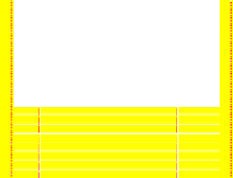

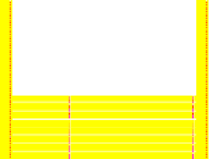

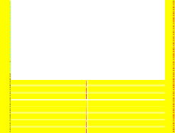

































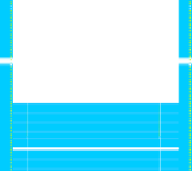



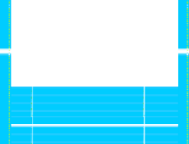





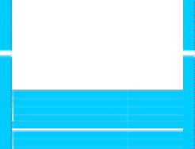










Summary of Accounting Effects
Accounting Effects for a Firm with Zero Value Added
Accounting Method | Investment Pattern | Operating Income | Residual Income Level | Residual Income Pattern | P/B | P/E
Neutral Conservative Liberal | Constant Constant Constant | Normal Normal Normal | Zero Positive Negative | Constant Constant Constant | Normal Above Normal Below Normal | Normal Normal Normal
Neutral Conservative Liberal | Growing Growing Growing | Normal Below Normal Above Normal | Zero Positive Negative | Constant Growing Declining | Normal Above Normal Below Normal | Normal Above Normal Below Normal
Neutral Conservative Liberal | Declining Declining Declining | Normal Above Normal Below Normal | Zero Positive Negative | Constant Declining Growing | Normal Above Normal Below Normal | Normal Below Normal Above Normal
Constant residual income implies zero AOIG Growing residual income implies positive AOIG Declining residual income implies negative AOIG

Slide 30
Typical Conservative Accounting Practices
Practices that decrease book values:
Accelerated depreciation of tangible assets
Accelerated amortization of intangible assets such as patents, copyrights and purchased goodwill
LIFO inventory methods
Underestimates of
  net accounts receivable (high bad debt estimates)
  impairment values
Overestimates of
  pension and postemployment benefits liabilities
  warranty liabilities
  provisions for restructuring and other future events
  deferred revenue
Conservative (high) estimates of
  pension and post-employment benefit liabilities
  warranty expenses
  provisions for restructurings and other future events

Slide 31
Typical Conservative Accounting Practices
Practices that record no book value at all:
Expensing R&D expenditures
Expensing advertising expenditures ("brand assets")
Expensing investment in intellectual and human capital

Slide 32
Typical Liberal Accounting Practices
Practices that increase book values:
Revaluing tangible assets upwards (UK)
Booking brand-name assets (UK)
Charging no depreciation (some firms in UK)
Overstating deferred tax assets through valuation allowances (US)
Practices that record no book value at all:
Omitting contingent liabilities (for environmental damage, lawsuits and stock compensation, for example)

