Slide 1










Slide 2

Outline
The Required Return and the Expected Return
The Nature of Risk
Fundamental Risk
Price Risk
Inferring Expected Returns for Active Investing
Risky Growth and Valuation

Slide 3

The Big Picture for this Chapter
The active investor recognizes that we do not know the cost of capital (the required return)
She thus seeks ways to finesse the problem
Reverse engineering produces methods
to finesse the problem

Slide 4

Understand a Key Difference
The required return is the return that an investor demands to compensate for the risk she bears in making an investment
  More risk means a higher required return
The expected return is the return one expects from buying a share
at the current market price (𝑃₀)
  Expected return = required return only if the market price is
efficient (𝑃₀= 𝑉^{𝐸})
0
If 𝑃₀ < 𝑉^{𝐸}, expected return > required return
0
If 𝑃₀ > 𝑉^{𝐸}, expected return < required return
0

Slide 5
The Nature of Risk
Value is determined by expected payoffs discounted for risk.
Risk is determined by the likelihood of getting payoffs that are different from the expected payoff.
Risk is characterized by the set of possible outcomes that an investor faces and the probabilities of these outcomes: a payoff (or return) distribution.

Slide 6
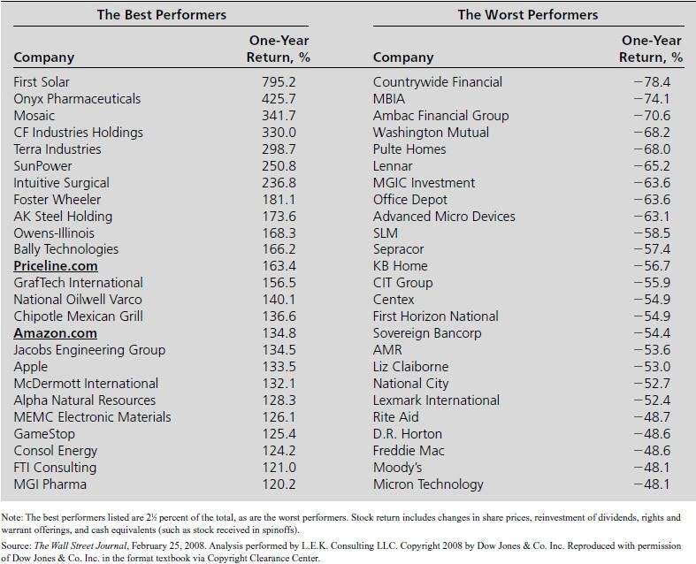
The Nature of Risk
Best and Worst 2007 Stock Return Performance for the 1,000 Firms in WSJ’s Shareholder Scorecard
This variation in possible outcomes is the risk of investing.
The investor’s perception of this variation determines the return she requires for an investment.
If no variation in returns is expected, the investment is said to be risk free.
For a risky investment: Required return = Risk-free return + Risk premium

Slide 7

The Distribution of Returns
Probability Distributions
  When an investment is risky, there are different returns it may earn.
  Each possible return has some likelihood of occurring.
  This information is summarized with a probability distribution, which
assigns a probability, P_{R} , that each possible return, R , will occur.

Slide 8


The Distribution of Returns
Given the probability distribution of returns, we can compute the expected return as a weighted average of the possible returns, where the weights correspond to the probabilities.
The investor is seen as having an expected return but also is aware of the probabilities of getting outcomes different from the expected return.
The risk premium she requires depends on her perception of the form of the distribution around the mean.

Slide 9
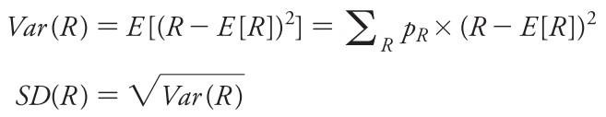
The Distribution of Returns
Two common measures of the risk of a probability distribution are its variance and standard deviation.
In finance, we refer to the standard deviation of a return as its volatility. While the variance and the standard deviation both measure the variability of the returns, the standard deviation is easier to interpret because it is in the same units as the returns themselves.

Slide 10
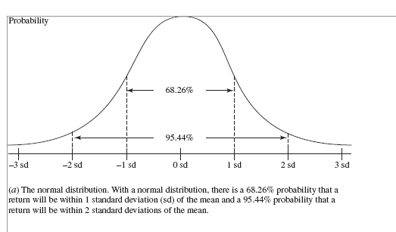

Models of the Distribution of Returns: The Normal Distribution

Slide 11
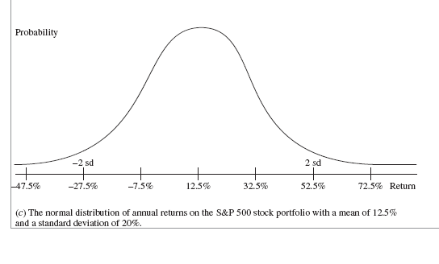

The Normal Distribution for the S&P 500 Portfolio

Slide 12
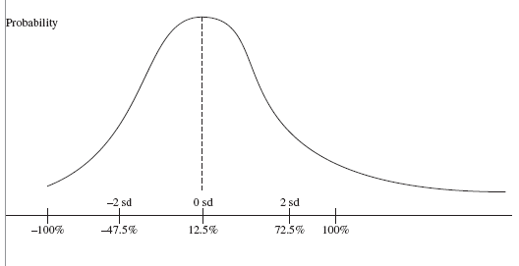

The Actual Distribution of Annual Stock Returns

Slide 13
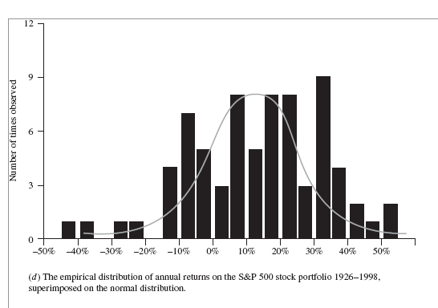

The Actual Distribution of S&P 500 Portfolio Annual Returns, 1926-98
Source: Based on data from the Center for Research in Security Prices, University of Chicago

Slide 14
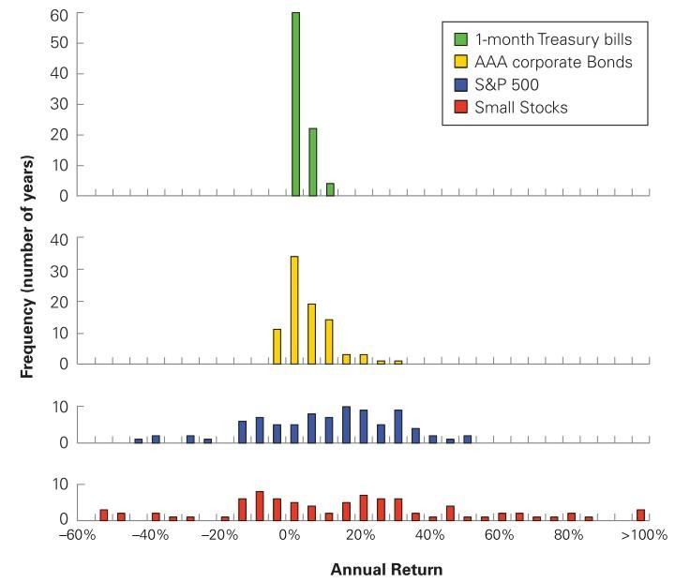

The Empirical Distribution of Annual Returns for S&P 500, Small Stocks, Corporate Bonds, and Treasury Bills, 1926–2011.
Source: Berk and DeMarzo (2013), Corporate Finance.

Slide 15

Diversification and Risk
Firm-specific vs. Systematic risk
  Fluctuations of a stock’s return that are due to firm-specific news are firm-specific, idiosyncratic, unique, or diversifiable risks. These risks are unrelated across stocks.
  Fluctuations of a stock’s return that are due to market-wide news
represent systematic, undiversifiable, or market risk.
When we combine many stocks in a large portfolio, the firm-specific risks
for each stock will average out and be diversified.
The systematic risk, however, will affect all firms—and therefore the entire portfolio—and will not be diversified.

Slide 16

Diversification and Risk
Firm-specific vs. Systematic risk
  Consider two types of firms:
    Type S firms are affected only by systematic risk. There is a 50% chance the economy will be strong and type S stocks will earn a return of 40%; There is a 50% change the economy will be weak and their return will be –20%.
    Type I firms are affected only by firm-specific risks. Their returns are equally likely to be 35% or –25%, based on factors specific to each firm’s local market.
  Actual firms are affected by both market-wide risks and firm-specific risks.

Slide 17
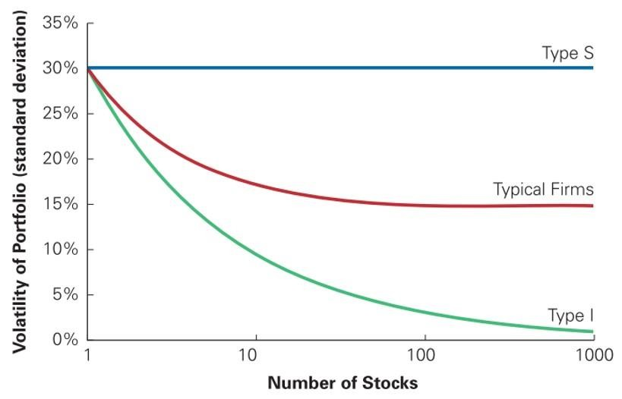
Diversification and Risk
Source: Berk and DeMarzo (2013), Corporate Finance.

Slide 18
Diversification and Risk
The risk premium of a security is determined by its systematic risk and does not depend on its diversifiable risk.
To determine the risk premium investors will require to undertake an investment, we first need to measure the investment’s systematic risk.
Sensitivity to systematic risk: Beta
– The beta (β) of a security is the expected % change in its return given a
1% change in the return of the market portfolio.

Slide 19


Beta and the Cost of Capital
Estimating the risk premium
– The market risk premium: is the reward investors expect to earn for
holding a portfolio with a beta of 1—the market portfolio itself
– Adjusting for beta
Estimating the cost of capital of an investment from its beta:

Slide 20

The Problems with “Asset Pricing” Models
Risk factors are hard to identify
Risk premiums on risk factors are very hard to measure
Models often assume normal distributions of returns

Slide 21

The CAPM is “Seductively Precise”
Normally distributed stock returns are assumed
The market risk premium is a big guess
Is it 3½%, 4½%, 8%, or 9½%?
Betas are estimated with error
Estimates of the cost of capital are made from market prices and assume that the market is efficient
V
E 0
V
D 0
ρ =
_{V} F
ρ +
_{V} F
ρ
F
E
D
0
0

Slide 22
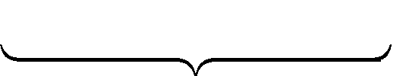
Fundamental Risk
Fundamental risk is the risk that an investor bears as a result of the way a firm conducts its activities.
A basic distinction: operating and financing risk
Required Return for Equity = Required Return for Operations
+[Market Leverage × Required Return Spread]
_{V}D
0 _{(ρ}
- ρ )
ρ_{E} = ρ +
_{V}E
F
F
D
Operating Risk
0
Financing Risk

Slide 23

A Framework for Analysis of Fundamental Risk
To understand the determinants of operating and financing risk, appreciate first what is at risk….
VE =CSE + ^{RE1} + ^{RE 2} + ^{RE3} +---
0 0
ρ_{E}
_{ρ}2 _{ρ}3
E E
Shareholder value is at risk because expected RE are at risk.
Instead of earnings adding to current book values, the book values might be used up with losses in operations.
Accordingly, expected RE are “discounted” for this possibility with a required return, 𝜌_{𝐸}, that incorporates the risk.
The calculated value reflects risk & expected return.
RE_{t} = ⎡⎣ROCE_{t} - (ρ_{E} -1)⎤⎦ CSE_{t-1}
Profitability Growth Risk Risk

Slide 24
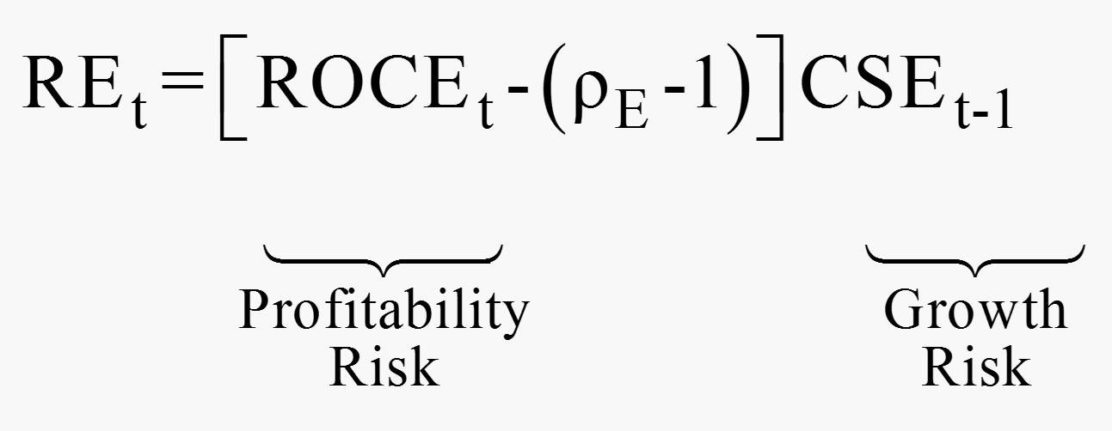

A Framework for Analysis of Fundamental Risk
The same drivers that yield RE can drive RE away from its expected level.
Risk is determined by the chance that a firm will not earn the forecasted ROCE or will not grow investments to earn at the ROCE.

Slide 25
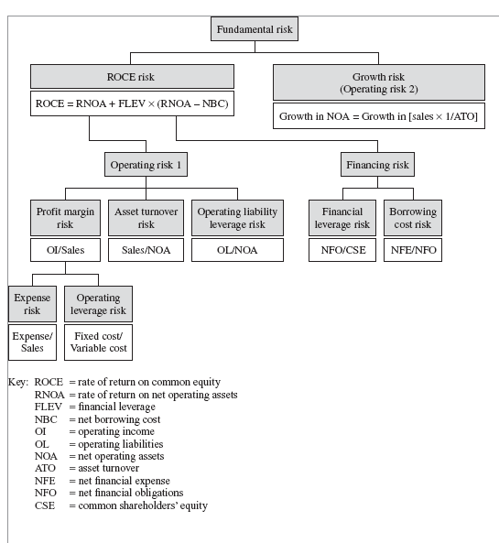

The Analysis of Fundamental Risk

Slide 26
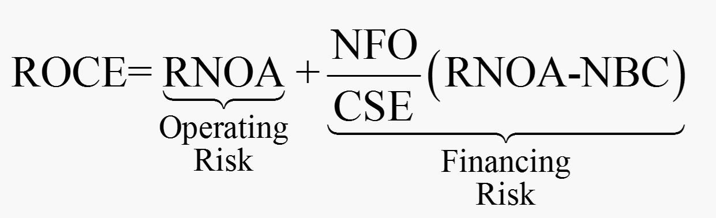

Profitability Risk: The Chance of Getting Poor ROCE
Return on common equity = Return on net operating assets
+ (Financial leverage × Operating spread)
Just as the drivers here determine the expected ROCE, so they determine the risk that the expected ROCE will not be earned.

Slide 27

The Analysis of Operating Risk
The potential variation in RNOA generates operating risk.
Drivers of operating risk
  Profit margin (PM) risk
    Expense risk – e.g. labor & material costs ↑, per $ of sales
    Operating leverage risk – if sales ↓, PM ↓ by a larger amount if costs are fixed rather than variable
  Asset turnover (ATO) risk
    Sales may fall if consumer demand shifts or competitors erode market share.
    If NOA are inflexible, ATO falls with a drop in sales, reducing RNOA.
  Operating liability leverage (OLLEV) risk
    OL may fall as % of NOA – e.g. if the firm gets into difficulties that cause margins & turnover to fall, suppliers may not grant credit, reducing payables and OLLEV.

Slide 28

The Analysis of Financing Risk
Financing risk is driven by the amount of financial leverage and the
variations in the spread, RNOA – NBC.
Drivers of financing risk
  Financial leverage (FLEV) risk
    A fall in RNOA reduces the operating spread and the effect on ROCE is levered
by FLEV.
    For firms with positive leverage: RNOA-NBC<0, leverage turns unfavorable
  Net borrowing cost (NBC) risk
    Increases the chance that operating spread will decline.
    Firms with variable-interest-rate debt have higher borrowing cost risk than firms with fixed-rate debt.

Slide 29
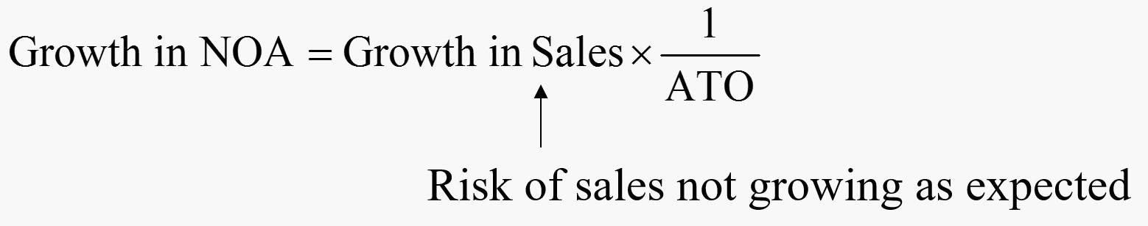
The Analysis of Growth Risk
RE are driven by both ROCE and growth in investment, so ROCE risk is
compounded by the risk that CSE will not increase as expected.
For a given financial leverage, growth in CSE is driven by growth in NOA. So uncertainty about whether the firm can grow investment in NOA is an additional aspect of operating risk.
Sales risk is the primary business risk, affecting both the growth in NOA and RNOA.
  If NOA are inflexible, a reduction of sales will reduce RNOA & RE as ATO↓
  If NOA are flexible, a sales decline will reduce RE as NOA↓

Slide 30
Value-at-Risk Profiles
Risk was depicted as a distribution of possible return outcomes. Each possible outcome implies a valuation.
So risk can also be depicted as a distribution of values.
Plotting that distribution of values – how value might differ from expected value – prepares a value-at-risk profile.
Value-at-Risk profiles are developed by preparing pro forma financial statements for each possible outcome and then calculating the values for each outcome.

Slide 31
Value-at-Risk Profiles
Steps to prepare value-at-risk profiles
Identify economic factors that affect the risk drivers
Identify risk protection mechanisms in place within the firm
Identify the effect of economic factors on the fundamental risk drivers
Prepare pro forma financial statements under alternative scenarios for the fundamental risk drivers
Forecast residual operating income for each scenario and, from these forecasts, calculate the set of values from the scenarios

Slide 32
Value-at-Risk Profiles
Example
Consider only ONE risk factor: the variation in the performance of the economy as a whole (i.e. GDP growth)
This factor affects only three drivers of firm A & B: sales, PM, and ATO.
Both firms have the same sales for a given GDP growth scenario and so have the same sales risk from the GDP factor.
But the two firms differ on PM risk and ATO risk:
  Firm A has higher operating leverage (fixed-cost/variable cost) risk and thus higher PM risk + less adaptable NOA and thus higher ATO risk

Slide 33

Value-at-Risk Profile: Firm A
Scenario | 1 | 2 | 3 | 4 | 5 | 6 | 7
Factor: GDP growth | −1% | 0% | 1% | 2% | 3% | 4% | 5%
Probability of scenario | 0.1 | 0.1 | 0.2 | 0.2 | 0.2 | 0.1 | 0.1
Fundamentals affected
Sales ($ million) | 25 | 50 | 75 | 100 | 125 | 150 | 175
Operating expenses
($ million)
Fixed costs | 20 | 20 | 20 | 20 | 20 | 20 | 20
Variable costs | 18 | 36 | 54 | 72 | 90 | 108 | 126
Total expenses | 38 | 56 | 74 | 92 | 110 | 128 | 146
Operating income | −13 | −6 | 1 | 8 | 15 | 22 | 29
($ million) Profit margin | −52% | −12% | 1.3% | 8.0% | 12% | 14.7% | 16.6%
Asset turnover | 0.63 | 1.03 | 1.30 | 1.50 | 1.65 | 1.77 | 1.87
RNOA | −32.7% | −12.3% | 1.7% | 12.0% | 19.8% | 26.0% | 30.9%
Beginning NOA | 39.7 | 48.7 | 57.7 | 66.7 | 75.7 | 84.7 | 93.7
($ million) ReOI (R=1.06) | −15.4 | −8.9 | −2.5 | 4.0 | 10.5 | 16.9 | 23.4
Value with | −40 | −49 | −16 | 133 | 251 | 366 | 484
limited liability
PM risk driver: ATO risk driver:
Operating expense = 20 + 72% of sales Net operating assets = 30.7 + 36% of sales

Slide 34
Value-at-Risk Profile: Firm B
Scenario 1 |  | 2 | 3 | 4 | 5 | 6 | 7
Factor: GDP growth −1% |  | 0% | 1% | 2% | 3% | 4% | 5%
Probability of scenario 0.1 |  | 0.1 | 0.2 | 0.2 | 0.2 | 0.1 | 0.1
Sales ($ million) 25 |  | 50 | 75 | 100 | 125 | 150 | 175
Operating expenses ($ million) Fixed costs 4 |  | 4 | 4 | 4 | 4 | 4 | 4
Variable costs | 22 | 44 | 66 | 88 | 110 | 132 | 154
Total expenses | 26 | 48 | 70 | 92 | 114 | 136 | 158
Operating income | −1 | 2 | 5 | 8 | 11 | 14 | 17
($ million)
Profit margin | −4% | 4% | 6.7% | 8.0% | 8.8% | 9.3% | 9.7%
Asset turnover | 0.81 | 1.17 | 1.37 | 1.50 | 1.59 | 1.65 | 1.70
RNOA | −3.3% | 4.7% | 9.1% | 12.0% | 14.0% | 15.4% | 16.6%
Beginning NOA | 30.7 | 42.7 | 54.7 | 66.7 | 78.7 | 90.7 | 102.7
($ million)
ReOI (R=1.06) | −2.8 | −0.6 | 1.7 | 4.0 | 6.3 | 8.6 | 10.8
Value with | −31 | 33 | 83 | 133 | 184 | 234 | 283
limited liability
Fundamentals affected
PM risk driver: ATO risk driver:
Operating expense = 4 + 88% of sales Net operating assets = 18.7 + 48% of sales

Slide 35
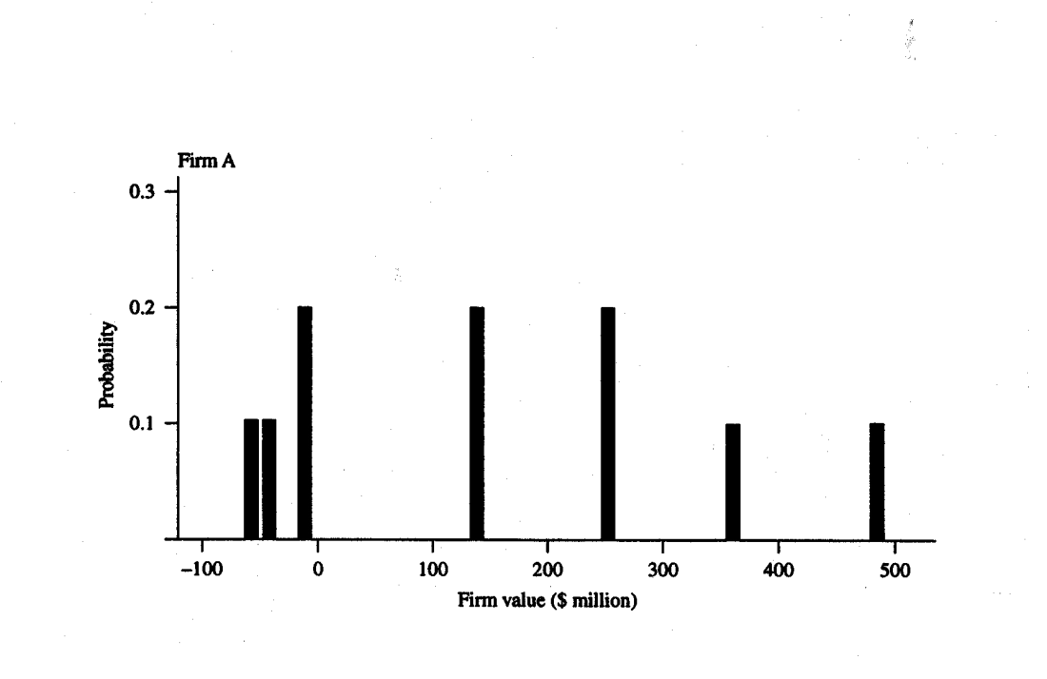
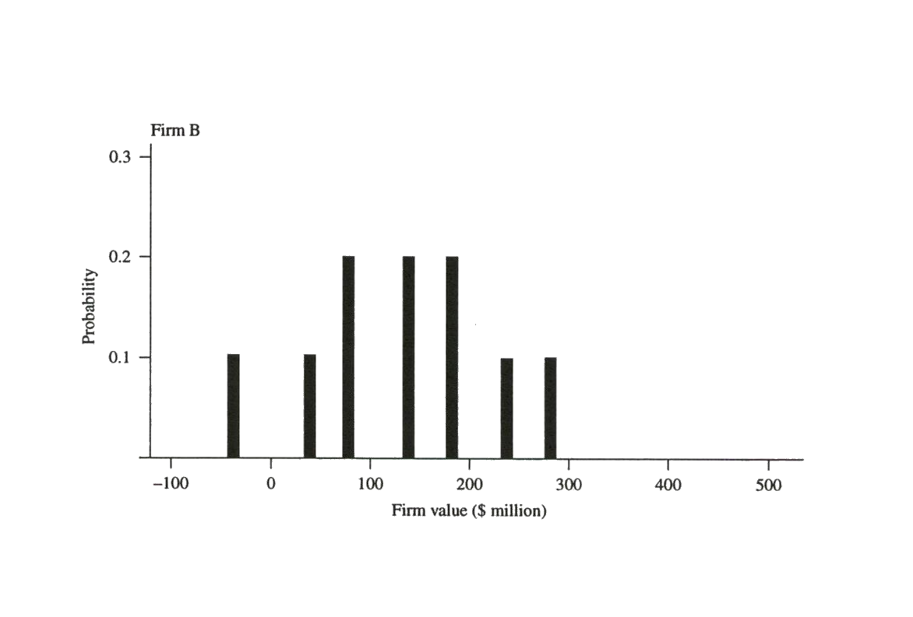

Value-at-Risk Profiles: Firms A and B
The profiles are generated for 7 scenarios for GDP growth.
The valuation is based on each outcome being a perpetuity:
𝑉^{𝑁𝑂𝐴} =NOA +Forecasted ReOI/0.06
0
0
The set of possible values reflects not only sales risk, PM risk, and ATO risk but also protection from risk through limited liability.
Firm A has higher PM risk and higher ATO risk.
These risk factors give Firm A a higher prob. of low value outcomes but also a higher prob. of high value outcomes.

Slide 36

Scenario Planning and Pro Forma Analysis
Pro forma analysis can be used to model outcomes for different planning scenarios. Investigate, for example,
Adaptation Options
Growth Options
Strategic Risk Management Options
Different future paths can be articulated with pro forma
analysis. The value of each path can then be calculated.

Slide 37

Price Risk and Fundamental Risk
Fundamental Risk is the risk of value not being realized because of fundamental factors that affect the firm’s activities.
Price Risk is the risk of value not being realized in prices because of factors other than fundamentals.

Slide 38

Price Risk
Market Inefficiency Risk
The market price may not reflect the “fundamental value (V)”
Scenario A risk: the stock is currently mispriced but the price will return to fundamental value as the market corrects the mispricing; an investor fails to recognize the mispricing may lose the value as P → V.
Scenario B risk: the stock is appropriately priced at its fundamental value but the price will be “carried away” from its fundamental value; an investor who thinks he is trading at fundamental value but does not anticipate the price deviation may lose the value as P deviate from V.
Fundamental analysis reduces Scenario A risk, but Scenario B risk can
still affect a diligent fundamental investor.

Slide 39
Price Risk: Scenario A and Scenario B
Scenario A: Price gravitates to fundamental value
Cum-dividend Value
PT^{C} = VT^{C}
Normal return,
P^{C} − V
T 0
Actual return,
V₀
P^{C} − P
Abnormal return,
V₀ − P₀
T 0
P0
Time
0 1 2
Scenario B: Price deviates from fundamental value
Cum-dividend Value
3
4
T
PT^{C}
Abnormal return,
P^{C} − V^{C}
V_{T}C
T T
Actual return,
P^{C} − P
Normal return,
T 0
V^{C} − V
T 0
P0 = V0
Time
0
1
2
3
4
T

Slide 40

Liquidity Risk
Selling at a price less than fundamental value can harm returns. But an
investor can get a poor price by simply not finding other investors to sell to.
The risk of having to trade at a price that is different from intrinsic value because of a scarcity of traders is called liquidity risk.
  Liquidity discounts – the discount that a seller takes for illiquidity
Mechanisms to reduce liquidity risk
Brokers: finding buyers/sellers on the other side of a trade
Market makers: matches buy and sell orders on stock exchanges
Investment banks (“deal makers”): find buyers for large issues of securities
The fees of these specialists are the costs of reducing the liquidity discount.

Slide 41

The Weighted-Average Formula for the Enterprise Expected Return
_{P} N O A
₊ [R N O A₁ − ( ρ _{F} − 1) ]× N O A ₀
= N O A
ρ − g
0
0
F
Expected return for operations =
⎡ N O A ₀ ⎤
N O A ₀
R N O A
1 ⎥
+ ⎡ (1 −
) × ( g
− 1 ) ⎤
⎢
P
N O A
⎢
P
N O A
⎥
⎣ 0
⎦ ⎣
0
⎦
The expected return is a weighted average of profitability and growth, where the weights are given by the enterprise book-to-price ratio.

Slide 42

The Expected Return for Nike
Enterprise price = $31,446 million NOA₂₀₁₀ = $5,514 million
Enterprise book to price = 5,514/31,446 = 0.175
Forecasted RNOA₂₀₁₁ = 30.1%
Forecasted growth rate = 4.6%
ER = [0.175 × 30.1%] + [(1-0.175) × 4.6%]
= 5.3% + 3.8%
= 9.1%
If you forecast a growth rate of 4.6%, you expect to earn
9.1% annually from investing in the enterprise.

Slide 43
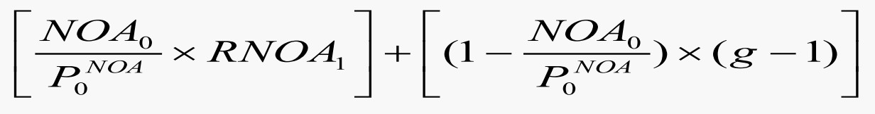
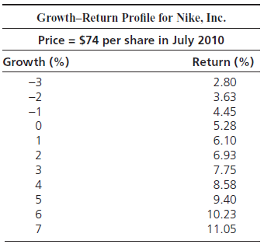

Growth-Return Profiles
Plot ER for various growth rates
For Nike

Slide 44
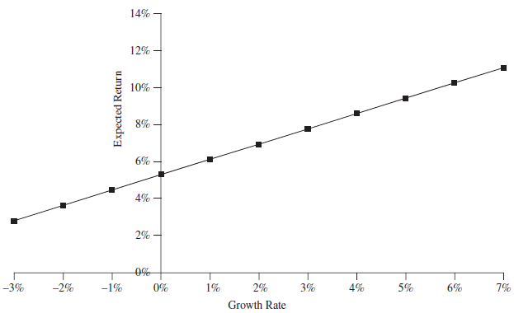
The Growth-Return Plot: Nike
Compare with plots for firms in the same risk class: Which has the better growth-return profile?

Slide 45
Finessing the Required Return Problem in Active Investing
Group firms with similar Value-at-Risk profiles: Holding risk constant
Rank firms within each group on implied expected returns
Buy those with high expected returns, sell those with low expected returns

Slide 46

A Final Admonition
Beware of Paying for Risky Growth
Challenge growth forecasts in the market price
Ask what your expected return profile looks like for buying growth
More growth requires a higher return, for growth is risky

Slide 47
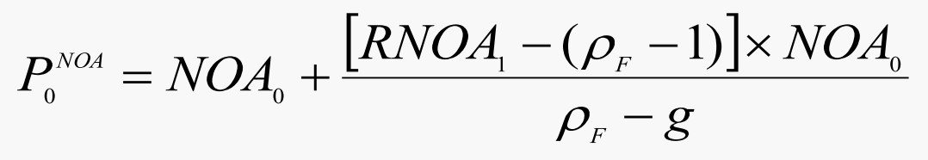

Risky Growth and Valuation
Consider the short-form model:
Growth may be risky: Do not think of growth and the
required return as independent inputs to a valuation
Recommendation: If a high g is forecast, require a higher
𝝆_{𝑭} for safety: more g, higher 𝝆_{𝑭}

