Slide 1
Lesson 6
Long-term Assets

Slide 2
Type of long-term assets
Investment 长期投资
PP&E 厂场设备
Natural resources 自然资源
Intangible assets 无形资产
Other assets

Slide 3
Investments
Debt securities 债权
Equity securities 权益

Slide 4
Investments in Equity Interests: Control
Ownership Percentage
0% 20% 50% 100%
Little Significant CONTROL
or none
Level of Influence

Slide 5
Property, Plant, and Equipment (PP&E)
PP&E include:
land, building, structures and equipment
machinery, furniture and tools
They are not held for resale
They are long term and are subject to depreciation (except land)
They are tangible

Slide 6
Types of Plant Assets
Land and land improvements
Buildings
Machinery and equipment
Furniture and fixtures
Notes:
Plant assets include land, buildings, equipment, and furniture. Often, plant assets are referred to as Property, Plant, and Equipment. There are several types of plant assets. Common account groupings include land and land improvements, buildings, machinery & equipment, and furniture & fixtures.

Slide 7
Acquisition Cost 取得成本
Historical cost is the basis for determining cost
Historical cost includes:
  the asset’s cash or cash equivalent price, and
  the cost of readying the asset for use
Costs incurred after acquisition are:
  added to asset’s cost, if they provide future service potential, or
  expensed, if they do not add to service potential
Land-land improvement-building
Lump-sum purchase

Slide 8
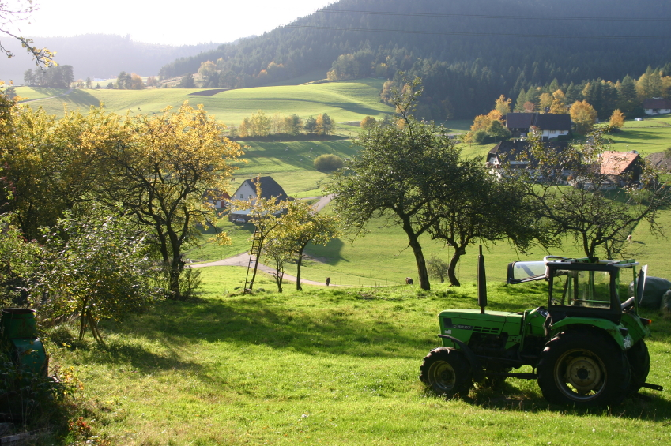
Land
NOT depreciated
Costs included in land:
  Purchase price
  Brokerage fees
  Survey and legal fees
  Property taxes
  Title transfer
  Costs of clearing and removing unwanted buildings
Notes:
The cost of land is not depreciated. It includes the following costs paid by the purchaser:
• Purchase price
• Brokerage commission
• Survey and legal fees
• Property taxes in arrears
• Taxes assessed to transfer the ownership (title) on the land
• Cost of clearing the land and removing unwanted buildings

Slide 9
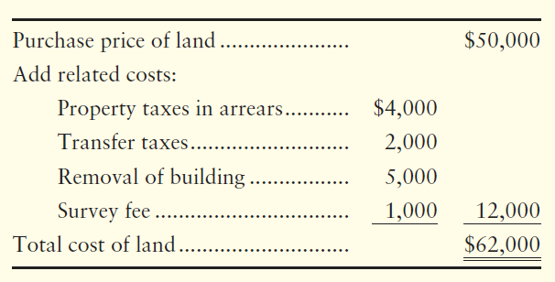
Measuring Cost of Land
Capitalized
Notes:
Suppose a company needs property and purchases land for $50,000 with a note payable for the same amount. It also pays cash as follows:
$4,000 in property taxes in arrears.
$2,000 in transfer taxes.
$5,000 to remove an old building.
$1,000 survey fee.
What is the company’s cost of this land? $50,000 + $4,000 + $2,000 + $5,000 + $1,000 = $62.000. The journal entry would include a debit to Land for $62,000; a credit to Notes payable for $50,000; and a credit to Cash for $12,000.
This entry capitalized the Land. Capitalized means that an asset account was debited (increased) because the company acquired an asset.

Slide 10
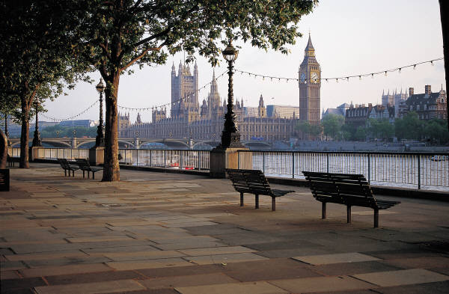
Land Improvements
Subject to depreciation
Examples:
  Fencing
  Paving
  Sprinkler systems
  Lighting
  Signs
Notes:
The cost of land does not include the following costs:
• Fencing
• Paving
• Sprinkler systems
• Lighting
• Signs
These separate plant assets—called land improvements—are subject to depreciation. Suppose a company then pays $20,000 for fences, paving, lighting, landscaping, and signs on August 15, 2013. The journal entry would include a debit to Land improvements for $20,000 and a credit to Cash for $20,000.

Slide 11
Land versus Land Improvements
Two entirely separate assets
Land
Not Depreciated
Land Improvements
Depreciated
Notes:
Land and land improvements are two entirely separate assets. Recall that land is not depreciated. However, the cost of land improvements is depreciated over that asset’s useful life.

Slide 12
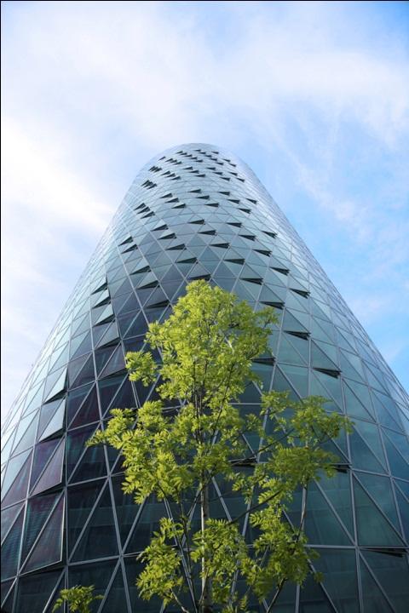
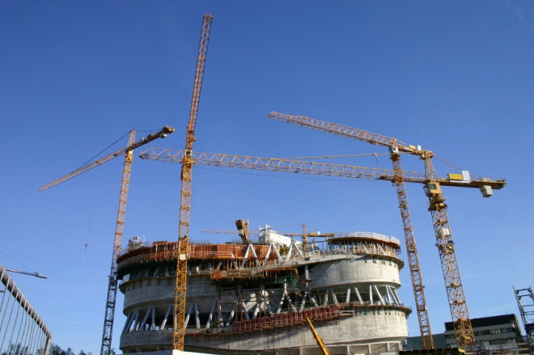
Buildings
Building Constructed
  Architectural fees
  Building permits
  Contractor charges
  Payments for material, labor, and overhead
  Capitalized interest cost, if self-constructed
Building Purchased
  Purchase price
  Costs to renovate the building for use
    Similar to construction costs
Notes:
The cost of a building includes:
• architectural fees.
• building permits.
• contractor charges.
• payments for material, labor, and overhead.
The time to complete a building can be months, even years. If the company constructs its own assets, the cost of the building may include the cost of interest on borrowed money. If it purchases an existing building, its cost includes the purchase price, plus the cost to repair and renovate the building for its intended use.

Slide 13
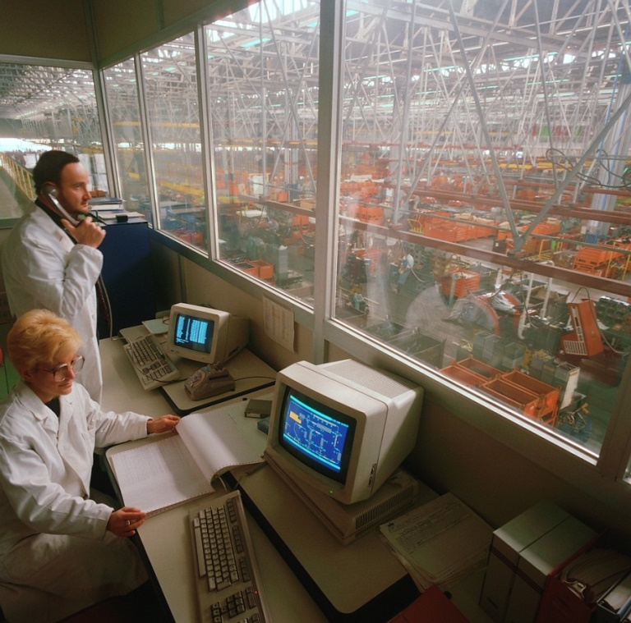
Machinery and Equipment
Cost includes:
  Purchase price (less any discounts)
  Transportation charges
  Insurance while in transit
  Sales tax and other taxes
  Purchase commission
  Installation costs
  The cost of testing before
  it is used
Notes:
The cost of machinery and equipment includes its:
• purchase price (less any discounts).
• transportation charges.
• insurance while in transit.
• sales and other taxes.
• purchase commission.
• installation costs.
• cost of testing the asset before it is used.
After the asset is up and running, the company no longer debits insurance, taxes, and maintenance costs to the Equipment account. From that point on, insurance, taxes, repairs, and maintenance costs are recorded as expenses.

Slide 14
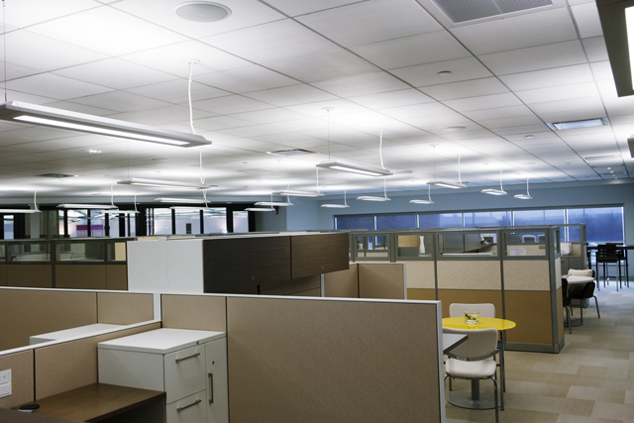
Furniture and Fixtures
Purchase price (less any discounts)
Shipping charges
Costs to assemble
Notes:
Furniture and fixtures include desks, chairs, file cabinets, display racks, shelving, and so forth. The cost of furniture and fixtures includes the basic cost of each asset (less any discounts), plus all other costs to ready the asset for its intended use.

Slide 15
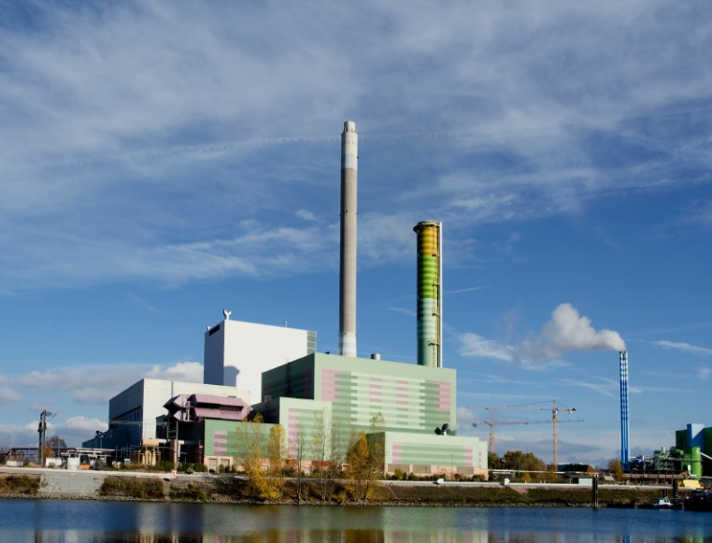
Lump Sum Purchase (Basket)
Purchase a group of plant assets for a single price
  Also called basket purchase
Assign cost to individual assets based on
relative sales values
  Land
  Land Improvements
  Building
  Equipment
Notes:
A company may pay a single price for several assets as a group—a “basket purchase.” For accounting, the company must identify the cost of each asset. The total cost paid (100%) is divided among the assets according to their relative sales or market values. This is called the relative-sales value method.

Slide 16
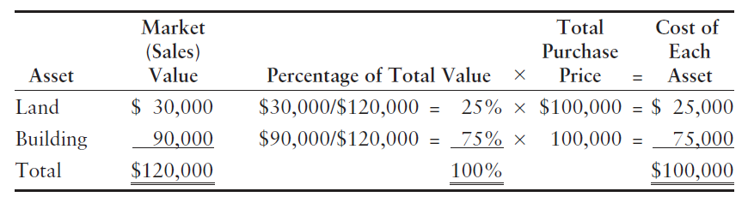
Lump Sum Purchase
Obtain a recent appraisal
Compute the ratio of each asset’s market value to the total
The journal entry to record the purchase:
Notes:
A recent appraisal performed before the purchase indicates the individual land and building market (sales) value. Use this total to allocate the purchase price using the appraisal ratio. First, figure the ratio of each asset’s market value to the total for both assets combined.
The total appraised value is $120,000. The purchase price for the land and building is $100,000. The land makes up 25% of the total market value, and the building makes up 75% of the total market value. Land equals 25% times the $120,000 purchase price or $25,000. Building equals 75% times the $120,000 purchase price or $75,000.
The journal entry to record the purchase includes a debit to Land for $25,000, a debit to Building for $75,000 and a credit to cash for the total of $100,000.

Slide 17
Costs subsequent to Acquisition
If cost incurred increase future benefits, capitalize costs
If costs maintain a given level of services, expense costs
Costs incurred after acquisition can be:
additions
improvements and replacements
rearrangements and reinstallation
repairs

Slide 18
Depreciation – Concept折旧
Depreciation is a means of cost allocation.
It is not a method of valuation.
Depreciation involves:
allocating the cost of tangible assets to expense
in a systematic and rational manner
to periods expected to benefit from use of assets

Slide 19
Factors in the Depreciation Process
Questions to be answered:
What is the depreciable base of the asset?
What is the asset’s useful life?
What method of cost apportionment is best for the asset in question?

Slide 20
Depreciable Base
Depreciable base is the amount subject to depreciation.
It is determined as:
Original cost of the asset less
Estimated salvage or disposal value

Slide 21
Estimated Service Lives
An asset’s service life and physical life are not the same.
Assets are retired (from productive life) due to:
  physical factors (such as casualty), or
  economic factors (such as obsolescence)
Economic factors in turn include
  Inadequacy (asset can not meet current demand)
  Super cession (by a better asset)
  Obsolescence (other factors)

Slide 22
Depreciation Methods
Depreciation methods can be classified as follows:
  Financial accounting Depreciation methods
Financial accounting methods are:
  straight-line
  accelerated methods, or

Slide 23


Depreciation Methods: Overview
Depreciation
Methods
Financial Accounting
Depreciation Methods
Tax
Depreciation
Activity
method
Straight-line
method
Accelerated
methods
1. Declining Balance
2. Sum-of-the-years’ digits

Slide 24
Depreciation Methods: Example
Amber corporation buys a truck on January 1, 20x1. Information relating to the truck is as follows:
Cost, $34,000
Estimated service life, 5 years (or 60,000 miles)
Salvage value end of five years or use, $4,000
Actual miles driven:
20,000 miles (in 20x1); 15,000 miles (in 20x2)

Slide 25
Straight-line method
1. Depreciable base = $34,000 less $4,000 = $30,000
2. Annual depreciation = $30,000 / 5 years = $6,000
3. Depreciation Schedule: (years 1 and 2)
Year Book Depreciation Accumulated Book value
(beg) Depreciation end of year
1 $34,000 $6,000 $6,000 $28,000
2 $28,000 $6,000 $12,000 $22,000

Slide 26

Activity method (unit = mile)
作业量法
1. Depreciable base = $34,000 less $4,000 = $30,000
2. Depreciation per mile = $30,000 / 60,000 = $0.50
3. Depreciation (20x1) = $0.50 * 20,000 miles = $10,000
4. Depreciation Schedule: (years 1 and 2)
Year Book Depreciation Accumulated Book value
(beg) Depreciation end of year
1 $34,000 $10,000 $10,000 $24,000
2 $24,000 $ 7,500 $17,500 $16,500

Slide 27
Sum-of-the-years’-digits (SYD) method年数总和法
1. Depreciable base = $34,000 less $4,000 = $30,000
2. SYD fraction = (1+2+3+4+5) = 15
3. Depreciation (20x1) = $30,000 * (5/15) = $10,000
Depreciation (20x2) = $30,000 * (4/15) = $ 8,000
Depreciation (20x3) = $30,000 * (3/15) = $ 6,000
Depreciation (20x4) = $30,000 * (2/15) = $ 4,000
Depreciation (20x5) = $30,000 * (1/15) = $ 2,000
Decreasing Fractions

Slide 28
Sum-of-the-years’-digits (SYD) method
4. Depreciation Schedule
Year Book Depreciation Accumulated Book value
(beg) Depreciation end of year
1 $34,000 $10,000 $10,000 $24,000
2 $24,000 $ 8,000 $18,000 $16,000
3 $16,000 $ 6,000 $ 24,000 $10,000
4 $10,000 $ 4,000 $ 28,000 $ 6,000
5 $ 6,000 $ 2,000 $ 30,000 $ 4,000

Slide 29
Double Declining balance method
双倍余额递减法
1. Rate of depreciation = 2 * (1/5) = 0.40
2. Depreciation (20x1) = $34,000 * 0.40 = $ 13,600
Depreciation (20x2) = $20,400 * 0.40 = $ 8,160
Depreciation (20x3) = $12,240 * 0.40 = $ 4,896
Depreciation (20x4) = $ 3,344 /2 = $ 1,672
Depreciation (20x5) = $ 3,344 /2 = $ 1,672
Total depreciation taken = $ 30,000

Slide 30
Double declining balance method
3. Depreciation Schedule
Year Book Depreciation Accumulated Book value
(beg) Depreciation end of year
1 $34,000 $13,600 $13,600 $20,400
2 $20,400 $ 8,160 $21,760 $12,240
3 $12,240 $ 4,896 $ 26,656 $ 7,344
4 $ 7,344 $ 1,672 $ 28,328 $ 5,672
5 $ 5,672 $ 1,672 $ 30,000 $ 4,000

Slide 31
Revision of Depreciation Estimates
Determination of depreciation involves initial estimates (life, salvage value.)
When these estimates are revised, we re- compute depreciation.
These revised depreciation expenses apply prospectively to the remaining life of asset
These changes do not affect prior periods.

Slide 32
Revision of Depreciation Estimates: Example
Amber corporation buys a depreciable asset on January 1, 2021 for $95,000.
  Estimated life was 20 years.
  Estimated salvage value was $5,000.
On January 1, 2027, estimates were revised as follows:
  salvage value, $2,000
  estimated life : 24 years (years 2021 through 2044)
Determine depreciation for 2027
  based on straight line method of depreciation.

Slide 33
Revision of Depreciation Estimates: Example
Accumulated depreciation to date of revision of estimates:
    ($95,000 - $5,000) / 20 years = $4,500 dep
    $4,500 * 6 years = $27,000 accumulated depr.
Amount to be depreciated (years 2027 through 2044 = 18 years)
  ($95,000 - $27,000 - $2,000) / 18 years
  = $3,667 (rounded) annual depreciation

Slide 34
Dispositions of PP&E 处置
Plant assets may be:
  retired voluntarily, or
  disposed of by sale, exchange, involuntary conversion
Depreciation is recorded up to the date of disposal before determining gain or loss
Gains or losses from involuntary conversion are often reported as gain or loss.

Slide 35
Dispositions of PP&E
YE SUN AccountingEnglish
Entry will be
  DR accu depr
  Dr cash
  Dr loss
  CR asset
  Or Cr cash
  Or Cr gain

Slide 36
Global Positioning Net purchased equipment on January 1, 20x2, for $36,000. Global Positioning Net expected the equipment to last for four years and to have a residual value of $4,000. Suppose Global Positioning Net sold the equipment for $26,000 on December 31, 20x3, after using the equipment for two full years. Assume depreciation for 20x3 has been recorded.
Journalize the sale of the equipment, assuming straight-line depreciation was used.
Journal Entry
DATE | ACCOUNTS AND EXPLANATIONS | DEBIT | CREDIT
Dec 31 | Cash | 26,000
 | Accumulated depreciation | 16,000
 | Equipment |  | 36,000
 | Gain on sale of asset |  | 6,000
Notes:
Short Exercise 9-8 provides an example on how to account for the sale of an asset at a gain or a loss.

Slide 37
Depletion: Terminology折耗
Depletion refers to the cost basis write-off of natural resources - activity method
Natural resources are characterized by:
complete removal of the asset, and
replacement of the asset only by an act of nature

Slide 38
Intangibles: Characteristics
They lack physical existence
They represent entity’s rights and privileges
They are not financial instruments
They are long term in nature

Slide 39
Classification of Intangibles
Intangibles are either grouped or separately identified based on the following factors:
  Are the assets developed internally, or acquired singly or in groups?
  Is the expected benefit from the asset limited or indefinite?
  Are the rights transferable or are they a substantial part of the business?

Slide 40
Valuation of Intangible Assets
Intangibles
Purchased
Internally-
Created
Specifically
Identifiable
Goodwill-
type assets
Specifically
Identifiable
Goodwill-
type assets
Capitalize
Capitalize
Expense,
except
direct
costs
Expense

Slide 41
Amortization of Intangible Assets
无形资产摊销
Intangibles are written off over their useful lives, where the assets have determinable useful lives.
Where the intangibles have indefinite useful lives, they are not amortized.
Acquired intangibles should not be written off at acquisition.

Slide 42
Specific Intangibles: Types
Marketing-related (i.e., trademark, trade name).
Customer-related (i.e., customer lists, customer relationships).
Artistic-related (i.e., copyrights).
Contract-related (i.e., franchise, licenses or permits).
Goodwill.
Technology-related (i.e., product patent, process patent).

Slide 43
Marketing-Related Intangibles: Trademarks and Trade Names
Trademarks and trade names are renewable indefinitely by the original user in periods of 10 years each.
Costs of acquired trademarks or trade names are capitalized.
If trademarks or trade names are developed by the a business, all direct costs are capitalized*.
*R&D cost
  Research cost – expensed
  Development cost – capitalized conditionally

Slide 44
Artistic-Related Intangibles: Copyrights
Copyrights are granted for life of the creator plus 50 years.
Copyrights can be sold or assigned, but cannot be renewed.
Copyrights are amortized over their useful life.
Costs of acquiring copyrights are capitalized.

Slide 45
Contract-Related Intangibles: Franchises and Licenses
A franchise is a contractual agreement under which:
  The franchisor grants the franchisee:
    the right to sell certain products or services,
    the right to use certain trademarks or trade names, or
    the right to perform certain functions, within a certain geographical area.

Slide 46
Franchises and Licenses
A franchise may be for a limited time, for an indefinite time period, or perpetual.
The cost of a franchise (for a limited time) is amortized over the franchise term.
A franchise (for an unlimited time) is carried at cost and not amortized.
Annual payments for a franchise are expensed.

Slide 47
Technology-Related Intangibles: Patents (Product Patents and Process Patents)
A patent gives an exclusive right to the holder for 20 years.
Costs of purchasing patents are capitalized.
Patents are amortized over the shorter of the legal life (20 years) or their useful lives.
Legal fees incurred to successfully defend patents are capitalized.

Slide 48
Goodwill商誉
Goodwill is the most intangible of all assets.
Goodwill can be sold only with the business.
Goodwill is the excess of:
  the cost (purchase price) over
  the amounts (price) assigned to tangible and intangible net assets.
Goodwill has an indefinite life and should not be amortized.

Slide 49
Intangibles: Impairments减值
An impairment occurs when:
  the carrying amount of an asset is not recoverable, and
  a write-off of the impaired amount is needed
To determine the amount of impairment, a recoverability test is used.

Slide 50
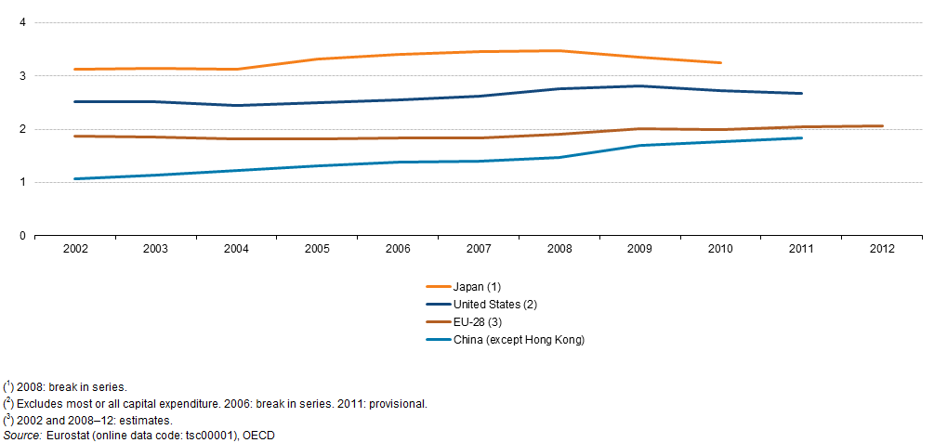
File: Gross domestic expenditure on R&D in the Triad and China,
2002–12 (% of GDP)
https://stats.oecd.org/

Slide 52
Return on total assets & asset turnover
Return on assets=(net income + interest)
/ average total assets
Asset turnover = net sales
/ average total assets

Slide 53
End of lesson 6

