Slide 1


SUFE Year 1 Postgraduates
A Critical Study of English Poetry
Lecture One 1) Brief Introduction to the Course
2) Brief Introduction to Ezra Pound, Ernest Fenollosa, and Modern English Poetry
Prof. Dr. Joan Qionglin Tan
tan.qionglin@mail.shufe.edu.cn
厚德博学
经济匡时

Slide 2
Lecture One Brief Introduction to the Course
I Course Description
II Course Materials
III Open Yale Course: Modern Poetry
IV Mini Teaching & Studying
V Case Study: Different Levels of Understanding the Poem “Riprap”
Contents

Slide 3

I Course Description
Course: A Critical Study of English Poetry
Course Type: Compulsory
Credits: 2
Contact Hours: 32
Semester: Fall, Week 1-11
3 classes per week
Course Instructor:
Prof. Dr. Joan Qionglin Tan
Specialty: Ecopoetics, Ekphrasis, and Environmental Ethics

Slide 4
Focus: modern and contemporary British and American poetry
Theories: literary criticism, cultural study, and environmental philosophy
Characteristics:
Chinese material objects in English poetry
Self-study of Open Yale Course: Modern Poetry
Joan Qionglin Tan’s research
Learning Outcome:
to critically analyze English poetry with diverse methods and theories
to learn the impact of Chinese material culture on English poetry
to cultivate some abilities of self-study and interdisciplinary study
Grading:
Participation in Class and Presentation on Required Topics: 20%
Reports on Required Lectures: 10%
Course Paper: 70%

Slide 5
Main British and American Poets
Open Yale Course
Robert Frost, William Butler Yeats, Ezra Pound, T. S. Eliot, Hart Crane, Langston Hughes, William Carlos Williams, Marianne Moore, Wallace Stevens, W. H. Auden, Elizabeth Bishop
Joan’s Lectures
Alexander Pope, John Keats, Walt Whitman, Howard Nemerov, E. E. Cummings, Kenneth Rexroth, Gary Snyder, Philip Whalen, Lew Welch, John Cage, Jack Kerouac, Jane Hirshfield, Mike O’Conner, James Lenfestey, Louis Simpson
Chinese Material Culture
ideogram, painting, calligraphy,
classical poetry, Tang and Sung poets, Tao, Heart Sutra, Wen Fu
Main Motifs
Imagism
Beat Generation
San Francisco Renaissance
Sound Poetics
Buddhist Ecopoetics
Ekphrasis
Transfiction
Biosemiotics
Ecosemiotics
Late Modernism

Slide 6
Course Description
This is a required course for MA English Literature, aiming at cultivating students how to analyze and appreciate English poetry, especially modern and contemporary British and American poetry. Diverse methods and theoretical principles of literary criticism, cultural study and environmental philosophy will be employed in textual analysis, such as ecocriticism, gender criticism, media studies, cultural studies and identity studies. This course will also enable students to learn how Chinese material objects are acculturated and adapted in English poetry, ranging from Chinese ideograms, calligraphy, landscape paintings, porcelain, walls, axes to brushes. Students are encouraged to have a self-study of Yale University Open Course on Modern Poetry, in which some great poets will be discussed in class, such as Robert Frost, Ezra Pound, William Carlos Williams, Wallace Stevens, Marianne Moore, W. H. Auden, Gary Snyder, Philip Whalen, and Lew Welch. Meanwhile, through the case study of Chinese cultural elements in British and American poetry, this course will enhance students’ cultural confidence, promote their self-awareness of spreading Chinese culture, and develop their research ability in the participation of jointly building the Chinese discourse system.

Slide 7
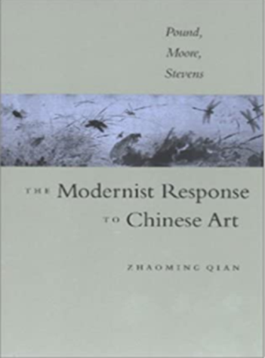
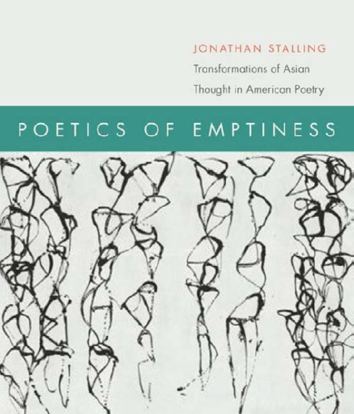
II Course Materials
Textbooks & Handouts
Zhaoming Qian. The Modernist Response to Chinese Art: Pound, Moore, Stevens. University of Virginia Press, 2003. ISBN 0-8139-2175-9；ISBN 0813921767
Jonathan Stalling. Poetics of Emptiness: Transformations of Asian Thought in American Poetry. Fordham University Press, 2010. ISBN 978-0-8232-3144-7
Handouts and Selected Poems from Gary Snyder’s Riprap, Myths &Texts and Mountains and Rivers Without End, and Axe Handles

Slide 8
Reference Books
Anthony Mellors. Late Modernist Poetics from Pound and Prynne. Manchester University Press, 2005.
Robert Kern. Orientalism, Modernism and the American Poem. Cambridge University Press, 1996.
Jonathan Stalling. Poetics of Emptiness: Transformations of Asian Thought in American Poetry. Fordham University Press, 2010. ISBN 978-0-8232-3144-7
Zhaoming Qian. Ezra Pound’s Chinese Friends. Oxford University Press, 2008.
Zhaoming Qian. Orientalism and Modernism: The Legacy of China in Pound and Williams. Duke University Press, 1995.
Zhaoming Qian. East-West Exchange & Late Modernism: Williams, Moore and Pound. University of Virginia, 2017.

Slide 9
Chinese Versions Related to the Textbooks
钱兆明著，王凤元、裘禾敏译，中国美术与现代主义：庞德、摩尔、史蒂文斯研究，北京：中国社会科学出版社，2020年，2023年。
钱兆明著，徐长生、王凤元译，“东方主义”与现代主义：庞德和威廉斯诗歌中的华夏遗产，杭州：浙江大学出版社，2016年。
钱兆明著，跨越与创新：西方现代主义的东方元素，北京：北京大学出版社，2023年。

Slide 10
Useful Handbooks for Understanding Modern English Poetry
Cleanth Brooks and Robert Penn Warren. Understanding Poetry. 4th edition. Foreign Language Teaching and Research Press, and Thomson Learning, 2016.
Neil Roberts. Ed. A Companion to Twentieth-Century Poetry. Blackwell Publishing Ltd, 2001.
Stephen Fredman. Ed. A Concise Companion to Twentieth-century American Poetry. Blackwell Publishing Ltd, 2005.

Slide 11
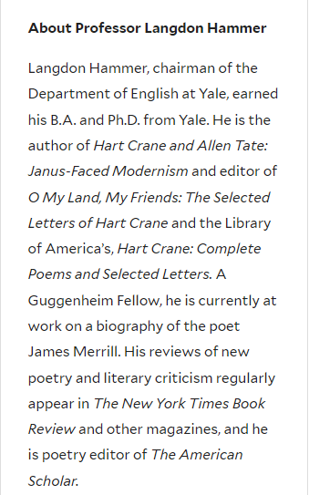
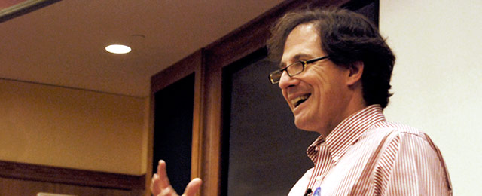
Open Yale Course: Modern Poetry (Course Number: ENGL 310)
About the Instructor: Prof. Langdon Hammer
chairman of the Department of English at Yale
About the Course: This course covers the body of modern poetry,
its characteristic techniques, concerns, and major practitioners.
Website: https://oyc.yale.edu/english/engl-310

Slide 12
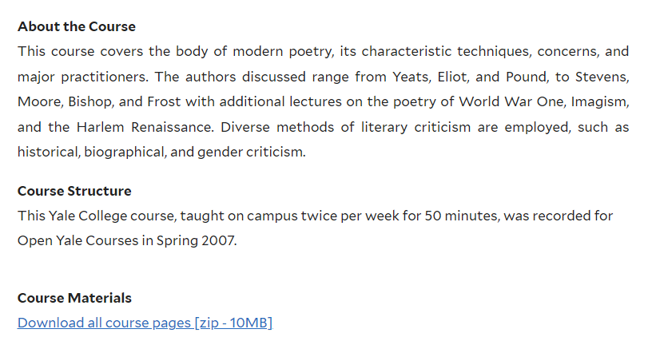
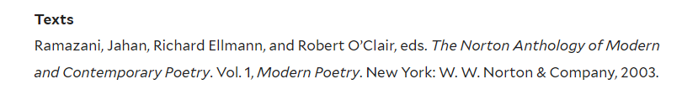

Slide 13
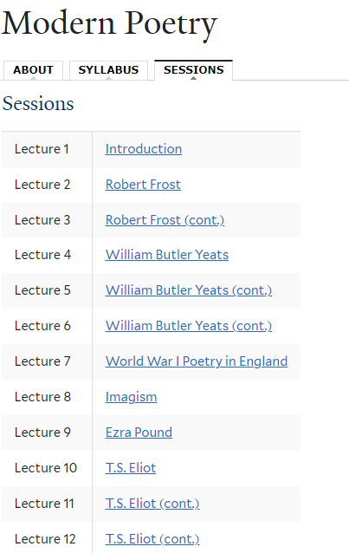
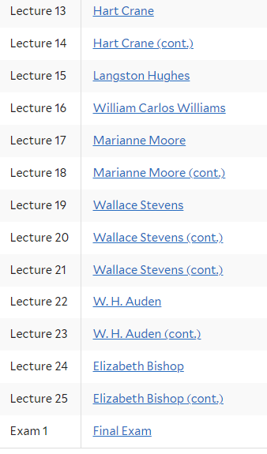

Slide 14
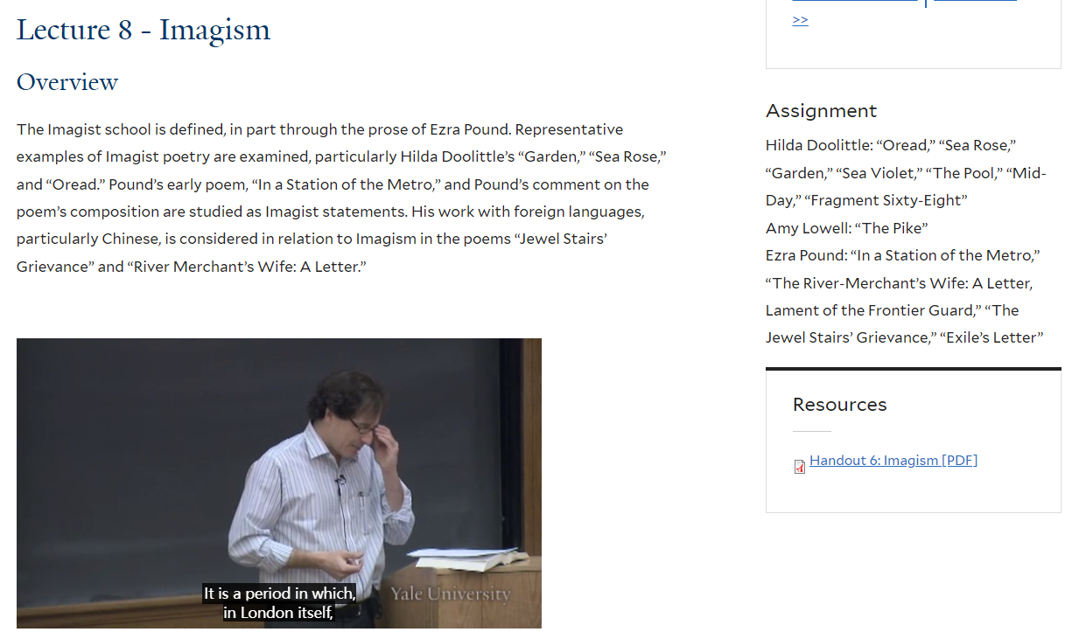
Ways of Studying Yale Open Course for Modern Poetry

Slide 15
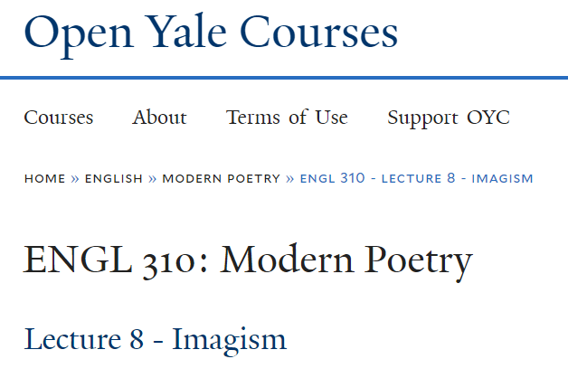
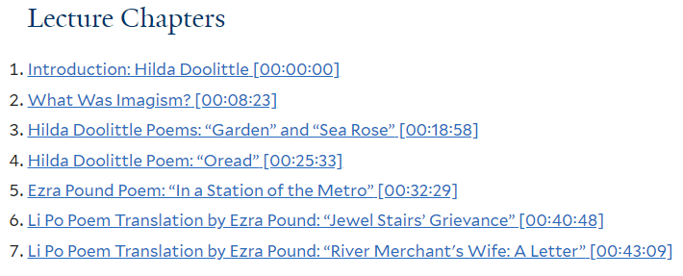

Slide 16
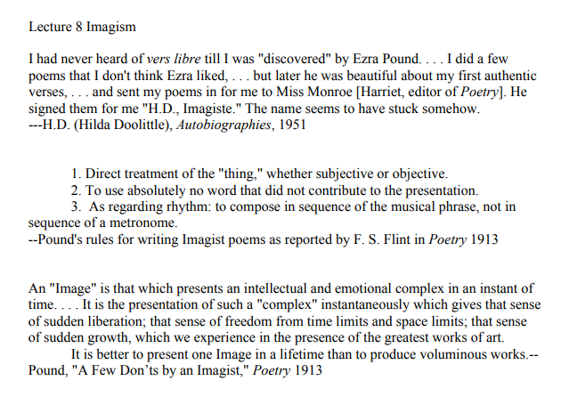
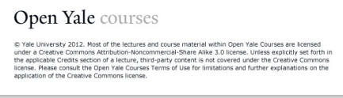

Slide 17
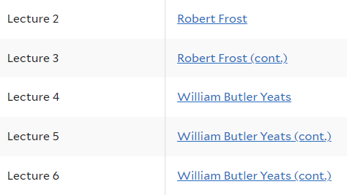
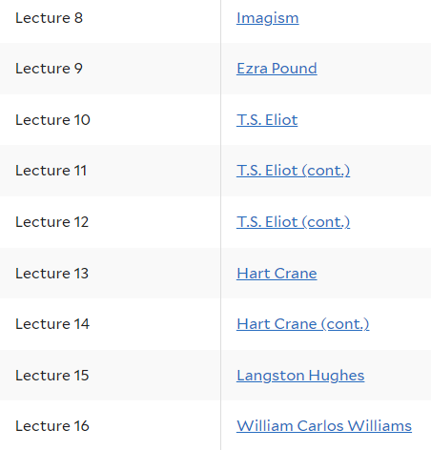
Selected Watching and Self-Learning Yale Open Course for Modern Poetry
Poets and Schools Related to Our Course
More Poets by Self-Studying

Slide 18
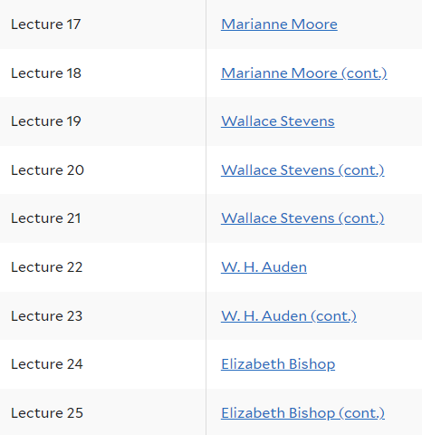
Poets Related to Our Course
More Poets by Self-Studying
Discussion: Yale Open Course for 11 Modern Influential Poets One Session Hour

Slide 19
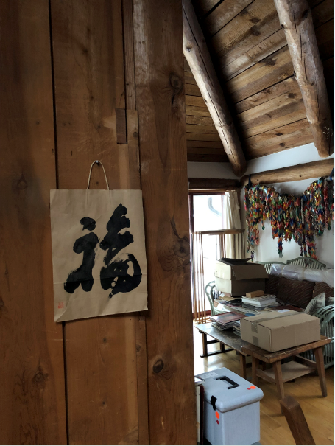



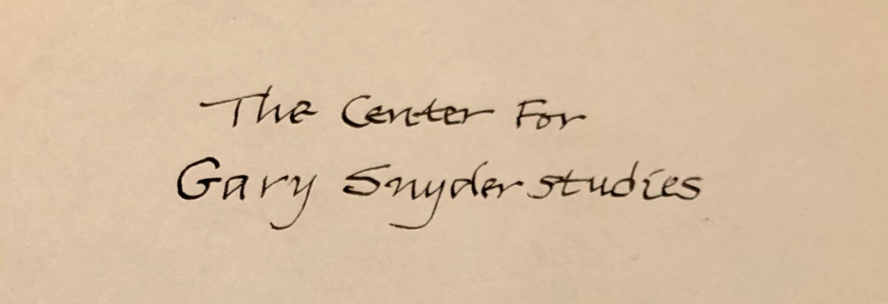
IV Mini Teaching & Studying
Notes:
更改填充的图片即可

Slide 20
Gary Snyder and China
Semiotic Fitness: Chinese Culture in Gary Snyder’s Ecopoetics
transfiction, intertextuality
AAA: adaptation, appropriation, acculturation
character
poetry
calligraphy
painting
religion
history
objects
minority
I
II
III
Snyder’s Karmic Empathy
for Chinese Culture
Snyder’s Ecopoetic Way with
a Link to Chinese Culture
Snyder’s Acculturation of Chinese Elements in Poetry

Slide 21
Part I Snyder’s Karmic Empathy for Chinese Culture
1.1 Subcultures as the Other: Chan Buddhism
1.2 Snyder’s Two Kinds of Poetry: Lyrical and Mythical
1.3 Snyder’s Two Parallel Poetic Traditions: Occidental and
Oriental
1.4 Snyder’s Preference to Chinese Culture: Poetry,
Character and Painting
1.5 Snyder’s Ideogrammic Method: Riprapping
2.1 Snyder’s Three Turning Points in Career: Han Shan,
Japan and Kitkitdizze
2.2 Snyder’s Creative Poetic Tradition: Han Shan-Chan-
Ecology
2.3 Snyder’s Hatching a New Cosmic Myth: Han Shan as a
Mythical Chan Buddhist Sage
Part II Snyder’s
Ecopoetic Way with
a Link to Chinese Culture

Slide 22
3.1 Snyder’s Appropriation and Adaptation of Heart Sutra:
Form and Emptiness
3.2 Snyder’s Appropriation and Adaptation of the Book of
Poetry: Nature as Home
3.3 Snyder’s Appropriation and Adaptation of Essay on
Literature: Axe-handle
3.4 Snyder’s Appropriation and Adaptation of Tang and
Sung Poems: Chan Enlightenment
3.5 Snyder’s Appropriation and Adaptation of Tao Teching:
the Tao
3.6 Snyder’s Appropriation and Adaptation of Ku:
Spatiotemporality
3.7 Snyder’s Appropriation and Adaptation of Chinese
Ideograms: Riprapping and Word into Picture
3.8 Snyder’s Appropriation and Adaptation of Chinese
Calligraphy: Nature-text
…….
Part III Snyder’s Acculturation of Chinese Elements in Poetry

Slide 23
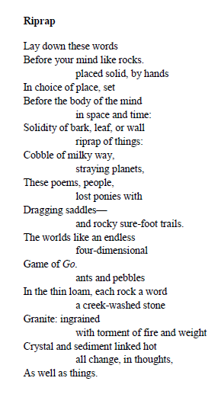
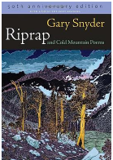
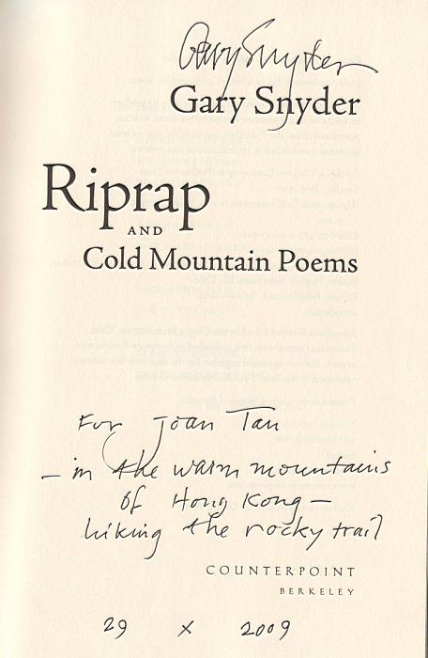
Case Study
Riprapping: Gary Snyder’s Ideogrammic Methods

Slide 24
Three Levels and Possible Routes of Studying the Title Poem “Riprap” in Riprap
Preliminary Level: “Riprap”
Aesthetical Study: understanding of the title poem “Riprap”
Comparative Study: Snyder’s lyrical poetry vs. Chinese classical poetry
BA and MA Presentation: Understanding of English Poetry
Intermediate Level: Riprap
Aesthetical Study: link with the book Riprap with 23 poems
Interarts Study: editions with different front covers: Riprap (1959);
Riprap & Cold Mountain Poems (1969); Riprap and Cold Mountain Poems (1999);
50th anniversary edition Riprap and Cold Mountain Poems (2009)
Paratext Study: dedication, preface, afterword and a new afterword with implied meanings
Transfiction Study: Han Shan and Cold Mountain Poems
Comparative Study: Oriental and Occidental cultures in Riprap
MA Coursework Paper: A Study of English Poetry

Slide 25
Advanced Level: beyond “Riprap” and Riprap
Comparative Study: Snyder’s first lyrical poetry Riprap (1959) vs. Snyder’s first mythical poetry Myths & Texts (1960) vs. Snyder’s translation Cold mountain Poems (1958) within one context (Han Shan-Chan-Ecology as one continuum) due to Snyder’s notion of “riprap” with two sides
Pound’s ideogrammic method vs. Snyder’s ideogrammic method
Snyder’s unique riprapping: Chinese ideograms, Chinese ideogrammic method, form and emptiness
Sound Study: performance, performativity, sound poetics
Ecological and Green Religious Study: work, Chan and ecology
Empirical, Anthropological and Archeological Study: field work; manuscript
Poetic Legacy Study: Mary Oliver’s Use of “Riprap”
Material Study: riprap of things
MA Thesis: A Critical Study of Snyder’s Poetics and Poetry
PhD Dissertation: one chapter or part of Gary Snyder Studies

Slide 26
Joan Qionglin Tan’s Research
Pound’s Invention of the Ideogrammic Method
Snyder as Follower of the Poundian Ideogrammic Line
Semiotic Fitness: Chinese Ideograms as both an Image and a Translated Image in English Poetry
Impact Chinese Classic Poetry on Snyder’s Poetics
Snyder’s Notion of Riprap
Snyder’s Title Poem “Riprap”
Riprapping as Ideogrammic Method Employed in Snyder’s Poetry
Riprapping: Gary Snyder’s Ideogrammic Method

Slide 27
Mini Teaching: Learning Outcome
to learn how to study Gary Snyder’s title poem “Riprap” aesthetically, philosophically and interdisciplinally
to know the Poundian ideogrammic line
to understand the main differences between Pound’s ideogrammic method and Snyder’s riprapping
to discern Chinese elements acculturated in Snyder’s lyrical poetry
to enlarge one’s vision of studying Snyder’s “Riprap”
to learn how to study English poetry critically
to differentiate 3 levels of studying English poetry: preliminary, intermediate, and advanced;
to employ diverse methods and theories to analyze the text
to expand the poetic study into other fields

Slide 28
Further Self-study
Gary Snyder. Riprap and Cold Mountain Poems. San Francisco: Four Seasons Foundation,1969; rerp. New York: North Point Press, 1999.
(50th. anniversary edition, 2009 )
Joan Qionglin Tan’s Related Publications on Riprap and Cold Mountains Poems
Joan Qionglin Tan. “Visualization and Gary Snyder’s Translation of Cold Mountain Poems.” Journal of Translation Studies, 11.2(2008), 31-53.
谭琼琳： 加里·斯奈德的“砾石成道”表意法研究，《外国语》2012年
第3期149-56页。
(Tan Qionglin. Riprapping: Gary Snyder’s Ideogrammic Method)
谭琼琳：加里· 斯奈德神话长诗中的“寒山-禅-生态”命题研究，
《英美文学研究论丛》，2017年春第26辑第333-344页。
(Tan Qionglin. Exploration of the Thesis of Han Shan-Chan-Ecology in Gary
Snyder’s Mythical Long Poems)

Slide 29
Lecture One Ezra Pound, Ernest Fenollosa, and Modern English Poetry
I Ezra Pound and Ernest Fenollosa’s Manuscript
II Reading of “the Chinese Written Character as a Medium of Poetry”
III Watching of Open Yale Course: Imagism
IV Discussion: Fenollosa’s Manuscript and Pound’s Imagism
Contents

Slide 30
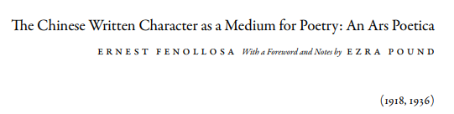
Ezra Pound, Ernest Fenollosa and Modern English Poetry
Research Questions
How to understand Snyder’s riprapping as his unique ideogrammic method?
How to understand the significance of Fenollosa’s manuscript?
Why is the Chinese written character seen as a medium or vehicle for English poetry?
Brief Reading and Understanding
Ernest Fenollosa’s Manuscript Edited by Ezra Pound

Slide 31
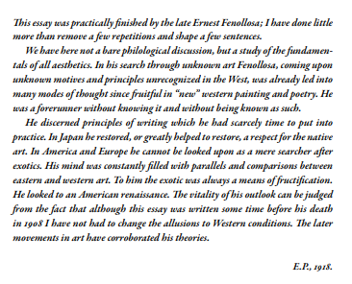
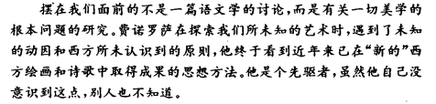
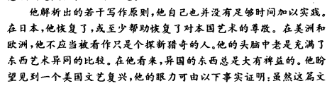

Slide 32
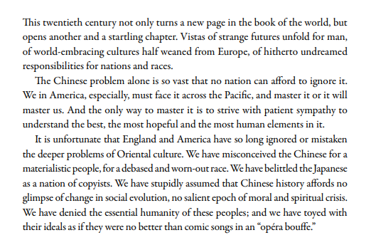

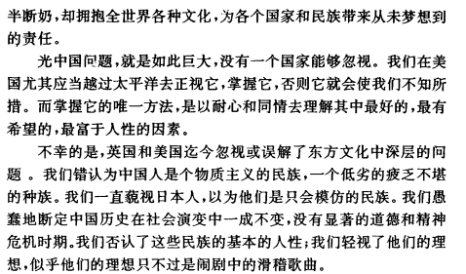

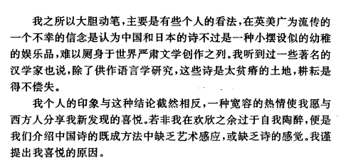
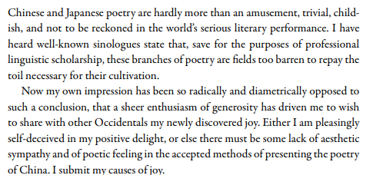

Slide 33
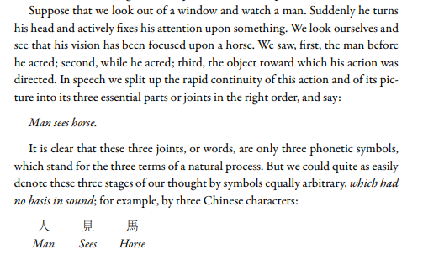
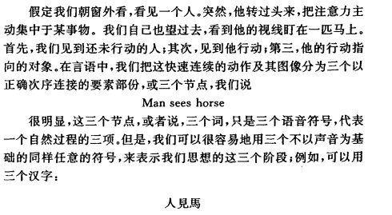

Slide 34
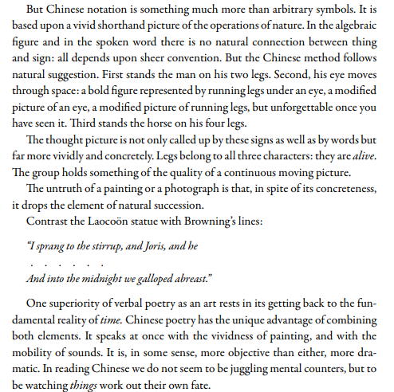
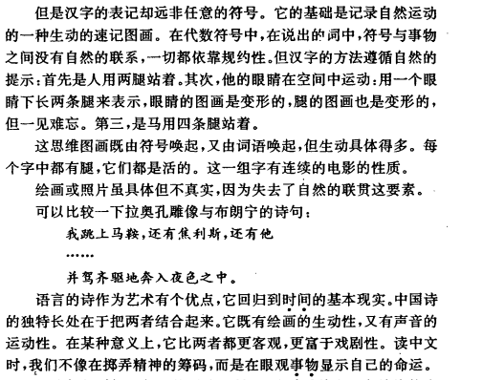

Slide 35
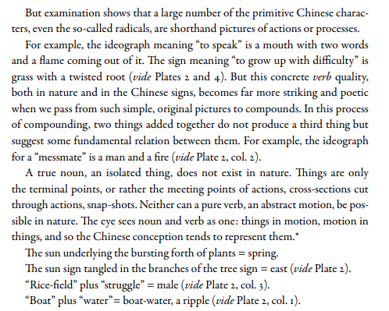
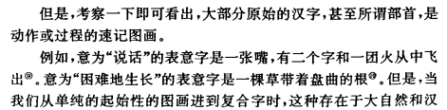
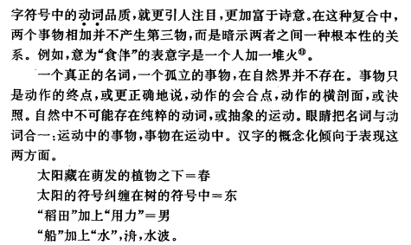

Slide 36

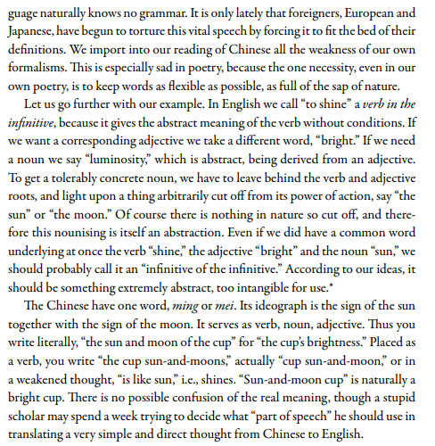
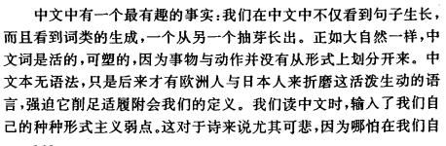
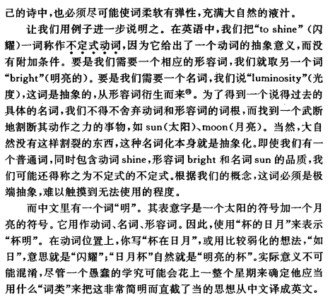

Slide 37
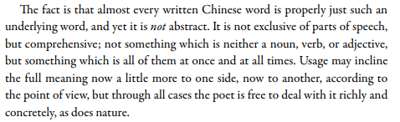
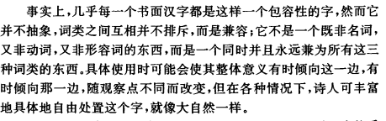

Slide 38
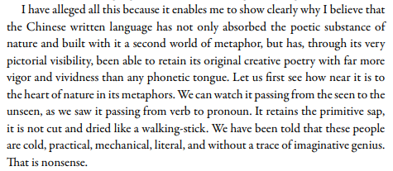
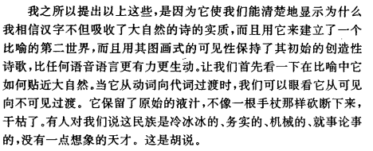

Slide 39
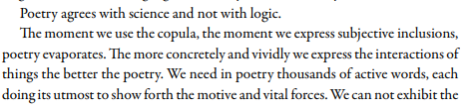
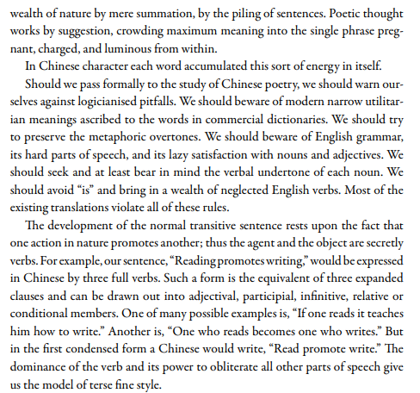

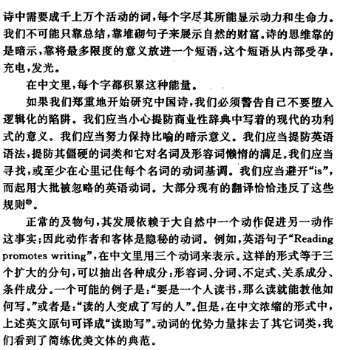

Slide 40
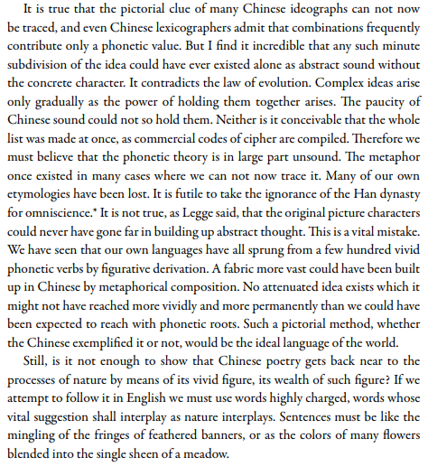
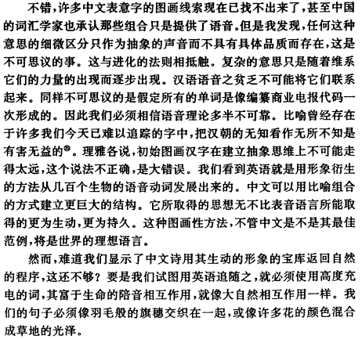

Slide 41

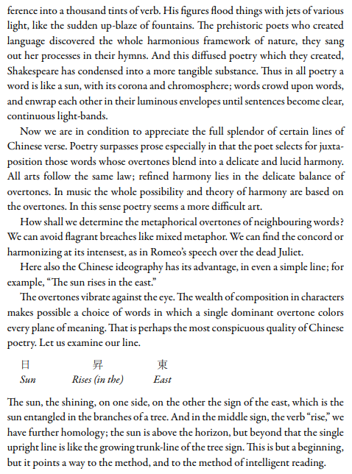
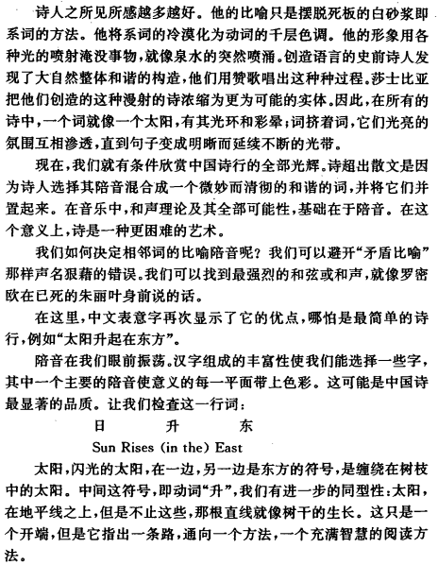

Slide 42

Review and Assignment for Next Week

Slide 43

THANK YOU

