Slide 1
SUFE Year 1 Postgraduates
A Critical Study of English Poetry
Lecture Two Semiotic Fitness: The Chinese Written Character and
its Metamorphosis in Modern American Poetry
Prof. Dr. Joan Qionglin Tan
tan.qionglin@mail.shufe.edu.cn
厚德博学
经济匡时

Slide 2
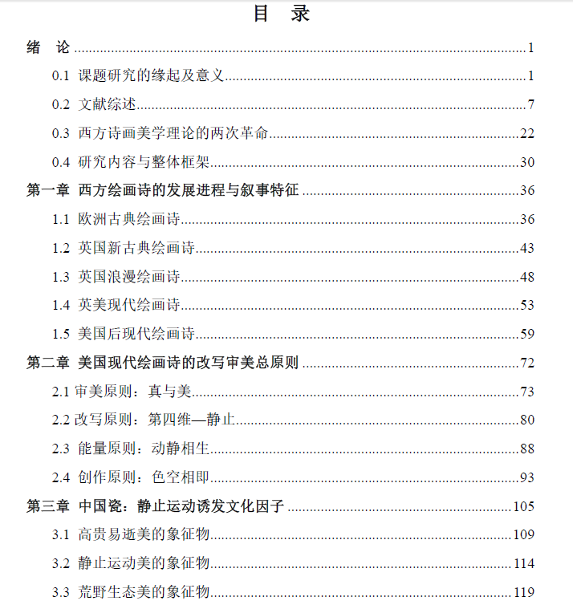
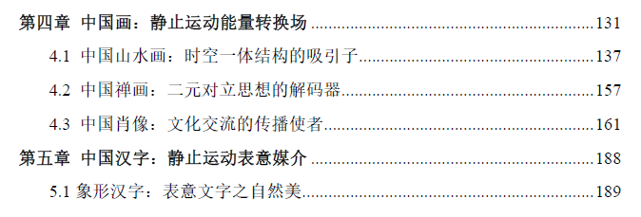
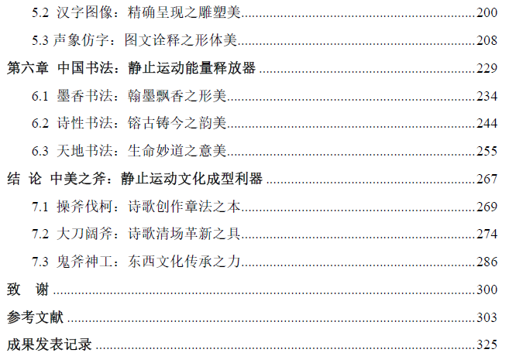

Slide 3
Semiotic Fitness: The Chinese Written Character and its Metamorphosis in Modern American Poetry
Introduction
The Semiotic Fitness Principle
The Transfiction Principle
The Chinese Written Character as a Translated Image
The Chinese Written Character as a Verbal-and-Visual Image
The Transformed Chinese Written Character as Thinking-and-Thinging Image
Conclusion
Contents

Slide 4
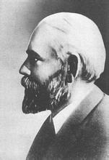
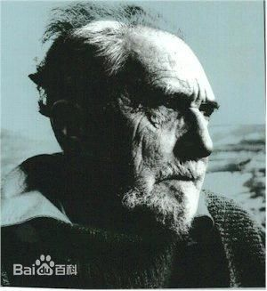
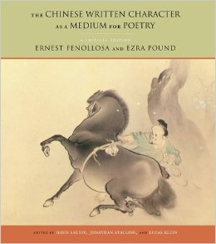
1. Introduction: 1913 Emergent Event in Modern American Poetry and Poetics
Ernest Fenollosa
(1853–1908)
Ezra Pound
(1885–1973)
The Chinese Written Character
as a Medium for Poetry
1903-1906: Ernest Fenollosa’s completion of the manuscript
1913: Mary McNeil Fenollosa meeting Ezra Pound three times: 29/09, 06/10, 11/10;
mid-December, Fenollosa’s notes and manuscripts concerning the
Chinese language, Chinese and Japanese poetry, and art were sent to Ezra Pound
1913: in March, Pound in London for the Imagist Movement ; three principles of Imagisme
with F. S. Flint

Slide 5
1913: Pound found an approach to “perfect Imagism with new models”: the first principle of
imagism, “Direct treatment of the ‘thing,’ whether subjective or objective” is in accordance
with the nature of the Chinese written character
1918: Pound’s compilation: The Chinese Written Character as a Medium for Poetry: An
Ars Poetica
1919: essays publication in No. 5, 6, 7, 8 of Little Review
1936: book publication with “Number 1 of Ideogramic Series” on the cover
Result:
the Chinese written character as a medium for modern English poetry
Pound’s invention of the ideogrammic method
“the juxtaposition of seemingly unrelated particulars capable of suggesting ideas and concepts through their relation” (Géfin 27)

Slide 6
Emergent Event:
In the history of twentieth-century American literature, the year 1913 is of significance, due to the Chinese written character’s official entry into modern American poetry and poetics.
It is the innovative use of the Chinese written character which triggered a revolutionary movement for literary Americanization: “Make it new.”
Philosophical Notion of Emergence
An “emergent” event is one whose novelty meets no available, matching or adequate discourse in representation, discussion or judgement.
When a physical system of sufficient complexity is a suitable configuration, new properties are “emergent” in a way that could not have been predicted from physical laws governing less complex or differently configured systems.

Slide 7
Pound’s complaint, commendation and expectation:
“the whole Occidental is still in crass ignorance of the Chinese art of verbal sonority”
Fenollosa’s essay as “a study of the fundamentals of all aesthetics” and “fruitful in ‘new’ western painting and poetry”
“an American renaissance”
T. S. Eliot:
Pound is the inventor of Chinese poetry for our time.
English literary critic and poet Donald Davie:
“a major document of twentieth-century American poetry and poetics,” “perhaps the only English document of our time fit to rank with Sidney’s Apologie, and the Preface to Lyrical Ballads, and Shelley’s Defence.”

Slide 8
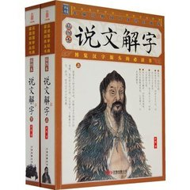
Misunderstanding of the Chinese Written Character
Pound takes all Chinese written characters as ideograms.
Liu Shu: Six Scripts or Six Graphic Principles or Principles of Chinese Writing
Shuo-wên chieh-tzu (Explanations of Simple and Composite Characters), a second-century dictionary script by Hsü Shen in 121 (East Han Dynasty 25-220).
Hsü Shen: only 4% were pictographic characters, while semantic-phonetic (or signific-phonetic) characters accounted for 82%.
象形、指事 【造字法】
形声、会意【组字法】
转注、假借【用字法】
xiang xing: Imitating the Form / simple pictogram
zhi shi: Pointing at the Thing
hui-yi: Understanding the Meaning / compound ideogram
xing-sheng: Harmonizing the Sound
zhuan-zhu: Mutually Defining
jia-jie: Borrowing

Slide 9
Fenollosa’s Awareness and Misunderstanding:
“the pictorial clue of many Chinese ideographs can not [sic] now be traced, and even Chinese
lexicographers admit that combinations frequently contribute only a phonetic value.”
“a large number of the primitive Chinese characters, even the so-called radicals, are
shorthand pictures of actions or processes” (Fenollosa and Pound 59, 46)
Ignorance of Two Writing Systems: the alphabetic and the ideographic
Wrong: The etymon of ideogram is naturally related to an ideographic writing system.
Fact: The ideogram has a link with the alphabetic writing system. For example, Egyptian
hieroglyphics, though originally pictographic, had already developed into sound language.
Pound: “The Egyptians finally used abbreviated pictures to represent sounds, but the Chinese
still use abbreviated pictures AS pictures”.

Slide 10
Two Lacking Studies
the direct appropriation of Chinese written characters in American poetic works
a mimesis of spatial visibility caused by transformed Chinese signs, a kind of linguistic metamorphosis using the romanized spelling or character dismantlement
Research Basis
The shared function of character or word dismantlement existing in both ideographic and alphabetic writing systems, in turn, makes the Chinese written character meaningful in another poetic language.
In the alphabetic system, such Chinese written characters or transformed Chinese signs appearing between the lines create visible images when they are presented to the audience in an unfamiliar way.
This distancing effect generates a power of spatial visibility, which attracts the reader’s attention.

Slide 11
Research Questions
What is the semiotic fitness principle? What is the transfiction principle? What are the interconnectedness between these two principles?
How do the Chinese written character and its linguistic metamorphosis act in modern American poetry?
How are the Chinese written character and its linguistic metamorphosis semiotically fit in modern American poetry?

Slide 12
2. The Semiotic Fitness Principle
Definition of Semiotic Fitness
Fitness depends on a relation: something can be fit in the given context.
— Jesper Hoffmeyer
Semiotic fitness in its broader sense can be defined as the success of a subject in adapting to its environment, its skill in bringing together information originating from itself and information originating from the environment with the help of semiotic processes. An organism is semiotically fit if it succeeds in interpreting its organismic information in respect to the surrounding environment and vice versa. While adapting to the environment the subject localizes itself in the environment; thus, semiotic fitness indicates success in localization. — Timo Maran
Meaning is definable by the environment. — Eugene Nida

Slide 13
Understanding Timo Maran’s Notion of Semiotic Fitness
Such a semiotic process is, to a degree, a reflection of a translator’s interpretative activities, which is referred to semiosis.
Three main elements – semiotic selection, semiosis, and semiotic fitness – are involved in the translation process: “semiotic selection” determines the value of the subject in its original culture, “semiosis” interprets the information of the subject, and “semiotic fitness” measures the acculturation of the subject in its new environment.
Maran posits that a subject can be analogous to a living organism. In order to survive, this organism-subject should be semiotically fit when “interpreting its organismic information in respect to the surrounding environment.”

Slide 14
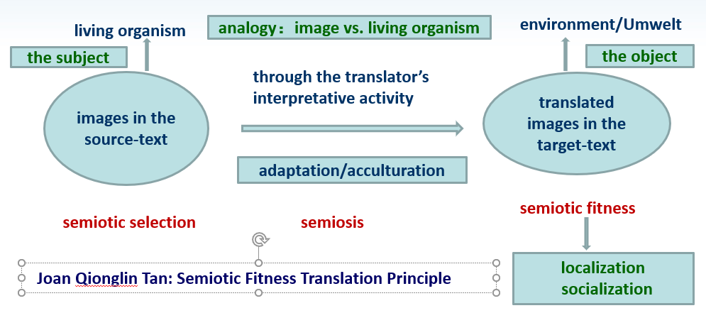
Through translation, a translated image, though changed in some aspects, is still related to the original image created by the translator. If a translated image is semiotically fit and embraced by the reader in the target culture, we can infer that the translated image is successful.

Slide 15
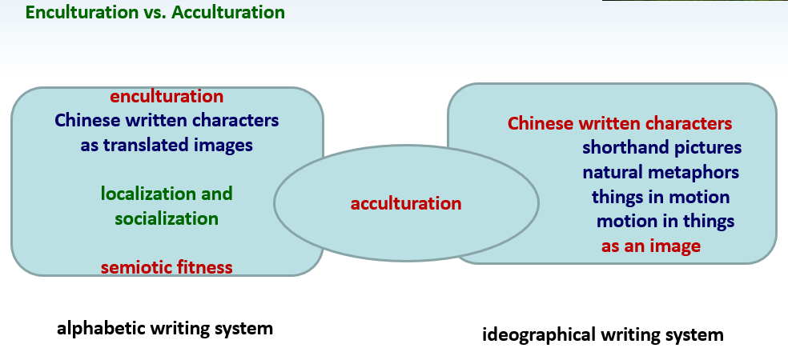
enculturation: the process by which an individual learns the traditional content of a culture and assimilates its practices and values
acculturation: cultural modification of an individual, group, or people by adapting to
or borrowing traits from another culture

Slide 16
3. The Transfiction Principle
While translating an image, the poet, acting as both the translator and the reader, recreates
such exotic imagery in literary production “by using the device of fictitious translation, i.e.
by presenting their work as the translation of another’s work.” His / her visualization is
much involved in the process of semiosis.
This visualization is a representation of a poet’s interpretative activities, or a manifestation
of a poet’s translatorial action, even translatorial power, when the Chinese written
character imagery is assimilated into another culture.
This kind of translation is now referred to as transfiction, a burgeoning field, which focuses
on the study of translation-related phenomena from a cultural-and-social perspective.
In transfiction, though no clear demarcation concerning the boundaries between fiction and
reality is attempted, “translation is not seen as a text-based activity but rather as a
metaphor for cultural processes.”

Slide 17
By contrast, “fiction” can be taken as “a privileged site in which our imagery finds the necessary
freedom to express even our most hidden obsessions and aspirations.” “As a result, change,
transformation, fragmentation, dislocation and cracks have become key coordinates for
understanding the motion created by translation.”
When the Chinese written character embedded in English poetry is examined from the
perspective of transfiction, we discover that the Chinese not only acts as an image, but that it
also can be understood as a translated image.
When a Chinese written character enters an English poem, its spatial visibility and pictorial
visibility make it function as a thing or a visual image in the alphabetical writing system, which
can be both read and seen.
However, for most Western readers, even the translator-poet, seeing a Chinese written
character as a thing is more natural than reading or pronouncing it, due to their limited
knowledge of Chinese writing.

Slide 18
At the same time, the adoption of the Chinese written character in another poetic language
is a kind of the translator-poet’s visual-creative “copy” or translation work to create a
translated image in his or her literary production.
As part of this creative process, selection, interpretation, imagination, appropriation and
adaptation are involved. The process of translation is, thus, similar to that of visualization as
well as the process of inter-signs or inter-symbols undertaken by the poet, whose aim is to
discover a language or a discourse to translate or communicate his or her own vision.
In this respect, a combination of interlingual translation, intralingual translation, and
intersemiotic translation is unavoidably involved in recreating the Chinese written
character imagery in literary works.
In essence, to examine the dramatically effective use of the Chinese written character in
Western poetry is to examine its semiotic fitness as a translated image in the alphabetical
system.

Slide 19
Gary Snyder’s Standard of a Classic:
The Classic provides a kind of norm. Not the statistical norm of behaviorism but a norm that is proved by staying power and informed consensus. Staying power through history is related to the degree of intentionality, intensity, mindfulness, playfulness, and incorporation of previous strategies and standards within the medium—plus creative reuse or reinterpretation of the received forms, plus intellectual coherence, time-transcending long-term human relevance, plus resonances with the deep images of the unconscious. To achieve this status a text or tale must be enacted across many nations and a few millennia and must have received multiple translations. (Snyder 2010: 79)
Snyder’s elaboration of the Classic provides a paradigm for measuring the Chinese written character as a successful translated image. The three “plus” principles he advocates are what the semiotic fitness principle adheres to.

Slide 20
谭琼琳终译：
经典（标准语）提供一种标准。但此“标准” 不是行为主义基于统计学的标准，而是由保持权威和达成共识所认可的一种标准。自古至今，保持权威与意图、强度、专注、愉悦和协作等因素所表现的程度密切相关。此外，相关因素还有：对已认可的标准形式进行的创造性的重新使用或诠释；知识的连贯性以及超越时代的、长期的人类共通性；无意识的潜在意象所引起的共鸣。为了达到这一目标，一个文本或一个故事必须传播到很多国家，传播几个世纪，且一定要有大量的翻译。
谭琼琳初译：
经典提供一种标准。不是行为主义使用的统计学标准，而是这样的一种标准—它的验证是通过长期保持的权威性和基于可靠信息的大众舆论。大众传播手段事前采取的策略和标准一定考虑其意图、强度、注意力、有趣性和相互结合等因素，而在历史上自始至终地保持经典的权威性是与这些因素的表现程度密切相关。此外，加上创造性的重新使用或重新诠释已经确认为标准的形式，加上知识阶层思想上的一致和超越时代长期的、人类的相关性，加上无意识的深度意象所引起的共鸣。为了达到这种的状态，一个文本或一个故事一定要传播到很多国家，传播几个世纪，且一定要有大量的翻译。

Slide 21
4. The Chinese Written Character as a Translated Image
Feasibilities of the Shifting of Two Writing Systems
In the evolution of written signs, apart from Chinese oracle bone script, other proto-written signs (such as Egyptian hieroglyphs, Sumerian cuneiform, Indus script and Maya glyphs) have long disappeared. These ancient logograms not only lacked the ability to capture and express philosophical ideas, profound thoughts, and deep feelings, but they also failed to record the mysterious, complicated things that happened in the physical world.
One fact, though, is unquestionable: that all written signs originate from pictograms or ideograms, which makes feasible the shifting of the Chinese written character from an ideographic system to an alphabetic system in poetic production. This shifting process depends upon both a written sign’s own graphemic creativity and the poet’s creative use of it.

Slide 22
Elaine S. Wong: Her conception of “graphemic creativity” “focuses more on creativity as a function of language than on the human agent’s power to create.”

Slide 23
The Chinese written character as an image and as picture-thing in the West
1811: Jean Pierre Abel-Rémusat, Essai sur langue et la littérature chinoises
Chinese characters “present to the eye not the sterile and conventional signs of pronunciation but things themselves. ”
Chinese ideogram does not try to the picture of a sound, or to be a written sign recalling a sound, but it is still the picture of a thing; of a thing in a given position or relation, or of a combination of things. It means the thing or the action or situation, or quality germane to the several things that it pictures. — Ezra Pound, ABC of Reading
Reading Chinese, for Fenollosa, was a process not of interpreting abstract signs but simply of seeing, of “watching things work out their own fate.” This conception of linguistic possibility appealed powerfully to Pound, who was in the midst of formulating his own notion of the poetic image as the supreme component, the only aesthetically valid component, of verse.
— Robert Kern, Orientalism, Modernism, and The American Poem

Slide 24
Ezra Pound’s Definition of an Image
An image is that which presents an intellectual and emotional complex in an instant of time. (seen vs. unseen)
It is the presentation of such a “complex” instantaneously which gives that sense of sudden liberation; that sense of freedom from time limits and space limits; that sense of sudden growth, which we experience in the presence of the greatest works of art. (mentality vs. art)
The primary pigment of poetry is the IMAGE. (poetry vs. painting)
Phanopoeia is “a casting of images upon the visual imagination.” (verbal vs. visual)

Slide 25
Joan Tan’s Deduction
An image is created by the poet’s imagination, which can be seen with the mind’s eye. An image is the basic, yet powerful component in a poem, through which the poet presents a picture of the things in his/her mind.
A translated image is an image translated, even recreated by the translator for his/her own purpose based on the source text. In a poetic form, it is the result of the translator-poet’s visual-creative “copy”/translation work in his/her literary production.
When Chinese written characters are taken as picture-things, they are cast as material images seen in poetry, resulting in their power of pictorial visibility.
Through the Chinese written character imagery, visualization and art are harmonized in a new form of visual poetry in the twentieth century, which had a great impact on imagist poetry, concrete poetry, and calligrammes.

Slide 26
Some Examples of the Chinese Written Character as a Translated Image
Ezra Pound’s Method of Inserting Chinese written characters in His Cantos
Pound inserted more than one hundred Chinese written characters between lines: some of
these are in accord with the Chinese Confucian culture, such as words concerning the ethical
codes: “benevolence,” “integrity,” and “happiness;” and words regarding the celestial symbols:
“sacrifice,” “spirit,” and “sensibility.”
To project the spatial visibility and pictorial visibility of the selected Chinese written characters
and make them readable, they are typeset into a boldface image, sometimes marked with
pronunciation and tone.
Typographically, this positioning makes a contrast with the lightface English words within the
text; sometimes an etymological interpretation provides a clue for readers to seek the unseen
relations between the lines.

Slide 27
Ezra Pound’s “Canto LIII” (53) from Cantos
If you can make it new every day, you will feel fresh day by day, and you have another new day.
Through his etymological interpretation, readers can understand that the poet’s purpose of clearing with an ax is to make it new by “cutting underbrush” and “keeping it growing.” The capitalized “MAKE IT NEW,” as both a translated image and a visual image, encourages readers to imagine its role toward a new American poetics.

Slide 28
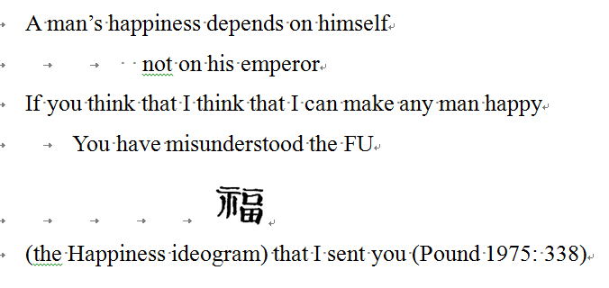
Ezra Pound’s “Canto LXI” (61) from Cantos
In order to interpret the Chinese written character correctly, Pound uses the bracket and the pronunciation “FU” to signify “the Happiness ideogram.” His poetic paraphrase, “A man’s happiness depends on himself,” but “not on his emperor,” enhance the readers’ understanding of this character. Accordingly, the character he selected and translated is semiotically
fit in the poetic stanza.

Slide 29
Gary Snyder: Another for the Same
…….
the best of your beauty
always hidden, yū 幽
“a glow of red leaves in the dark woods”
in your gray eyes.
This poem is composed after the poet watched the Noh play Sotoba Komachi and employed the Chinese written character 幽 to describe the beauty of Ono No Komachi (825–900?), a waka Japanese woman poet.
In Explanations of Simple and Composite Characters,幽 means “deep, serene, tranquil.” The oracle bone scripture is
In order to let readers better understand the status of tranquil beauty, the poet dismantles the character into 幽=山+红/纟+红/纟reliance upon the pictorial quality of its oracle bone scripture.
The double quotation marks of the line, “a glow of red leaves in the dark woods,” indicates the reliability of the text. The sound yū helps readers read it, whereas the character幽 makes readers see it as a picture. It also exhibits the poet’s visual imagination of “always hidden” beauty: the best beauty of a woman is hidden in her body, whereas the best beauty of nature is the whole body of nature hidden everywhere.

Slide 30
5. The Chinese Written Character as a Verbal-and-Visual Image
To the Western mind, the Chinese written character is the picture-thing whose materiality, owing to its spatial visibility and pictorial quality, makes it act as a visual image in poetry.
By contrast, as written sign, the Chinese written character is imagery, the immateriality with picture-as-code of which makes it function as a verbal image to express the imaginary thing in the mind.
Hence, from the perspective of interarts studies, the Chinese written character signifies a verbal-and-visual image to seek “the representation of the unrepresentable” (Krieger 22).

Slide 32
The Chinese Written Character and Chinese Calligraphy as Nature-Text
Historically, Chinese writing has been evolving for six thousand years, from the ancient script types, including the oracle bone script, bronze inscription, large seal script, and small seal script, to modern script types, including official script, cursive script, regular script, and semi-cursive
script.
Each type has its own typical handwriting, which has been developed into the art of calligraphy. In this respect, the Chinese written character is a representation of nature-text when the calligrapher imitates the traces left by winding streams, running lava, flickering wings, swaying
branches, and galloping hooves in the physical world.

Slide 33
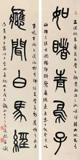
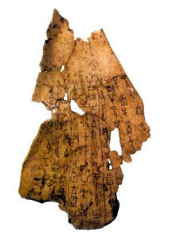
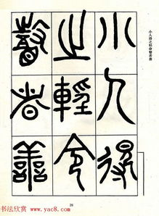
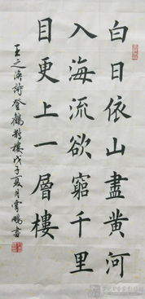
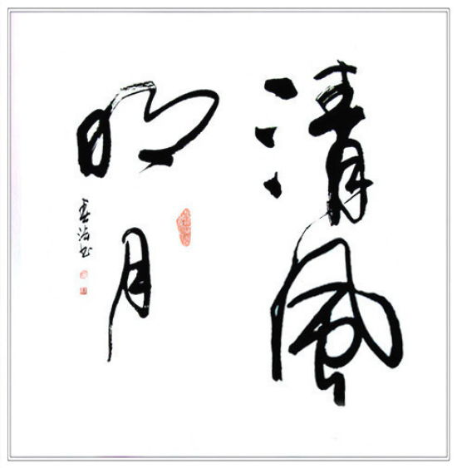
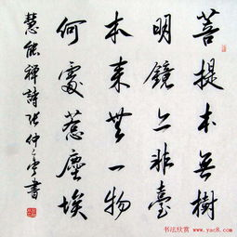
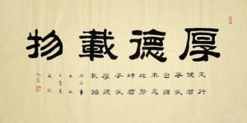
Evolution of the Chinese Written Character (around 6000 years)
oracle bones甲骨文
bronze inscription 金文
large seal script 大篆
small seal script 小篆
official script 隶书
cursive script 草书
semi-cursive script 行书
regular script 楷书

Slide 34
The Chinese Written Character as Natural Metaphor
Fenollosa explains that “the Chinese written language has not only absorbed the poetic substance of nature and built with it a second world of metaphor, but has, through its very pictorial visibility, been able to retain its original creative poetry with far more vigor and vividness than any phonetic tongue” (Fenollosa and Pound 55).
What Fenollosa discovered is the ontological principle of poetry writing extracted from the Chinese written language as natural metaphor: from the seen natural image to the unseen intellectual image.
Here, “the seen” signifies its superficial structure, indicating visual, natural actions, whereas “the unseen” uncovers its deep structure, suggesting a kind of spirituality beyond its materiality.

Slide 35
Fenollosa’s Discovery: the Ontological Principle of Poetry
“Chinese would be a poor language and Chinese poetry but a narrow art, could they not go on to represent also what is unseen. The best poetry deals not only with natural images but with lofty thoughts, spiritual suggestions and obscure relations. The greater part of natural truth is hidden in processes too minute for vision and in harmonies too large, in vibrations, cohesions and in affinities. The Chinese compass these also, and with great power and beauty.”
As natural metaphor, the Chinese written character has its own “power and beauty,” due to its graphemic creativity and pictorial visibility. Energy erupts when “[p]oetic thought works by suggestion, crowding maximum meaning into the single phrase pregnant, charged, and luminous from within.”
This eruption represents the semiotic fitness of the Chinese written character in adapting to its new environment – when both the seen and the unseen qualities are successfully presented in another language through the interpreter’s semiotic selection and semiosis.

Slide 36
This stanza is adapted from Snyder’s translation of “Climbing Crane Tower” by Wang Zhihuan, a Tang poet.
The poem encourages the enlightened beings, represented as the stones, the trees, the moth and the deer, to speak out their enlightenment through “the use of light. ”
The poet passes the seen material light into the unseen immaterial relations. The Chinese traditional written character 禪 (Chan/Zen) at the bottom suggests that the Buddha light---Prajna/wisdom---will be used for transcendence and enlightenment.
Gary Snyder: The Uses of Light
……
A high tower
on a wide plain.
If you climb up
One floor
You will see a thousand miles more.
禪
The white space between the character禪 and the English line “You will see a thousand miles more” indicates the transcendence will enable people to see the real land. This character acts as a mental image / metaphor for a “right seeing” of the cultural and political situation.

Slide 37
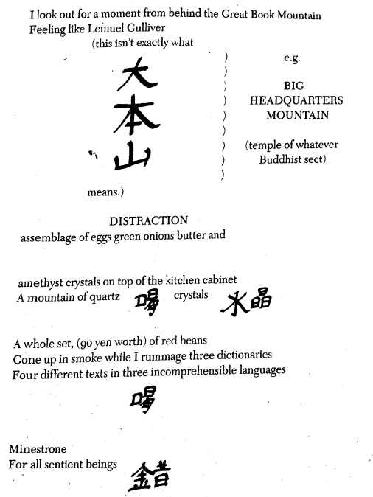
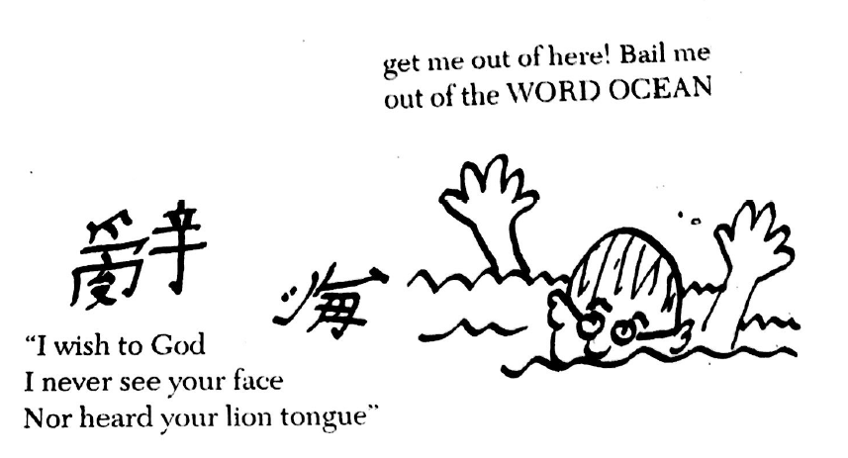
Philip Whalen: Scenes of Life at the Capital
Whalen points out that some serious mistakes are unavoidably made if the Chinese written character is understood word by word, in particular when the character is a polysemant.
To alert other poets, Whalen, like a painter or a calligrapher, draws a simple picture with special pigment in this poem: a man with glasses is dropped into the “word ocean,” where he screams out: “get me out of here! Bail me out of the WORD OCEAN.”

Slide 38
6. The Transformed Chinese Written Character as Thinking-and-Thinging Image
Imitation of Character Dismantlement with Typographical Design
Unlike the calligrams of the concretists, modern American poets have created their own poetic
form, the “concrete ideogram,” which is a less visually abstract use of word design. Instead,
more pictorial Chinese ideogrammic elements are employed in their creative works; hence,
typographic design is a crucial means to make the whole poem look like the “thing” depicted
phonetic writing.
In their poetic experiments, American poets prefer to use indented lines, white space,
romanized spelling, and character dismantlement in the text. They attempt to make the
transformed Chinese written character function as a thinking-and-thinging image.

Slide 39
Character dismantlement is “the Chinese rhetorical device based upon graphemic recombination of characters,” which shows “the regenerative vitality of a graphemic system that can also be found in alphabetic writing.”
“In graphemic creativity, the expression becomes an expressible that intervenes in sense together with content-expressible.”
The poet’s graphemic creativity enables him/her to make words into picture through typographical design of alphabetic letters, which are expressible in both sense and content.

Slide 40
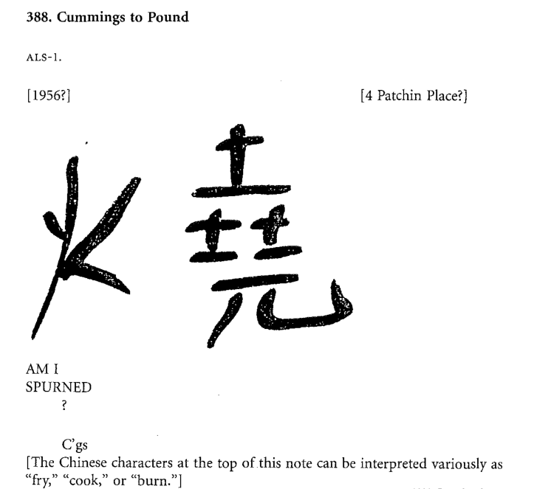
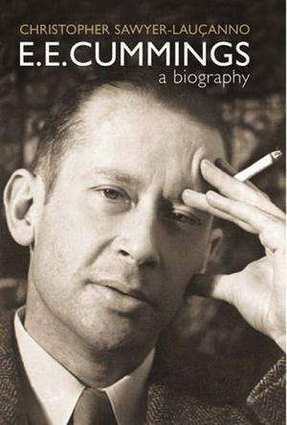

Slide 41
Beautiful
is the
unmea
ning
of (sil
ently) fal
ling (e
ver
yw
here) s
Now
falling snow: an material image
beautiful: unseen immaterial concept, features: pure, simple, natural, yet sometimes transitory
Beautiful is the unmeaning of (silently) falling (everywhere) snow
Character Dismantlement:
Beautiful snow: here and Now
unmeaning: unmea-ling, sil-ently, fal-ling, e-ver-yw, s-Now
sound of falling snow: ning, ling, sil, s

Slide 42
The poet employs the material image “falling snow” to visualize the dynamic process of nature
and make the reader perceive what is “beautiful.”
To express “the unmeaning of falling snow,” Cummings adopts the character dismantlement approach to split “unmeaning” into “unmea + ning,” which interrupts the continuity of the meaning. His direct treatment of “falling snow” as an “unmeaning” thing corresponds to the first principle of Imagism that Pound advocated.
To project its spatial visibility and temporal transiency, the poet dismantles “everywhere” into “e + ver + yw + here” and “snow” into “s + Now,” in which the meaningful phrase “here and Now” induces readers to experience the visuality of snow falling everywhere.
The capitalized “Now” illustrates a visual picture of the momentarily falling snow “here,” right on the spot which the poet sees or pictures mentally. Also, the dismantled parts, like “ning,” “ling,” “sil,” and “s,” make readers “here” seem to hear the sound of “silently falling snow.”

Slide 43
Cummings utilizes his typical “visual stanza,” a spatial structure, in this “falling snow” poem to “create meaning which is not present in the words themselves” (Heusser 278). In such a “visual stanza” poem, “lines are arranged in reference, not to rhyme and meter, but to a shape reflecting the poet’s thought” (Triem 12).
For Cummings, the main qualities of “beautiful” are embodied in pure, simple, natural, yet sometimes transitory things, like “falling snow” in the physical world.
In this poem, through the material image of “falling snow,” the poet, therefore, unravels the unseen immaterial relations with the concept of “beautiful,” in which “the expression becomes an expressible that intervenes in sense together with content-expressible” (Wong 7).

Slide 44
Manifest Intertextuality of Thinking and Thinging
Manifest intertextuality is another approach used by American poets to seek the representation of the unseen relation in the process of acculturation. It is used to describe the explicit reference within a text to other texts.
It extends Julia Kristeva’s original concept of intertextuality, which is defined as “the transposition of one or more systems of signs into another, accompanied by a new articulation of the enunciative and denotative position” (Kristeva 15).
“In manifest intertextuality, individual other texts are explicitly present in the text under analysis” (Fairclough 1992: 271). Its objective is “to specify what other texts are drawn upon in the constitution of the text being analysed, and how” (Fairclough 2006: 233).
William Carlos Williams: No ideas but in things.
Wallace Stevens: No ideas about the thing but the thing itself.
Ezra Pound: Direct treatment of the “thing,” whether subjective or objective.
Ernest Fenollosa: Thinking is thinging.

Slide 45
Allen Ginsberg: Wichita Vortex Sutra
Language, language
Ezra Pound the Chinese Written Character for truth
defined as man standing by his word
Word picture: forked creature
Man
standing by a box, birds flying out
representing mouth speech
……
The war is language,
language abused
for Advertisement,
language used
like magic for power on the planet:
Black Magic language,
formulas for reality—
Communism is a 9 letter word
used by inferior magicians with
the wrong alchemical formula for transforming earth into gold
信 = 人 + 言
言 = 人 + 丶 + 口
Manifest Intertextuality
Fenollosa’s Essays
“Man and word, man standing by his word, man of his word, truth, sincere, unwavering.”
“The word sign is radical supposedly from combination of tongue and above: ? Mouth with tongue coming out it.”

Slide 46
The title “vortex” has a twofold meaning:
Pound’s poetic revolutionary movement in the wake of imagism (later “vorticism”) that Ginsberg claims to follow;
the nation’s crisis of integrity, for it is now falling into a vortex.
The word “sutra” suggests that this poem appears to be like a Buddhist teaching on integrity.
Thinking-and-Thinging
The dismantled part “mouth” from the character “word,” “representing mouth speech,” makes the character “truth” in this poem shift from the moral thinking of the “truth” to the natural process of the “word picture,” a sort of thinging.
Language is a record of one’s thinking, but its unseen power should not be ignored, for it can be used as a weapon.

Slide 47
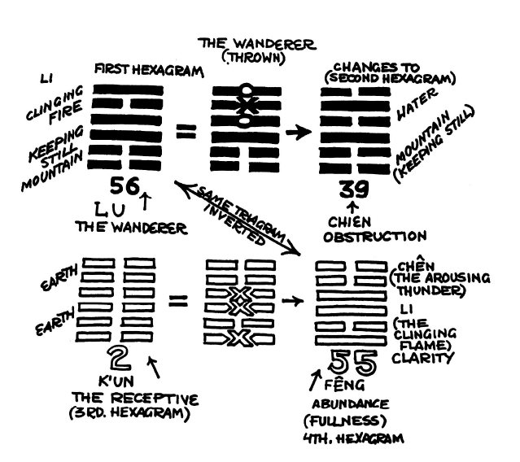
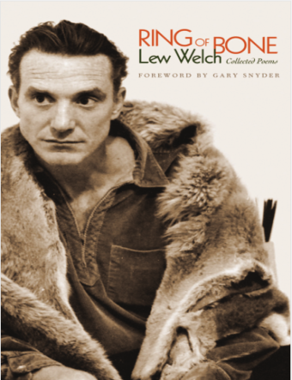
Lew Welch (1926-1971)
The Wanderer
dynamic changes of signs/trigrams
from — to ‒ ‒ with O: broken
from ‒ ‒ to — with X: unbroken

Slide 48
There was fire on the mountain,
And, seeking to put it out,
he chose to move to the right—
an Easterly direction, against
all Nature (for he had not
noticed that the Sun, his sign,
moves Westerly—and that all
Men follow the Sun.
Thus the Wanderer walked
All the 64 spokes of the
Great Wheel—of course,
he was fortunate enough,
or fool enough, to have
lept over many of the
Stations of The Way.
Perhaps he was only born
upside down, or with his
eyes turned in the wrong
direction
……
his wandering would have ended in a single step —
his present abundance almost instantly known
……
Forgive me for being so stupid for taking too much time to see.

Slide 49
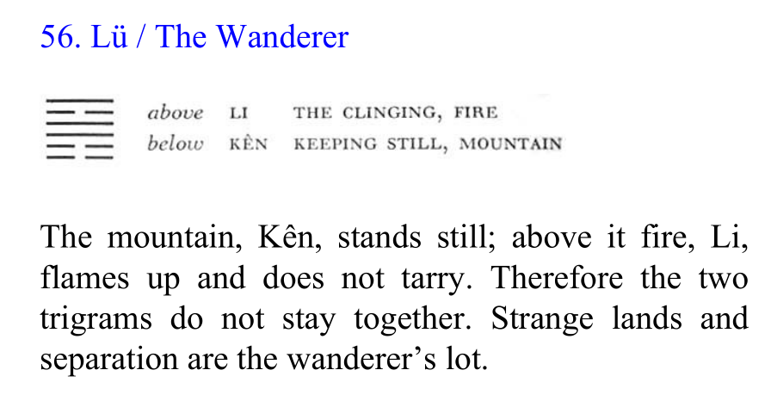
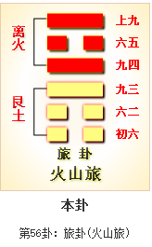
The first stanza is about the first hexagram LU (THE WANDERER), which consists of two trigrams: LI (☲, CLING FIRE) and KEN (☶, KEEPING STILL MOUNTAIN).
The poem starts a description of “fire on the mountain” and his “seeking to put it out.”
When he “chose to move to the right,” the poet found his destiny is changed, due to the wrong direction.

Slide 50
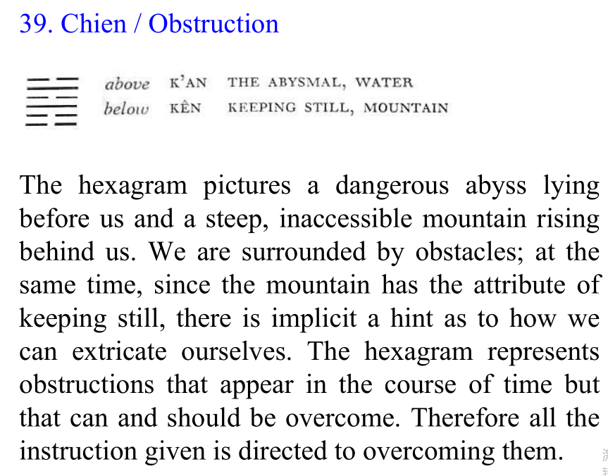
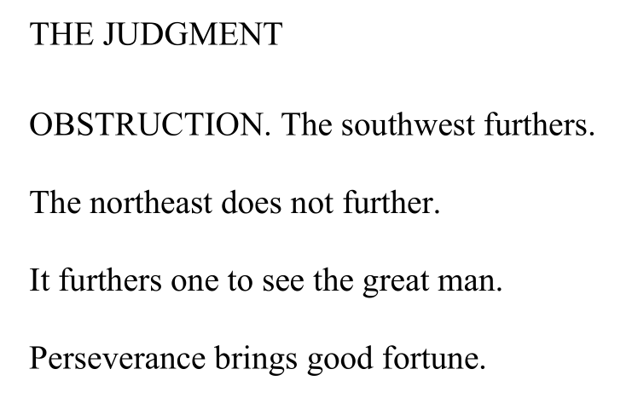
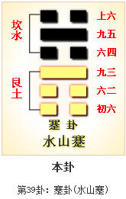
In the second hexagram, because “fire, LI, flames up and does not tarry,” LI (☲) is now changed into KAN (☵), “the abysmal, water” situation.
The Chinese character for CHIEN can be dismantled into two parts: “obstruction” and “feet,” a visual perception of overcoming obstacles by walking.
39 蹇卦：利西南行，不利东北行
蹇 = 塞 + 足，obstruction, difficulties

Slide 51
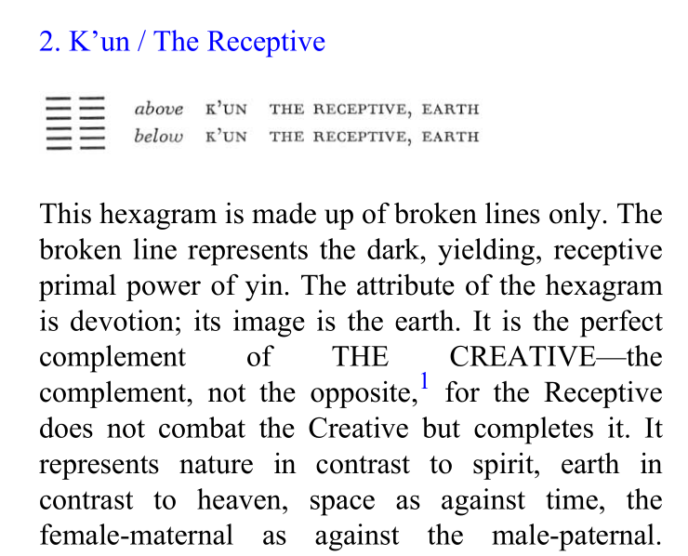
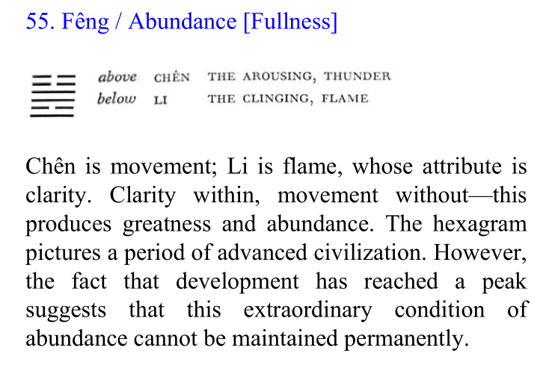
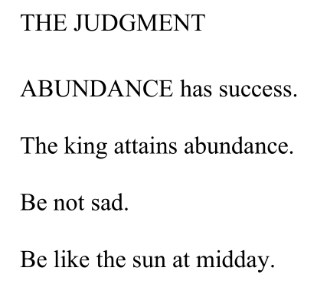

Slide 52
Manifest Intertextuality
Cultural Conceptual Metaphor: Life is a journey.
between the poet’s hand-made trigram/hexagram and the text The Wanderer
between the poet’s hand-made trigram/hexagram and I Ching (The Book of Changes)
between the poet’s life experience (away from the Beat Generation Literary Movement) and the text The Wanderer
Interart Studies
Chinese ideograms within English alphabetical writing system
calligraphy with bold type and lean type
life circle with four hexagrams: 56, 39, 2, 55
ekphrastic poem with trigrams/hexagrams

Slide 53
Philosophical Ideas of Four Hexagrams as Life Circle
56 and 55 can be inverted for they are the same trigrams, so “perseverance brings good fortune for the wanderer” (56 Lu).
“When one encounters an obstruction, … the correct thing is, … to retreat for the time being, … [and] to await the right moment for action” (39 Chien).
“The receptive brings about the sublime success, furthering through the perseverance of a mare,” for “quiet perseverance brings about good fortune” (2 Kun).
Hence, “to bring about a time of abundance, a union of clarity with energetic movement is needed” (55 Feng).

Slide 54
Lew Welch’s Life Wrong Direction as Thinging
Welch unfortunately missed the famous historical poetry reading at the Six Gallery in San Francisco in October 1955, launched by Kenneth Rexroth, Allen Ginsberg, Jack Kerouac, Gary Snyder, Philip Whalen, and Michael McClure, when he went to Chicago for part-time work.
Lew Welch’s Han Shanian Death as Thinging
On May 23, 1971, Welch walked out of the poet Gary Snyder's house in the mountains of California, leaving behind a suicide note. He had carried a stainless steel Smith & Wesson .22 caliber revolver. His body was never found.

Slide 55
Lew Welch’s Life Wrong Direction as Thinking
His journey from San Francisco to Chicago is absolutely “an Easterly direction against all Nature” as he depicts in his poem, for he had not anticipated the influence of this poetry reading in society, nor did he realize that this historical meeting of young poets from eastern and western coasts would be recorded as a big event in American literary history.
Lew Welch’s Han Shanian Death as Thinking
The poem may suggest his own philosophical thinking about his planned mysterious death, for the poet addresses his wife Magda: “It’s enough to be home, / at last, Magda, for / when you found me I / wasn’t even wandering / anymore, just lost— / Abundance, fullness, right / before my eyes” (218).
The fourth hexagram 55 (FÊNG) is the same hexagram inverted as the first hexagram 56 (LU), indicating a life circle, from dust to dust.

Slide 56
7 Conclusion
Of the unprecedented influence of the Chinese ideogram in Western poetry, in particular in modern American poetry, Fenollosa asserted in the opening of his manuscript, “[t]his twentieth century not only turns a new page in the book of the world, but opens another and a startling chapter” (Fenollosa and Pound 42).
This startling chapter is about the advent of the Chinese written character (including its linguistic metamorphosis) as a medium for modernist poetry, which points towards a new poetics of literary visual culture.

Slide 57
When the Chinese written character as an image or a translated image is semiotically fit in its new environment, we cannot take for granted that it is only one character or a combination of characters as picture-thing placed in another language. It should be understood as an intertextual or a manifest intertextual text, in which the deep structure of the character,
including philosophical thinking, can be interpenetrated through the seen material character to its unseen immaterial relations, eventually to achieve its semiotic fitness in its adapted environment.
In this sense, manifest intertextuality involving the Chinese written character in modern American poetry is a reflection of Fenollosa’s organicism: “The real process of thought does not merely label things, like so many apothecary’s jars on a shelf. A thought grows like a living tissue”; “thinking is thinging, to follow the buds of fact as they open, and see thought folded away within thought like so many petals.”

Slide 58
In light of Fenollosa-Pound’s ideogrammic-etymological method, we have to acknowledge that Fenollosa emphasized the Chinese written character as nature metaphor, a vehicle for English poetry.
By contrast, Pound invented the ideogrammic method out of the Chinese written character and took it as a scientific method, a method of poetry generated out of its etymological link with the root of the Chinese written character as picture-thing.
In Pound’s view, “Fenollosa’s essay was perhaps too far ahead of his time to be easily comprehended. He did not proclaim his method as a method. He was trying to explain the Chinese ideograph as a means of transmission and registration of thought” (Pound 1961: 19).
What Pound cares about is “to get his method correct, the method for The Cantos and for modernist poetry;” rather than “whether he represented the Chinese character correctly or Fenollosa correctly (Qian 2003: 152).

Slide 59
The Poundian ideogrammic method fascinated many young American poets in the 1950s so that they started to translate, imitate, emulate and innovate the Chinese ideogram as an image and as translated image in their own poetic writing.
For them, the application of the ideogrammic method goes beyond how to understand the Chinese written character itself; it is not only a new method for their poetry writing, but also a new tradition deviating from the mainstream represented by giants such as T. S. Eliot.
Following the Poundian ideogrammic tradition means that they would have the chance of becoming “part of a movement representing a ‘new poetry,’ one generated by an altered conception of the poet’s relation to phenomenological and artistic experience” (Beech 19).

Slide 60
As both images and translated images, by self-entanglement, Chinese written characters produce beauty and power, which enables them to be semiotically fit in modern American poetry. Like living organisms, the survival of Chinese written characters in another language articulates their success in reinterpreting related organismic information while adapting to its new environment.
Whatever etymological, historical, or aesthetic strata they reside in, as verbal-and-visual images in modern American poetry, Chinese written characters testify to both the success of a revolutionary art of words into pictures, and the semiotic fitness of the Chinese written character as a translated image in a target language.
As David A. Colón holds, “[t]he ‘ideogram’ must be understood as a protracted endeavor that spanned the entire Modernist period.”

Slide 61
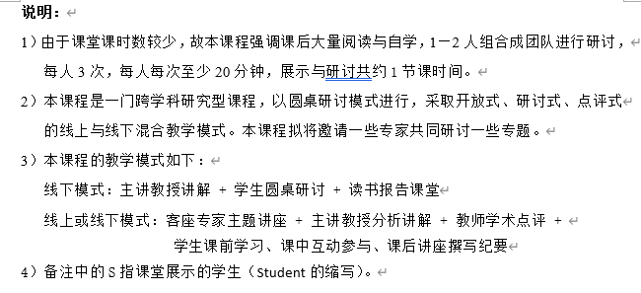
Assignment for Next Week

Slide 62
THANK YOU

