Slide 1
SUFE Year 1 Postgraduates
A Critical Study of English Poetry
Lecture Four Work, Chan and Ecology:
Rethinking Gary Snyder’s First Lyric Poetry Riprap
Prof. Dr. Joan Qionglin Tan
tan.qionglin@mail.shufe.edu.cn
厚德博学
经济匡时

Slide 2
Work, Chan and Ecology:
Rethinking Gary Snyder’s First Lyric Poetry Riprap
The Clasification of Snyder’s Poetry
Debate and Criticism: The Discrete Structure
Riprapping: Snyder’s Ideogrammic Method
Paratext: An Invisible, Yet Logical Theme
Ecological Poetic Narration: Work, Chan and Ecology
Weakness in Riprap
Conclusion
Contents

Slide 3
1 The Corpus of Snyder’s Poetry
Two Classes: Lyrical Poems and Mythical Poems
Snyder’s Self-assessment: I write lyrical poems which are shorter and which are pretty easy to understand on one level. […] The other type is […] more on the order of working with myths and symbols and ideas. Working with old traditions and insights.
Two Parallel Traditions: the Occidental and the Oriental
Occidental: American culture (including that of the American Indians)
the major Western influences: D. H. Lawrence, Ezra Pound, Robert Duncan, Charles Olson, Robinson Jeffers and Kenneth Rexroth
Oriental: Chinese and Japanese culture
the major Oriental influences: Han Shan, Chinese classical poetry, Chinese landscape painting, Mahayana Buddhism (including Chinese Chan and Japanese Zen), Japanese Haiku and Japanese Nō plays
Consensus Among Critics
These two traditions are yoked skillfully to give a unity to his poetry.

Slide 4
Snyder’s Preference to Chinese Culture (Poetry, three teachings and landscape painting)
The Paris Review Interview in 1996
It is a karmic empathy that is inexplicable. I love Japanese literature and Japanese poetry too, but I feel a deep resonance with Chinese poetry.
The East West Interview in 1977 (recalling his study at Reed College 1947-1951)
I read Ezra Pound’s and Arthur Waley’s translations of Chinese poetry, a translation of the Tao Te Ching, and some texts of Confucius.
My interest in writing brought me to the twentieth-century modernists and Chinese poetry; and my thoughts on nature and wilderness brought me to Taoism and then to Zen. This growing awareness of Zen was also interwoven with the discovery of Chinese landscape painting.

Slide 5
Snyder’s Statement on His Lyric Poetry
I tried writing poems of tough, simple, short words, with the complexity far beneath the surface texture. In part the line was influenced by the five and seven-character line Chinese poems
I’d been reading, which work like sharp blows on the mind.
I would like to work at deep sea levels, a little bit up from that absolute bottom transparency of the Chinese type poetry, a little more mythic, a little more archetypal.
Two Levels of Snyder’s Statement
1. Snyder concentrated on the imitation and innovation of Chinese poetic aesthetics:
nature-Chan images, laconic diction, elliptical syntax, paralleled structure, and empty space
2. Snyder tried to express “the complexity” :
meditation on American wilderness, ecological concerns, ineffable emptiness and satori

Slide 6
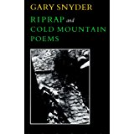
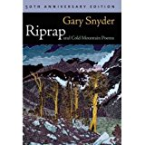
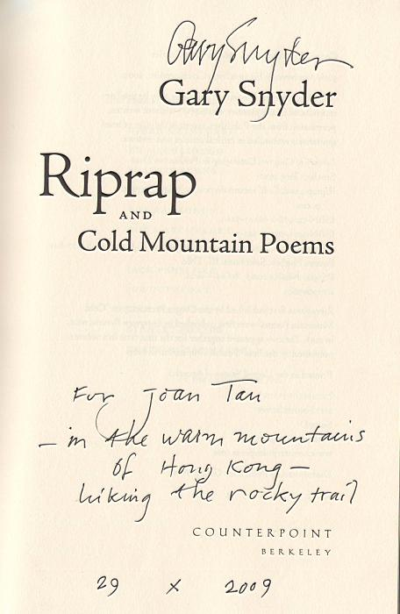
2 Debate and Criticism: the Discrete Structure
Publication of Riprap
1958: Cold Mountain Poems (Evergreen Review 2.6 (1958): 68-80)
1959: Riprap
1965: Riprap, & Cold Mountain Poems (San Francisco: Four Seasons Foundations)
1990: Riprap and Cold Mountain Poems (the new edition) (New York: North Point Press)
(later 1999, 2003)
2009: Riprap and Cold Mountain Poems (50 th anniversary)

Slide 7
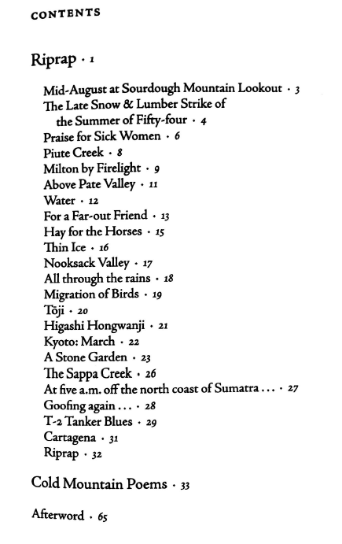
Contents of Riprap and Cold Mountain Poems
23 poems + his translation of 24 Han Shan’s poems
interconnectedness between Han Shan, Chinese poetics, Chan/Zen Buddhism and American wilderness
The last title poem “Riprap” as a summation of Snyder’s unique aesthetic or ideogrammic method riprapping.
Criticism from Critics: A Discrete Structure
These poems do not connect, they are discrete.
They possess incoherent syntax, unrelated theme and monotonous typography.
Q: Does Riprap really possess a loose, discrete
structure? If not, how to prove it logically?

Slide 8
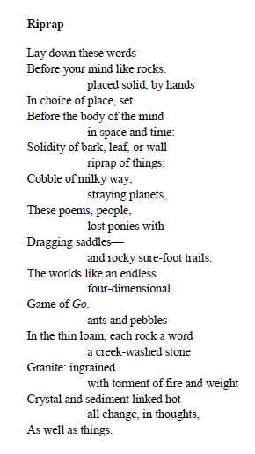
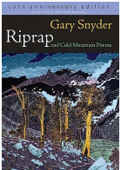
谭琼琳：加里·斯奈德的“砾石成道”表意法研究，《外国语》2012年第3期第149-156页。
1 a video link to Snyder’s reading Riprap
2 Riprap by Snyder

Slide 9
3 Riprapping: Snyder’s Ideogrammic Method
About the Title Riprap
Riprap as Technique for Rock Pavement
“Riprap” is a technical word for laying rocks on a rough, eroding trail leading up to mountains or down to mines. This technique for rock pavement came from England and Scotland to American Yosemite in the 1950s by those immigrants who had preserved this oral tradition in their work with stones for more than one thousand years.
Riprap as Subsistence for Gary Snyder
Riprap has become the single most important erosion-control trail technique in the Sierra, where Snyder worked part time as a trail crew labourer in the summer of 1955 and learned this rock-laying technique from others.

Slide 10
Riprap as Snyder’s Poetic Technique
Snyder: Riprap is really a class of poems I wrote under the influence of the geology of the Sierra Nevada and the daily trail-crew work of picking up and placing granite stones in tight cobble patterns on hard slab. “What are you doing?” I asked old Roy Marchbanks. - “Riprapping,” he said. His selection of natural rocks was perfect - the result looked like dressed stone fitting to hair-edge cracks. Walking, climbing, placing with the hands.
Joan’s Conclusion
Snyder gleaned the idea of “riprapping” from two sources: his concept of ‘”he real work,” and his Chinese language and poetry seminars with Professor Ch’en Shih-hsiang. It may be safe to say that Snyder drew his inspiration from both his personal experiences and from Chinese poetry.

Slide 11
One definition with two levels:
1) riprap: a cobble of stone laid on steep, slick rock to make a trail for horses in the mountains.
2) Poetry a riprap on the slick rock of metaphysics
This bipartite feature, surface texture and deep structure, is what Snyder pursued in his poetry.
Features of Classical Chinese Poetry
the absent ‘I’ dissolving into nature as a phenomenon; the adoption of nouns, verbs and adjectives as dynamic nature pictures; the selection of laconic words, asyndetic syntax or paralleled structures, etc.

Slide 12
Pound’s Ideogrammic Method vs. Snyder’s Riprapping Ideogrammic Method
The Paris Review Interview in 1992
Weinberger: Were you getting the ideogrammic method from Pound or from the Chinese poetry directly?
Snyder: From the Chinese poetry directly. I could never make sense of that essay by Pound. I already knew enough about Chinese characters to realize that in some way he was off, and so I never paid much attention to it.
Poundian Ideogrammic Method
the juxtaposition of seemingly unrelated particulars capable of suggesting ideas and concepts through their relation

Slide 13
Snyder’s Notion of Ideogrammic Method
It is a fragmented text which appears fragmented but actually leads you somewhere because the relationships that are established between the fragments express a deeper level of connectedness, which becomes clear to the reader’s mind if he is able to follow it.
Snyder’s Statement about His First Lyric Poetry Riprap
The idea of a poetry of minimal surface texture, with its complexities hidden at the bottom of the pool, under the bank, a dark old lurking, no fancy flavor, is ancient. It is what is “haunting” in the best of Scottish-English ballads and is at the heart of the Chinese shi (lyric) aesthetic. […] In some of the riprap poems, then, I did try for surface simplicity set with unsettling depths.

Slide 14
About the Title Poem Riprap
the surface texture is made up of rocks:
“pebbles”; “a creek-washed stone”; “Granite: ingrained / with torment of fire and weight”; and “Crystal and sediment linked hot”
2. riprap of things: solidity of bark, leaf, or wall
As “riprap of things”, those rocks are placed “by hands” to make “rocky sure-foot trails.”
3. The complexity is caused by the rocklike words related to “the body of mind.”
In Snyder’s mind, shaping an ecopoetic way is like riprapping in the workplace of ecopoetry. The purpose is to place ecological concerns in mind to make an ecological “sure-foot” trail. This is much the same as “picking up and placing granite stones in tight cobble patterns on hard slab” to “make a trail for horses in the mountains.”

Slide 15
Riprap
word vs. rock
Word, as a structure-unit of a poem, must have the substance and weight of a rock.
To compose a poem means to choose and lay down words before the mind and not after the mind, for an eco-poet learns that writing an eco-poem is a natural process.
An eco-poet, like an artisan, needs to select and filter a variety of elements from other cultures to write his eco-poems. This action should be finished “before the mind.”
Clearly, there is a difference between Gadamer’s belief that reality occurs within language and Snyder’s belief in a reality before language. Reality is experienced for Gadamer in language and for Snyder in mind.
Lay down these words
Before your mind like rocks.
placed solid, by hands
In choice of place, set
Before the body of the mind
In space and time:
Solidity of bark, leaf, or wall
riprap of things:
Misunderstanding
码放好这些词语
在你的心灵变得像岩石之前。

Slide 16
Snyder’s Notion of Word and World
A poet sort of faces two directions: one is to the world of people and language and society, and the tools by which he communicates his language; and the other is [to] the non-human, non-verbal world, which is [the] world of nature as nature is itself, and the world of human nature - the inner world - as it is itself, before language, before custom, before culture. There’s [sic] no words in that realm. There aren’t any rules that we know and that’s the area Buddhism studies, and that’s why you can’t talk about it: because it’s not concerned with anything that you can talk about.

Slide 17
Cobble of milky way, straying planets, These poems, people, lost ponies with Dragging saddles— and rocky sure-foot trails. The worlds like an endless four-dimensional Game of Go.
Once a poet determines to take ecological concerns as his obligation, it means that he comes to the entrance of the Ecopoetic Mountain.
A novice will get lost easily, like “lost ponies with dragging saddles” on the trail, or “straying planets” off course. But the final goal is to make “cobble of milky way,” or “rocky sure-foot trails.”
The “Game of Go” is a Chinese or Japanese game, where a rock or heavy object is thrown to determine the possibility and order of movement. The hopping and strategic positioning of elements is achieved with things in the world, just as poetic composition will be achieved with words in nature.

Slide 18
Body (real work), speech (poetry) and mind (Chan), in Snyder’s eyes, are all material things, no matter how big (planets) or how small (ants, pebbles).
In this constantly changing world, “with the torment of fire and weight,” rocks will be changed into granite, crystal and sediment.
Likewise, when different cultures, thoughts and passions encounter each other, they will infiltrate, change and melt.
ants and pebbles
In the thin loam, each rock a word
a creek-washed stone
Granite: ingrained
with torment of fire and weight
Crystal and sediment linked hot
all change, in thoughts,
As well as things.

Slide 19
Summary: Riprap
“Riprap” can be seen as Snyder’s formal aesthetic statement in poetic form. The poem itself is a good example of presenting the reader with “the complexity far beneath the surface texture.”
To create visual effects, Snyder mimics Chinese landscape paintings to give appropriate blank space. He often deals with this through his use of indented lines, that is, through a visual and spatial dismemberment of the line into small units.
The arrangement of lines in “Riprap” is, when seen from the bottom, like solid rocky steps up a mountain. To express ineffable nonduality, emptiness and satori, Snyder likes to employ phrases as compositional units and small nature-Chan images.

Slide 20
In “Riprap,” the image of burning rocks alludes to sudden satori after the Buddhist Fire. Through burning, all things are changed. People achieve transcendence in a similar way to the transformation of rocks into granite, crystal and sediment.
To illustrate the nature of nature, Snyder often borrows features of Chinese classical poetry such as the absent “I” dissolving into nature as a phenomenon, the adoption of nouns, verbs and adjectives as dynamic nature pictures, and the selection of laconic words, asyndetic syntax or paralleled structures.
Such linguistic characteristics also signify that human being as subject should have less control of nature, and let nature sing its own songs. It is in accordance with Snyder’s notion of form and emptiness from his study of Heart Sutra.
Form–leaves things out at the right spot / ellipse, is emptiness.

Slide 21
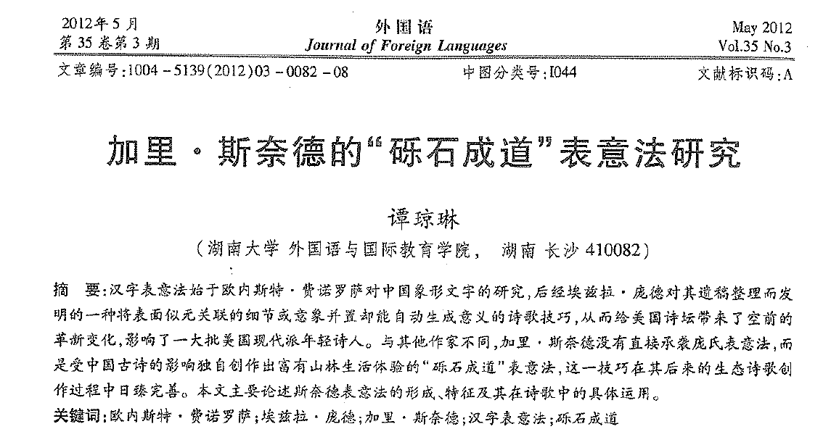

Slide 22
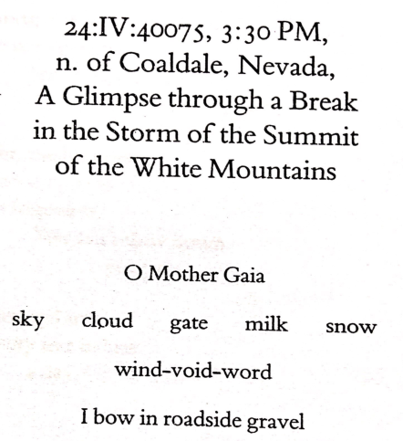
1) This is a typical poem of immediacy on sudden enlightenment. The title is rather long: 《1975年4月24日下午3点半在内华达州科尔代尓鬼城北部，于白山峰顶骤降暴风雨时一瞥》（Axe Handle，71）
2) The poet used the Paleolithic dating system to write 1975 as 40075, aiming at creating a sense of remoteness, mystery and immediacy. There is no punctuation mark in the whole poem. Besides the last sentence, the first three lines of poems are all brief superposition of noun images, which are similar to Chinese nature images using nouns. It represents the typical feature of the Chinese written character: things in motion, and motion in things.

Slide 23
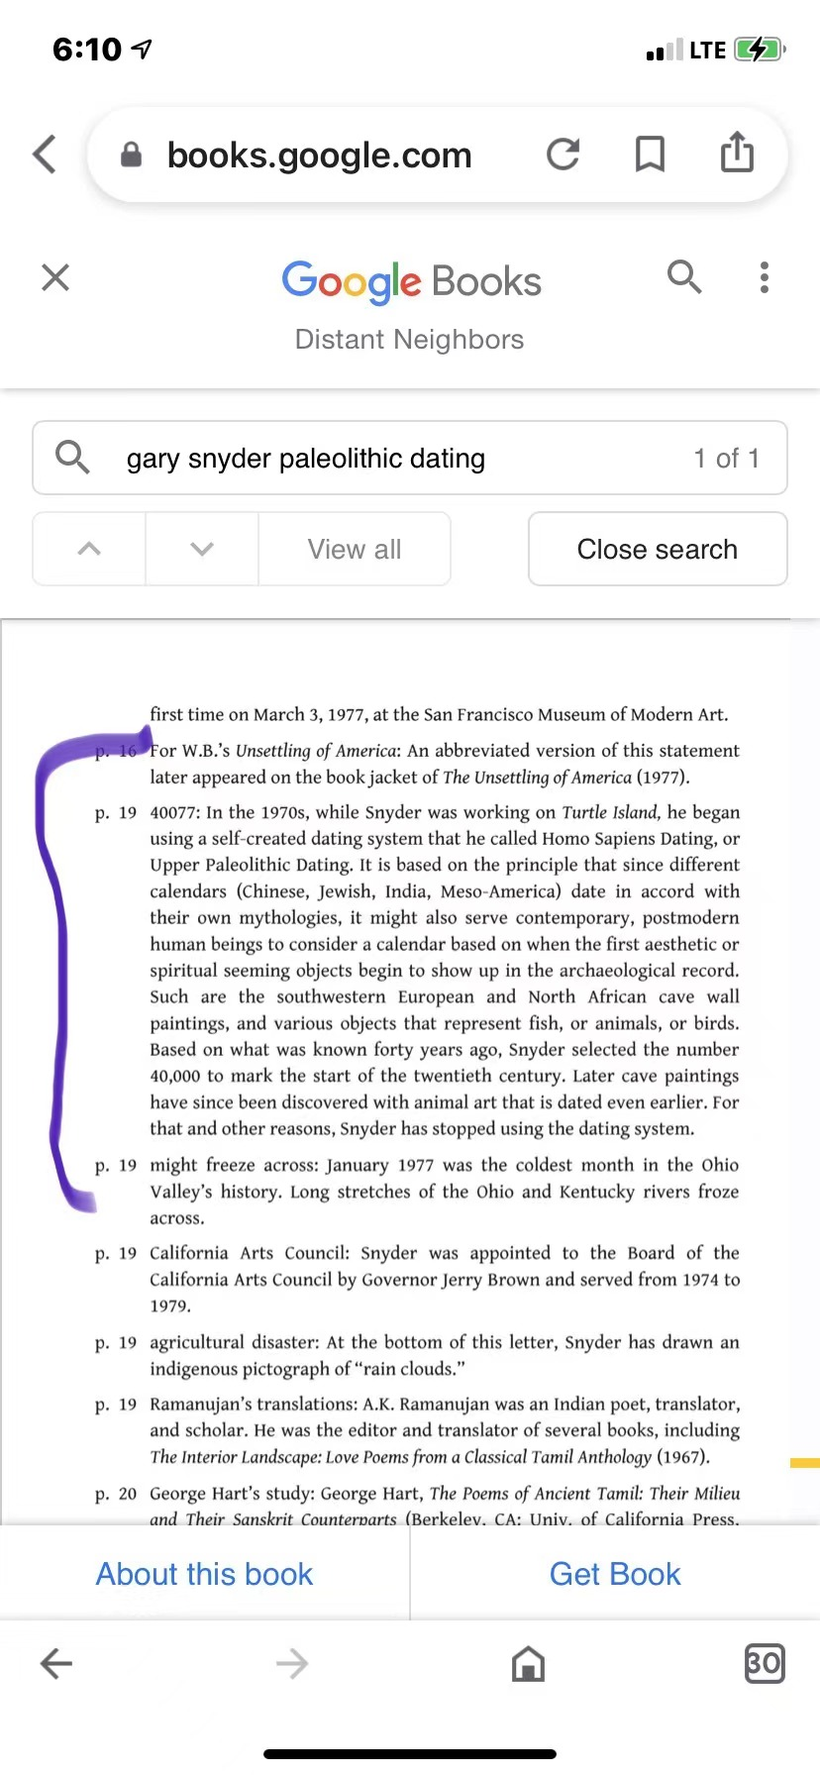
As for Gary’s dating system: it was based on a Paleolithic (not Neolithic) starting point.
This is from Distant Neighbors, the book of Gary’s correspondence with Wendell Berry.

Slide 24
考古时期
旧石器时代（Paleolithic；距今约300万年～距今约1万年），以使用打制石器为标志的人类物质文化发展阶段。地质时代属于上新世晚期到更新世，从距今约300万年前开始，延续到距今1万年左右止。
Paleolithic /ˌpæliəˈlɪθɪk/: a prehistoric period of human history (from 2.6 million years ago to around 10,000 BC, followed by the Mesolithic) characterized by the use of knapped stone tools, although at the time humans also used wood and bone tools.
During the Paleolithic period, humans grouped together in small societies such as bands, and subsisted by gathering plants and fishing, hunting or scavenging wild animals.
scavenge /ˈskævɪndʒ/: If people or animals scavenge for things, they collect them by searching among waste or unwanted objects

Slide 25
4 Paratext: An Invisible, Yet Logical Theme
Definition and Function of Paratext
paratext: a cover (with associated cover art), title, front matter (dedication, opening information, foreword / preface), back matter (endpapers, colophon, afterword), footnotes, and many other materials not crafted by the author
front matter (前页)：the pages of a book, such as the title page and preface， that precedes the main text
back matter (书后所附补充资料): matter following the main text of a book
title page (扉页、书名页) : a page at the front of a book that has the title and the author's name on it
endpaper (衬页、书籍卷首及卷尾之空页): a blank or decorated page stuck inside the front or back cover of a book
colophon (书籍的末页；版本记录，版权页标记): the name or symbol of a publisher which is printed on a book（印在书上的）出版社名称（或标志）; a publisher's emblem on a book 出版社商标

Slide 26
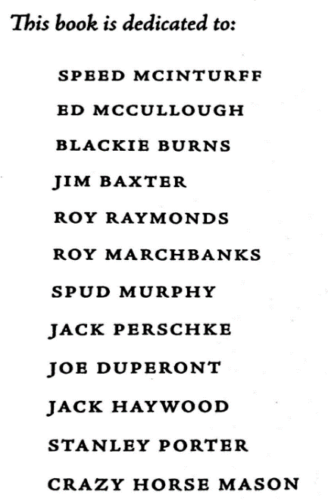
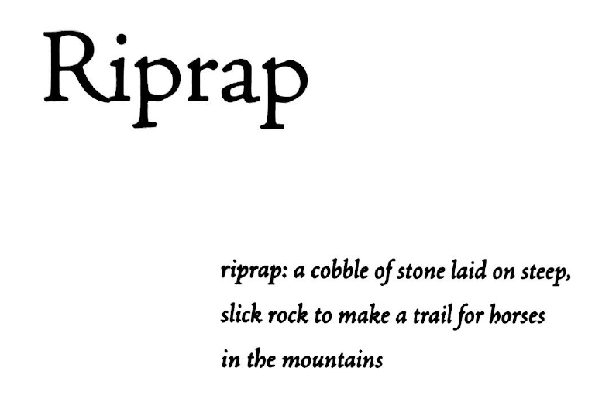
Literary theorist Gérard Genette describes paratext as “a fringe of the printed text which in reality controls one‘s whole reading of the text”; “a zone between text and off-text” ; “More than a boundary or a sealed border, the paratext is, rather, a threshold.”
Front Matter in Riprap: Work and Ecology
work by hand, craft of making a horse-trail, mountains, wilderness

Slide 27
Afterword
Back Matter in Riprap:
Work, Buddhism and Ecology
reason of turning to the Oriental: unfit modernism
contents: mountains, the work of hands, meditation after work
images: seeing the universe as Indra’s net
style: Chinese poetic features
route: western America, Kyoto, at sea
new poetic challenge / a marvelous risk: invisibility, surface simplicity with complexities beneath

Slide 28
The Function of the Front and Back Matter in Riprap
Two Clear Things in Snyder’s Account
This collection is arranged according to the chronological order during the period of 1955-1958.
Perspectives on Chan / Zen Buddhism are interwoven with his work experiences, including as a trail crew labourer in the Sierra in 1955, as a Zen practitioner in Japan in 1956, and as a wiper in the engine room of Sappa Creek at sea in 1957.
Snyder’s Meditation After Work
The mutually-reflecting-and-embracing universe actually alludes to the totality of Buddhist teaching reflected in Huayen Buddhism, one sect of Chinese Buddhism.
Snyder prefers to use “Indra’s net” as a metaphorical and metonymical notion of interpenetration for all beings in his Buddhist ecopoetics.
Snyder’s Marvelous Poetic Risk of Invisibility
In this respect, we may safely infer that work, Chan and ecology as one continuum shapes an invisible thematic structure throughout the collection of Riprap.

Slide 29
5 Ecological Poetic Narration: Work, Chan and Ecology
Snyder’s Notion of Work in Riprap
the work of laboring: long day’s hard work with shovel, pick, dynamite, and boulder
the work of thinking: meditation after work at nights
the work of writing: the appropriation of Chinese poetic style of crispness, the monosyllabic step-by-step placement in his poems
Snyder’s work, meditation and writing: three different places (America, Japan and Persian Gulf; or in mountains, in Zen temples and at sea; the work of his literary and topographical turning from West to East

Slide 30
Rearrangement of the Thematic Structure: From Invisible to Visible
Motifs | Rearranged Poems
meditation on work (1953, 1954) | The first two poems act as a prelude to the poet’s meditation on work after his descent from mountains.
women and nature | “Praise for Sick Women,” “For a Far-out Friend”
word and world | “Piute Creek,” “Milton by Firelight,” “Thin Ice”
natural trails and the dao | “Above Pate Valley,” “Water,” “Migration of Birds”
labour and mind | “Hay for the Horses,” “Goffing Again,” “The Sappa Creek,” “T-2 Tanker Blues,” “Nooksack Valley”
harmony of nature | “All Through the Rains”
days in Japan and at sea | “Toji, ” “Higashi Hongwanji,” “Kyoto: March,” “A Stone Garden,” “At five a.m, off the north coast of Sumatra,” “Cartagena”
ecological aesthetics | The last title poem“Riprap” is an epitome of Snyder’s ecological aesthetics. Riprapping is taken as Snyderian ideogrammic method.

Slide 31
David Wyatt’s comments
The speaker observes an external motion while he simply drinks, or looks, or reads. Speaker and reader are confronted with a spectacle before which nothing at all needs to be done.
David Wyatt. The Fall into Eden: Landscape and Imagination in California. New York: Cambridge University Press, 1986.
Tim Dean’s Comments
The “I” is just drinking, waiting and watching - but waiting and watching for nothing in particular: the motionless attention is an end in itself, is not strictly purposive.
Tim Dean, Gary Snyder and the American Unconscious: Inhabiting the Ground. London: The Macmillan Press, 1991.

Slide 32
Textual Analysis: Overt-and-Covert Poetic Progression
Overt Poetic Progression
The collection is arranged according to the chronological order of Snyder’s work experiences with his meditation after his work during the period of 1953-1958.
Snyder’s work runs a circle from West to East, and back to West: as a fire lookout on Sourdough Mountain in 1953, as a trail crew labourer in the Sierra in 1955, as a Zen practitioner in Japan in 1956, and as a wiper in the engine room of Sappa Creek at sea in 1957.
Covert Poetic Progression
Snyder’s Riprap was published in 1959, one year after the publication of his translation of Cold Mountain Poems (1958) in Evergreen Review, and one year before the publication of his first mythical poetry Myths & Texts (1960), but some of his lyrical and mythical poems and translation poems were written during the same period 1955-1958.
Snyder’s adaptation of Cold Mountains Poems was embedded in his poetic narration of Riprap, which in turn give a unity to the thematic structure “work, Chan and ecology” in its covert poetic progression.

Slide 33
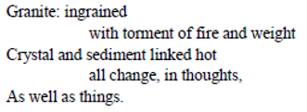
Case Study
Example 1: the first poem “Mid-August at Sourdough Mountain Lookout”
Down valley a smoke haze
Three days heat, after five days rain
Pitch glows on the fir-cones
Across rocks and meadows
Swarms of new flies.
I cannot remember things I once read
A few friends, but they are in cities.
Drinking cold snow-water from a tin cup
Looking down for miles
Through high still air. (RCM 3)
main features of Chinese style: two short stanzas, a five or seven-character line, laconic diction, paralleled structure, small-juxtaposed images, and plain style
omission of “I” and “the /a ” before ‘valley’ in the first stanza: The adverbial phrase, “down valley,” hints at the persona ‘I’ looking down the scenes from a mountain top before his decent. The reader still feels his existence as an observer.
nature-Chan image: “Three days heat, after five days rain” not only produces a caesura, but also indicates that after forest fire and rain, the poet began his meditation on the land.
In the first stanza, the poet perceives that things have obviously changed: “swarms of new flies” due to fire and rain, which recalls the last lines of the poem “Riprap.”
In this constantly changing world, “with the torment of fire and weight,” rocks will be changed into granite, crystal and sediment. Likewise, when different cultures, thoughts and passions encounter each other, they will infiltrate, change and melt.

Slide 34
6) In the second stanza, the poet appears with his thoughts changed. The first two lines of the
second stanza suggest that the speaker is already alienated from his past.
7) His “drinking cold snow-water” enables him to pacify his mind and to turn his back on his
illusionary thinking.
8) The last image is the result of his meditation. “Through high still air” on the mountain, the
speaker can see for “miles” across the mountain clearly.
Compare
Criticism from Some Critics About the First Poem: The speaker had nothing to do in the poem.
David Wyatt
The speaker observes an external motion while he simply drinks, or looks, or reads. Speaker and reader are confronted with a spectacle before which nothing at all needs to be done.
Tim Dean
The “I” is just drinking, waiting and watching - but waiting and watching for nothing in particular: the motionless attention is an end in itself, is not strictly purposive.

Slide 35
Joan Tan’s Analysis and Comments
First Stanza
The speaker is absent, but the reader still feels his existence as an observer.
The adverbial phrase, “down valley,” hints at the persona “I” looking down the scenes from a mountain top before his decent. The omission of “the” or “a” before “valley” is a Chinese poetic feature.
The second line is a key to the whole stanza. The comma between the two paralleled structures, “Three days heat, after five days rain,” not only produces a caesura, but also indicates that after forest fire and rain, the poet began his meditation on the land.
The images of the fire and rain recall the last lines of the title poem “Riprap,” indicating that an emergent event will take place right now.
The poet perceives that things have obviously changed: “swarms of new flies.”

Slide 36
Second Stanza
The poet appears with his thoughts changed: “ I cannot remember things I once read. / A few friends, but they are in cities.” It suggests that the speaker is already alienated from his past.
His “drinking cold snow-water from a tin cup” enables him to pacify his mind and to turn his back on his illusionary thinking.
The last image is the result of his meditation. “Through high still air” on the mountain, the speaker can see for “miles” across the mountain clearly. It indicates that a chain of events will be happening: “no place to work, ” a theme in the second poem.
With the alienation from the mainstream, the statement – “I cannot remember things” - in the first poem is changed into another positive voice in the second poem: from “no place to work,” to “No place to think or work / drifting,” and then to “I must turn and go back.”

Slide 37
Rethinking the First Poem of Riprap in the 21st Century
EmergencE/Y, Anachrony, Slow Violence and Anthropocene
Emergence
when a physical system of sufficient complexity is in a suitable configuration new properties “emerge” in a way that could not have been predicted from physical laws governing less complex or differently configured systems. (Simon Prosser)
当一个足够复杂的物理系统处于合适的配置中时，新的特性就会以一种无法从控制不那么复杂或配置不同的系统的物理定律中预测到的方式“涌现”
Emergency
a sudden serious and dangerous event or situation which needs immediate action to deal with it
An ‘emergent’ event is one whose novelty meets no available, matching or adequate discourse in representation, discussion or judgement. (Timothy Clark)
Anachrony 时序倒错
a term used in modern narratology to denote a discrepancy between the order in which events of the story occur

Slide 38
An emergent event, “a forest fire” in the summer of 1953 made the poet descend from Sourdough Mountain Lookout. He began his meditation on the land and perceived that things are obviously changed: “swarms of new flies.”
Big Changes
50 years later, Snyder himself pondered over his first jobs in 1952-53 as fire lookout in the Skagit District of the Mount Baker forest, northern Washington Cascades, Crater Mountain, and Sourdough Mountain.
“Guarding against forest fires, finally I has found Right Occupation…… The joke’s on me fifty years later as I learned how much the fire suppression ideology was wrong-headed and how it has contributed to our current problem.”
The speaker “I” in the first poem was actually engaged in an environmental destructive practice in a way unrecognized at that time.
Slow Violence
Fire prevention and fire suppression in the forests may lead to environmental destruction in the age of Anthropocene.

Slide 39
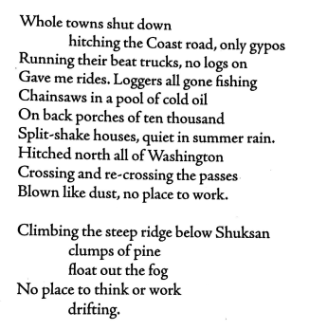
The Late Snow & Lumber Strike of the Summer of Fifty-Four
The second poem completes the intrinsically logical thinking about the poet’s turning.
The first stanza is a description of the lumber strike, in which the speaker “I” lost his work.
The transition from “hitching” to “hitched” indicates the beginning and the end, and charts the change in the speaker’s mood from active “hitching” to disappointing “hitched,” and lastly to the despondent “no place to work.”
In the second stanza, the poet tried to transcend the self by climbing the steep ridge below Shuksan.
The nature images “clumps of pine” and “drifting fog” caused the poet to rethink “work” in the mountain.

Slide 40
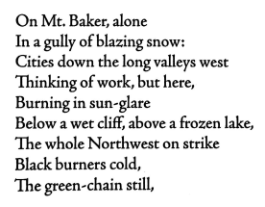
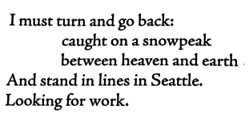
The phrase, “caught on a snowpeak,” alludes to the tough way to enlightenment: “between heaven and earth.”
The poet chose to descend from being “caught on a snowpeak,” “looking for work.” From there, the poet began his contemplation of work, Chan and ecology.
This descent marks the beginning of his spiritual quest through “work.” Accordingly, the rest of the poems of Riprap are, in the main, concerned with the poet’s “work.”
误译
我必须转身回去：
瞥见一座雪峰
在天堂与大地之间
屹立，与西雅图齐平。
盼望着工作。

Slide 41
Heidegger’s Notion of Meditative Thinking
Heidegger describes “meditative thinking” as distinct from “merely calculative thinking”: “Meditative thinking demands of us not to cling one-sidedly to a single idea, nor to run down a one-track course of ideas. Meditative thinking demands of us that we engage ourselves with what at first sight does not go together at all” (Discourse on Thinking 53).
“The issue,” he writes, “is the saving of man’s essential nature. Therefore, the issue is keeping meditative thinking alive.”
海德格尔将“冥想思维”描述为不同于“仅仅是计算思维”:“冥想思维要求我们不要片面地执着于单一的想法，也不要沿着单一的想法路线前进。冥想思维要求我们把自己和那些乍一看完全不相关的东西联系起来“
“这个问题，”他写道，“是拯救人的本质。因此，问题是要保持冥想思维的活力。”

Slide 42
Snyder’s Notion of Meditation and Poetry
Traditions of deliberate attention to consciousness, and of making poems, are as old as humankind. Meditation looks inward, poetry holds forth. One is private, the other is out in the world. One enters the moment, the other shares it. But in practice it is never entirely clear which is doing which. In any case, we do know that in spite of the contemporary public perception of meditation and poetry as special, exotic, and difficult, they are both as old and as common as grass. The one goes back to essential moments of stillness and deep inwardness, and the other to the fundamental impulse of expression and presentation.
刻意关注意识和诗歌创作的传统与人类一样古老。冥想是向内看的，诗歌则是向外表达的。一个是私人的，另一个是面向外面的世界。一个进入当下，另一个分享当下。但在实践中，谁在做什么从来没有清晰明了。无论如何，我们确实知道，尽管当前公众认为冥想和诗歌是特殊的、异域的和困难的，但它们都像草一样古老和普通。一种是回归到静止和内心深处的重要时刻，另一种是回归到“表达与呈现”的基本冲动。

Slide 43
Snyder’s Notion of Meditation and Poetry
Snyder’s recognition of the kinship of meditation and poetry is linked to his belief in the possibility of breaking down rationally constructed opposites such as mind-body, self-world, metaphysical-physical, and subject-object. These models are antithetical to his perception of the interconnectedness of all things. The best of Snyder’s earlier poetry works meditatively with the idea of dissolving the notion of a separation between a subject and its environment.
斯奈德认识到冥想和诗歌之间的亲缘关系，这与他相信理性构建的对立可以被分解的可能性有关，如思维—身体、自我—世界、形而上—物质、主体—客体。这些模式与他所认为万物相互联系是对立的。斯奈德早期最好的诗歌作品是沉思性的，其目的是消除主体和环境之间的分离。

Slide 44
6 Weakness in Riprap
For the weakness in Riprap, critics tend to hold the similar opinion in relation to its incoherent syntax, unrelated theme and monotonous typography.
Nowadays Snyder is a widely-acknowledged expert at using poetic space as a concept of energy in language. However, typography in Riprap appears to be strictly modelled with the first capitalised word of each line, and left aligned lines, even aligned indented lines within a poem, which gives one a tedious impression when reading through the whole collection.
Patrick D. Murphy criticised the poem, “All Through the Rain,” which ‘strikes [him] as one of the least successful in the collection, in that the story it relates does not carry on the surface the same level of interest or quality that one finds in “Hay for Horses.”
For another poem, “A Stone Garden”, Murphy also pointed out that ‘[s]tylistically it is quite a strange poem within this collection, being written in a loosely iambic pentameter with various end rhymes and inverted diction apparently for the sake of the meter, such as “more the sweet.”

Slide 45
According to Snyder’s two compilations No Nature (1992) and The Gary Snyder Reader (1999), we may safely infer that in Riprap poems about his trail crew work are much better than poems about his days in Japan and at sea.
In other words, what Snyder crossed out are those poems with some incoherent problems recognised by critics. For example, about the theme of woman and nature, Snyder deleted two poems in No Nature, “Praise for Sick Women| and “For a Far-out Friend.”
It is obvious that in these two poems, the poet stands in the male-dominated patriarchal line, articulating that “All women are wounded”; “sea cries / Sick women”; “I once beat you up / Drunk, stung with weeks of torment”; and “Visions of your body / Kept me high for weeks” (RCM 7, 13).
This voice goes far away from his later ecological notions of woman as Mother-nature, and nature as Gaia. These lines fall into ecofeminists’ criticism, who explain ecological crisis as the outcome of the patriarchy that follows the “logic of domination.”

Slide 46
7 Conclusion
Riprap is Snyder’s first experimental practice of Chinese style and Chan/Zen meditation in his lyrical poetry. In some sense, Snyder establishes his poetic indebtedness to Han Shan-Chan-ecology in a logical way.
In Riprap, Snyder wrote twelve real names on the front page of the book, declaring that his book Riprap is dedicated to those who are “in the woods & at sea”. Snyder refers to his work not only as a labourer in the mountains and at sea, but also this work also signifies what was occurring within his mind, as he became a practitioner of meditation on Chan, landscape and ecology. The latter is closer to the Chinese tradition.
Though there is no unified style in Riprap, some poems are obviously successful imitations of Chinese Chan poetry. With nature-Chan images, the reader can detect the basic Chan teachings.
The theme of “turning” is present throughout turning to the Far East, to Chan, and to ecology. Snyder is striving for a healing which will “make it new” in his poetry.
His great innovation in Riprap lies in his own unique ideogrammic method - riprapping, a result of his turning to Chan, Han Shan and Chinese landscape poetry.

Slide 47
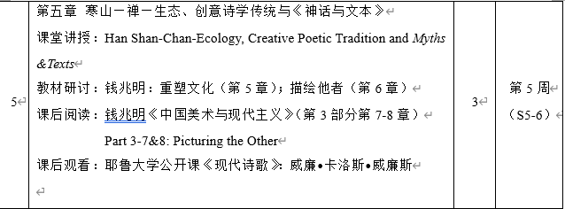
Assignment for Next Week

Slide 48
THANK YOU

