Slide 1
SUFE Year 1 Postgraduates
A Critical Study of English Poetry
Lecture Eleven 20th Century Influential British and American Poets
Prof. Dr. Joan Qionglin Tan
tan.qionglin@mail.shufe.edu.cn
厚德博学
经济匡时

Slide 2
20th Century Influential British and American Poets
T. S. Eliot 艾略特
William Carlos Williams 威廉斯
Hart Crane 克莱恩
W. H. Auden 奥登
Langston Hughes 休斯
Elizabeth Bishop 毕晓普
Contents

Slide 3
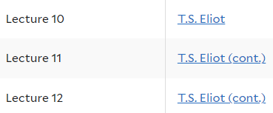
Yale University Open Course: Modern Poetry
Instructor: Langdon Hammer
Website: https://oyc.yale.edu/english/engl-310 【全英文】
http://open.163.com/special/sp/modernpoetry.html 【中英文字幕】

Slide 4
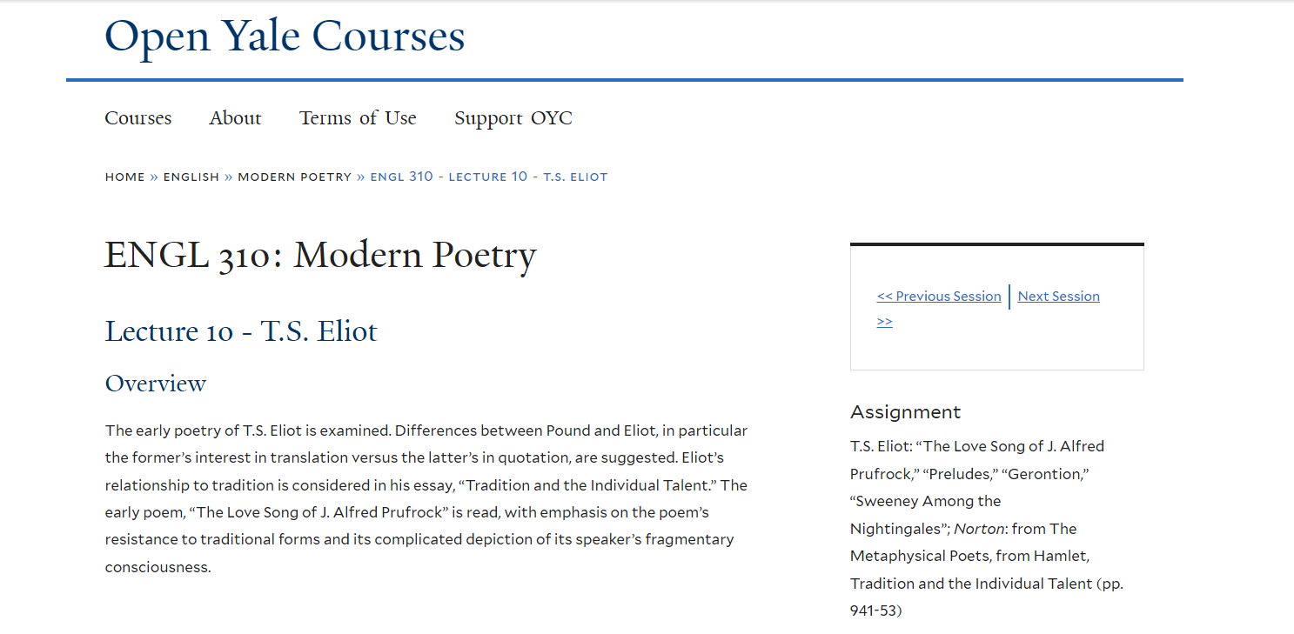

Slide 5
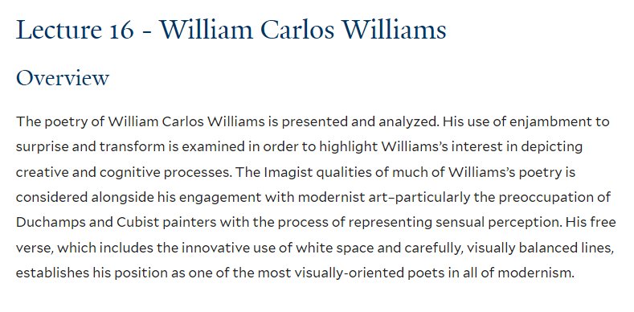

Slide 6
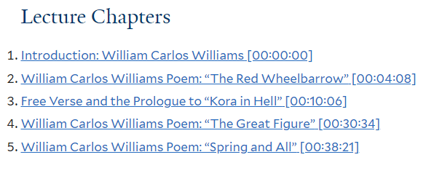
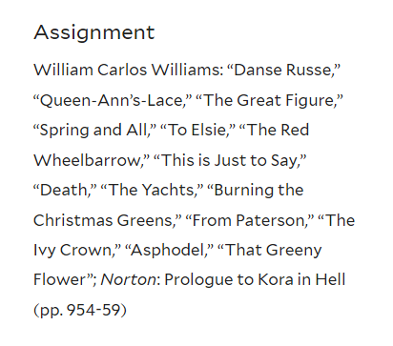

Slide 7
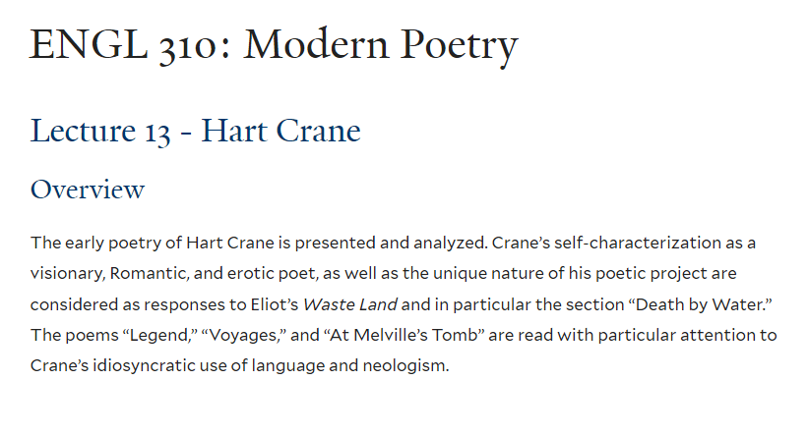

Slide 8
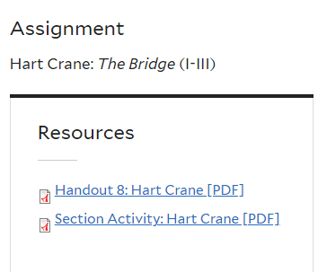

Slide 9
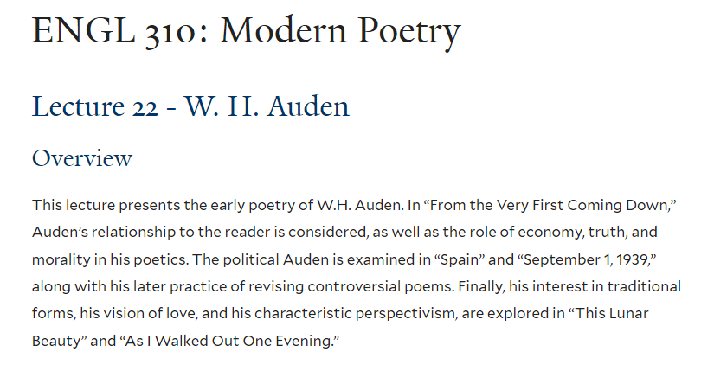

Slide 10
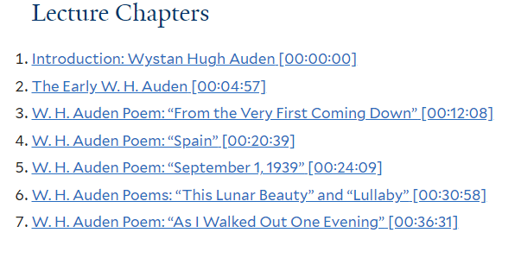
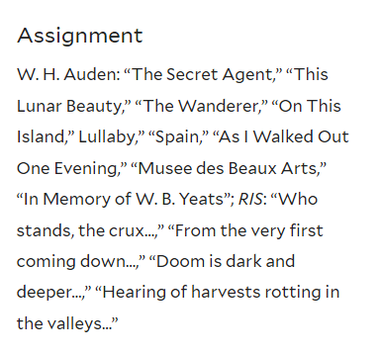

Slide 12
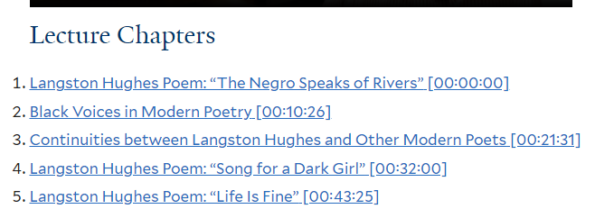

Slide 13
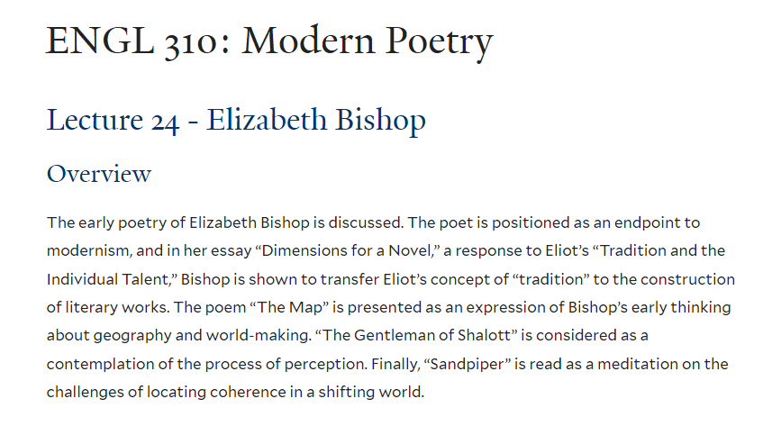

Slide 14
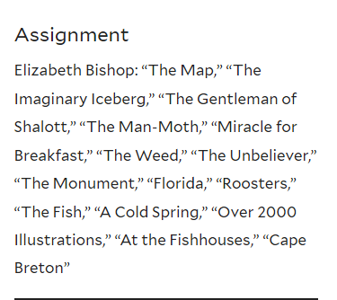
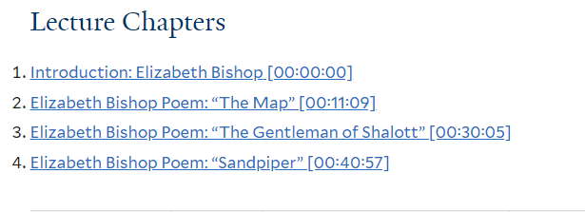

Slide 15
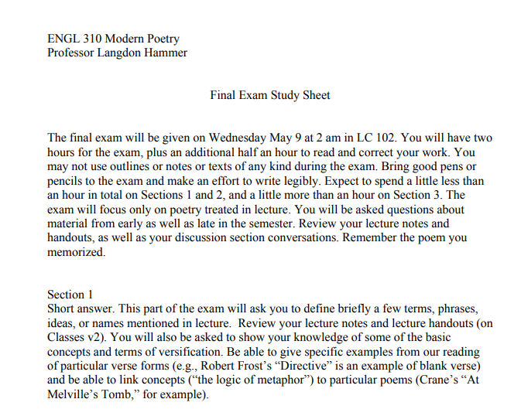

Slide 16
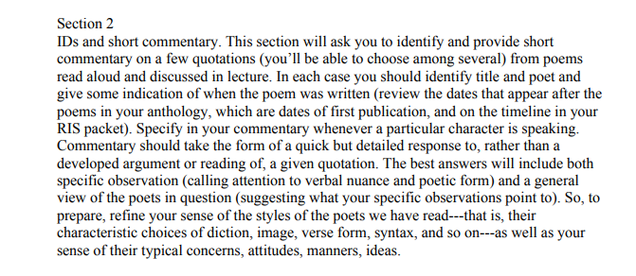

Slide 17
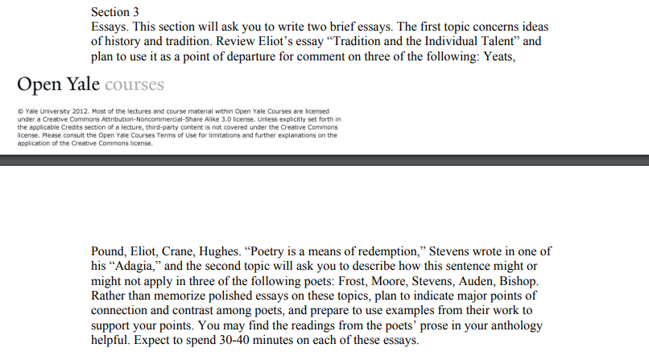

Slide 18
THANK YOU

