Slide 1


第三讲 会计信息的价值相关性
黄 俊

Slide 2
The Value Relevance Approach
Assumes securities market efficiency
Investors responsible for predicting future firm performance
  - Role of financial reporting to provide useful information for this purpose
  Usefulness of financial information evaluated by magnitude of security price response to that information

Slide 3
Reasons for Security Price Response
An application of decision theory model
  - Investors have prior probabilities of future firm performance
  - Investors obtain useful information from financial statements
  - Investors revise their probabilities
  - Leads to buy/sell decisions
  - Security prices change

Slide 4
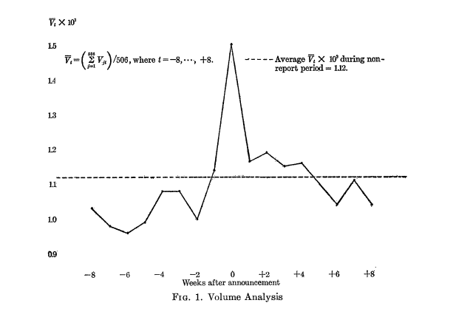
Beaver’s Research (1968)
Trading volume
Trading volume is noisier than market price (Kim and Verrcchia, 1997)

Slide 5
Finding the Market Response
The date of net income report
A narrow window of a few days surrounding the reporting date
  - Information may leak early
  - Market may take some time to digest the information
  Evaluated relative to what investors expected
  - Investor expectation: previous earnings or analyst forecast

Slide 6
Separating Market-wide and Firm-specific Share Returns
Use a market model to estimate market-wide return on firm’s shares around the narrow window
  - R_{jt} = a_{j} + β_{j}R_{Mt} +∈_{jt}
  Abnormal share return during narrow window = actual return – expected return

Slide 7
Ball and Brown Study
The first study to document statistically an abnormal share price response to the financial statement (1968)
Methodology still in use today
  - Event study

Slide 8
B&B Methodology
Estimate investors’ earnings expectation
  - Proxy by last year earnings
  - Classify as GN (actual earnings > expected earnings), or BN (vice versa)
  Estimate abnormal share return for the month of earnings release (month 0)

Slide 9
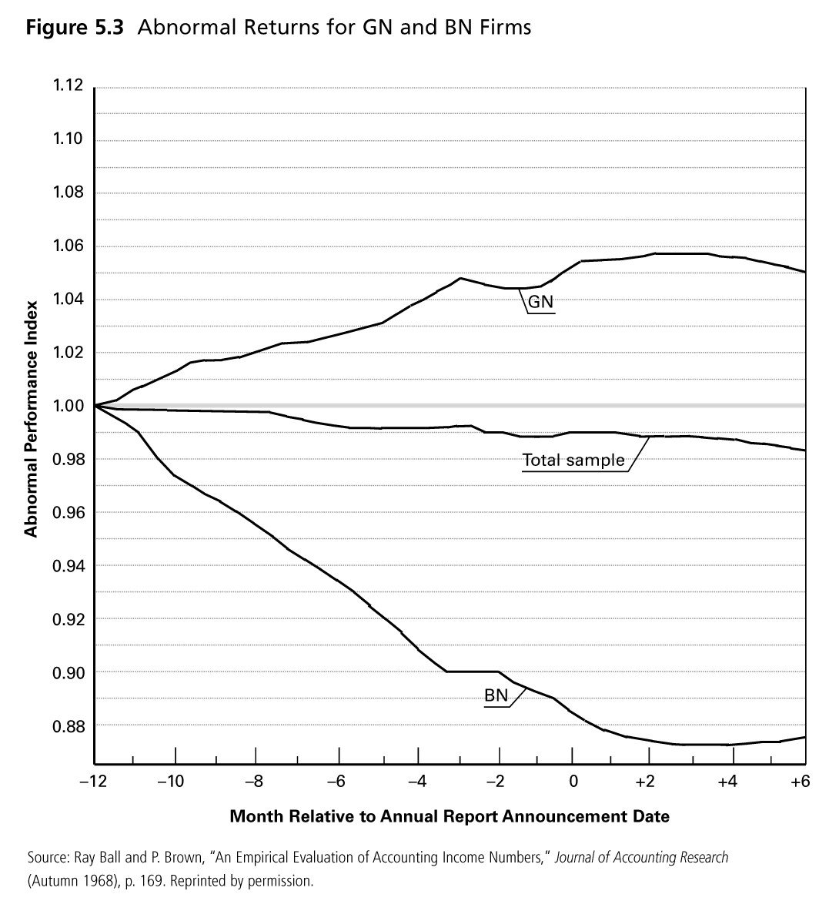
B&B Results

Slide 10
Earnings Response Coefficients (ERC)
ERC definition
- The extent of a security’s abnormal return in response to the unexpected component of reported earnings of the firm

Slide 11
Determinants of ERC
Reasons for different market response
- Beta
- Capital structure
- Earnings quality
- Growth opportunities
- Similarity of investor expectations
- Price informativeness

Slide 12
Determinants of ERC
Beta
- The lower the Beta, the higher ERC (Collins and Kothari, 1989; Easton and Zmijewski, 1989)
- The higher beta acts as a brake on the investor’s demand for GN security
Capital structure
- The lower the debt ratio, the higher ERC (Dhaliwal, Lee and Fargher, 1991)
- For highly levered firms, the increase in earnings add strength and safety to creditors

Slide 13
Determinants of ERC
Earnings quality
  - The higher the earnings quality, the higher ERC (Kormendi and Lipe, 1987)
How to measure earnings quality
  - Earnings persistence
      Higher persistence → higher quality
      Three types of persistence
    Permanent: ERC>1, equal to (1+Rf) /Rf
    Transitory: ERC=1
    Price irrelevant: ERC=0, accounting policy change
  - Accruals quality
      DeChow & Dichev (2002): higher accruals quality → higher earnings quality

Slide 14
Determinants of ERC
Growth opportunities
- The higher the growth opportunities, the higher ERC (Collins and Kothari, 1989)
How to measure growth opportunities
- PB ratio: equity market value/equity book value

Slide 15
Determinants of ERC
Similarity of investor expectations
  -The more similar the earnings expectations, the greater the effect of a dollar of unexpected earnings on share price, the greater ERC
  - How to measure the similarity
      More precise analysts’ forecasts (Abarbanell, Lanen, and Verrecchia, 1995)

Slide 16
Determinants of ERC
Informativeness of price
  - The more informative the price, the less will be the information content of accounting earnings, the lower the ERC
  - Proxy for price informativeness
      Firm size

Slide 17
Implication of ERC Research
Improved understanding of market response suggests ways that accountants can further improve the decision usefulness of financial statements
- Capital structure: disclosure of financial instruments
- Growth of opportunities: disclosure of segment information, MD&A
- Earnings quality: disclosure of components of net income

Slide 18

Thank You!

