Slide 1


第四讲 决策有用性的计量观
黄 俊

Slide 2
What is the Measurement Perspective?
Greater use of fair values in the financial statements
A balance sheet approach of financial reporting
Definition
- Incorporate fair values into the financial statements
- Assume that this can be done with reasonable reliability

Slide 3
Are Securities Markets Fully Efficient?
To extent markets not efficient, the logic of information perspective is not solid
Much empirical evidence on usefulness of financial statement information relies on efficient securities markets
If securities markets are not fully efficient, improved financial reporting may be helpful in reducing inefficiency, and improving the operation of securities markets

Slide 4
Are Securities Markets Fully Efficient?
Behavioural finance
Prospect theory
Is beta dead?
Excess stock market volatility and bubbles
Efficient securities market anomalies

Slide 5
Some Attributes of Investors
Limited attention
- Not process all information
Conservative
- Revise beliefs by less than Bayes’ theorem implies
- Retain excess weight on their prior beliefs
Overconfident
- Overestimate the precision of information they collect themselves

Slide 6
Some Attributes of Investors
Representativeness
- Assign too much weight to evidence consistent with one’s impression
Self-attribution bias
- Good outcomes are due to their abilities, but bad outcomes are due to misfortune
  Motivated reasoning
  - If information is inconsistent with investors’ preference, investors tend to discredit it

Slide 7
Prospect Theory
An alternative to the theory of the optimal investment decision
  - Separate evaluation of gains and losses
  - Lose aversion: dislike even very small losses
u(x)
z gain
loss

Slide 8
Prospect Theory
  Deposit effect
  - Do an experiment
  - Hold on losers and sell winners

Slide 9
Prospect Theory
  Weighting of probabilities
    - Rare events overweighted: salient, anecdotal and extreme
    - Likely events underweighted: abstract, statistical and relevant

Slide 10
Is Beta Dead?
CAPM implies Beta is sole risk measure to explain share return
Fama and French (1992)
-Three factors model: B/M, Size and Beta
Four factor model (Carhart,1997)
- Momentum

Slide 11
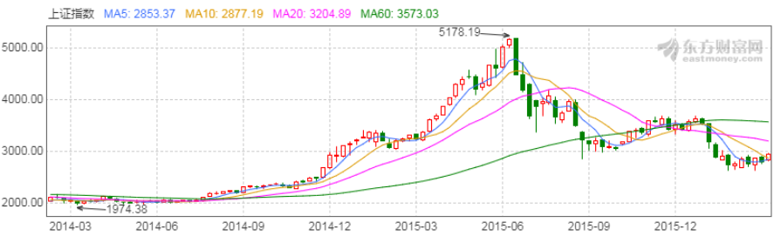
Excess Market Volatility
Shiller (1981)
  Variability of the stock market index several times greater than variability of aggregate dividends

Slide 12
Efficient Securities Markets Anomalies
Post-Announcement Drift (PAD)
  Abnormal share returns drift upwards or downwards for some time following GN or BN in quarterly earnings
  Efficient securities market theory predicts immediate response to GN or BN

Slide 13
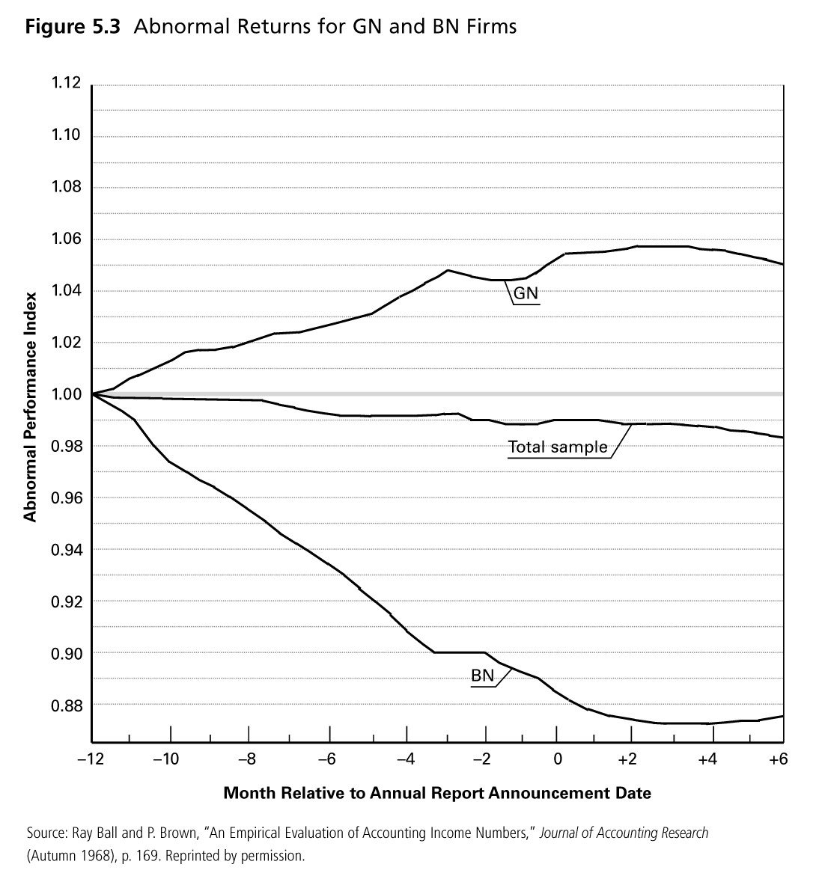
Efficient Securities Markets Anomalies

Slide 14
Efficient Securities Markets Anomalies
Bernard and Thomas (1989)
  - Sell-and-buy strategy, and hold for 60 days
  - Earn 18% AR before transaction cost
  - Investors underestimate the implications of current earnings for future earnings

Slide 15
Efficient Securities Markets Anomalies
Accruals anomaly (Sloan, 1996)
- Net income = OCF ± net accruals
- Accruals have lower persistence than cash flows
- Investment strategy
# Buy if net accruals/OCF is “low”
# Sell short if net accruals/OCF is “high”
- This strategy earned 10.4% more than market return over one year
- Should not happen if markets are efficient

Slide 16
Efficient Securities Markets Anomalies
Possible explanations for anomalies’ continued existence
  - Behavioural biases
    E.g., limited attention, conservatism, noise traders
  - Rational investors, but subject to:
    Transactions costs
    Idiosyncratic risk
      To exploit anomalies, investors depart from diversified investment strategy

Slide 17
Conclusions: Investor Rationality and Market Efficiency
Rational decision theory model of investment is still the most useful model to guide accountants about investor decision needs
Securities markets not fully efficient, but close enough that accountants can be guided by its reporting implications
  - To extent markets not fully efficient, role of financial reporting increases
  - Current value accounting helps to fulfil this increased role

Slide 18
Low Value Relevance of Financial Statement Information
Low R² problem
  - R² is a measure of proportion of share return explained by accounting information
    Empirical evidence shows R² quite low (2 – 5%, Lev 1989)
    Getting worse ?
  - Effect of accounting information on share price can be statistically significant (e.g., ERC research) but practically insignificant (i.e., low R²)
  - Lev (1989) attributes this low share to poor earnings quality
  - Suggests lots of scope to improve financial reporting, eg, current value accounting

Slide 19
Ohlson’s Clean Surplus Theory
What is it?
  - Expresses value of firm in terms of accounting variables: balance sheet and income statement components
Firm value = net assets + PV of expected future abnormal earnings (goodwill)

Slide 20
Estimating Firm Value
Choose a time horizon (e.g., 7 years) over which abnormal earnings expected to persist
Calculate ROE from financial statements for year of valuation
Calculate dividend payout ratio (k)
Year-by-year over time horizon
  - Project book value
    - End-of-year BV = opening BV + (1-k)NI

Slide 21
Estimating Firm Value
  Estimate actual earnings
    - Estimated Actual Earnings = ROE × Opening BV
  Calculate expected normal earnings
    - Cost of Capital × Opening BV
    - Cost of Capital: CAPM model
  Abnormal earnings = actual earnings - expected earnings

Slide 22
Estimating Firm Value
Calculate PV of expected abnormal earnings at cost of capital over time horizon
Estimated firm value = net assets ± PV of expected abnormal earnings
Example 6.2, P195

Slide 23
Implication of Clean Surplus Theory
An alternate approach to estimating firm value
  - Theoretically sound
  - Uses accounting variables, may be easier to apply than discounted cash flow or dividends
Supports measurement approach
  - Current value accounting moves more of firm value onto the balance sheet
  - This improves estimates of firm value since more of firm value can be read from the balance sheet, and less goodwill to be predicted

Slide 24
Auditors’ Legal Liability
Auditors face legal liability
  - Failure of financial institutions in the early 1980s
  - Overestimate financial assets
Will a measurement approach reduce auditor liability?
  - Perhaps, if investors subject to limited attention
    Auditor can claim that the financial statements properly anticipate value changes

Slide 25
Conclusions
Assuming reasonable reliability, current value accounting can increase decision usefulness relative to information approach

Slide 26

Thank You!

