Slide 1


第六讲 盈余管理
黄 俊

Slide 2
What is Earnings Management?
Earnings management is the choice by a manager of accounting policies, or real actions that affect earnings, so as to achieve some specific reported earnings objective
  - Accrual-based earnings management includes, for example, managing the allowance for bad debts, changing amortization policy
  - Real actions to manage earnings include, for example, cutting or increasing R&D and advertising; manufacturing for stock
    When managing accruals is costly

Slide 3
What is Earnings Management? (cont’d)
“iron law” of accruals reversal
  - If accruals increase earnings this period, their reversal lowers earnings in future periods

Slide 4
What is Earnings Management? (cont’d)
Two types of accruals
  - Non-discretionary: management has little discretion to control amounts
  - Discretionary: management has discretion to control amounts
  - To discover role of accruals in earnings management, accountant needs to separate these two types
    Jones (1991) model usually used for this separation

Slide 5
Patterns of Earnings Management
Taking a bath
  - Largely decrease net income
Income minimization
  - Less extreme
  - Incentive to lower profitability
Income maximization
  - Increase compensation
  - Avoid debt covenant violation

Slide 6
Patterns of Earnings Management (cont’d)
Income smoothing
  - Receive relatively constant compensation
  - Reduce volatility of net income to smooth debt covenant ratios
  - Convey inside information to the market about persistent earnings

Slide 7
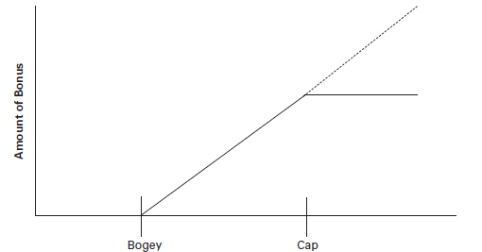
Motivations for Earnings Management
Contractual motivations
  - Bonus plan hypothesis: manage earnings to maximize cash bonus
    # Evidence: Healy (1985)

Slide 8
Healy’s Study (1985)
Earnings management pattern
  - Low NI (below bogey): take a bath>>>high NI, next year
  - High NI (over cap): reduce NI>>>high NI, next year
  - NI between bogey and cap: increasing NI, this means bonus plan hypothesis applies only when NI is between bogey and cap

Slide 9
Jones’s Study (1991)
How to separate nondiscretionary accruals from total accruals?
Findings
  - Discretionary accruals were significantly negative in the ITC investigation years
  - Significant negative accruals not found in the years immediately preceding and following the investigations

Slide 10
Motivations for Earnings Management (cont’d)
  Debt covenant hypothesis: to avoid violation of debt covenants
  - Sweeney (1994)
  # Beginning five years prior to the year of default, significantly more voluntary income-increasing accounting policy changes

Slide 11
Motivations for Earnings Management (cont’d)
To meet earnings expectations
  - Earnings expectation: last year earnings or analyst forecast
  - Significant negative effects on share price and manager reputation if expectations not met
  - Strong incentive when managers hold ESOs or other share-related compensation
Other motivations
  - Initial public offerings (IPO)
  - Seasoned equity offering (SEO): 10% phenomenon in China

Slide 12
Earnings Performance Surrounding IPO Year

Slide 13
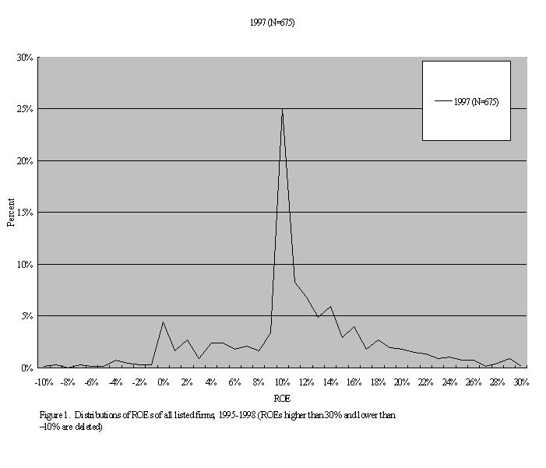
10% Phenomenon in China

Slide 14
Good Side of Earnings Management
  Contract-based arguments
  - To give firm some flexibility in the face of rigid, incomplete contracts
  # Bonus contracts based on net income
  - New accounting standards may lower net income and/or increase volatility; May adversely affect manager effort
  # Debt covenant contracts
  - New accounting standards may increase probability of debt covenant violation
  # Contract violation is costly, earnings management may be low-cost way to work around

Slide 15
Good Side of Earnings Management (cont’d)
  Investor-based arguments
  - To credibly communicate inside information to investors
  # Blocked communication may inhibit direct disclosure of earnings expectations
  # Discretionary accrual management as a way to credibly reveal management’s inside information about earnings expectations
  - Manage reported earnings to an amount management expects will persist

Slide 16
Bad Side of Earnings Management: Opportunism
  Contracting perspective
  - Healy (1985)
  # Use earnings management to maximize managers’ bonus
  - Dechow, Sloan, and Sweeney (1996)
  # Earnings management to maintain an overvalued share price and maximization of the proceeds of new share issues by firms with financial misstatement

Slide 17
Bad Side of Earnings Management :Opportunism(cont’d)
  More recent studies of bad earnings management
  - Leuz, Nanda & Wysocki (2003)
  # Countries with poor investor protection experience more earnings management
  - McInnis & Collins (2011)
  # Increase in accrual quality (i.e., less bad earnings management) following availability of cash flow forecasts

Slide 18
Can Accountants Control Bad Earnings Management?
  Full disclosure
  - Revenue recognition policies
  - Unusual, non-recurring and extraordinary items disclosure
  # Enables investors to better evaluate earnings persistence

Slide 19
Conclusions
  Earnings management can be good if used responsibly
  Full disclosure helps to control bad earnings management

Slide 20

Thank You!

