Slide 1
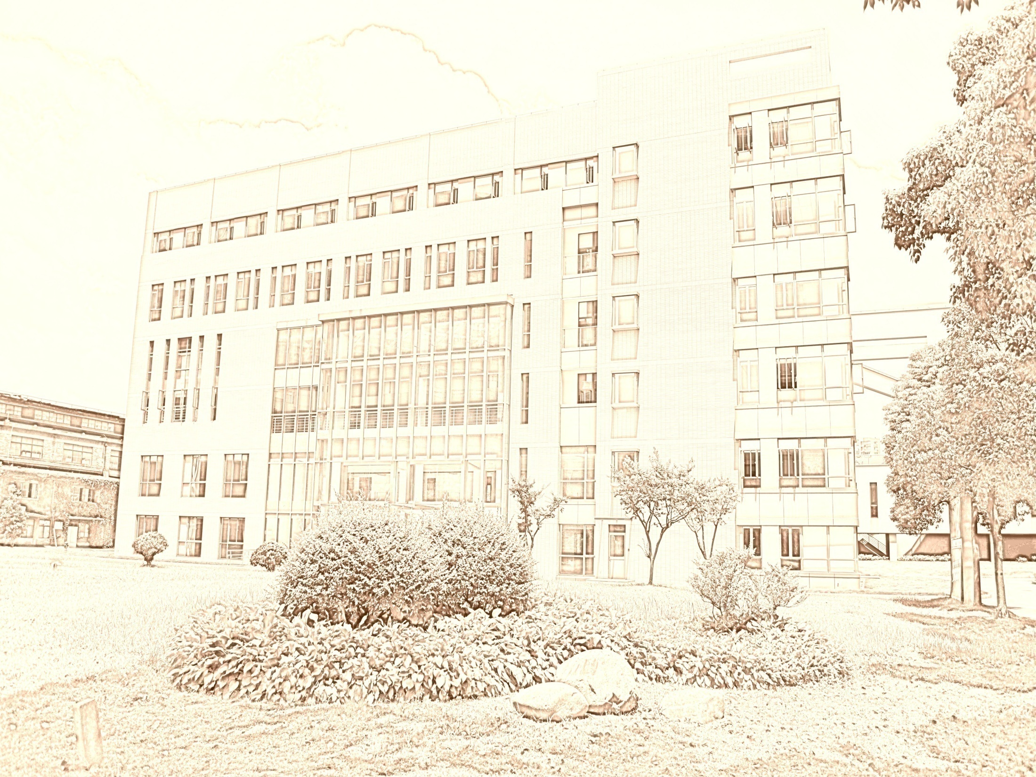
Introduction To Public Administration
SUFE SPEA
Instructor: WANG, Feng

Slide 2
Week 1
Introduction & Course Overview

Slide 3
Agenda for Today
Get to know each other
The last lecture
Structure of the course
  Textbook and syllabus review
  Course expectations and requirements
Understanding of public administration (PA)

Slide 4
Get to know each other
About me
http://spea.shufe.edu.cn/4615/list.htm
About you
  Where are you from?
  What do you want to do most when you graduate?
  What do you expect to learn from this course?
  What do you expect from the instructor?
  How do you spend your free time?
  Anything else you want to share…

Slide 5



The last lecture
Get the direction right
- 辛德勒的名单
Set priorities and stay focused
- 阿甘正传
Be persistent and positive
  肖生克的救赎

Slide 6
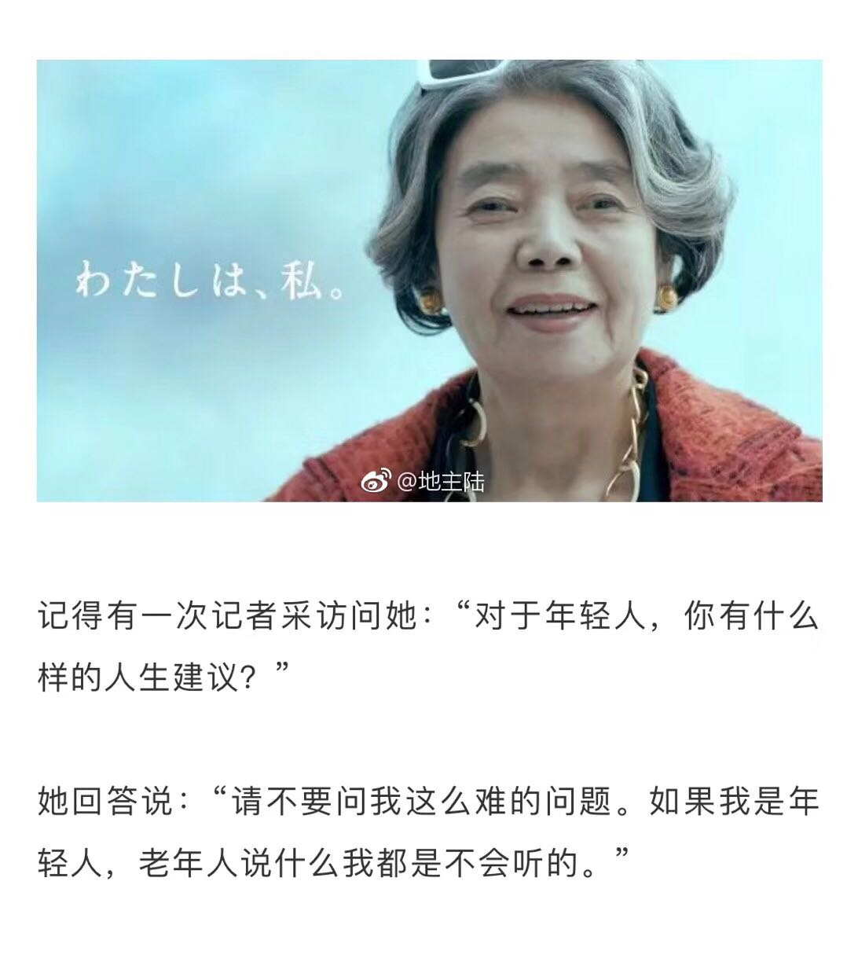

Slide 7
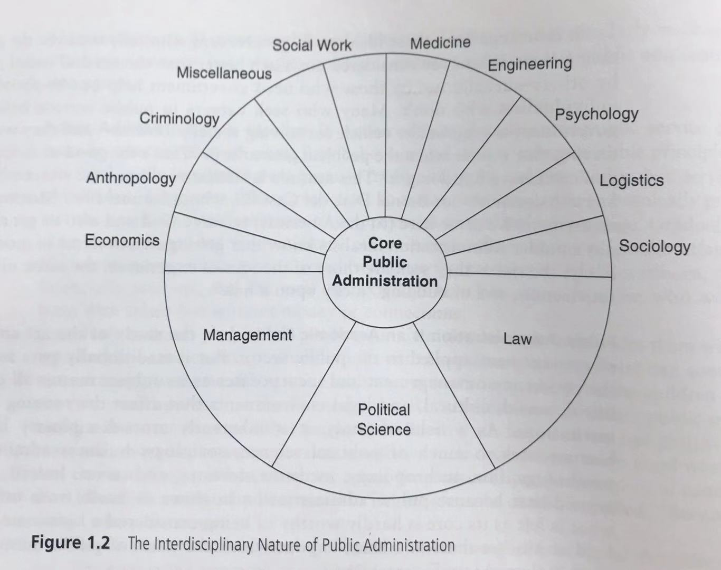
Interdisciplinary nature

Slide 8
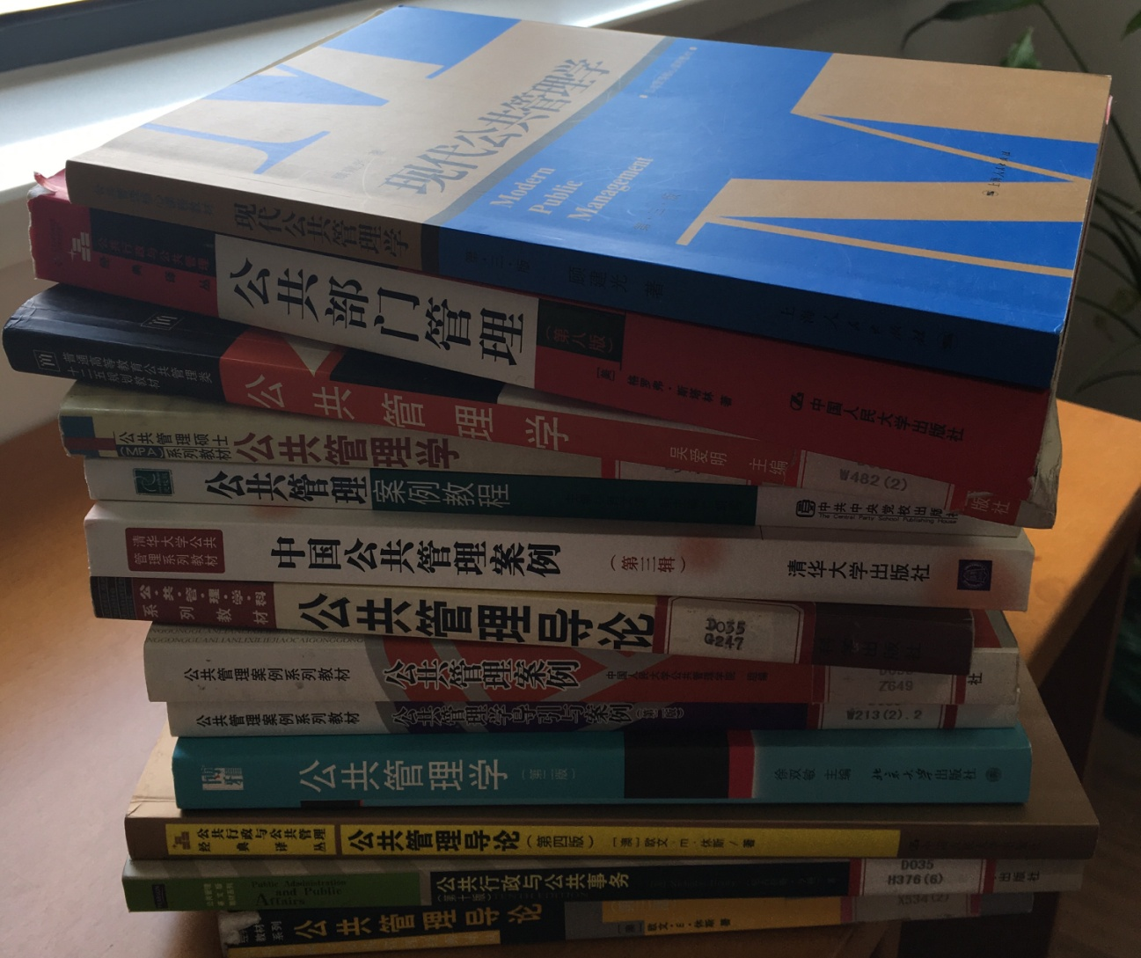
Many textbooks 诸多教材

Slide 9
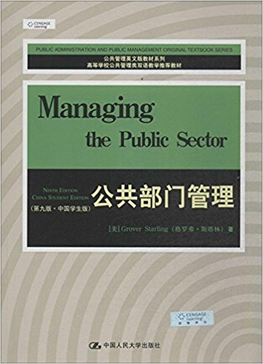
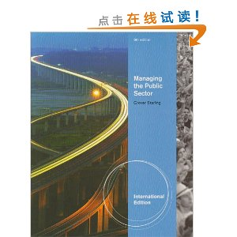
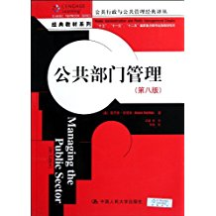
Textbook （English & Chinese Versions）
9

Slide 10
Important Things to Know
Grades will be calculated as follows:
  30% Attendance, Participation & Assignment (case leading)
  30% Midterm
  40% Final Group Report
Midterm： Nov. 25, 2020 (open book, single-choice, open-ended questions)
Final group reports’ oral presentations are scheduled on Dec. 16 & 23, 2020.
Group report is due on Dec. 30, 2020
BB system 上财教学网 （平时作业，通知等）& We-chat group

Slide 11
Understanding of PA

Slide 12

Early Graduate Education in Public Administration
In 1924 In 1924 Maxwell School of Citizenship and Public Affairs at Syracuse University established the first graduate education in public administration.

Slide 13
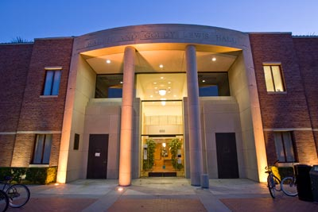
USC- Price School of Public Policy
In 1929 School of Public Administration at the University of Southern California became the second in the nation to offer graduate program in public administration.

Slide 14
2019 US News

Slide 15
Public Affairs Specialties
Public Management and Administration (MPA)
Public Finance & Budgeting
Nonprofit Management
Public Policy Analysis (MPP)
Social Policy
Health Policy & Management
Environmental Policy & Management
City Management & Urban Policy

Slide 16
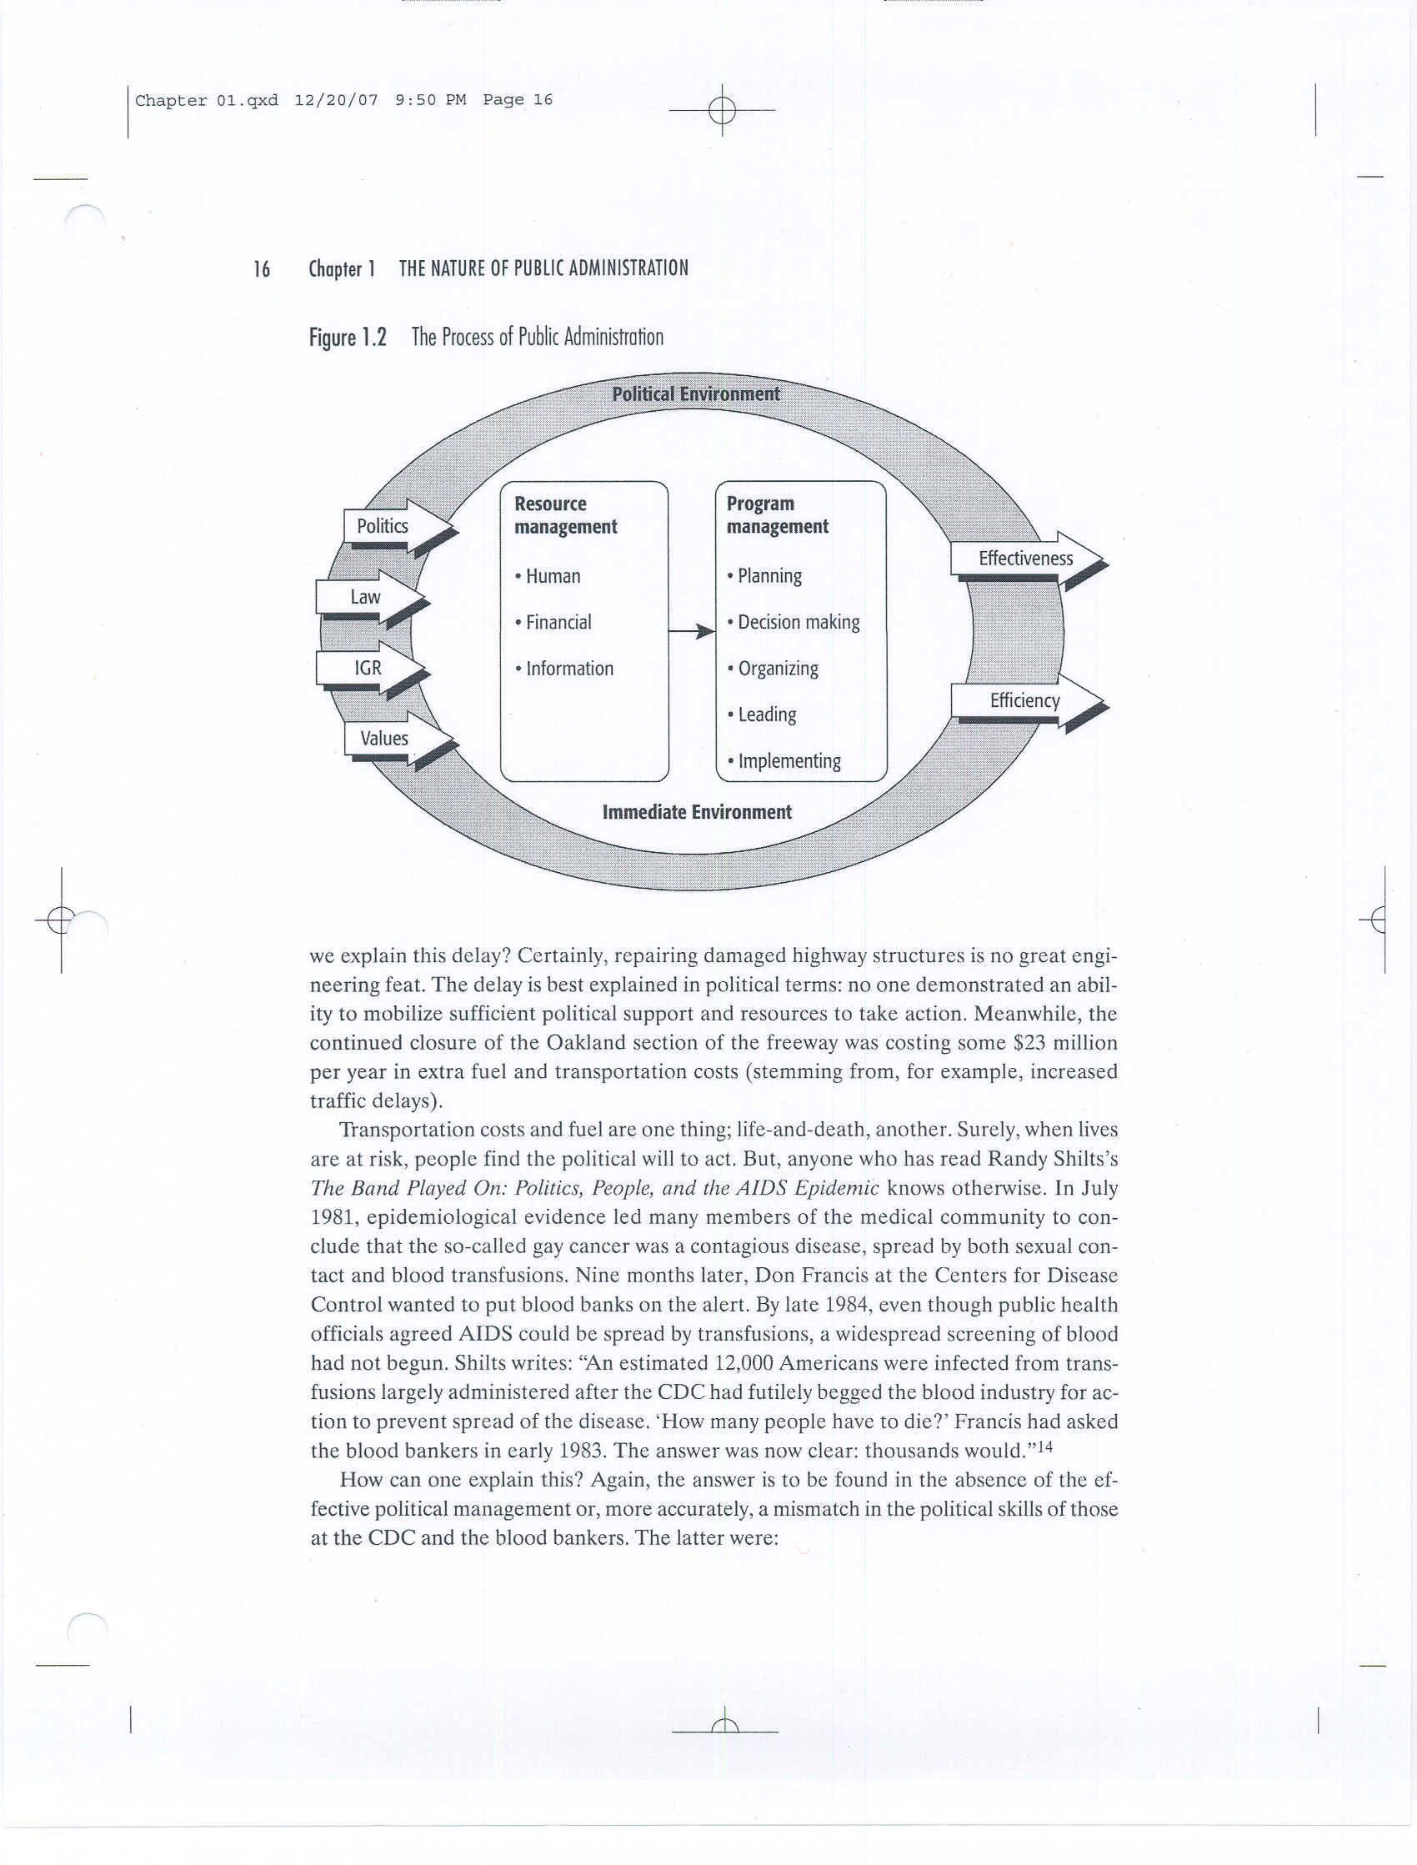
The Process of Public Administration

Slide 17
Political Management
Public administrators must have knowledge of political institutions and processes.
Political knowledge alone is not enough; good administrators must also have political skills. They must be able to:
  Analyze and interpret political, social, and economic trends
  Evaluate the consequences of administrative actions
  Persuade and bargain and thereby further their organization’s objectives

Slide 18
Program Management
Besides being good political managers, public administrators should be good program managers.
Public administrators skilled at program management ensures that tasks are done in an efficient and effective manner.
  Efficiency refers to getting the most output from the least input. “do the thing right”
  Effectiveness is often described as “doing the right thing” -- that is, engaging in activities that will help a government agency reach its goals.

Slide 19
Five Management Functions
Planning (strategic management)
  Where the organization wants to go in the future and how it is going to get there.
Decision Making
  Process of identifying problems and opportunities, generating alternatives, and selecting an alternative.
Organizing (organizational structure)
  Reflects how an agency tries to attain the objectives of its programs.
Leading (leadership)
  The use of influence to motivate civil servants to achieve program objectives.
Implementing
  Monitoring and adjusting of the agency employees’ activities to ensure that the program remains on track toward its objectives.

