Slide 1

Introduction To Public Administration
SUFE SPEA
Instructor: WANG, Feng

Slide 2
Week 2
Understanding of Public Administration (PA)

Slide 3
Agenda for Today
Three perspectives on Public Administration
Intellectual root

Slide 4
The concept of PA

Slide 5
Three Perspectives on PA
The political approach is associated with legislative 立法 policy-making concerns.
  Core value: representativeness, responsiveness, accountability through elected officials to citizens.
The managerial approach is associated with the executive 行政 branch’s interest in implementation of the law–similar to practices in the private sector.
  Core value: efficiency
The legal approach focuses on government’s adjudicate function and commitment to maintaining constitutional rights and the rule of law. (judicial 司法)
  Core value: regulation and sovereignty, constitutions, equity

Slide 6
What is PA? --Political Definitions
PA is what government does.
PA is a phase in the public policymaking cycle.
PA is implementing the public interest.
  Promote equity
  Compensate for market failure
PA is doing collectively which cannot be done so well individually.

Slide 7
Stages in the Policymaking Process
1. Problem
identification
2. Agenda
setting
3. Policy
formulation
6. Implementation
5. Budgeting/
Appropriation
4. Policy
Adoption/
Legitimization
7. Evaluation

Slide 8

Anti-Poverty Act (1968)

Slide 9
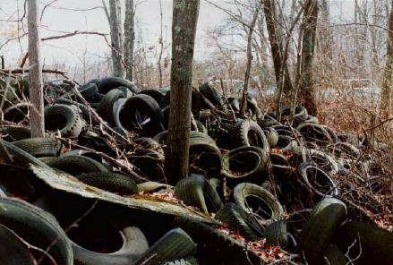
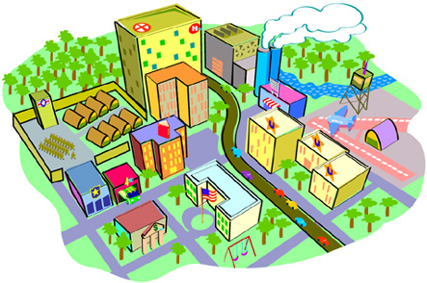
Two Possible Reasons for Market Failure
Externalities
  When one’s actions create costs for another without the other’s permission. (The photo shows indirect costs of automobile use)
Markets tend to under-produce public goods.
  Public goods cost little or nothing for an extra individual to enjoy (non-ravel) and the costs of preventing any individual from enjoying are high (non-excludable).

Slide 10
Classification of Goods
(Adapted from Weimer and Vining, 1992)
nonrival(非竞争） rival
non-
excludable
（非排他）
excludable
Pure public goods -National defense -Clean air -Radio signal -lighthouse beams | Common pool resources -Pasture -Fishery -Ocean fish
Toll/club goods -Toll bridge -Cable TV -Sports event | Private goods -Books -A cup of coffee -Car

Slide 11
纯粹公共物品
(Pure public goods)
公共物品
(Public goods )
公共资源
(Common-pool goods)
物品
(goods)
俱乐部物品
(Club goods)
私人物品
(Private
goods )

Slide 12
Common-Pool Resources
The New England lobster fishery, in 1966
  The efficient number of traps set would have been about 450,000;
  The actual number was nearly one million.
The North Atlantic stock of minke whale
  The efficient stock size was about 67,000 adult males;
  The open-access stock had been depleted to 25,000 (Amundsen et al. 1995)
The Pacific halibut fishery in the Bering Sea
  The efficient number of ships was nine;
  The actual number was 140 (Huppert 1990)

Slide 13
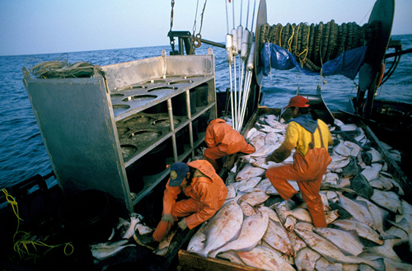

Slide 14


Case：The Pacific Halibut Fishery
Open access
Fishing unduly
1970s: Close to extinction
Notes:
Open access had led to a gradually diminishing stock throughout the 1970s.

Slide 15
How to Protect Halibuts?
Limit annual catches
Restrictions on allowed technologies
Closure of particular areas
Imposition of limited seasons
Qualifying fisherman

Slide 16

Decrease catching days
1975:125days
1980:25 days
1994:2days
Notes:
In an effort to reduce the harvest, the season was first reduced from 125 days in 1975 to 25 days in 1980, and then to just 2 days in 1994.

Slide 17
The Results of Regulation
Overcapitalization of the fishery was rampant.
“Ghost fishing” from abandoned nets.
Fresh halibut became a rarity.
The targeted total allowable catch exceeded in two out of three years (Homans and Wilen 1997).
Notes:
By 1994, crews remained out for the entire 48 hours of the season, leading to high rates of injury—and even mortality. Due to the rushed fishing, the by-catch (of other species) was exceedingly high, as was so-called “ghost fishing” from abandoned nets. Fresh halibut became a rarity, because nearly all of the catch had to be frozen; much of it decayed on docks due to insufficient processing capacity. Furthermore, the regulatory approach failed even to limit the catch, with the targeted total allowable catch exceeded in two out of three years (Homans and Wilen 1997).

Slide 18
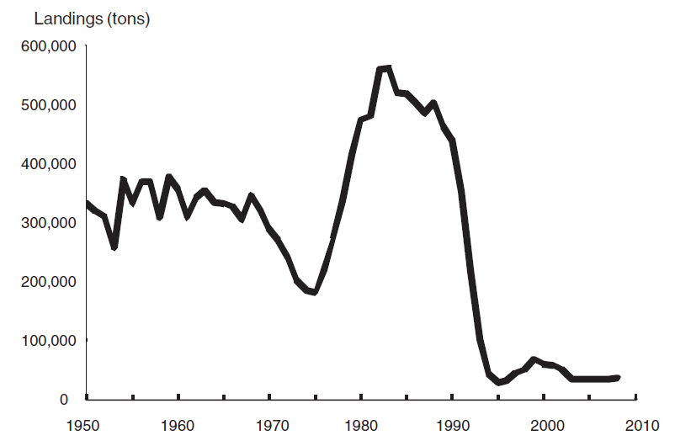
Annual Harvest of Atlantic Cod, 1950-2008
Notes:
Such situations with conventional open-access fisheries regulation are commonplace: overfishing occurs, the fishery stock is depleted, the government responds by regulating the catch, thereby driving up the cost of fishing, fishermen complain that they cannot make a profit, and harvests continue to fall.

Slide 19

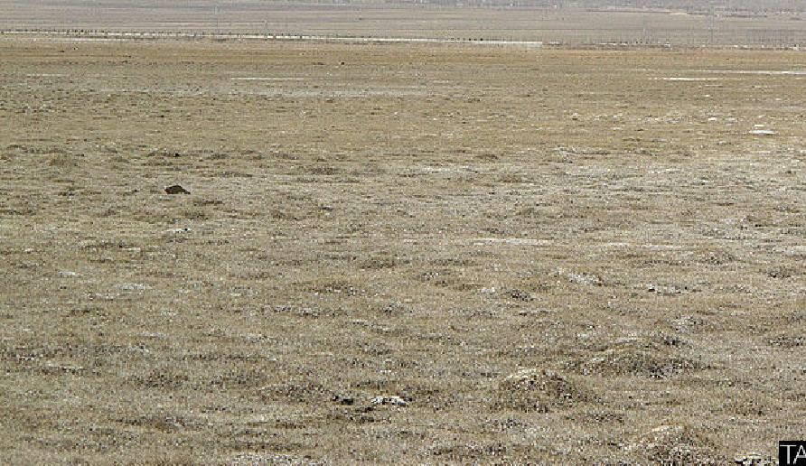

Tragedy of the Commons

Slide 20
Policy treatment: Cap-and-Trade
(份额交易)
An Individual Transferable Quota system was established in 1995.
  The season length increased from two days to more than 200 days.
  Safety problems were diminished, by-catch was reduced by 80 percent, ghost fishing losses fell by 77 percent, and the quality of fish in the market increased.
  -1994-1999, the number of fishing vessels decreased by 10 percent, while the value of the harvest increased by 34 percent.
  Total allowable catch has not been exceeded since the inception of the program.

Slide 21
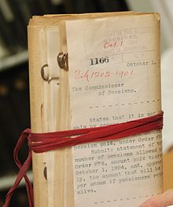
What is PA?- Managerial Definitions
PA is the executive function in government.
PA is a management specialty.
  Management refers both to the people responsible for running an organization and to the running process itself to achieve an organizational goal.
  Middle management
PA is Mickey Mouse.
  Red tape: symbol of excessive
  formality and attention to routine.

Slide 22
What is PA?- Legal Definitions
PA is law in action. (e.g. O’Neill)
  Administrative Law: the law of how, when and where the government actions can be taken.
PA is regulation.
  Regulation: The totality of government controls on the social and economic activities of its citizens and businesses; the rulemaking process of those administrative agencies charged with the official interpretation of laws.
  Make some problems rare happened (e.g. earthquake)

Slide 23
Environmental regulations
In a 1995 US national survey on environmental issues, 94 percent of Americans said that they considered the Environmental Protection Agency to be necessary in today’s economy.
      Report Center at the University of Connecticut.

Slide 24
Environmental Laws Enforced by U.S. EPA

Slide 25
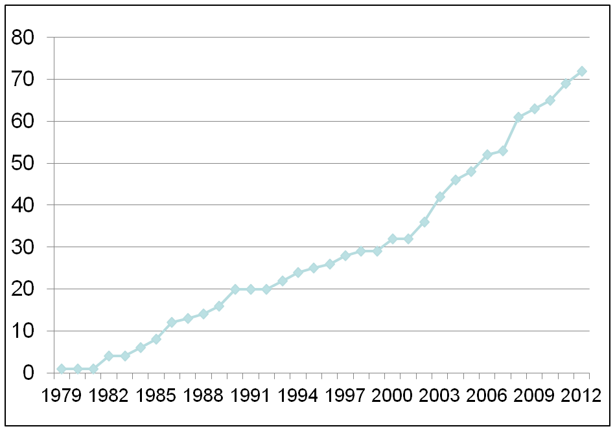
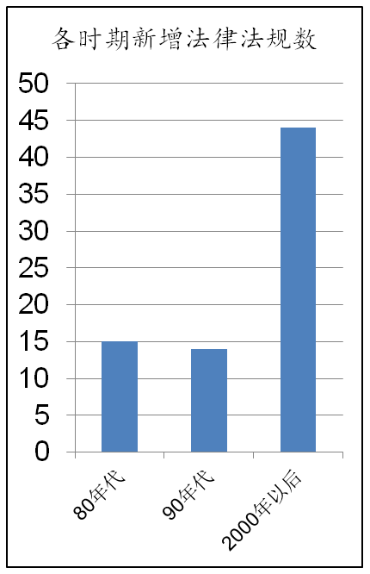
Environmental Laws and Regulations in China
Source：Website of Ministry of Environmental Protection

Slide 26
Concept of PA
What is Public Administration?
PA is the use of political, managerial, and legal theories and processes to fulfill legislative, executive and judicial governmental mandates for the provision of regulatory and service functions for the society. It is whatever governments do. (Rosenbloom,1998:6)
公共管理就是运用政治、管理和法律相关理论和实践来实现政府立法、行政和司法的指令，以帮助政府履行为社会提供规制和服务的职能。公共管理就是政府所做的一切。(Rosenbloom,1998:6)

Slide 27
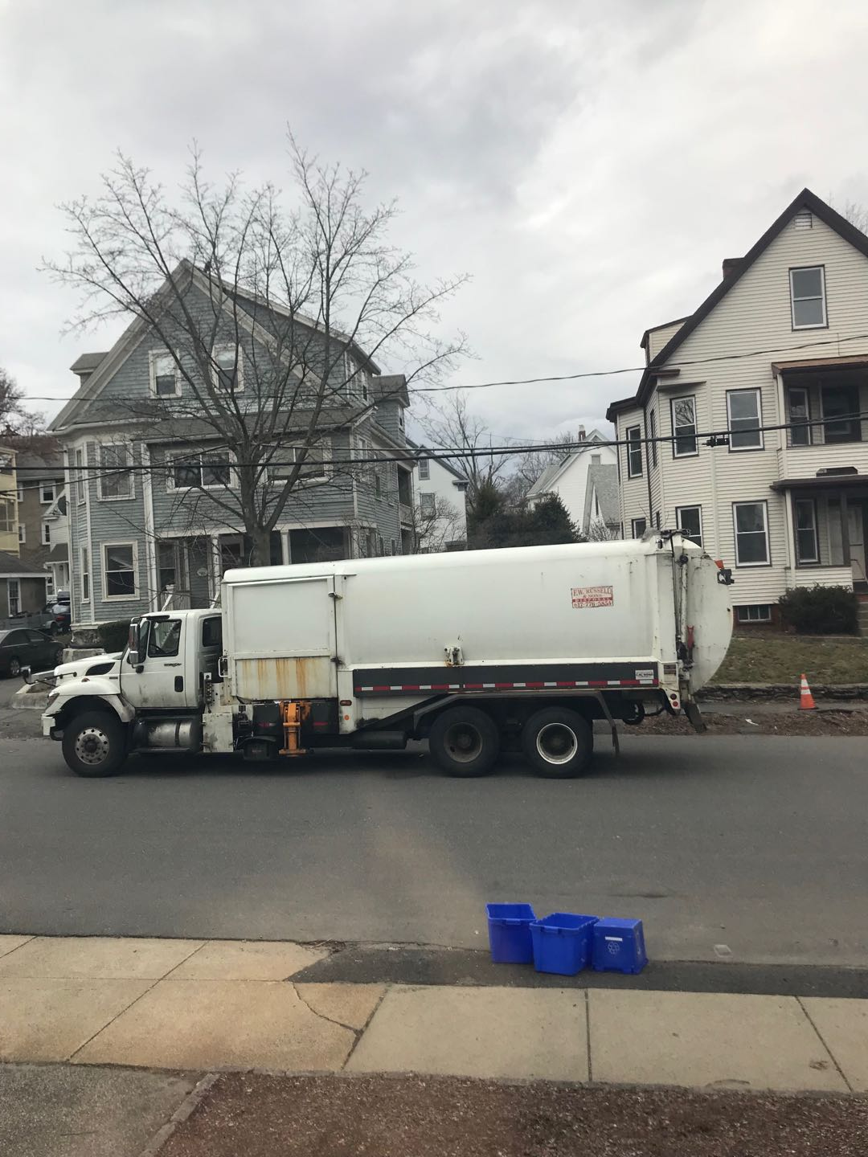
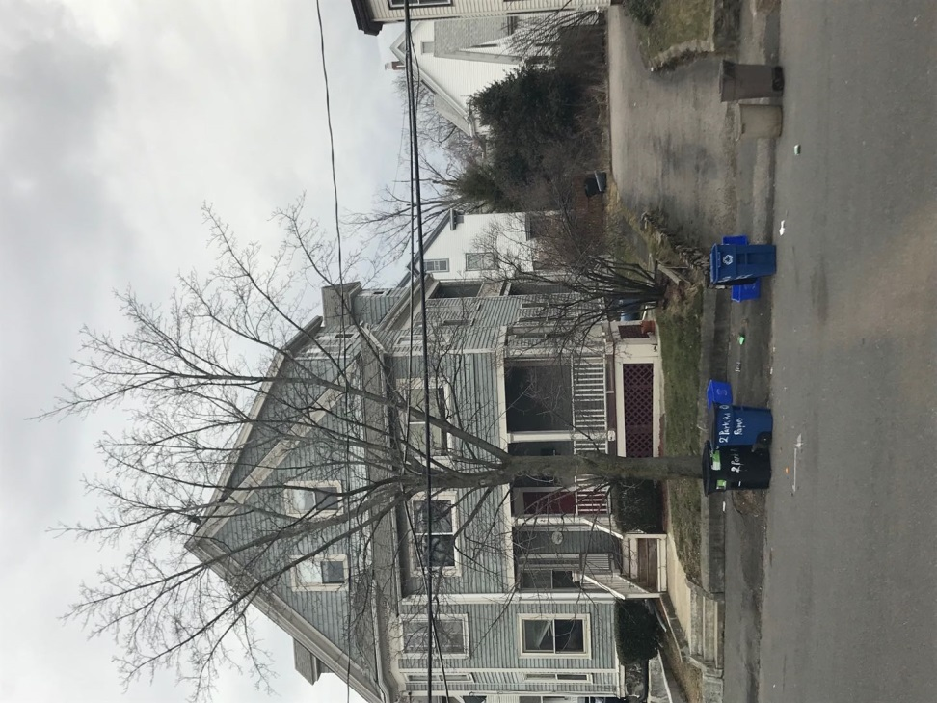
Public services in our daily life

Slide 28



Slide 29

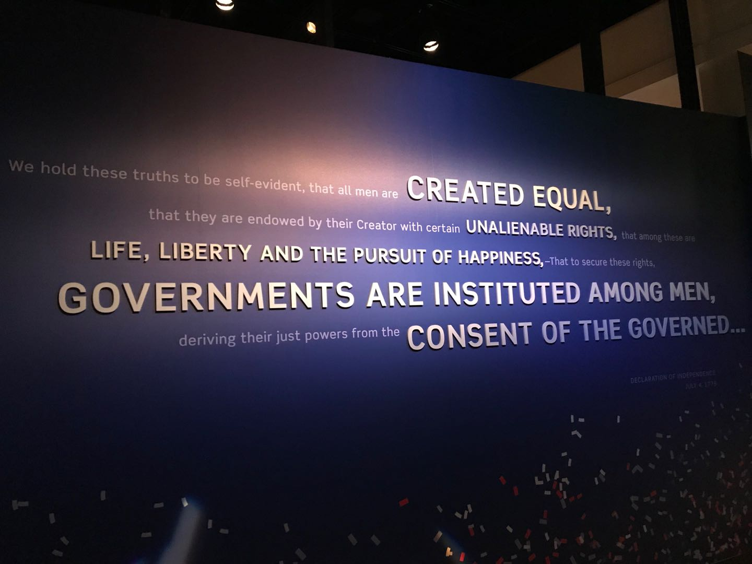

Slide 30

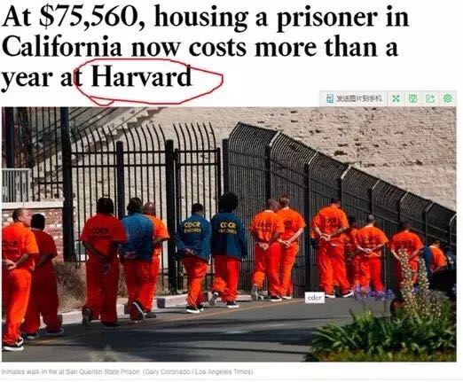

Slide 31
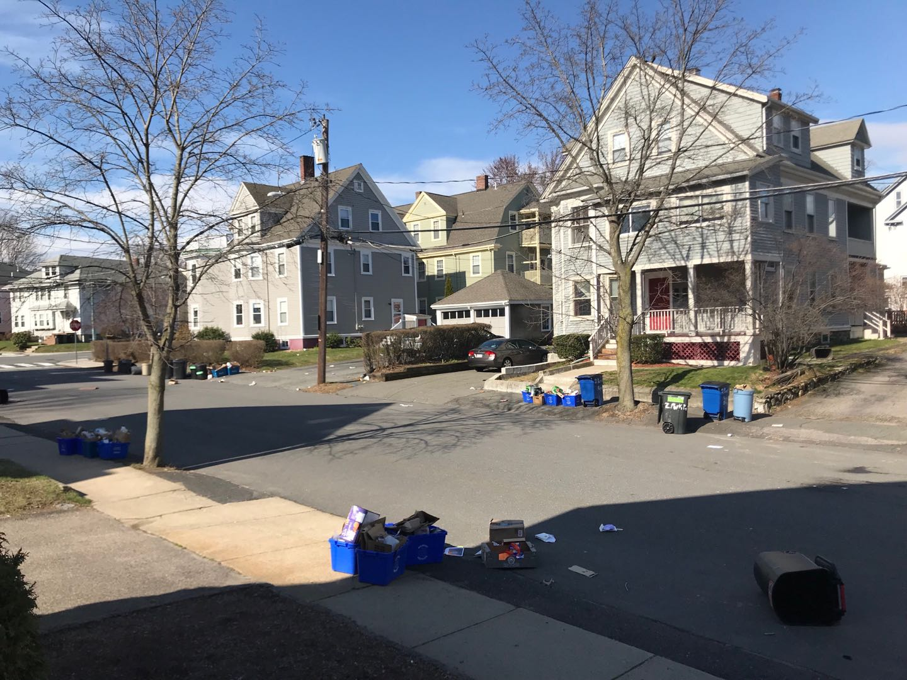
What a mess…

Slide 32
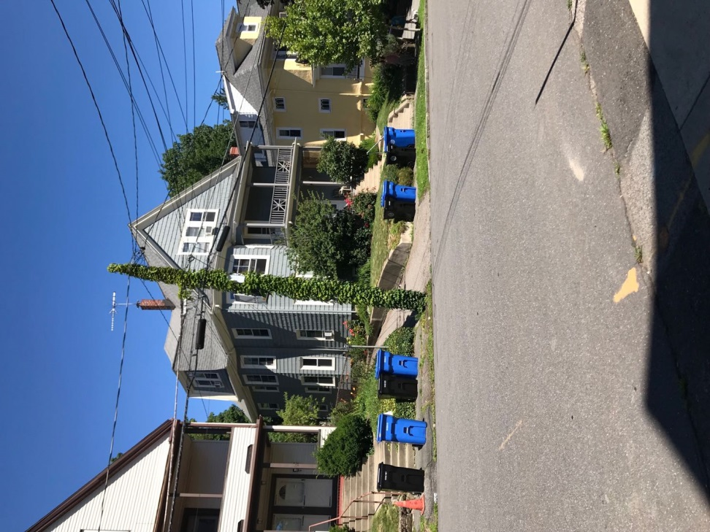
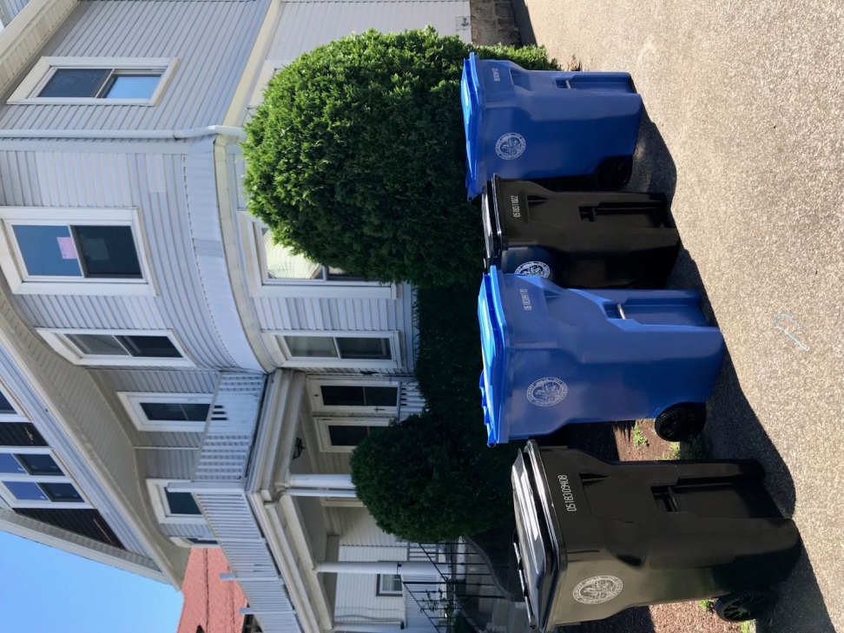
Three months later…

Slide 33
PPT 主要内容
中文翻译

Slide 34
从三个角度理解公共管理
政治的角度（立法）-与立法决策有关。
-核心价值：公共性
管理的角度 （行政）-与行政部门的执行有关
-核心价值：效率
法律的角度 （司法）-专注政府的仲裁功能，并且承诺维护宪法的权威和法律的执行。
-核心价值：主权、宪法、规则、平等

Slide 35
I. 政治的角度
公共管理是公共政策制定周期的一个阶段。
公共管理是维护和贯彻公共利益。
  促进社会公平
  弥补市场失灵：公共物品（例如邮件服务）
  讨论问题：如何判断政府是否执行的是公共利益？
公共管理是做那些单独个体无法很好完成的事情。

Slide 36
公共政策制定周期
1. 识别问题
2. 提上议事日程
3. 政策制定
6. 执行
5. 预算/
拨款
4. 政策采纳/
合法化
7. 评估

Slide 37
公共利益
  利益：
    是人类为了生存和发展所必须具有的资源与条件。当人的需求没有受到限制时，资源与条件并不表现为利益。
公共利益
  是指公众的、与公众有关或为公众、公用需要的利益。
不同于共同利益，与私人利益可能存在排斥

Slide 38
可能导致市场失灵的两个原因
外部性 （externality）
  个人行为造成的成本并没有得到其它人的同意。
公共物品
（public goods）
  增加一个人对这种物品消费的成本很低或几乎没有（非竞争性）；阻止一个人对这种物品消费的成本很高（非排他性）. 公共物品的市场倾向是低生产。（例如邮件服务）

Slide 39
物品的分类
(Adapted from Weimer and Vining, 1992)
非竞争性 竞争性
非排他性
排他性
纯公共物品 -国防 -无线电信号 -灯塔 -路灯 | 公共池塘资源 -牧场 -鱼塘 -海洋渔场 -煤矿
俱乐部物品 -收费公路 -有线电视 -体育赛事 | 私人物品 -书本 -咖啡 -汽车

Slide 40
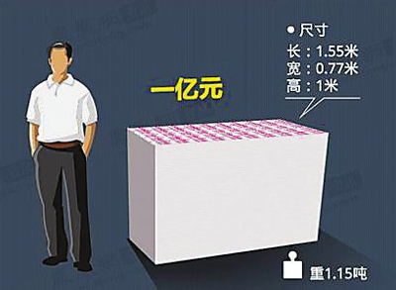
对公共利益的实践误区一
公共利益个人化：小官大贪现象层出不穷

Slide 41
对公共利益的实践误区二
对公共利益的解读的误差
  公职人员个人背景
  技术官僚的专业狭隘性
  与服务群体的密切关系

Slide 42


对公共利益实现的误区三
公共利益部门化：从碘盐治病到碘盐致病

Slide 43
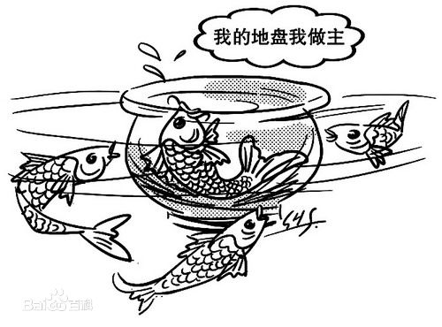
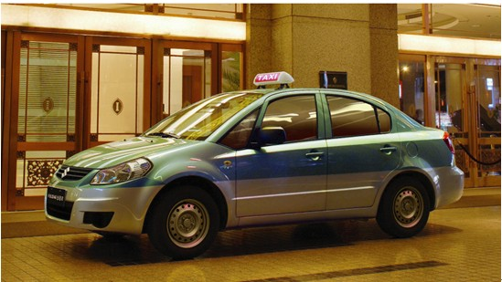
对公共利益实现的误区四
公共利益地方化：
  出租车的地方保护
  网约车管成出租车

Slide 44
II. 管理的角度
就是政府执行功能的实施。
  大多是对现有项目的管理。
公共行政是一种专业管理。
  管理既指负责组织运行的人，又指组织完成目标的运行过程。
  中层的管理
公共行政就是米老鼠。
  繁文冗节（Red tape），例如学位认证

Slide 45
III. 法律的角度
就是法律的执行。(例如O’Neill)
  行政法：是对政府用什么方式、在什么时间和什么地点可以采取行动进行规定的法律。
就是规制（管制）。
  最古老的政府功能：告诉公民和社会
  （不）可以做什么 （例如汉莫拉比法典）
  规制：政府控制公民社会和经济活动的总和；是负责法律解释的行政机关制定规则的过程。
  使一些问题更少发生(例如地震)

Slide 46
公共管理的概念
What is Public Administration?
PA is the use of political, managerial, and legal theories and processes to fulfill legislative, executive and judicial governmental mandates for the provision of regulatory and service functions for the society. It is whatever governments do. (Rosenbloom,1998:6)
公共管理就是运用政治、管理和法律相关理论和实践来实现政府立法、行政和司法的指令，以帮助政府履行为社会提供规制和服务的职能。公共管理就是政府所做的一切。(Rosenbloom,1998:6)

Slide 47
二、公共管理的学科起源

Slide 48
几个基本名词
  Administration：行政学
  Public Administration：PA，公共行政学
  New Public Administration：NPA，新公共行政学
  Management：管理学
  New Public Management：NPM，新公共管理
  New Public Service：NPS，新公共服务

Slide 49
现代公共管理的理论沿革
1887年，伍德罗·威尔逊发表《行政学研究》，标志着公共行政学诞生；
20世纪上半叶，行政学在中国有所发展。
20世纪80年代，行政管理学在新中国开始起步。
名称上，行政管理更具中国特色，公共行政更具西方色彩，两者其他无区别，英文均为Public Administration （PA）。

Slide 50
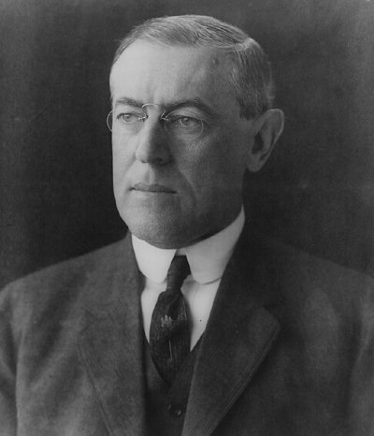
公共管理学科的开始
作为实践，公共管理从有人类历史记载就已开始。
作为一门学科，通常认为从伍德罗· 威尔逊（Woodrow Wilson）1887年所著论文《行政学研究》 （The Study of Administration）开始。
“公共管理学科的目标即发现 1）政府能恰当而成功地做什么 (what)；2）以及如何(how)以最高的效率和最低的成本（金钱或能量）去做那些政府该做的事情。”

Slide 51
威尔逊的观点
威尔逊：美国第28、29任总统
主要观点：
  政治和行政分离 (P-A 二分法)
  公共组织和私人组织的比较分析
  采取类似于商业部门的方式来提高公共组织日常运行效率。
  加强公务员的管理和培训、实施绩效考核的方式来提高公共服务的有效性。

Slide 52
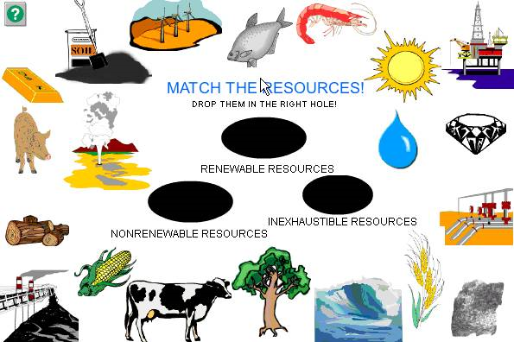
What Concerns You More

Slide 53
Theory-based Environmental Policy
For much of the past 90 years, economists have thought of environmental pollution as a classic—indeed, textbook—example of a negative externality (Arthur C. Pigou 1920).
→ Points to emission tax
A separate but related strand of literature has identified environmental pollution essentially as a public-good problem, that is, a problem of incomplete property rights (Ronald Coase1960).
→ Points to Tradable Permits System

Slide 54
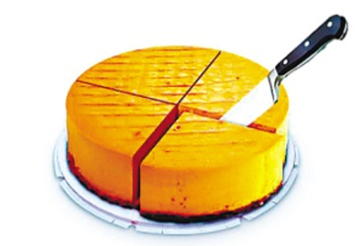
Cap and Trade (份额交易)
从经济学的视角解决问题：
科斯定理：只要财产权是明确的，并且交易成本为零或者很小，那么，无论在开始时将财产权赋予谁，市场均衡的最终结果都是有效率的，实现资源配置的帕雷托最优。
定额分配捕鱼数量，并且额度可以转让。

Slide 55
Size of Environmental and Energy Agencies in the U.S. and China
U.S. | Number of Employees | China | Number of Employees
Environmental Protection Agency | 17,106 | Ministry of Environmental Protection | 311
Department of Energy | 15,671 | National Energy Administration | 240

