Slide 1
Introduction To Public Administration
SUFE SPEA
Instructor: WANG, Feng

Slide 2
Week7 The Process of PA and Its Political Context

Slide 3
Agenda for Today
Overview of the Last Session
The Process of PA
The Political Environment of PA

Slide 4
Public VS. Private Management
Differences
The Nature of Organizations
Ownership
Funding
Social control
Environment
Goals
Managerial values

Slide 5
Similarities
Similar problems need to be addressed (Knott, 1993)
Task interdependence
Information asymmetry
Interests conflict (HR, material allocation, etc)
Similar bureaucratic structure for big orgs
Similar duties and management skills

Slide 6
Management duties and skills
Managerial duties (POSDCORB, Gulick,1937)
Planning (outline and methods)
Organizing (structure)
Staffing (personnel)
Directing (decision-making)
Coordinating (task management)
Reporting (communication and record-keeping)
Budgeting (fiscal planning, accounting, and control)
Management skills (textbook, chapter 1)
Political management
Program management
Resource management

Slide 7
The Process of Public Administration

Slide 8
Political Management
Public administrators must not only have knowledge of political institutions and processes, but also have political skills.
Examples:
-1989’s earthquake in San Francisco
- Centers for Disease Control vs. Blood Bankers

Slide 9
Program Management
Terminology（名词）
Policy: a statement of goals and of the relative importance attached to each. It comprises one or more plans.
broad, eg. welfare policy
Plan: a statement of objectives to be attained.
Program: a set of specific actions intended to help implement a plan.
specific, having a focus, eg. Medicaid; unemployment insurance; Temporary Assistance for Needy Families (TANF); Food stamps; public housing assistance.
Public administrators ensure that tasks are done in an efficient and effective manner.
→ Need a thorough grasp of the five traditional management functions.

Slide 10
An Idealized Structure of Public Policy
Example:
Increasing
physical safety
Decreasing Decreasing
violent traffic
crimes (25%) accident (25%)
Increase police force by 1000.
Set up youth afterschool program
Neighborhood Watch Program
…

Slide 11
Traditional Management Functions
Planning –goals & objectives
Where the organization wants to go and how it will get there.
Decision Making- alternative strategies for attaining the objectives.
Process of identifying problems and opportunities, generating alternatives, and selecting an alternative.
Organizing- structures and roles
Assignment of tasks (“these are the things we must do”)
& the grouping of tasks into organizational units (depts, offices)
Leading- motivating and interpersonal skills
The use of influence to lead and motivate civil servants to achieve program objectives.
Implementing
Monitoring and adjusting of the agency employees’ activities to ensure that the program remains on track toward its objectives.

Slide 12
Resource Management
Administrator’s skill at resource management impacts the success of implementing a policy.
Public administration is people intensive (HR management).
Few public administrative activities are voluntary and free (Financial management).
Information is becoming the most important resource in the 21st century (information management).

Slide 13
The Political Environment of Public Administration

Slide 14
The Political Field Surrounding a Public Administrator

Slide 15
The Political Appointee Connection
Presidential Appointees 政务官: Head every department in the federal government and work closely with the senior executives （高级事务官）of agencies (3000:7000)
Sources of tension between agencies and political appointees
Power base: agencies tends to be independent (by forming “iron triangle”铁三角)
Agencies have a tendency to be resistant to change because of the professional orientation of careerists.
Average tenure of political appointees is only 18 months. So, little time available to form strong ties.

Slide 16
The Legislative Connection
I. Congress exercises formal authority over agencies by setting policy.
Freedom of Information Act (FOIA) gives any person the right to request information from agencies and to file action in federal court if the request is denied.
Sunset laws provide that an agency is automatically abolished 废除, or self-destructs, after a period of years (7 or 10) unless the legislature passes a law extending its existence.
Sunshine laws requires that formal government business meetings be open to the public.

Slide 17
II. Oversight (监督）& Appropriations（拨款）
Oversight involves continuing, systematic supervision of the performance of the executive branch by Congress.
legislative oversight is often criticized to be micromanagement, which can be expensive.
Congress has the power of the wallet. Actions by the appropriations committees (of the US House of Representatives) may override 推翻 presidential directives or nullify(废除) laws enacted by the Congress itself.
It is in charge of setting the specific expenditures of money by the government.
Federal government shutdown (美国联邦政府关闭）
http://news.163.com/special/usgovernmentshutdown/

Slide 18
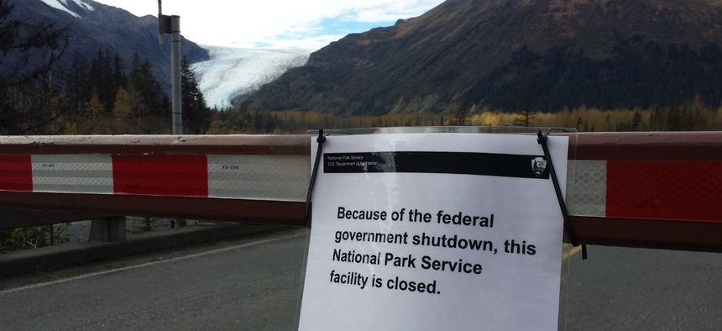
E.g.: The impact of appropriation on federal government operation (2019)

Slide 19
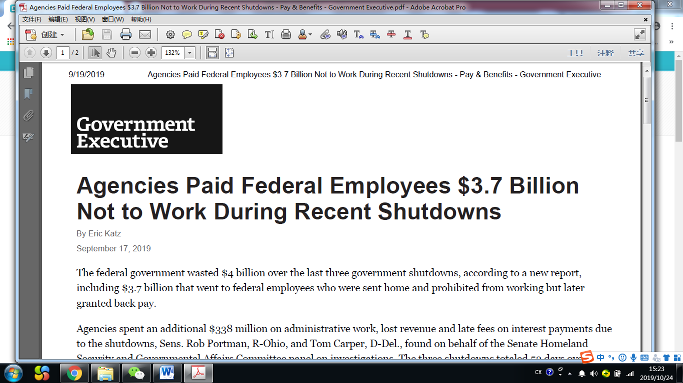

Slide 20
The Judicial Connection
Administrative Responsibility
Rulings of courts help ensure that the actions taken by public administrators are responsive, fair, and honest.
Administrative Law
The body of law that defines the power, limits, and procedures of administrative agencies.
Public Employees
The Supreme Court has placed important limitations on the flexibility of managers to supervise their employees and operate their organizations.

Slide 21
Examples of Illegal Administrative Action
Over a period of years, a small Mississippi town concentrated its economic development and new infrastructure in its business district and an adjacent neighborhood.
In Delaware, a patrol officer, for no particular reason other than that it was part of his job, made a routine stop of a car to check the driver’s license and registration.
Seeking to budget more rationally, Pennsylvania established a one-year residency requirement as part of their eligibility standards for receiving welfare benefits.

Slide 22
The Interaction of Management Strategy and Political Strategy
Example 1: recreation programs
Management: close those having few users
Political: stay open
Example 2: a new airport
Management: grasp investment opportunity no matter the location
Political: oppose the out-of-state site
Interaction: AIDs epidemic issue
Management: free needles, drug-treatment program; mandatory sex education
But neither libertarian nor conservatives satisfied;
“AIDS was the first major public health issue for which political values rather than health requirements determined the program structure.”-Dr. Joseph, former NY city commissioner of health.

Slide 23
Two Basic Types of City Government
The mayor-council form: reproduces the standard institutions of American government at the municipal level, with a separately elected legislature and chief executive (political responsiveness)
The council-manager form: the legislature appoints the chief of the executive branch—the city manager, who is a professional trained in city management and is supposed to administer city services in an expert, nonpartisan way (efficiency)

