Slide 1
Introduction To Public Administration
SUFE SPEA
Instructor: WANG, Feng

Slide 2
Week 8 Administrative Responsibility and Ethics

Slide 3
Agenda for Today
Overview of the Last Session
Administrative Responsibility and Ethics

Slide 4
The Process of Public Administration

Slide 5
The Political Field Surrounding a Public Administrator

Slide 6
Administrative Responsibility
and Ethics

Slide 7
Why The Guardians Need Guarding?
Misconception of the public interest
Representative of some social forces, e.g. higher level (gender, ethnics, region, etc.)
Specialization leads to a narrow outlook
A close relationship with a particular clientele(客户) group can lead to a misconception of public interest.
Corruption: A betrayal of the public trust for reasons of private interest.
Political exchange: what are acceptable?
Honest graft 以权谋利
Unilateral 单方面: (falsify data; embezzle 挪用grant; misuse of inside information)
Transactional (bribery受贿 , extortion勒索）

Slide 8
Discussion Question
In your opinion, what qualities that a government should have ?

Slide 9
The Ideal of Administrative Responsibility

Slide 10
Responsiveness（回应性）
Responsiveness: refers to the quick reaction to popular demands for policy change (e.g. COVID-19).
In some cases, responsiveness means that government actively resolve some problems or define the problems (e.g. food safety).
Methods: citizen surveys, asking input (focus group; town meeting, eg. 311 of NY)
Example: the less use of parks
Government: providing more playground equipment
Citizen: park safety

Slide 11
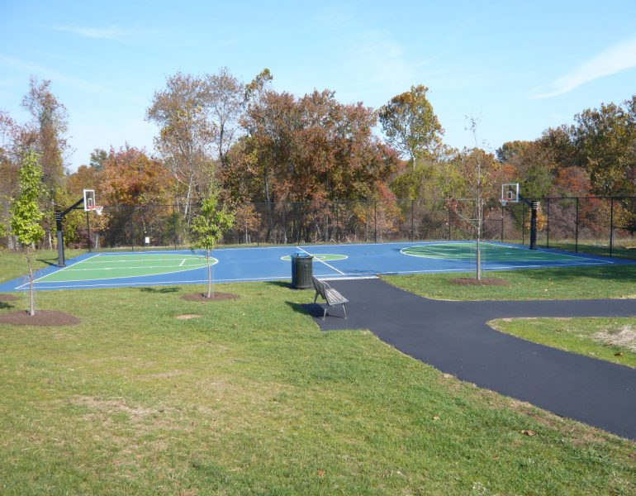
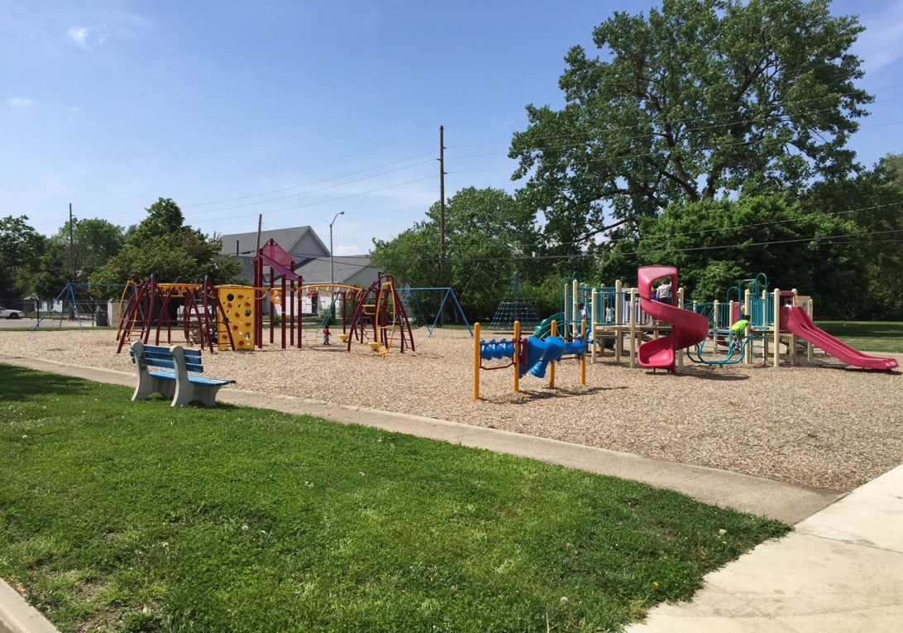

Slide 12
Fairness
To ensure that government will be administered by law, not by the arbitrary will of people.
To ensure that citizens have a chance to present their cases and be heard fairly, agencies follow due process (法定程序）.
Fairness concerns results as well as procedures.

Slide 13
Flexibility
Flexibility can be pursued only so far.
Top figure: ignoring individual groups, local concerns, or situational differences →might not meet anyone’s needs well
Middle figure: treating everyone individually is usually
→ too expensive and impractical
Bottom figure: searching for broad groupings that can be approached as segments.
E.g.: LA Weingart Center (p.57): “have-nots”, “can-nots”, “will-nots”

Slide 14
Honesty
Why Honesty Matters?
It breeds trust. The more trust exists in a society, the better that society functions.
The level of trust inherent in the society (Francis Fukuyama 福山)
Why public officials deceive?
Incompetence: Try to hide poor performance;
Superiority: 1) Arrogance；2) the people should be deceived “for their own good” (Movie: A few good man)

Slide 15
Honesty is More than Truth Telling p61
Malfeasance (渎职，不法作为）: Wrongful conduct by a public official. Performance by public officials of deeds that they are forbidden to perform by constitutional or statutory law, or by commonly accepted moral standards.
Misfeasance （过失，不当作为）: Doing a proper act in a wrongful or injurious manner. Improper performance of lawful duties. It involves administrative activity that is within the lawful mission of an agency but that violates constitutional standards or the public interest.
Nonfeasance（不作为）: Failure of a public official to performed required duties.

Slide 16
Accountability （可问责性）
Accountability: The extent to which one must answer to higher authority for one’s action in society at large or within one’s particular organizational position.
When things go wrong, someone must be held responsible.

Slide 17
Competence （能力）
Components of the New Model of Public Administration
Provide high-quality services.
Be evaluated and rewarded on the basis of how well they meet targets.
Ensured that the human and technological resources will be available.
Maintained open-minded attitude about which services belong to the private.

Slide 18
Discussions
What mechanisms could control government operations to be responsible?

Slide 19
The Managerial Perspective
Develop mechanisms internal to organizations.
Clearly assigned authority and responsibility
Strict subordination
A limited span of control
Formal disciplinary system
Audit

Slide 20
The Political Perspective
Develop mechanisms external to organizations.
General legislative oversight
Budgetary control
Rotation in office
Representation and public participation

Slide 21
The Legal Perspective
External Control
Constitutional values and requirements
Clear rules of conduct and enforcement mechanisms

Slide 22
Framework for Analyzing Controls on Government Operations
 | External | Internal
Formal | Judiciary Ombudsman（巡视员） Legislature | Agency head Whistleblower （检举者）statutes
Informal | Citizen participation Interest group representation Media | Professional codes Representative bureaucracy Public Interest Ethical analysis

Slide 23
The Nature of Judicial Control
The most rapidly expanding control over administrators in recent years.
A court’s responsibility is always after the fact.
The Supreme Court tends to support federal agencies more frequently.

Slide 24
Ombudsman （巡视员）
A government appointee who investigates complaints by private persons against the government.
Has the power to interview those who handled a matter in dispute and examine their records.
Makes recommendations and uses “reasoned persuasion” to achieve a remedy.

Slide 25
Whistle-Blower （检举者）
An informant who exposes wrongdoing within an organization in the hope of stopping it.
The U.S. Congress provides protection in Civil Service Reform Act of 1978. Act encourages disclosures of fraud, waste, or abuse by providing protection from reprisal (报复).
Whistleblower Protection Act of 1989 establish an independent agency responsible for protecting whistleblowers; investigating employee complaints of whistleblower reprisal; and initiating corrective and disciplinary actions.
https://www.sohu.com/a/378193492_145495
https://baike.baidu.com/item/%E5%90%B9%E5%93%A8%E4%BA%BA/1255128?fr=aladdin

Slide 26
Case: TIME names whistleblowers as Persons of Year
Questions: please discuss the questions with your team member:
What’s the threshold for blowing the whistle on one’s agency?
What’s the tradeoff between loyalty to your organization and your perception of the public interest？

Slide 27
Codes of Ethics
American Society of Public Administration:
https://www.aspanet.org/ASPA/Code-of-Ethics/ASPA/Code-of-Ethics/Code-of-Ethics.aspx?hkey=5b8f046b-dcbd-416d-87cd-0b8fcfacb5e7
International City Manager’s Association:
https://icma.org/icma-code-ethics

Slide 28
Limitations of Professional Codes
No one professional code can cover all the scope of an administrator’s activities.
The wording of these guidelines:
if too general, they are useless as a guide;
If specific enough to serve as guide to action, they might be too detailed to be unworkable不能实行的.

Slide 29
Ethical Analysis
Ethics:
A branch of philosophy that focuses on what is morally good and bad, right or wrong.
It refers to the values that guide a person, organization, or society — the difference between right and wrong, fairness and unfairness, honesty and dishonesty.”

Slide 30
The importance of ethics
Two research:
“maintaining ethical standards” was ranked the top important skill for success. (Table 4.1, textbook)
“Street-level bureaucrats are influenced by their moral judgments, not by organizational rules”.

Slide 31
Why Study Ethics?
Helps public administrator arrive at decisions more quickly. (e.g. policeman)
Leads to greater consistency in decision making.
Helps public administrators make more reflective 经过思考的 judgment -- ones that can be defended in public.

Slide 32
Some Common Ethical Problems

Slide 33
How Would You Answer?

Slide 34
The four levels of ethics
Personal morality: the basic sense of right and wrong (factors: parental influence, experience, religious beliefs, etc.)
Professional ethics: Professional codes/norms
Organizational ethics: organizational culture & environment (eg. agency rules)
Social ethics: Social obligation to protect individuals and further the progress of the group (formal: laws; informal: individual social conscience)
Milgram Experiment
Question：How do public managers handle conflicts between their personal values and public policy?

Slide 35
Process of Ethical Analysis

Slide 36
How Anthony Robbins Reworks Aristotle
First, Putting you values in order -- from the most important to the least.
Next, ask yourself three critical Qs:
What do my values need to be in order to create my ultimate destiny, in order to be the best person I can possibly be, in order to have the largest impact in my life?
What other values would I need to add?
What values should I eliminate from my list in order to achieve my ultimate destiny?
Finally, evaluate each value individually, asking what benefit you can get by having this value in this position on your hierarchy.

Slide 37
课件中文版本

Slide 38
为什么守夜人也需要被看守？
对公共利益的误解 （misconception）
社会背景
专业化→ 狭隘视角
与被服务对象的密切关系 → 容易代表其利益
腐败：为个人利益对公共利益的损害和背叛
政治交换
以权谋利
单方面: (挪用公款、造假数据、利用内部信息）
交易型： (bribery受贿 , extortion勒索）

Slide 39
讨论问题
你认为政府责任应该具备哪些要素？或者说，理想的政府应该具备什么特征？

Slide 40
行政责任的理想构成要素

Slide 41
快速回应性
回应性不只是对公众政策改变需求的快速回应（如SARS），有时也指政府主动解决某些公共问题或者对一些问题的判断（例如：食品安全）
方法：从公民获取必要信息：问卷调查，恳谈会，焦点小组讨论等）
例子：地方政府要对某些利用率少的公园进行改造
政府：提供更多运动器械
公民：公园安全问题

Slide 42
灵活性
只是理想目标。
[上图]：忽视群体、地方需求、形势的区别（每个人不能获得很好的对待）
[中图]：每个人的需要都被考虑（代价高，不切实际）
[下图]：把相近需求个体组成群体
例: 洛杉矶Weingart 中心 (NPO): 服务对象分为三类：
“无有者” have-nots,
“无能者”can-nots,
“无意愿者”will-nots

Slide 43
行政责任要素
公正 Fairness：依法办事：结果和程序公正。
诚实 Honesty：
重要性：可以培育信任。（”社会信任度越高，社会越能运作良好。”—Fukuyama 福山）
为什么官员会欺骗？
能力不足的掩饰
优越感：傲慢；是为他们“好”
可问责性 Accountability：我国开始“终身追责”
能力 Competency: 现代公共管理新要素

Slide 44
问题讨论：
设计什么制度来看守政府的行为？

Slide 45
从管理角度
设计组织内部机制：
清晰的责权
严格的隶属关系
合适的管理幅度
正式的纪律体系
审计
……等等

Slide 46
政治角度
外部监督机制
立法监督
预算控制
轮岗
公民参与

Slide 47
法律角度
外部控制
宪法
法律、法规
法规的执行

Slide 48
对政府的看守机制
 | 外部 | 内部
正式 | 司法部门 巡视组 立法部门 | 部门首长 揭发检举法规
非正式 | 公民参与 利益集团代表 媒体 | 职业道德规定 公共利益 伦理分析

Slide 49
职业道德规定
International City Manager’s Association:
http://www.icma.org/main/bc.asp?bcid=40&hsid=1&ssid1=2530&ssid2=2531
软性约束 & 有限性

Slide 50
检举者
检举人：对组织错误做法的揭发，以期停止该错误行为的人。
检举人保护制度：公务员改革法案（1978年），鼓励对浪费、错误和滥用权力的举报，并保护检举人不受组织报复的法案。
检举人保护法案（1989年）：建立独立部门，保护检举人，调查对检举人施加报复等行为，并且有纠正和管教的权力。

Slide 51
阅读《沉默的大多数》
讨论：
你认为一个人揭发自己组织错误行为的可接受标准是什么？
你认为应该怎么处理对组织忠诚和对公共利益的维护的冲突？如何平衡？

Slide 52
伦理分析
伦理：是哲学的一个分支，它关心什么是道德上的善与恶、对与错。它指的在对与错、公平与不公平、诚实与不诚实之间，引导个人、组织、社会的价值。

Slide 53
行政伦理的重要性
两个研究表明:
“维护道德标准”是成功的管理者具备的最重要的品德。
“街头官僚”大多通过道德判断，而不是组织规则来做决定。

Slide 54
公共管理者为什么要学习行政伦理?
这种研究可以帮助公务人员更加迅速的作出决策 (例如： 警察)
可以使诸多决策前后一致。
能够帮助公务人员做出更深思熟虑的判断：如当众予以辩护的判断。

Slide 55
一般的行政伦理问题

Slide 56
你如何处理如下问题？

Slide 57
伦理道德的四个层次
个人道德: 基于对和错的意识（影响因素：父母的影响、个人经验、宗教信仰等。）
职业道德：职业规范/职业标准
组织伦理: 组织文化与环境 ( 如：组织规章)
社会伦理: 保护个人的社会义务和团体进一步的发展 (正式的:法律; 非正式的:个人的社会意识)
Milgram Experiment（看视频）
讨论问题：公共管理者如何处理个人价值和公共政策之间的冲突？

Slide 58
《唤醒强大的内在》
首先, 把你的价值观从最重要的开始依次排序.
其次, 问自己三个关键的问题:
为了使我的一生拥有最大的影响、为了尽可能成为最好的人、为了达到我的终极目标，我的价值需求是什么？
我还需要增加哪些价值观？
为了实现自己的终极目标，应该从我的名单中删除哪些价值观？
最后，单独评估每一个价值，问问自己在这个位置的这一层次上，你可以得到什么好处。

Slide 59
伦理分析的过程

