Slide 1
Public Administration and Management
SUFE SPEA
Instructor: WANG, Feng

Slide 2
Week 9 Planning 规划

Slide 3
五种功能之
规划
（planning)
“我们国家好像一条巨大的游轮，甲板上有所有的奢侈品，却没有雷达，没有导航系统，也没有预防性的定期保养维护”。--《重塑政府》
对未来茫然不知，使政府在一次又一次的危机中自顾不暇。

Slide 4
Overview
Overview of students’ suggestions
Overview of the Last Session
One of the Traditional Management Functions—Planning

Slide 5
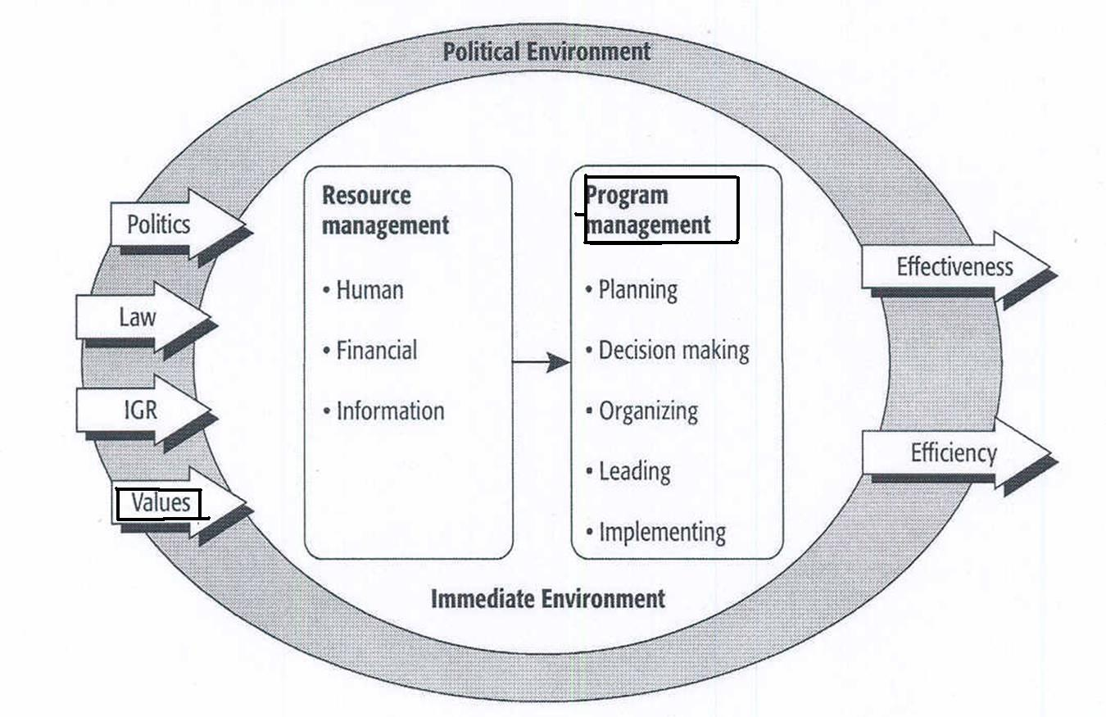
The Process of Public Administration

Slide 6
The Ideal of Administrative Responsibility

Slide 7
Framework for Analyzing Controls on Government Operations
 | External | Internal
Formal | Judiciary Ombudsman（巡视员） Legislature | Agency head Whistleblower （检举者）statutes
Informal | Citizen participation Interest group representation Media | Professional codes Representative bureaucracy Public Interest Ethical analysis

Slide 8
The four levels of ethics
Personal morality: the basic sense of right and wrong (factors: parental influence, experience, religious beliefs, etc.)
Professional ethics: Professional codes/norms
Organizational ethics: organizational culture & environment (e.g. agency rules)
Social ethics: Social obligation to protect individuals
formal: laws
informal: individual social conscience
Example: Milgram Experiment
Question：How do public managers handle conflicts between their personal values and public policy?

Slide 9
Process of Ethical Analysis

Slide 10
Governments in USA
Federal government
State government
Local government
County
Town
City
Example:
South California Region
Los Angels county, etc. 8 counties
City of Los Angeles, etc 88 cities

Slide 11
City Government Systems
Mayor-Council (市长-议会制)
Strong Mayor：mayor is directly elected by voters, can appoint department heads, propose budget plan, has veto power over council votes (large cities, LA, NY).
Week Mayor：chosen from council members. No appointing and veto power (small towns).
Council-manager (议会-经理人制)
council will hire a manager
middle-sized and small American cities

Slide 12
Planning
Goals and Plans: Some Terminology 术语
Planning Types & Models
Tools for Planning (Forecasting）
Strategic Planning/Management

Slide 13
I. Some Terminology
Planning is reasoning about how an organization will get where it wants to go.
Its essence is to see threats 危 and opportunities 机会 in the future and to exploit (利用) or combat (解决) them by making decisions in the present.
Policy: a statement of goals and of the relative importance attached to each. It comprises one or more plans.
Plan: a statement of objectives to be attained.
Program: a set of specific actions intended to help implement a plan.

Slide 14
An Idealized Structure of Public Policy p.96
Increasing
physical safety
Decreasing Decreasing
violent traffic
crimes (25%) accident(25%)
Increase police force by 1000.
Set up youth afterschool program
Neighborhood Watch program
…

Slide 15
Where Do Goals Come From?
Private sector: chief operating officer (CEO) with the advice and consent of the board of directors.
Nonprofit: top management with the advice and consent of the trustees.
Public sector: public policies (e.g. statutes).
eg: EPA 环保局’s goals derived from: Clean Air Act; Clean Water Act; Safe Drinking Water Act; Toxic Substance Control Act; Emergency Planning and Community Right-to-Know Act.

Slide 16
II. Planning Types & Models
Once goals are determined, managers should select a suitable planning approach that is flexible and adaptable to changing environments.
Rational planning model (comprehensive, general)
Logical incrementalism (comprehensive, general)
Contingency planning (specific)
Crisis management planning

Slide 17
The Rational Planning Model

Slide 18
Strengths of the Rational Model
Alerts/reminds 提醒 administrator:
To translate lofty goals into concrete actions. (目标具体化）
To set priorities and adhere to it. （建立优先次序）
To design structure after goals have been set up. （设计结构）
To analyze, experiment, and evaluate before launching program on a grand scale (在大规模实施项目之前进行分析和评估）.
To pay attention to feedback.
To periodically (定期）scan environment for new threats and opportunities.
To communicate about goals, alternatives and resource allocations, which help create a network of information.

Slide 19
Weaknesses of the Rational Model
Making goals explicit can generate political opposition.
Based on dubious 不可靠的 assumption that planner can peer into the future.
Fails to account for the politics within and outside to organization.
Discounts 低估 subjective 主观的 and qualitative 定性的factors in the planning process.

Slide 20
Logical Incrementalism
J. Quinn：
Rational Planning + Imcrementalism
Lindblom’s imcrementalism (林德布鲁姆的渐进主义)—muddling through: conservative & practical
Recommends policymakers meet challenges slowly, by taking small, incremental steps.
Weakness: can be too slow when conditions require swift action 快速行动 .

Slide 21
Contingency 权变 Planning
Define an organization’s response to specific situations such as emergencies or setbacks 挫折.
Identify uncontrollable factors and then decide how to minimize the effects of those factors once they occur.
Keep it simple. Sometimes just asking what-if questions is enough.
Scenario Planning: A long-term version of contingency planning.
Identifying several alternative future scenarios or “future histories”
E.g.: Shell 1970s: what if there is oil embargo (禁运) in the Middle East
1980s: what if the Soviet Union were to collapse?
Strength: Compensates for human tendency to assume everything will turn out as planned.

Slide 22
Crisis Management Planning
Three forms of crisis
Natural accidents / disasters
Normal accidents
Economic
Physical
Personnel 人事
Abnormal / intentional 故意的 accidents
Criminal, terrorism
Information
Reputation
Discussion: using the wheel of crises (textbook p.224)

Slide 23
Wheel of Crises

Slide 24
Stages of Crisis Management
Prevention: managers take activities to prevent crises from occurring and to detect warning signs of potential crises.
- Important part: to build relationship with stakeholders by open communication
2. Preparation: design detailed plans to handle a crisis when it occurs.
- Crisis Management Plan
3. Containment: focuses on the organizations response to an actual crisis and any follow-up concerns.
- Preventing the expansion of a hostile 敌对的 power or ideology (speed & candor 坦诚)
- crisis=danger (wei) & opportunity (ji)

Slide 25
Crisis Management Plan (CMP)
A detailed written plan that specifies the steps to be taken by whom in a crisis.
Important part: communication plan that designates a crisis command center and sets up a complete communications and message system.
Tailored to specific crises.

Slide 26
II. Forecasting as a Planning Aid 预测是规划的一个辅助工具
Good planning entails good forecasting (e.g. Miami’s Metrorail)
The Methods
Expert forecasting
Delphi technique
Trend extrapolation 趋势推断

Slide 27
Expert Forecasting 专家预测法
The oldest and the most intuitive直觉的 method.
Clarke’s law: When a distinguished but elderly scientist states that something is possible, he is almost certainly right. When he states that something is impossible, he is very probably wrong.

Slide 28
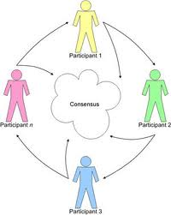
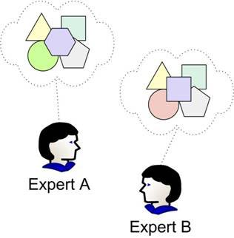
Delphi Technique 德尔菲技巧
A Delphi exercise asks a group of experts to state anonymously 匿名地 their opinions on when a future event might occur.
Their answers, with reasons, are summarized and fed back to the entire group for a second round.
This process can be repeated until the range of opinion narrows.

Slide 29
Trend Extrapolation Dilemma : Are We on Curve A or Curve B? 趋势推测困境：曲线A 还是B？

Slide 30
III. What can we learn from the private sector？Strategic Management
The entire set of decisions and actions used to formulate and implement strategies to achieve organizational goals.
Includes defining the organization’s mission, setting its objectives, and developing strategies to enable it to fit the environment.
Characteristics:
Involves decisions made by top management.
Involves resources allocation.
Has a significant long-term effect.
Focuses on the organization’s interaction with the external environment.
E.g. US. Homeland Security Strategic Plan

Slide 31
Strategic Plan – Department of Homeland Security
www.csub.edu/~rdaniels/DHS_StratPlan_FINAL_spread.pdf.

Slide 32
Strategic Management Process: A Public Sector Perspective

Slide 33
Step 1: Defining the Mission and the Desired Outcomes
Planning begins when agency develops strategic plan.
Plan should include comprehensive mission statement, set of outcome-related strategic goals, and description of how the agency intends to achieve those goals.
To large extent, plan is based on interests of stakeholders.

Slide 34
Barriers to Defining Desired Outcomes in the Public Sector
Bottom line (outcomes/results) is far less apparent than in the private sector.
Problems in collecting program performance data.
The diverse and complex factors affect agencies’ results.
Agencies have little control over some of those factors.

Slide 35
Step 2: Aligning Activities, Core Processes, and Resources
An organization’s activities, core processes, and resources must be aligned to support its mission and help achieve its goals.
It requires the organization firstly evaluate the extent to which their programs contribute to meeting the mission and desired outcomes.
If organization concerns mission-related outcomes, it is easier to alter old structures and procedures.
Agencies need ensure their core processes support mission-related goals.
Agencies should better link funding and anticipated results.

Slide 36
Step 3: Implementation
Successful implementation is reached when the expected objectives of a program are obtained.
But first two questions must be addressed:
What tools are available?
Which tools are most appropriate?

Slide 37
What Tools Are Available?
Political management
Organizational arrangements with other jurisdictions (IGRs)
Organizational arrangements with nonprofit and private sectors (Chapters 5 & 7 -Organizing and Implementation )
Leadership skills (Chapter 6)
Various management techniques

Slide 38
Which Tools Are Most Appropriate?
Public administrators need to know the different consequences of using different tools, consequences include:
Administrative feasibility
Effectiveness
Efficiency
Equity
Political feasibility
Public administrators need to decide which sector – government, nonprofit, or private -- would most likely produce the desired results.

Slide 39
Step 4: Performance Assessment
This step involves monitoring and reporting program accomplishments, particularly progress toward pre-established goals. Namely 2 types:
Performance measurement addresses program outcomes, not program activities/outputs. (internal)
Difficulties: 1) identifying goals; 2) developing measures.
Program evaluation is an individual, systematic study conducted periodically, or on an ad hoc (临时） basis, to determine how well a program is working. (external)

Slide 40
The Four Types of Program Evaluation
Process evaluation evaluates how a program is operating as it was intended.
Cost-benefit and cost-effectiveness analyses compare a program’s outputs or outcomes with the costs to produce them.
Impact evaluation looks at whether a program’s objectives have been met. What happened to participants? e.g. Head Start program
Outcome evaluation evaluates its actual effects on a problem.

Slide 41
五种功能之
规划
（planning)
“我们国家好像一条巨大的游轮，甲板上有所有的奢侈品，却没有雷达，没有导航系统，也没有预防性的定期保养维护”。--《重塑政府》
对未来茫然不知，使政府在一次又一次的危机中自顾不暇。

Slide 42
目标和规划：一些术语
规划类型与模型
规划工具（预测）
战略规划/战略管理

Slide 43
I. 一些术语
规划: 关于一个组织将如何达到它的目标的论证过程（reasoning）。其实质就是发现未来的机会和威胁，并通过现在制定的决策来利用未来的机会或消除未来的威胁。
政策: 对各种总体目标和每个目标具有的重要意义的阐述。 一项政策包含一个或多个方案。
方案: 要达到的具体目标的陈述。
项目:为执行一个方案而提出的一套具体的行动

Slide 44
公共政策的理想结构
Increasing
physical safety
Decreasing Decreasing
violent traffic
crimes (25%) accident(25%)
Increase police force by 1000.
Set up youth afterschool program
Neighborhood Watch program
…

Slide 45
目标来自哪里?
私营部门: 首席执行官（CEO）的建议和董事会的同意。
非营利组织: 最高管理者的建议和受托人的同意。
公共部门: 公共政策或法规。

Slide 46
II. 规划类型与模型
一旦目标被确定，管理者应选择一个灵活的和适应不断变化的环境的合适规划方案。
理性规划模型（综合，一般）
理性渐进主义（综合，一般）
应急战略（具体）
危机管理战略 （具体）

Slide 47
理性规划模型

Slide 48
理性规划模型的优点
警示/提醒项目管理者:
把崇高的目标转化为具体的行动
要设置优先等级并坚持它
结构要服从战略（在目标设定后进行结构设计）
在发起一个大规模项目前，需要进行分析，实验和评估
注重反馈在规划过程中的重要和持续作用
定期分析环境中新的威胁和机会

Slide 49
理性规划模型的缺点
明确的目标会产生政治反对派
基于规划者可以清晰、深入地看到未来的假设
没有在组织内外考虑政治因素
没有考虑规划过程中的主观和定性因素。

Slide 50
理性渐进主义模型
J. Quinn：
理性战略 +渐进主义
林德布鲁姆的渐进主义: 保守与实际
建议政策制定者慢慢地应对挑战，采取小的、渐进的步骤。
缺点：当条件要求迅速采取行动时可能太慢。

Slide 51
权变规划
确定一个组织对特定情形的反应，如突发事件或挫折。
识别不可控因素，然后决定如何将这些因素的影响降到最低。
保持它的简单性，有时只问“如果…”之类的问题就足够了。
情境规划：一个长远的规划。
确定几种未来情景或“未来的历史”的选择。
例：Shell 1970s: 中东可能出现石油禁运
1980s: 如果苏联解体，公司要怎样做?

Slide 52
危机管理规划
危机的三种类型
自然事故或自然灾害
常态灾难
经济危机 （深度衰退）
物质危机 （意外事故、供给短缺）
人事危机 （罢工、人才外流）
异常灾难（故意制造的灾难）
犯罪危机 （恐怖主义）
信息危机 (改写记录）
信誉危机 （谣言传播）

Slide 53
Wheel of Crises

Slide 54
危机管理的各个阶段
预防: 采取行动防止危机发生，发现潜在危机的信号。
关键步骤:与利益相关者通过开放式沟通建立关系。
准备: 做出详细应对计划。
危机管理方案:一个详细的书面方案，具体确定在危机中由谁采取何种步骤。
主要部分：一个通信方案，它确定一个危机指挥中心，并建立起一套完整的通信和信息系统.
控制: 阻止可怕力量和意识的扩散。
对实际危机以及任何后续问题的快速反应。
危机=危险+机遇
坦诚

Slide 55
II. 作为规划辅助手段的预测
好的规划要有预见性
迈阿密轻轨：7亿， 10%的客流。
背景：预期1975-1985年汽油价格成倍增长；中东关系紧张
挑战
美国政府更专注于提供服务，而不是预测和预防问题，忙于划桨（服务）而非掌舵（规划）
方法
专家预测法、德尔菲法
趋势推断 Trend extrapolation

Slide 56
专家预测法
最古老的、直觉的 预测方法
克拉克法则
当一位杰出且年长的科学家说某事是可能的，他几乎肯定是正确的，当他说某事是不可能的，他很可能是错误的。

Slide 57
德尔菲法
德尔菲法要求一组专家就某一主题匿名地发表意见，就某一未来事件提出解决方案.
将专家们的回答及其原因总结起来，并在第二轮中将其反馈给所有专家。
这一过程可能会重复多次，期望最初各种意见的差异能够最终缩小.

Slide 58
趋势外推的 困境 Are We on Curve A or Curve B?

Slide 59
III. 战略管理/规划
战略管理：是决定组织长期问题的一系列重大管理决策，通过制定和贯彻这种长期战略决策使组织在处理自身与环境关系过程中实现其愿景的管理过程。
包含界定组织使命、设定组织目标、制定使组织在所处环境中成功运行的战略。
特征:
涉及由最高决策层做出的决策
涉及大量资源的分配
具有重要的长期影响
集中关注组织与外部环境的互动

Slide 60
战略管理的过程：一种公共部门的视角

