Slide 1
Public Administration and Management
SUFE-SPEA
Instructor: WANG, Feng

Slide 2
Overview
Overview of the Last Session
One of the Traditional Management Functions—Decision Making

Slide 3
Planning
Goals and Plans: Some Terminology 术语
Planning Types & Models
Rational planning
Logical incrementalism
Contingency Planning
Crisis Management Planning
Tools for Planning (Forecasting）
Expert forecasting (Clarke’s law)
Delphi technique
Trend extrapolation 趋势推断
Strategic Planning/Management

Slide 4
II. Forecasting as a Planning Aid 预测是规划的一个辅助工具
Good planning entails good forecasting (e.g. Miami’s Metrorail)
The Methods
Expert forecasting
Delphi technique
Trend extrapolation 趋势推断

Slide 5
Expert Forecasting 专家预测法
The oldest and the most intuitive直觉的 method.
Clarke’s law: When a distinguished but elderly scientist states that something is possible, he is almost certainly right. When he states that something is impossible, he is very probably wrong.

Slide 6
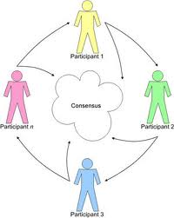
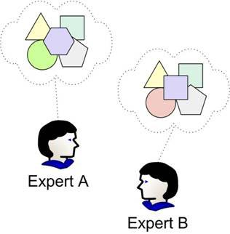
Delphi Technique 德尔菲技巧
A Delphi exercise asks a group of experts to state anonymously 匿名地 their opinions on when a future event might occur.
Their answers, with reasons, are summarized and fed back to the entire group for a second round.
This process can be repeated until the range of opinion narrows.

Slide 7
Trend Extrapolation Dilemma : Are We on Curve A or Curve B? 趋势推测困境：曲线A 还是B？

Slide 8
Strategic Management Process: A Public Sector Perspective

Slide 9
Step 1: Defining the Mission and the Desired Outcomes
Planning begins when agency develops strategic plan.
Plan should include comprehensive mission statement, set of outcome-related strategic goals, and description of how the agency intends to achieve those goals.
To large extent, plan is based on interests of stakeholders.

Slide 10
Step 2: Aligning Activities, Core Processes, and Resources
An organization’s activities, core processes, and resources must be aligned to support its mission and help achieve its goals.
It requires the organization firstly evaluate the extent to which their programs contribute to meeting the mission and desired outcomes.
If organization concerns mission-related outcomes, it is easier to alter old structures and procedures.
Agencies need ensure their core processes support mission-related goals.
Agencies should better link funding and anticipated results.

Slide 11
Step 3: Implementation
Successful implementation is reached when the expected objectives of a program are obtained.
But first two questions must be addressed:
What tools are available?
Which tools are most appropriate?

Slide 12
Step 4: Performance Assessment
Performance measurement addresses program outcomes, not program activities/outputs. (internal)
Difficulties: 1) identifying goals; 2) developing measures.
Program evaluation is an individual, systematic study conducted periodically, or on an ad hoc basis, to determine how well a program is working. (external)

Slide 13
Week 10 Decision-Making
“The task of ‘deciding’ pervades the entire administrative organization quite as much as the task of ‘doing’ – indeed, it is integrally tied up with the latter.”
-Herbert Simon

Slide 14
Four Steps in Decision Making
1. Identifying the problem (or opportunity)
2. Gathering the facts
3. Making the decision
4. Implementing and evaluating the decision

Slide 15
Step 1: Identifying the Problem- What Type of Problem One Faces?
Is the problem a pressing one or a dispensable one?
Is the “problem” really a symptom 症状 or an underlying problem?
Is the problem unique or generic?
Overall, you need to ask whether it is a programmed or non-programmed decision.

Slide 16
Types of Decisions
Programmed 程序性的 decisions
In response to recurring organizational problems
Repetitive and routine, decision rule has been established
Non-programmed decisions
In response to situations that are unique, are poorly defined and largely unstructured, and have important consequences to the org.

Slide 17
Programmed and Non-programmed Decision Differences
Certainty: all the information is fully available.
Risk: Decision has clear-cut goals; Good info. is available; Future outcomes associated with each alternative are subject to change.
Uncertainty: Managers know which goals they wish to achieve; Information is incomplete; Managers may have to come up with creative approaches to alternatives.
Ambiguity-The most difficult decision situation.
Goals to be achieved or the problem to be solved is unclear; Alternatives are difficult to define; Information about outcomes is unavailable.

Slide 18
Conditions that Affect the Possibility of Decision Failure
Organizational
Problem
Low
Possibility of Failure
High
Certainty
Risk
Uncertainty
Ambiguity
Programmed
Decisions
Nonprogrammed
Decisions
Problem
Solution

Slide 19
Step 2—Framing a Decision: The Upper and Lower Limits
Solutions should be ruled out due to the upper limits
(limitations that decide how far you can go)
Solutions should be ruled out due to the lower limits (What must occur for the problem to be solved)

Slide 20
Limiting (Strategic) Factor in Decision Making
This is the factor will “whose control, in the right form, at the right place and time, will establish a new system of conditions which meets the purpose.” (Chester I. Barnard)
If an administrator can discover the strategic factor, then the decision becomes not only simpler but also more economical.
Examples:
Increase of the yield of grain in a field. We analyze the soil and learn it lacks potash. Potash may be the strategic (or limiting) factor.
Operation Cease-Fire: prevent teenagers’ death by gun: targeting youth with prior criminal records.
AIDs prevention: targeting high-risk population (drug users & homosexuals)

Slide 21
Step 3: Making the Decision-- Some Techniques
Cost-benefit analysis (CBA)
Multi-objective models
Decision analysis
Nominal group technique

Slide 22
Cost-Benefit Analysis (CBA): Common Elements
The measurements of cost and benefits
The distributional impacts
The discount factor
Decision rules

Slide 23
Measurement of Costs and Benefits
Real benefits are the benefits derived from the final consumer of the public project and represent an addition to the whole society’s total welfare.
Real costs are resources withdrawn from other uses for the public project.
Pecuniary benefits (货币收益）and pecuniary costs come about due to changes in relative prices that occur as the economy adjusts itself to the provision of the public service. They do not reflect gains or cost to society as a whole.

Slide 24
Direct or Indirect Costs and Benefits
Direct benefits and costs are those closely related to the main project objective.
Indirect benefits and costs -- sometimes called externalities, or spillovers -- are more like by-products.
The term tangible 可见的 is applied to benefits and costs that one can measure in dollars; those one cannot are referred to as intangible.

Slide 25
Example: Major Categories of Cost and Benefits for Irrigation Project 灌溉项目

Slide 26
Discount Factor （贴现因子） Time (Net Present Value) Textbook: p.145

Slide 27
Present Value of a Future Dollar

Slide 28
Opportunity Cost
The value of what certain resources could have produced had they been used in the best alternative way.

Slide 29
Decision Rules
A simple project should be undertaken if and only if its net benefit (NB) exceed zero, i.e. NB >0.
When choosing one project from a set of mutually exclusive projects, choose the one with the greatest net benefit. If equal NB, then follow benefit-cost ratio (BCR).
Project 1: B=4, C=2, NB=2; Project 2: B=5, C=3, NB=2
BCR1=4/2=2; BCR2=5/3=1.67
An administrator might be faced with a case involving non-efficiency objectives (e.g. econ. development vs. unemployment issue)

Slide 30
Example of Cost-Effectiveness Analysis
If we only have 1 million. 360+200=560
Note: The advantage of cost-effectiveness analysis is that
output or benefits need not be expressed in dollars.

Slide 31
Multi-objective Models
A decision making technique useful in situations in which there are moral goals or when one or two goals cannot be quantified.
The model decomposes the decision analysis into three steps:
Select evaluation criteria.
Decide on the relative importance of or weight each criterion selected.
Assess each alternative in terms of how well it achieves the criteria.
E.g.: Who can receive fellowships?
GPA? Service? Community activities? Publications? Social activities?

Slide 32
Decision Trees
Used for decision situations that occur in sequence.
Consists of a pictorial representation用图画表现 of decision alternatives, states of nature, and outcomes of each course of action.
It contains four elements: Expected monetary value (EMV)=probability *payoff
Example (landslide: textbook p. 151).
Decision nodes
Chance nodes
Probabilities
Payoffs (outcomes)
3,000,000 *.2=600,000
0
EMV=600,000-200,000
-3,000,000*0.2
0

Slide 33
Exercise 2 (textbook p. 169)
As the head of a city housing agency, you must decide whether to submit either plan A or plan B (but not both) to the mayor, who, in turn, must submit it to the city council.
You estimate that there is a 90% chance that mayor would accept A but only a 50% chance that the council would accept it. The council likes B; indeed, you are certain they would accept it—if, that is, it ever got past the mayor (the odds of that happening are three to one). You prefer A and evaluate its utility at 1.00. in fact, because you think it the most socially desirable, even if the mayor accepts and has it rejected by the council, you would assign a unity of 0.40 to these consequences. If the rejection comes from your boss, the mayor, the utility would be 0.20. However, plan B, if accepted by the city council, has a utility of 0.80 to you. But the worst situation is to have it rejected, the utility is 0.00. What should you do?

Slide 34
1.00
Yes (.5)
Yes (.9)
Council
(.9) (.5) (1)
+ (.9) (.5) (.4)
+ (.1) (.2)
= .65
Mayor
No (.5)
.40
Plan A
No (.1)
.20
Yes (.75)
Council
.80
Plan B
Mayor
(.75)(1.0) (.8)
+ (.25) (0)
= .60
No (.25)
0

Slide 35
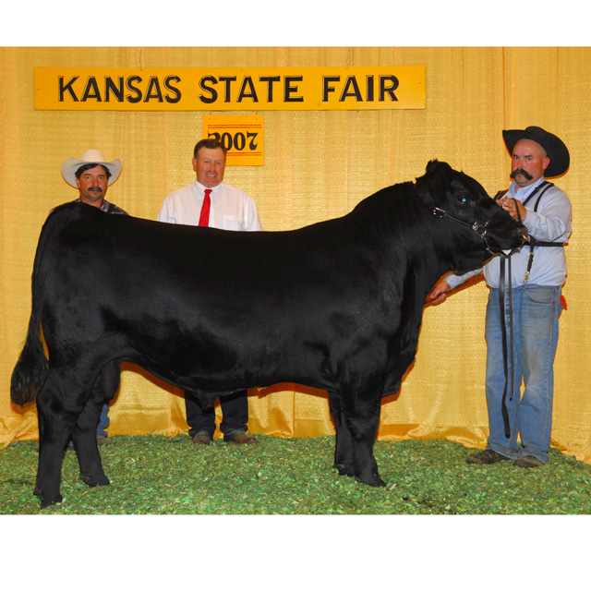
Group Decision-Making
The average of individual guesses was closer to the ox's true weight than the estimates of most crowd members, and also closer than any of the separate estimates made by cattle experts.
Notes:
35
).

Slide 36
Aggregated decisions of a group are often better than could have been made by any single member of a group.
Notes:
36
Rice in a jar

Slide 37
Four elements required to form a wise crowd
Diversity of opinion
Each person should have private information even if it's just an odd 反常的 interpretation of the known facts.
Independence
People's opinions aren't determined by the opinions of those around them.
Decentralization
People are able to specialize and draw on local knowledge.
Aggregation
Some mechanism exists for turning private judgments into a collective decision.
Notes:
37

Slide 38
No one person can be as smart as a group of informed, independent-minded people
Notes:
38
Who will win the 2008 presidential election?

Slide 39
Advantages and Disadvantages of Group Decision Making
Advantages
Offer more knowledge and information than individuals
Easier to implement
Bring together broader perspective
Disadvantages
Time-consuming
Expensive
Lack clear focus

Slide 40
When to Use Groups for Decision Making?
The problem is relatively uncertain or has potential for conflict.
The problem requires intergroup cooperation.
The problem and solution have important consequences.
There are significant but not immediate deadline pressures.
Widespread acceptance and commitment are crucial to successful implementation.

Slide 41
Improving Group Decision Making: Steps in Nominal Group Technique
Individual generate ideas independently
Everyone shares an idea from his/her list and they are recorded but not discussed
Group discusses all ideas
Group members vote for their top choices
Steps 3 & 4 are repeated as desired to add further clarification of the process.
Bottom-line: Technique was developed to ensure that every group member has equal input in the process.

Slide 42
Step 4: Program Evaluation
Steps in evaluation:
Define the goals of the program.
Translate the goals into measurable indicators of goal achievement.
Collect data on the indicators for those who have been exposed to the program and for those who have not.
Compare the data on the program participants and controls in terms of goals criteria.

Slide 43
Evaluation
 | BEFORE | AFTER
EXPERIMENTAL | a | b
CONTROL | c | d
The program is successful if (b-a) > (d-c)

Slide 44
Evaluation and Fluctuations of Time Series Data

