Slide 1
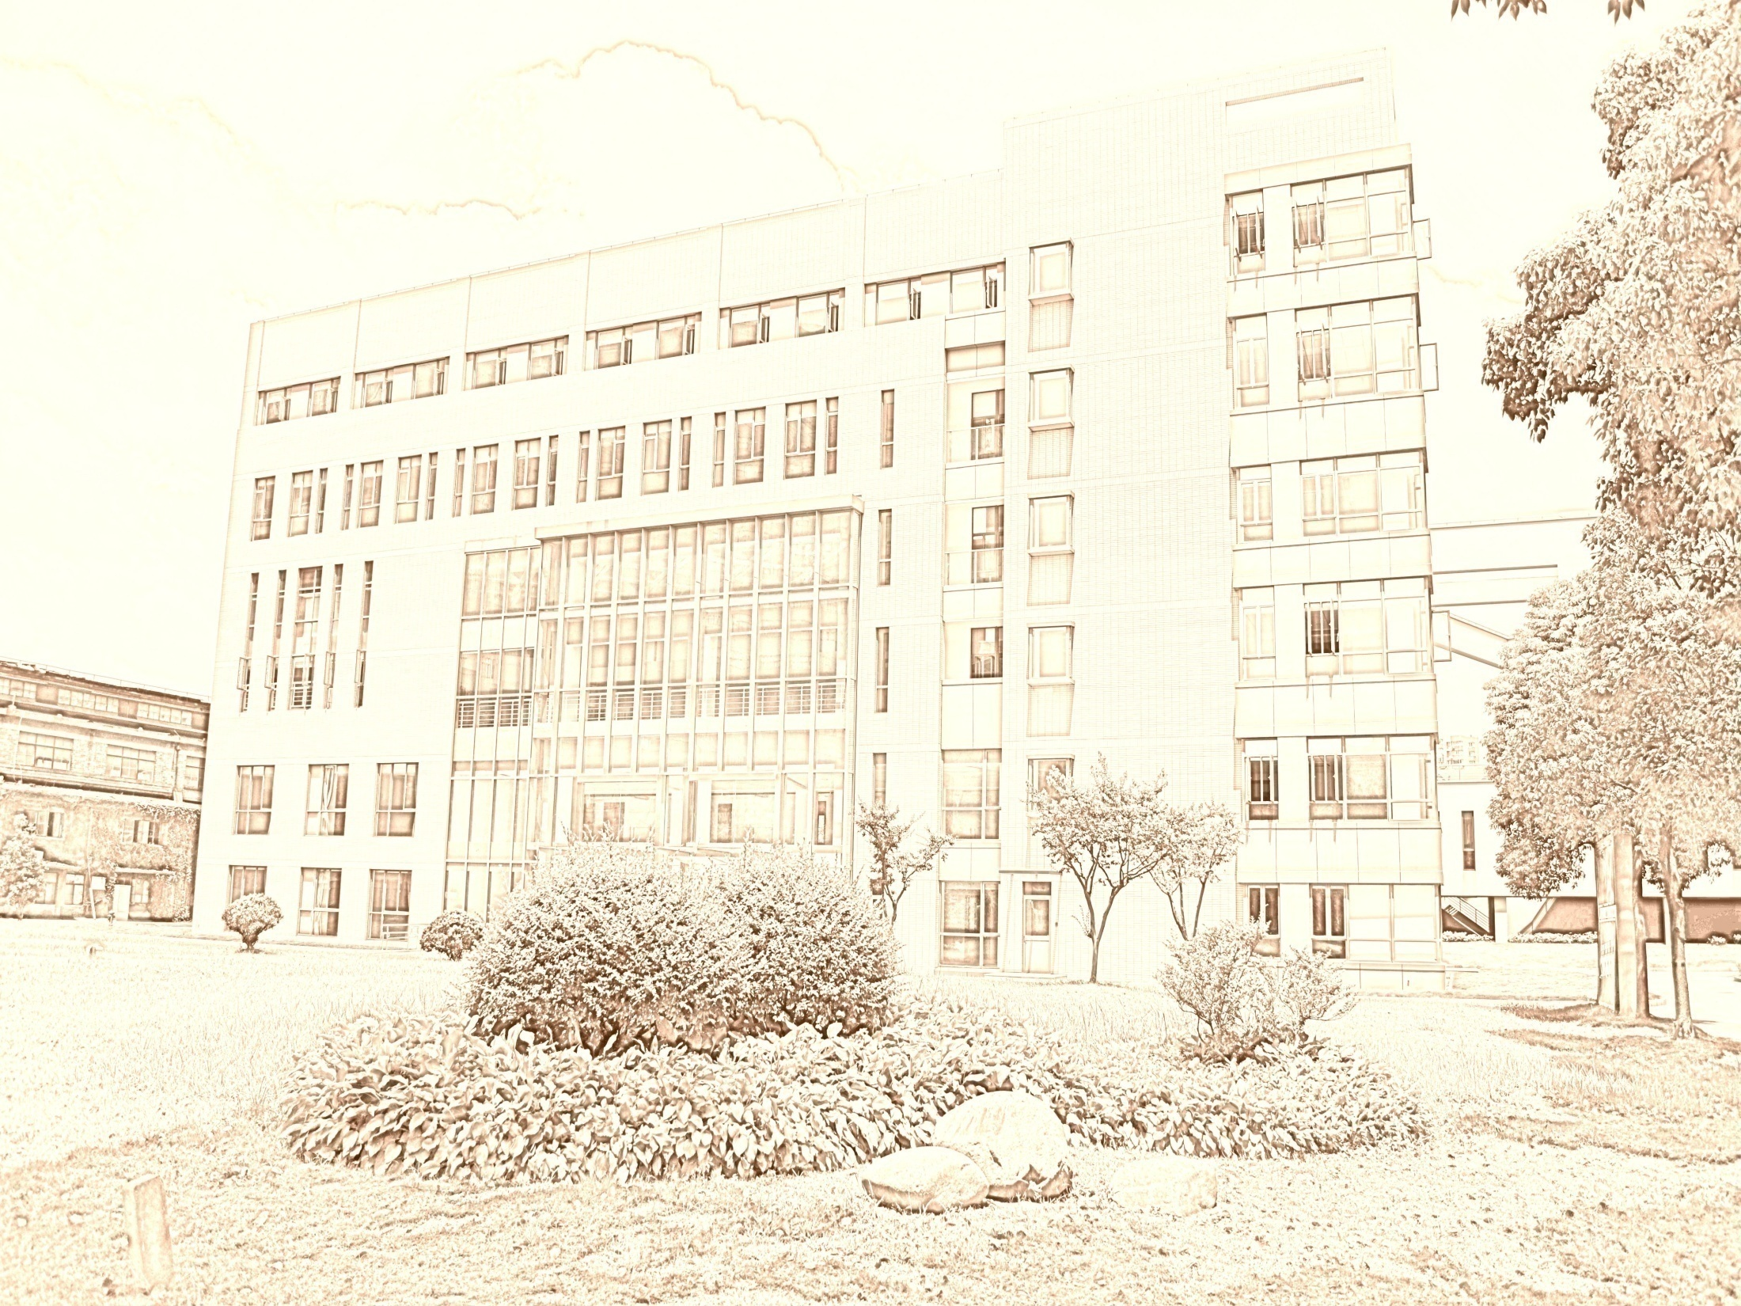
Public Administration & Management
SUFE SPEA
Instructor: WANG, Feng

Slide 2
Week 11
Organizing

Slide 3
Agenda
Overview of last session-decision making
  1. Identifying the problem (or opportunity)
  Programmed vs. nonprogrammed decisions
  2. Gathering the facts
  Framing a Decision: The upper & lower Limits
  3. Making the decision
  Some Techniques
  4. Implementing and evaluating the decision
  program evaluation

Slide 4
Chapter 5
ORGANIZING
Public managers need to design an appropriate organizational structure allowing employees to achieve organizational mission. They cannot “just throw everything together”.

Slide 5
Key Points Today
Important concepts
Five common organizational designs
How managers can design organizations?
Reinventing government/reorganizing

Slide 6
I. What Is Organizing?
Organizing is the process of creating an organization structure — the formal framework by which jobs and task are divided, grouped, and coordinated.

Slide 7
Fundamentals of Organizing
Organizational design involves decisions about four key elements:
  division of labor (分工、专业化 specialization)
  hierarchy (based on scalar principle等级原则)
  span of control （控制幅度）
  line and staff authority（直线与参谋人员）

Slide 8
Division of Labor
How should we group people into sub-units of the organization? By:
  Function (HR, Accounting…)
  Geography (headquarter and other countries)
  Process (manufactures)
  Clients (hospitals, Dell)
  Knowledge/skill (university departments)
  Products (P&G: Tides vs. Pringles)
  …
Notes:
Geography: Dept. of Interior: issuing green cards
Process: manufactures, cars

Slide 9
Hierarchy （层级制）
Hierarchy: It states that authority and responsibility should flow in a direct line vertically 纵向 from the highest level of the organization to the lowest level.
  Authority refers to rights inherent in a managerial position to tell people what to do and to expect them to do it.
  Responsibility refers to the obligation or expectation to perform.
  The unity of command principle states that a person should report to only one manager.
    Without it, conflicting demands and priorities from multiple bosses can create problems.

Slide 10
A Problem of Hierarchy
Top management wants to increase
reliability of behavior within the organization
Standard Operating Procedures (SOPs) are instituted
Categories used in
decision-making become
very restricted→ less likely
to search alternatives
SOPs take on a
value independent of
organizations goals
Personalized
relationships reduced
Behavior of organizational
members becomes rigid
Increased difficulty dealing with clients
Decreased employees’ personal development

Slide 11
Span of Control
1
4
1
8
16
64
64
512
256
Total # of manager: 73
employees:585
Total # of managers: 85
employees: 341
This principle concerns the number of subordinates （下属）a superior can effectively supervise.
In the U.S., in any given agency
  1960, 17 tiers
  1992: 32 tiers
FedEx: 6 tiers from chairman to couriers （邮递员）
Cost (salary), Efficiency (fast response), Effectiveness (goal attainment)

Slide 12
Span of control 控制幅度
Critical question: How many people who have to work with each other report to a manager? (police sergeant vs. secretary of energy)
The span of control (downward) is limited concept in public-sector management because public administrators must deal with so many lateral and external relations.

Slide 13
Line and Staff Authority
Line refers to the division between those agencies and individuals engaged in implementing programs.
Staff refers to those concerned with providing advice and assistance to top management.
Line authority means that people in management positions have formal authority to direct and control immediate subordinates.
Staff authority includes the right to advise, recommend, and counsel in the staff areas of expertise.
  Staff function grows fast.
  E.g. Higher education increase: student enrollment: 40% ; instructors:50%; full-time support staff: 200%.

Slide 14
Depicting 描绘 the Organization
Organization Chart
  A chart that shows the structure of the organization including the title of each manager’s position and, by means of connecting lines, who is accountable to whom and who has authority for each area.

Slide 15
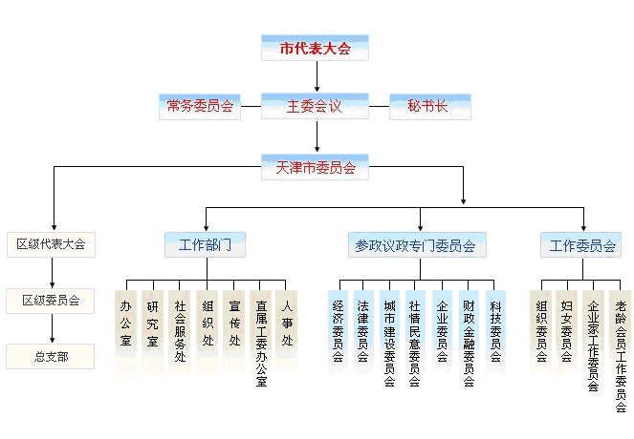
Organizational Chart

Slide 16
Limitations of Organizational Chart
Readers cannot tell the degree of responsibility and authority at the same management level.
Not easy to tell line and staff positions from the chart.
It does not show all lines of communication.
It fails to show the informal organization.
Interpretations may not be correct.

Slide 17
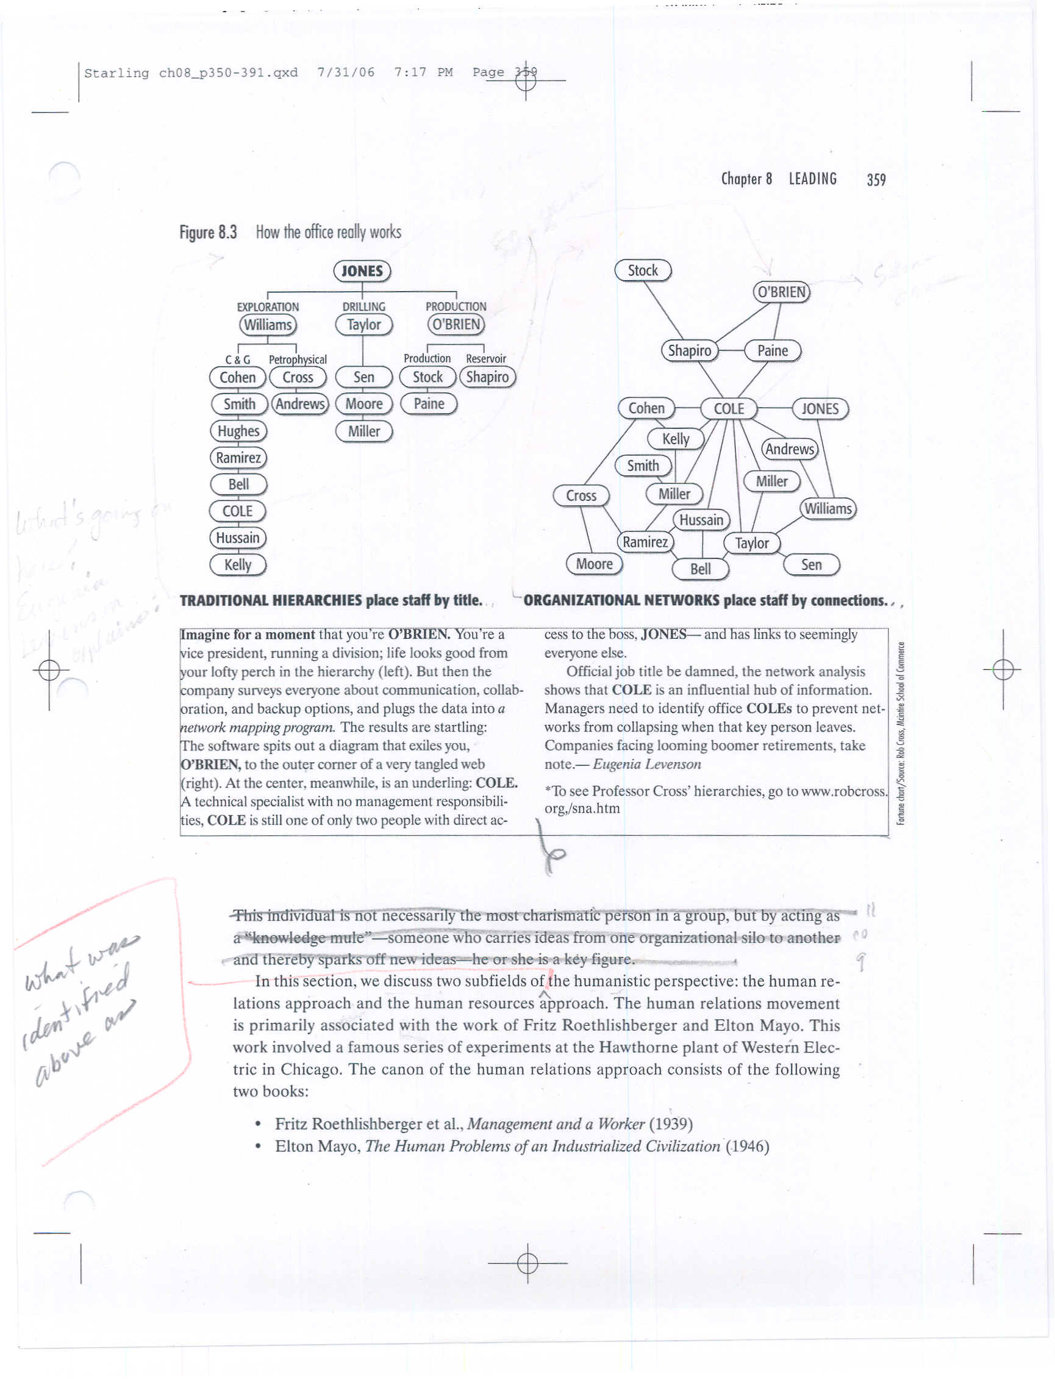
How the Office Really Works

Slide 18
II. Common Organizational Designs
Leader-Follower Organization
Bureaucracy
Matrix Approach
Team Approach
Network Approach

Slide 19
Leader-Follower Organization
According to Max Weber, there are three types of legitimate authority:
  Traditional: Associated with kings and parents.
  Charismatic 魅力型: Based on the members’ abandonment of themselves to an individual distinguished by holiness, heroism, and exemplariness (Leader-Follower)
  Legal: Associated with constitutional governments.
Weakness: Too often a leader is unwilling to adapt to new challenges.

Slide 20
Bureaucracy
Division of labor based on functional specialization.
Well-defined hierarchy of authority.
System of rules covering the rights and duties of employment.
Systems of procedures for dealing with work situations.
Impersonality of interpersonal relations.
Promotion and selection based on technical competencies.
Weakness: Standard programs→ Low capability for innovation

Slide 21
Matrix Organization
An organization structure in which employees are permanently attached to one department（永久属于一个部门）, but also simultaneously 同时have ongoing assignments in which they report to project, customer, product, or geographic unit heads.

Slide 22
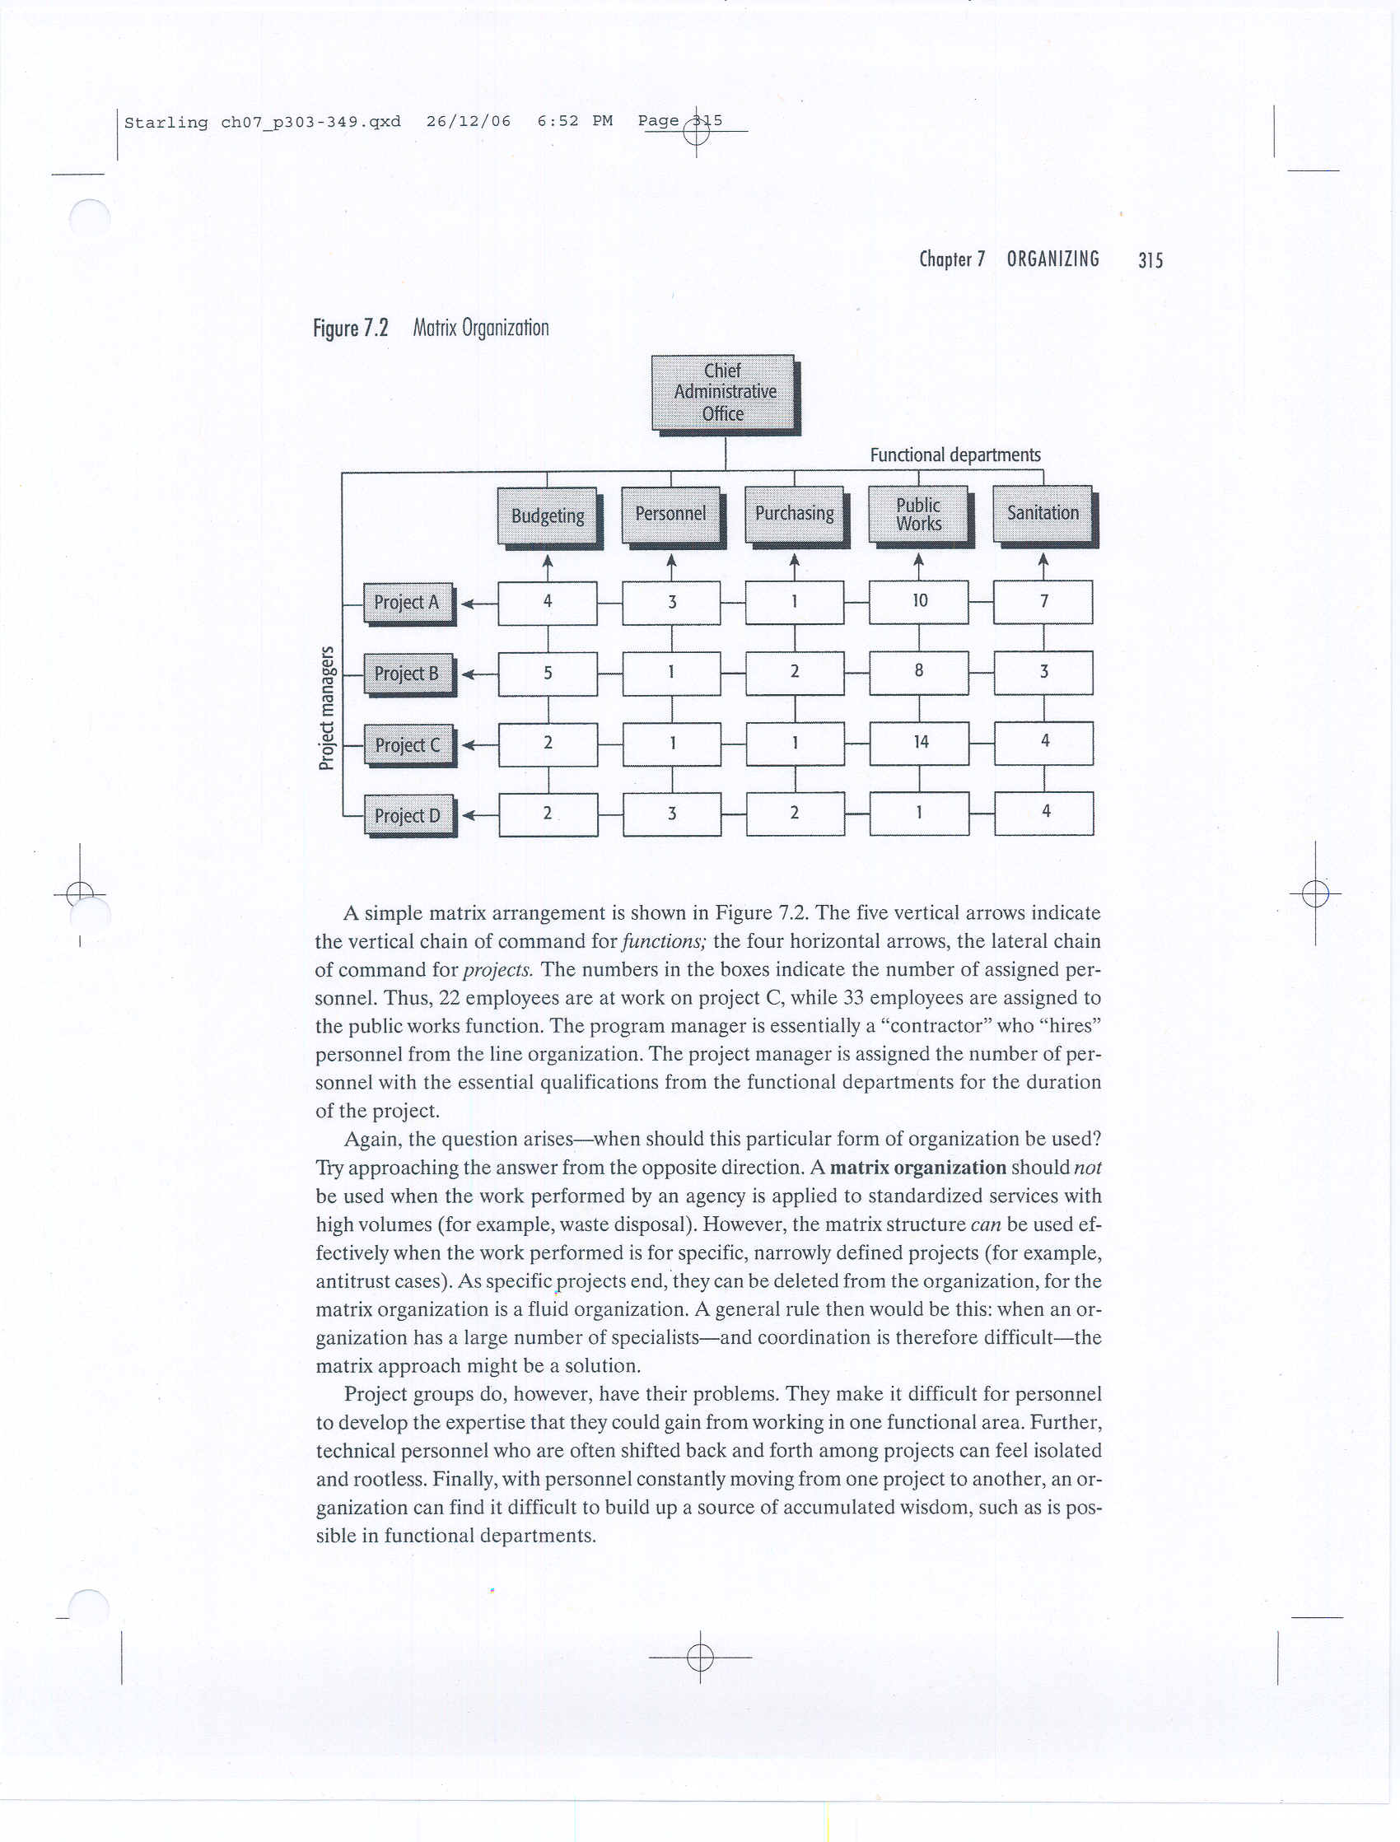
Matrix Approach
A number of project managers exert (行使) planning, scheduling, and cost control over people who have been assigned to their projects, while other managers exert more traditional line control over the same people.
A matrix structure can be used effectively when the work performed is for specific, narrowly defined projects.
When the organization has a large number of specialists, the matrix type could be best used.

Slide 23
Problems of Matrix Approach
They make it difficult for personnel to develop the expertise that they could gain from working in one functional area.
Technical personnel who are often shifted back and forth among projects can feel isolated and rootless.
Lost time in coordinating.
With personnel constantly moving from one project to another, an organization can find it difficult to build up a source of accumulated wisdom.

Slide 24
Team Approach
A team is a small number of people with complementary skills who are committed to a common-purpose goal and approach for which they hold themselves mutually accountable.
Cross-functional teams consists of employees from various functional departments who are responsible to meet as a team and resolve mutual problems.
Permanent teams are brought together as a formal department in an organization.

Slide 25
Types of Teams: A Sports Metaphor
“Baseball teams” (棒球队) are any decentralized, individually oriented organizations based on professional autonomy (e.g. university research centers)
“Football teams” （橄榄球队）are a centralized, top-down organizations; the word of the coach is law (e.g. hospital emergency teams)
“Basketball teams” （篮球队) have a small-group based, cooperative forms that require speed, flexibility, and innovation through cooperation (e.g. consulting firms)

Slide 26
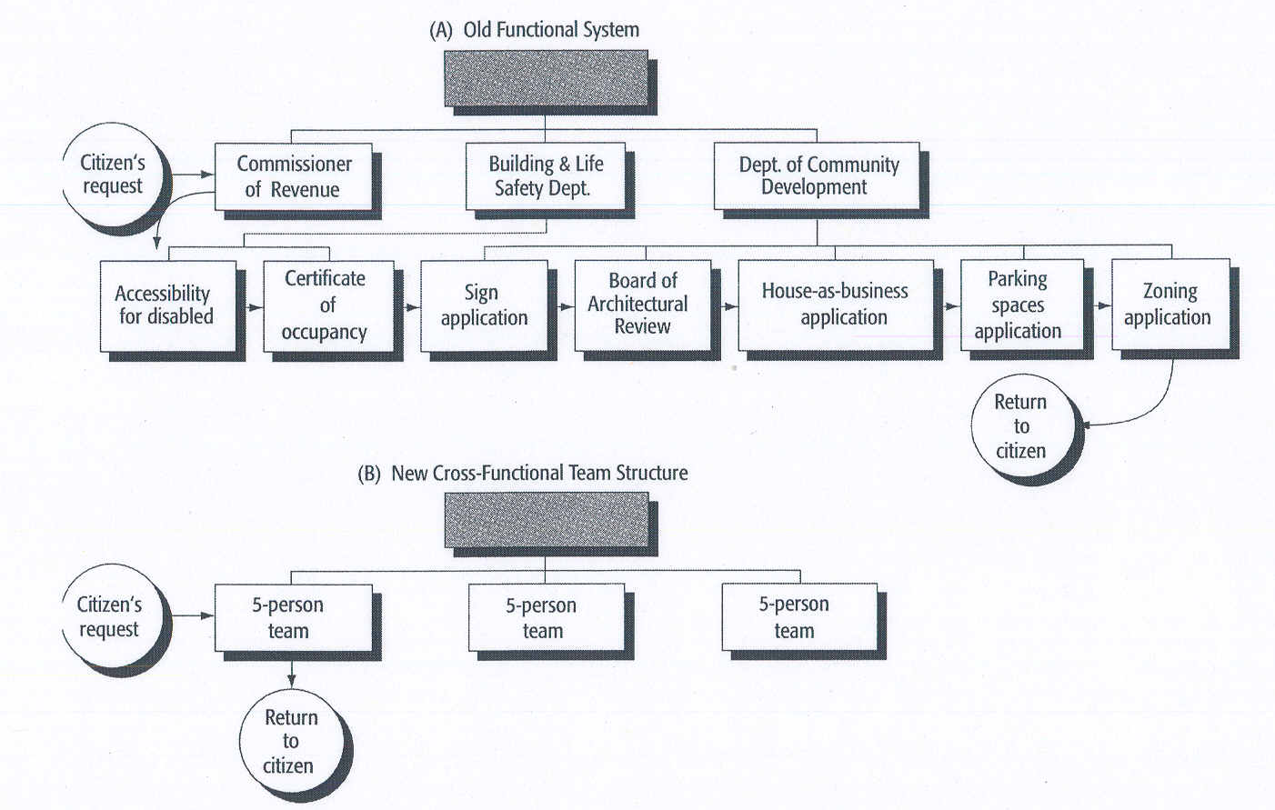
Team Structure in City Government

Slide 27
Advantages and Disadvantages of Cross-functional Teams
Advantages
Boosts productivity and innovation.
Allows organizations to retain some advantages of a functional structure, such as economies of scale and in-depth training, while gaining the benefits of team relationships.
Disadvantages
Employees may experience conflicts and dual loyalties.
Coordinating cost
Less likely to see a big picture.

Slide 28
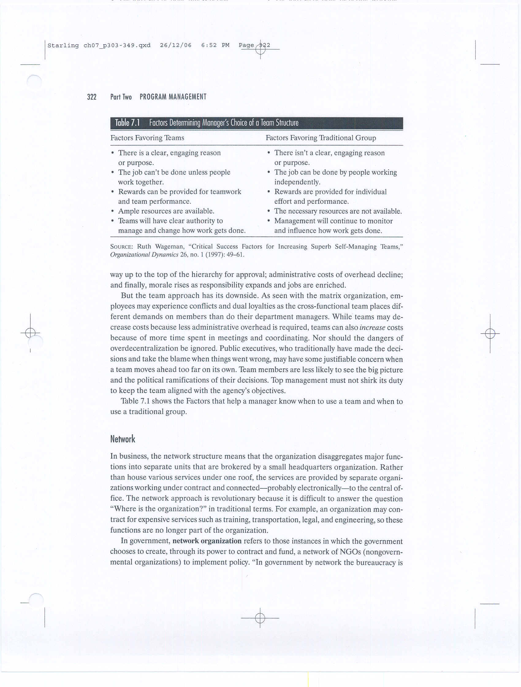
Factors Determining Manager’s Choice of a Team Structure (textbook p.199)

Slide 29
Network
A network structure means that the organization disaggregates major functions into separate units that are brokered by a small headquarters organization.
In government, network organization refers to those instances in which the government chooses to create, through its power to contract and fund, a network of NPOs. (Gov’t funds others to do the work.)

Slide 30
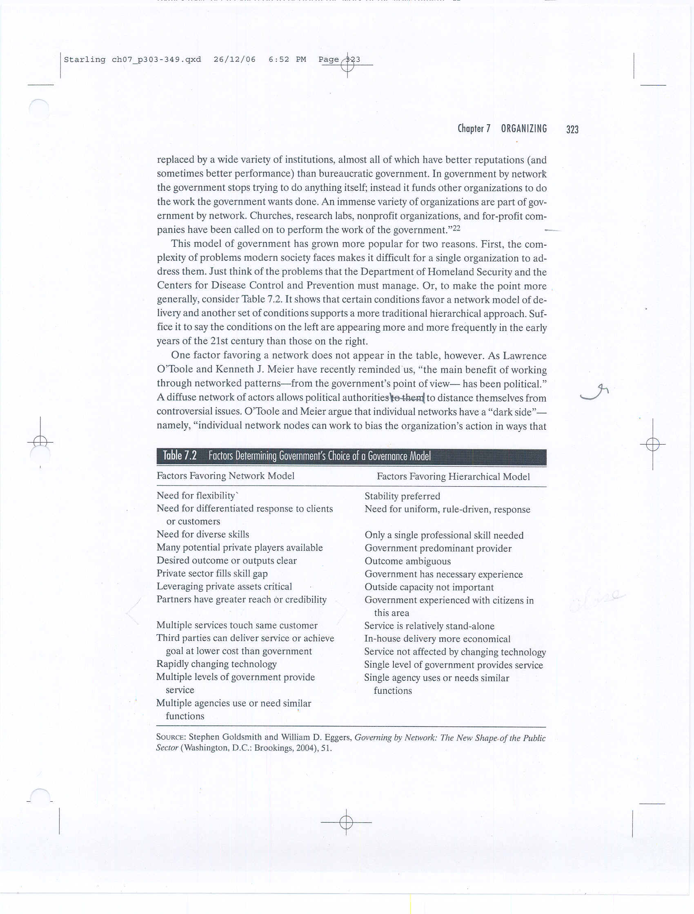
Factors Determining Government’s
Choice of a Governance Model (textbook p.200)

Slide 31
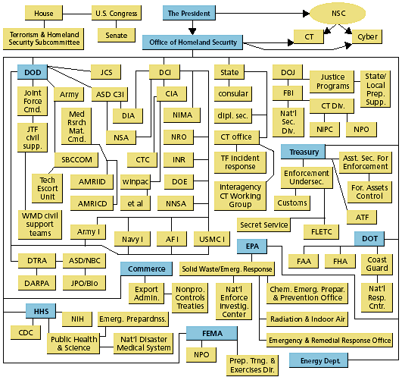
Office of Homeland Security

Slide 32
III. Critical Questions in Organizational Design
What are the key activities required to attain the organizations objectives?
What activities belong together and what activities belong apart?
Where decisions belongs to attain the organizations objectives?
Where do specific organizational components belong?
Rule: keep relationships to a minimum but make each count.

Slide 33
Four Major Organizational Activities Distinguished by Contribution
Top-management activities
  Maintaining external relations, major DM
Results-producing activities
  Directly contributing to the results
Results-contributing or staff activities
  Training, teaching, advising
Hygiene and housekeeping activities
  Medical dept., cleaning

Slide 34
What Activities Belong Apart?
Top-management activities are incompatible （不适配）with other activities.
Results-producing activities should never be subordinate （从属于）to nonresults-producing activities.
Support activities should never be mixed up with results-producing activities.
Advisory staffs should be few, lean, and nonoperational.
Hygiene and housekeeping activities should be kept separate from other work.

Slide 35
Where Do Decisions Belong?
The decision should be made:
  Delegation of authority (not responsibility): determines the proper level at which a decision should be made.
  At the lowest possible level and close to the scene of action as possible.
The more a decision is characterized by the following four factors, the higher level at which it must be made:
  Futurity 未来性: how long it commits to the org
  Reversibility可逆性: how fast to be reversed if it is wrong
  Impact 影响力: how great it affects the org
  Rarity 罕见性: how distinct the event is

Slide 36
Models of Organizations
Mintzberg（明茨伯格）: Five different models of organizational structure
  The simple structure
  The machine bureaucracy
  The professional bureaucracy
  The divisionalized form
  The “adhocracy” 委员会

Slide 37
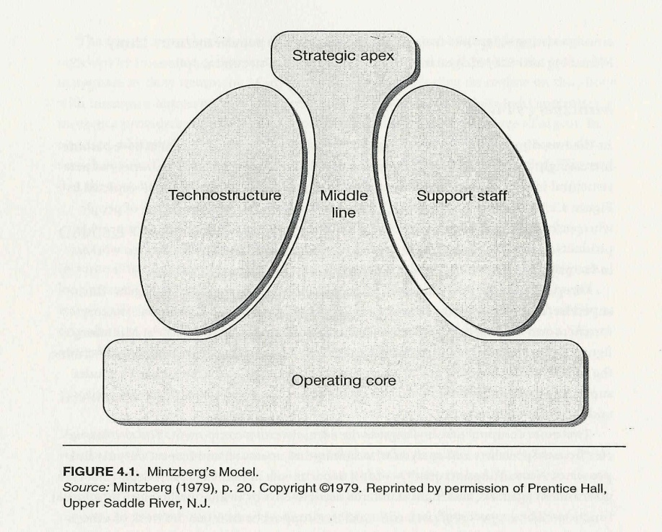
The Mintzberg Model of “Structure in Fives”
Structural Configuration, five basic parts of the organization:
  Strategic apex
  Middle management
  Operating core
  Techno-structure
  Support staff
Notes:
Strategic apex
Middle line (administrative)
Techno-structure (L)
Support staff (R)
Operating Core

Slide 38
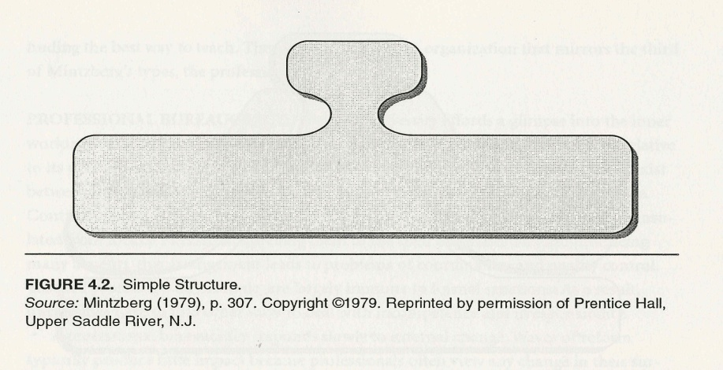
Simple Structure
Strategic apex
Operating core
Middle line
Techno-structure (L)
Support staff (R)
E.g. Microsoft, Google’s emerging stage

Slide 39
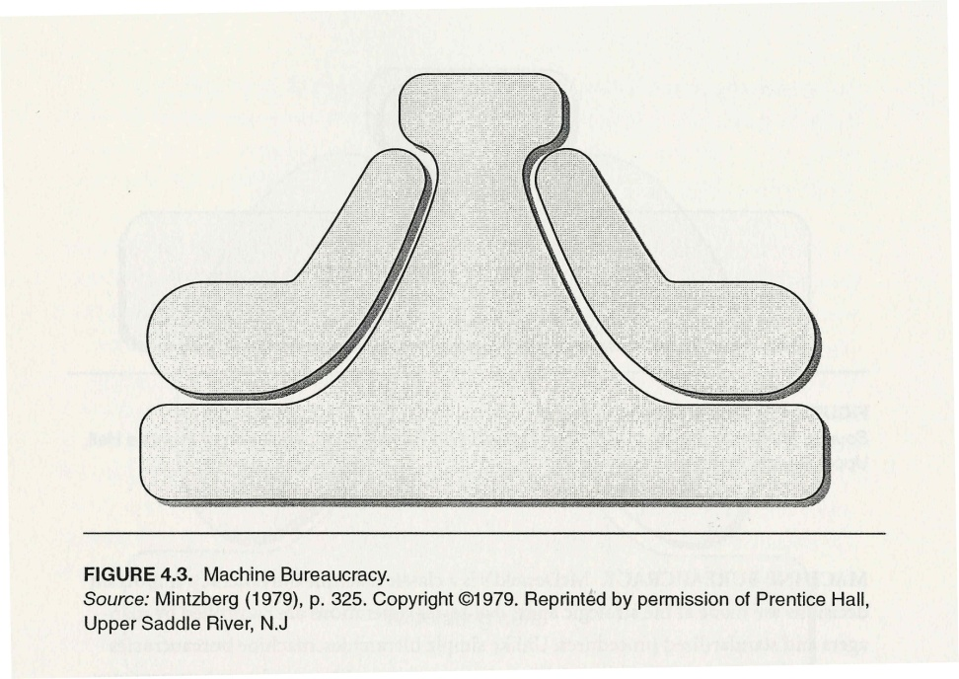
Machine Bureaucracy
Strategic apex
Middle line
Techno-structure (L)
Support staff (R)
Operating core
E.g. McDonald
Notes:
Question: How to motivate employees in the operating core

Slide 40
McDonald
Limited discretion about how to do their jobs
Work is controlled by technology
Parent company has powerful systems to ensure that food and service conform to standard specifications
Big Mac taste the same around the world.

Slide 41
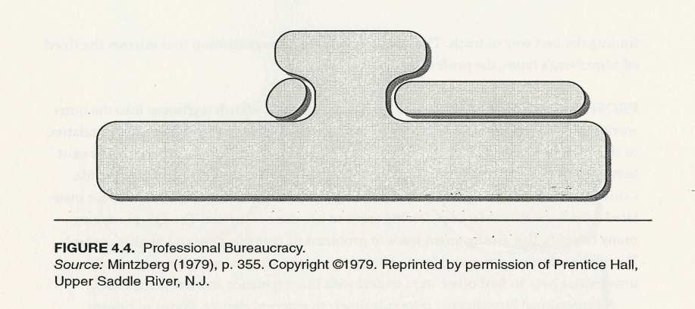
Professional Bureaucracy
Strategic apex
Operating core
Support staff (R)
Middle line (administrative)
Techno-structure (L)
E.g. Universities

Slide 42
Harvard University
Professors and Instructors
Small administrative group at the top
More geographically concentrated
All activities happen within a few miles of Cambridge, MA
Each school has a dean
Professors have choice of classes they teach
Each school has its own calendar

Slide 43
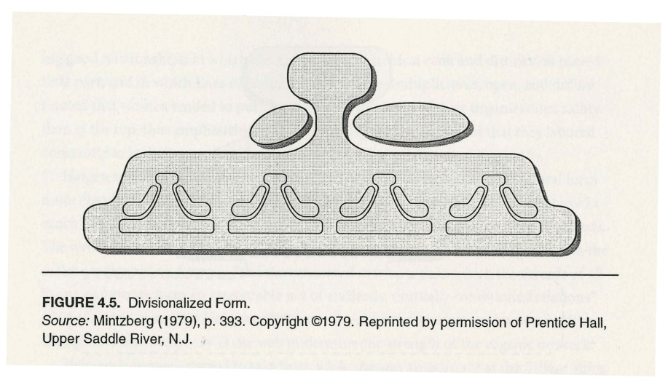
Divisionalized Form
E.g. Universities with multiple campus

Slide 44
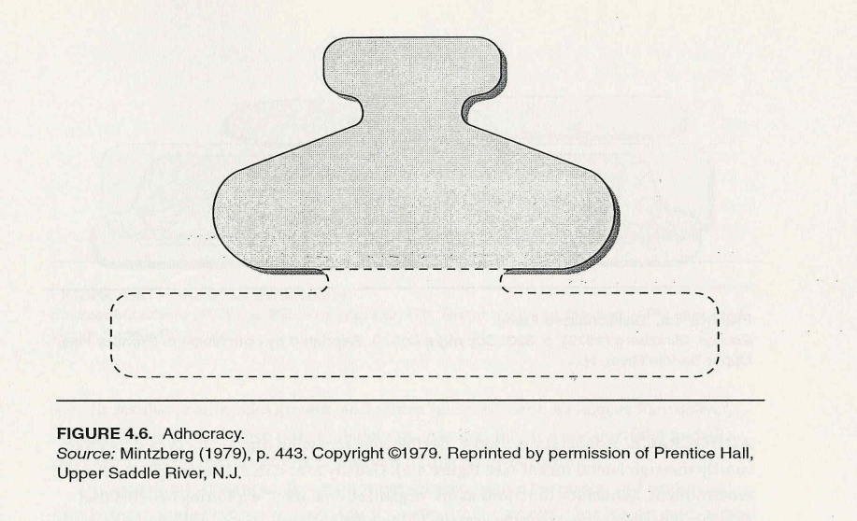
Adhocracy 临时委员会
E.g. consulting firms

Slide 45
Determinants of Organizational Structure
Size
History/Age
Mission/strategy
Organizational Structure
Core Process/
Technology
Environment
Nature of the workforce

Slide 46
Structural Imperatives
Dimension | Structural Implications
Size & age | Complexity and formalization increase with size and age
Core process/ technologies | They must align with structure
Environment | Stable environment→ simpler structures Uncertain/turbulent environment→ more complex, adaptable structures
Mission & Strategy | Variation in clarity and consistency of goals requires appropriate structural adaptations
Information technology | IT permits flatter, more flexible, and more decentralized structure
Nature of the workforce | Most educated and professional workers need and want greater autonomy and discretion

Slide 47
IV. Traits of Effective Organizations
Clarity
Economy
Direction of vision
Simplicity
Understanding of one’s task and the common task
Enhanced decision-making
Stability and adaptability
Self renewal
Overall: Structure will not be a barrier to an organization’s mission.

Slide 48
Symptoms of
Flawed Organizational Design
Multiplication 倍增 of management levels (“thickening of government)
Reoccurrence of problems 同一问题反复出现
key people’s attention is on secondary problems
Too many meetings attended by too many people
Over-reliance on assistants, coordinators, etc.
Constant reorganization

Slide 49
Reasons for Reorganization
To adjust to growth.
To create greater efficiencies and more logical combinations of functions.
To reflect changes in public policy.
To make government more politically responsive.
To respond to changes in the organization’s environment.

Slide 50
“Nine dragons managing water” (九龙治水)
When a frog is swimming in the river, it was managed by the Ministry of Water Resources (MWR).
When it jumps onto the riverbank, it was managed by the MLR (Ministry of land and Resources) and the State Forestry Administration (SFA).
When it jumps to a farm, it was managed by the Ministry of Agriculture (MoA).
Too many ministries with unclear responsibilities have muddied their management.

Slide 51
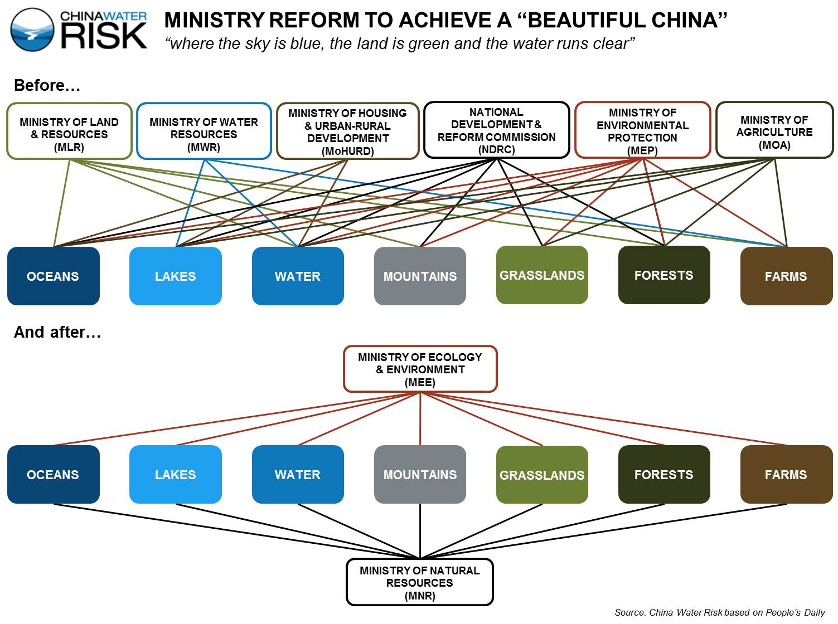
China’s Super-Ministry Reform
--9 dragons to 2

Slide 52
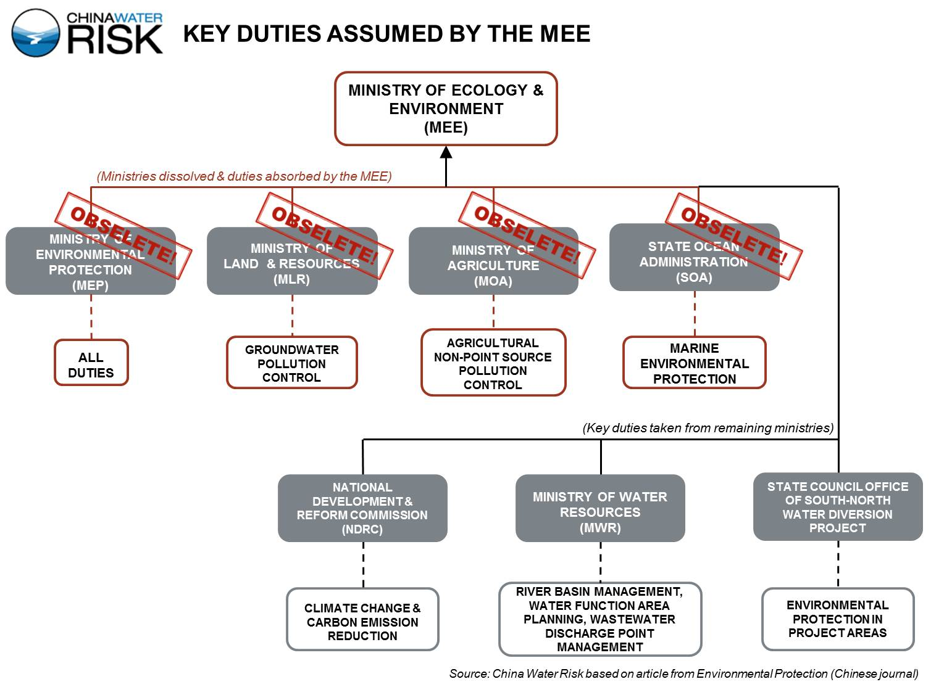

Slide 53
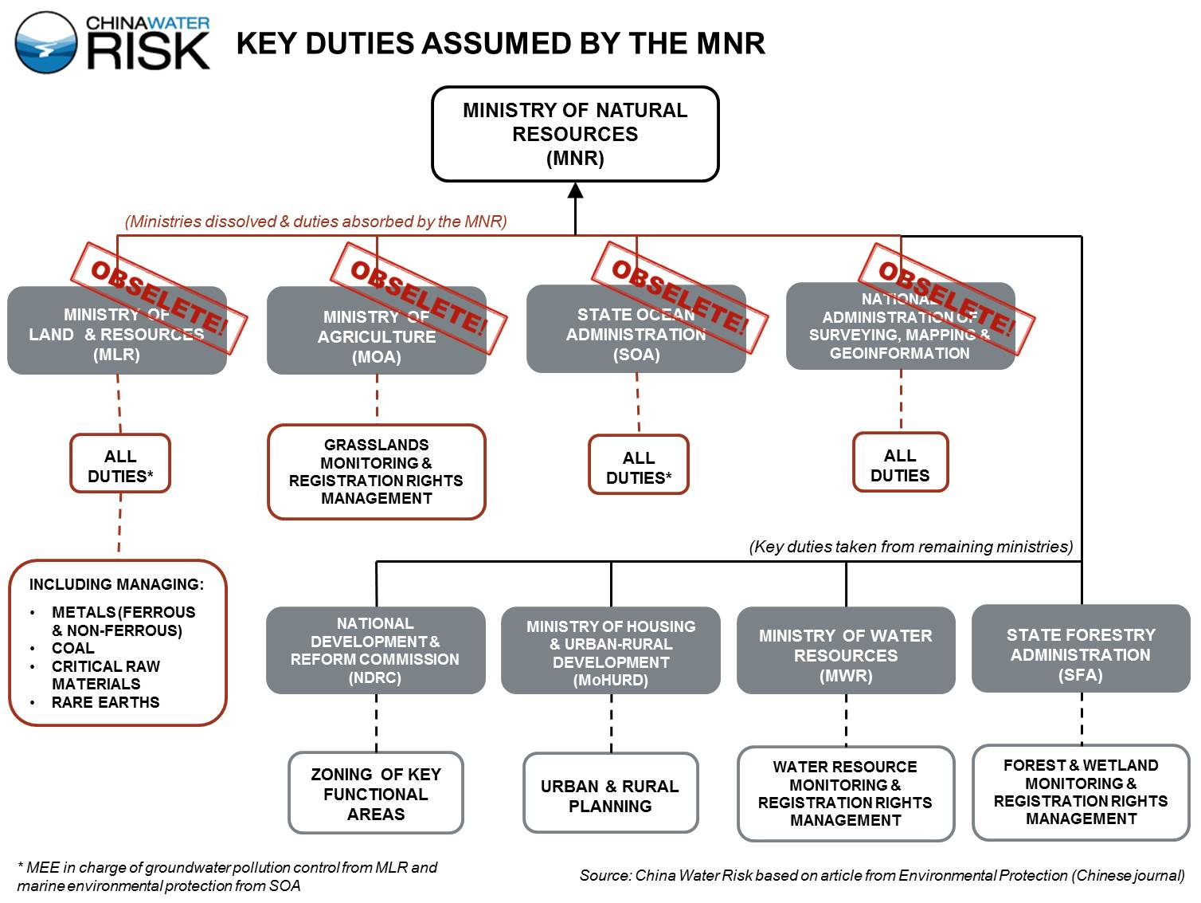

Slide 54
自然资源部: 将国土资源部的职责，国家发展和改革委员会的组织编制主体功能区规划职责，住房和城乡建设部的城乡规划管理职责，水利部的水资源调查和确权登记管理职责，农业部的草原资源调查和确权登记管理职责，国家林业局的森林、湿地等资源调查和确权登记管理职责，国家海洋局的职责，国家测绘地理信息局的职责整合，组建自然资源部，不再保留国土资源部、国家海洋局、国家测绘地理信息局。
生态环境部: 将环境保护部的职责，国家发展和改革委员会的应对气候变化和减排职责，国土资源部的监督防止地下水污染职责，水利部的编制水功能区划、排污口设置管理、流域水环境保护职责，农业部的监督指导农业面源污染治理职责，国家海洋局的海洋环境保护职责，国务院南水北调工程建设委员会办公室的南水北调工程项目区环境保护职责整合。

