Slide 1

Public Administration
and Management
SUFE SPEA
Instructor: WANG, Feng

Slide 2
Week 12
Leading

Slide 3
Chapter 6
LEADING
“that ineffable quality”
-Brian Mulroney

Slide 4
Overview
Theories & Leadership Styles
Leaders as motivators
Leadership Communication

Slide 5
Program Management as an Iceberg
Invisible aspects are important. Most of it is UNDER the water.
Visible Aspects
  Plans
  Decisions
  Specialization
  Hierarchy
Invisible Aspects
  Leadership styles
  Attitudes
  Motives
  Norms
  Values

Slide 6
  I. Leadership Theories

Slide 7
Trait 特征 Theory
Trait theory: An approach to leadership that assumes leaders have some traits that make them fundamentally different from followers.
Advocates of trait theory believe that some people have unique leadership characteristics and qualities that enable them to assume responsibilities not everyone can execute. Therefore, they are “born” leaders.
Criticisms:
  It cannot identify a certain trait for effective leaders.
  The situation influences leadership.

Slide 8
Contingency 权变 Theory
Many factors may influence a leader’s style.
Different leadership styles will differ in their effects in different situations.
The situation, not traits or styles, determines whether a particular leaders or style will be effective.

Slide 9
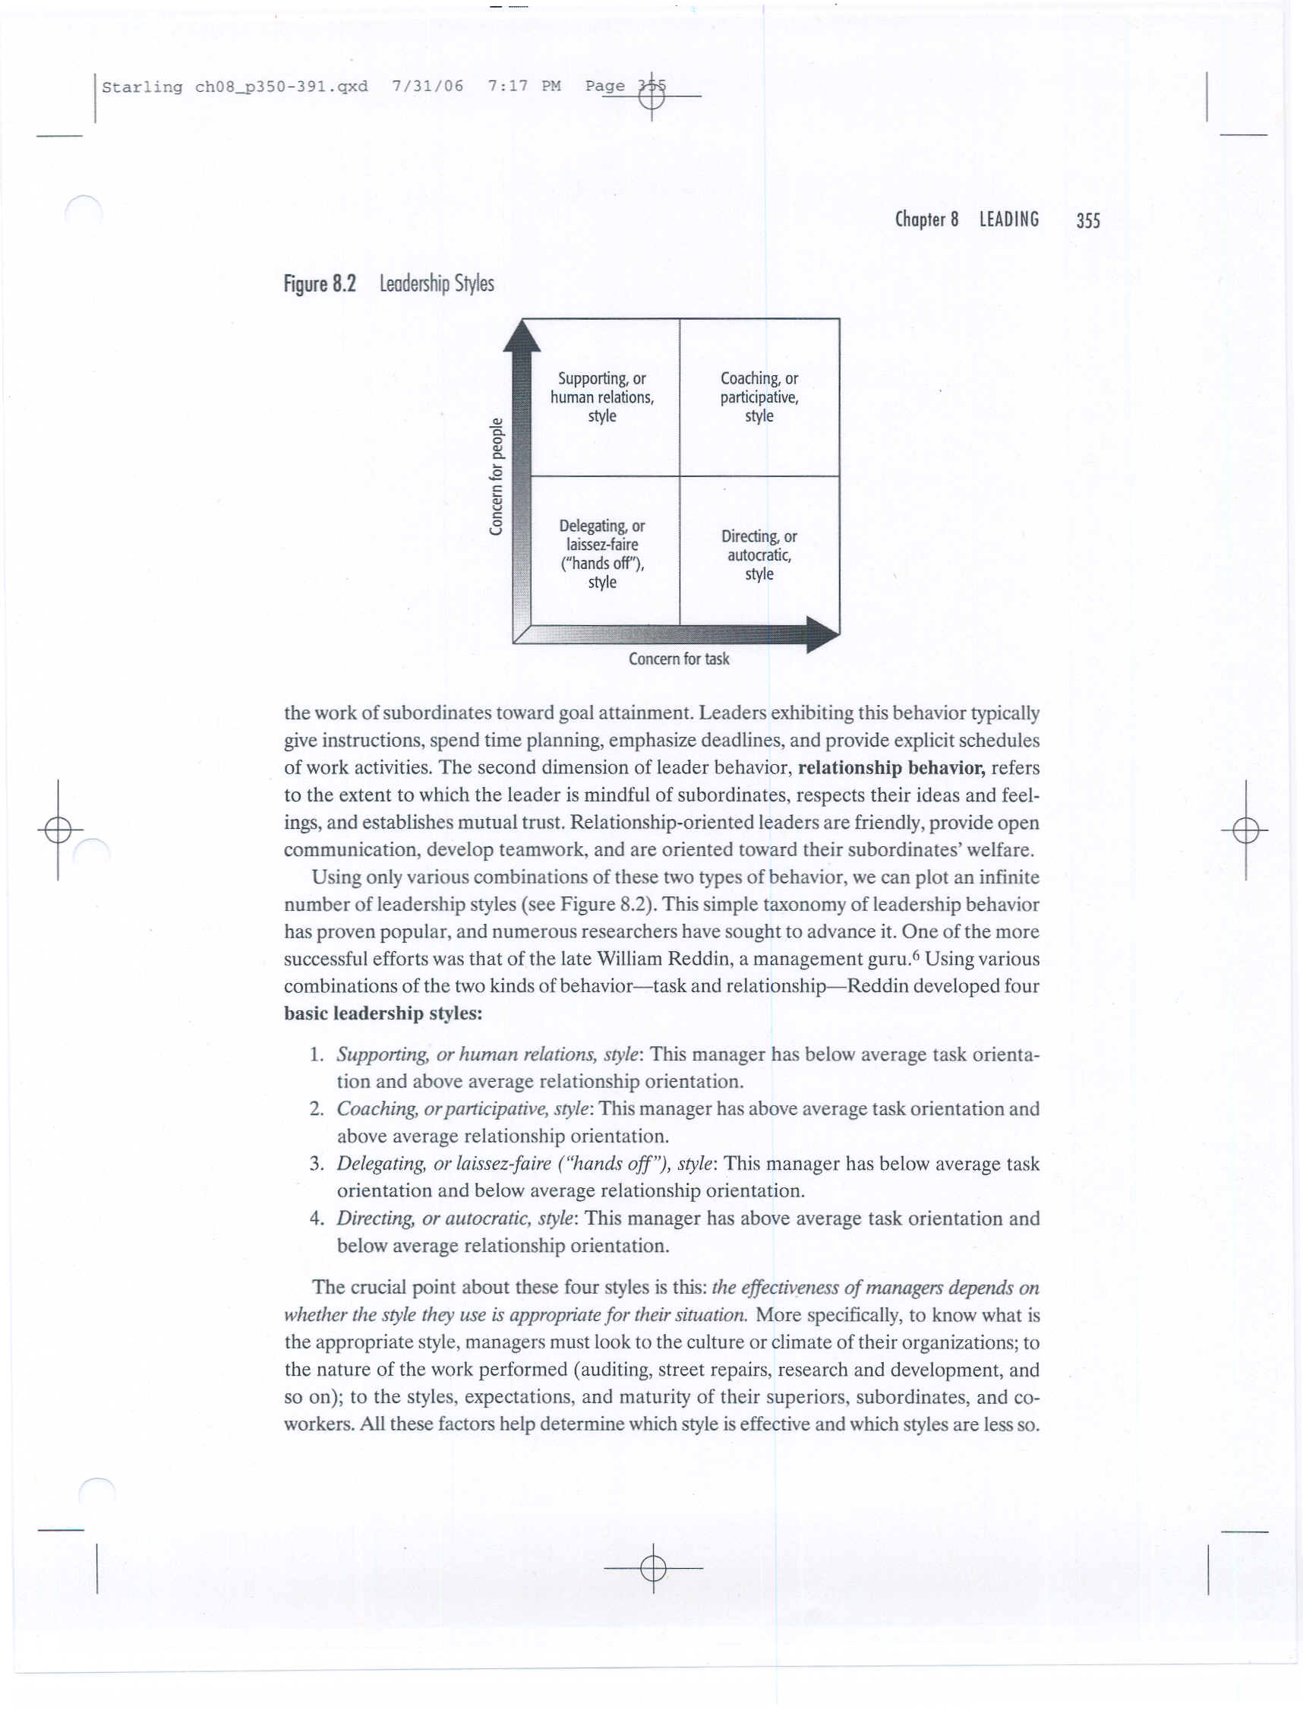
Leadership Styles (by Task & Relationship)
The effectiveness of managers depends on whether the style they use is appropriate for their situation.
Leadership=f(Leader, Follower, situation)

Slide 10
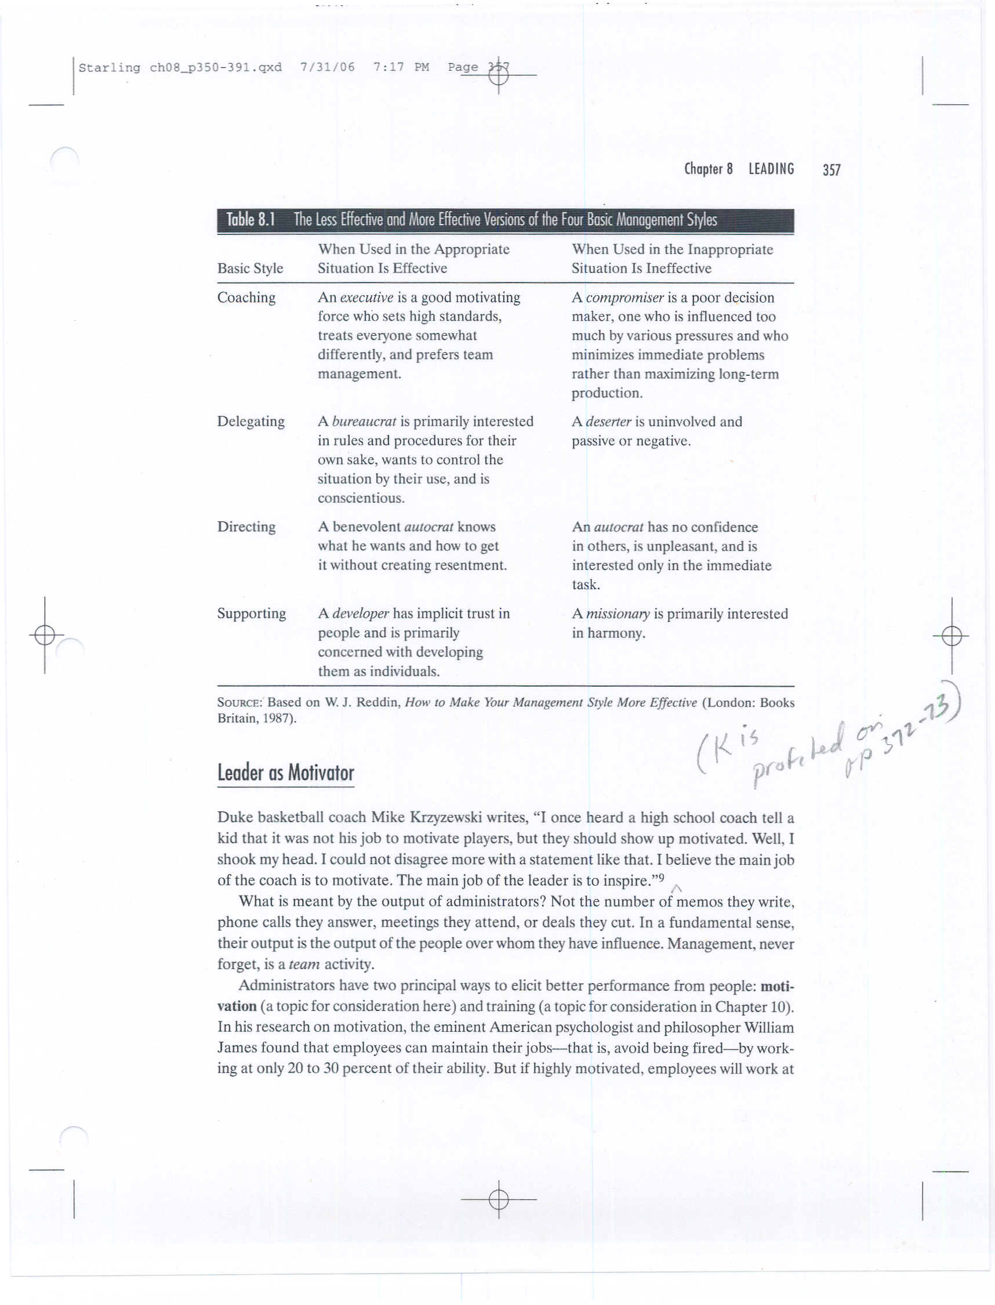
The Less Effective and More Effective Versions of the Four Basic Management Styles
(textbook, p229)

Slide 11
Class Exercise:
Leadership Orientation Scoring
（Bolman & Deal）

Slide 12
Write a number before each item!
For each item, give the number "4" to the phrase that best describes you, "3" to the item that is next best, and on down to "1" for the item that is least like you.
For Example:
___3__ a. Analytic skills
___4__ b. Interpersonal skills
___1__ c. Political skills
___2__ d. Gift for drama

Slide 13
1. My strongest skills are:
_____ a. Analytic skills
_____ b. Interpersonal skills
_____ c. Political skills
_____ d. Gift for drama

Slide 14
2. The best way to describe me is:
_____ a. Technical expert
_____ b. Good listener
_____ c. Skilled negotiator
_____ d. Inspirational leader

Slide 15
3. What has helped me the most to be successful is my ability to:
_____ a. Make good decisions
_____ b. Coach and develop people
_____ c. Build strong alliances 联盟 and a power base
_____ d. Inspire and excite others

Slide 16
4. What people are most likely to notice about me is my:
_____ a. Attention to detail
_____ b. Concern for people
_____ c. Ability to succeed, in the face of conflict and opposition
_____ d. Charisma 个人魅力

Slide 17
5. My most important leadership trait is:
_____ a. Clear, logical thinking
_____ b. Caring and support for others
_____ c. Toughness and aggressiveness
_____ d. Imagination and creativity

Slide 18
6. I am best described as:
_____ a. An analyst
_____ b. A humanist
_____ c. A politician
_____ d. A visionary

Slide 19
Compute your scores as follows:
_____ ST = 1a + 2a + 3a + 4a + 5a + 6a
_____ HR = 1b + 2b + 3b + 4b + 5b + 6b
_____ PL = 1c + 2c + 3c + 4c + 5c + 6c
_____ SY = 1d + 2d + 3d + 4d + 5d + 6d
__60_ Total

Slide 21
Summary
In a sample of 700+ managers | Structural | Human Resource | Political | Symbolic
10% rated themselves at or above: | 22 | 24 | 17 | 21
25% rated themselves at or above | 19 | 22 | 13 | 17
50% rated themselves at or above | 16 | 19 | 11 | 14
75% rated themselves at or above | 12 | 16 | 9 | 11

Slide 22
Structural
From sociology and management science.
Structural Leadership believes that when an organization has the right structure, and people understand it, the organization can achieve its goals and individuals can be effective in their roles.
Emphasizes goals, specialized roles, and formal relationships, responsibilities, rules, policies, procedures; rationality, logic, fact and data.

Slide 23
Challenges：
Problems arise when
the structure does not fit the situation.

Slide 24
Human Resource
From psychology.
A leader empowers people through participation and openness and through making sure that they have the autonomy and the resources that they need to do their jobs well.
Human resource leaders emphasize the importance of people; participation, motivation, teamwork, interpersonal relations, honest、two-way communication.

Slide 25
Challenges：
Challenge is to tailor organizations to people—how to find a way for individuals to get the job done while feeling good about what they are doing.

Slide 26
Political
Rooted in political science.
Believe that different interests competing for power and scare resources.
The job of leaders is to recognize the major constituencies, develop ties to their leadership, and manage conflicts as productively as possible. They emphasize building power bases, networks and use power carefully.

Slide 27
Challenges:
Problems arise when power is concentrated in the wrong places or is too broadly dispersed.
Solutions: political skill.

Slide 28
Symbolic
Draws from social and cultural anthropology.
Symbolic managers believe that the most important part of a leader’s job is to provide vision and inspiration.
Symbolic leaders are sensitive to an organization’s history and culture. They use symbols, stories to give people meaning and hope.

Slide 29
Challenges
Problems arise when actors play their parts badly, when symbols lose their meaning, when ceremonies and rituals lose their potency.
Solutions: Rebuild the expressive or
spiritual side of organization
through the use of symbol,
myth, and magic.

Slide 30
Role Play
背景：
  Cindy（年轻女性）：a new manager with a big challenge.
  被总部任命的新的部门经理。第一天早晨上班，到部门经理办公室，准备见一些下属。
  Howard（中老年男性）: 原部门经理, 有自己的一班下属。不愿意被Cindy取代。总部要求他再呆一周帮助Cindy了解情况。听说是年轻女性，决定第一天要给新经理一个下马威。
场景：Cindy进到部门经理办公室，发现Howard和一屋子人在里面，讨论部门问题。（Howard没有腾出办公室）。Cindy敲了敲门，和大家打招呼。这时，Howard说：“有什么事吗？秘书没有告诉你，我们正在商量部门重要事情吗？”
表演：如果你是Cindy，你会怎么回应？怎样有效?

Slide 31
Discussions
Regarding your scores, does the result seem right? If not, what’s wrong, or what is missing?
Is the result what you want?

Slide 32
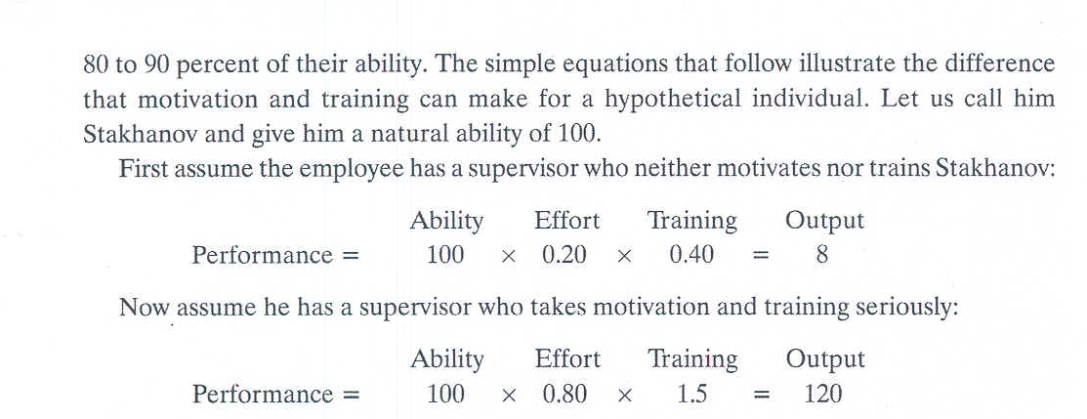
II. Leader as Motivator
Administrators have two principal ways to elicit better performance from people:
  Motivation
  Training

Slide 33
Classical Perspective on Management
Pioneers: Taylor, Fayol and Weber
This perspective gave managers fundamental new skills for establishing high productivity and effective treatment of employees.

Slide 34

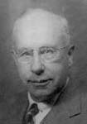
Humanistic Perspective
Pioneers: Mary P. Follett
Chester Barnard
Two subfield of the humanistic perspective:
  The human relations approach
    Hawthorne Studies
  The human resources approach
    Maslow: Hierarchy of Needs
    McGregor: Theory X & Y
    Herzberg: Two-Factor Theory

Slide 35
Human Relations Approach: Hawthorne Studies
Mayo found a significant factor affecting organizational activity was NOT physical conditions or monetary rewards, but interpersonal relations developed on the job.
The theory was this: improving interpersonal relations leads to increased productivity.

Slide 36
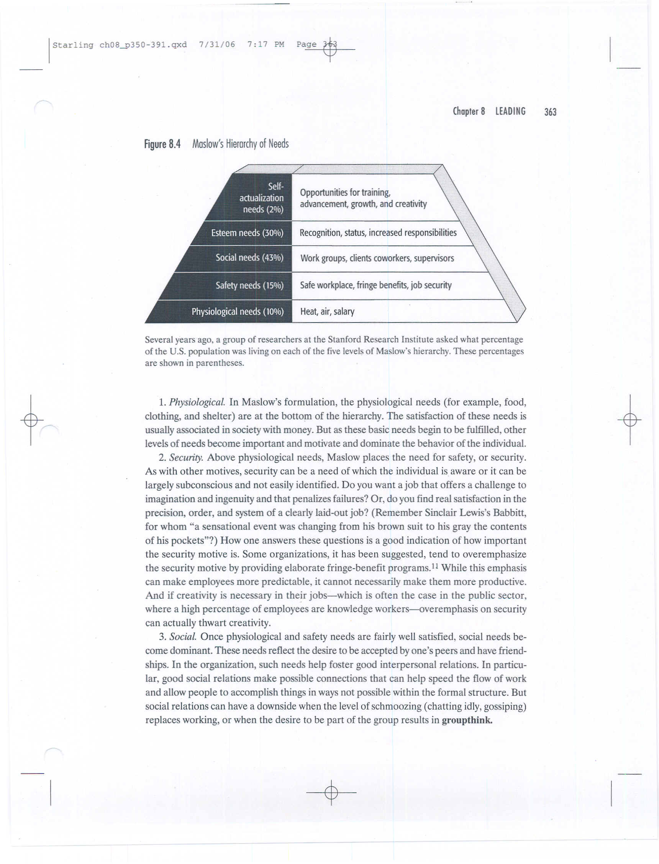
Human Resources Approach:
Maslow’s Hierarchy of Needs
According to Maslow, an individual’s behavior at a particular moment is usually determined by his strongest need.

Slide 37
Significance of Maslow’s Theory
Different people require different treatment by management.
The same person, over time, may require different treatment.
Management should never expect a cessation of complaints (没有抱怨）but rather should expect different ones.

Slide 38
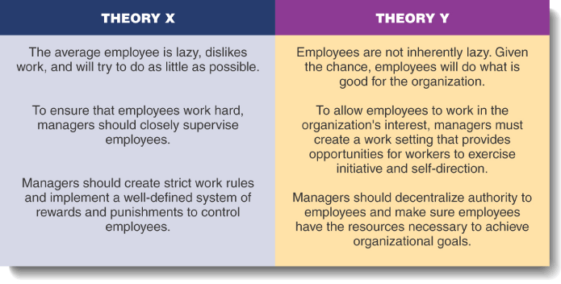
Human Resources Approach:
Douglas McGregor: Theory X & Y
Theory Y: Bottom line: Managers can benefit greatly by giving more attention to the social and self actualizing needs of people.

Slide 39
Frederick Herzberg’s Two-Factor Theory
Highly Satisfied
Area of Satisfaction
Motivators
Achievement
Recognition
Responsibility
Work itself
Personal growth
Intrinsic factors influence level of satisfaction
Neither Satisfied nor Dissatisfied 没有满意/
没有不满意
Area of Dissatisfaction
Hygiene
Factors
Working conditions
Pay and security
Company policies
Supervisors
Interpersonal
relationships
Extrinsic factors influence level
of dissatisfaction
Highly Dissatisfied

Slide 40
Satisfiers and Dis-satisfiers
(justice vs. equity)
Eliminating dissatisfiers will reduce employee dissatisfaction but will not motivate workers to high achievement levels.
Recognition, challenge, and opportunities for personal growth are powerful motivators and will promote high satisfaction and performance
Managers role: to remove the dissatisfiers and then use the five motivators to meet higher-level needs and propel employees toward greater achievement and satisfaction.

Slide 41
III. Leadership Communication
Leadership cannot happen without effective communication.
Communication can be defined 定义 as the process by which information and ideas travel from A to B and are then understood by B.
Communication is not just sending information, because A often intends to motivate or influence the behavior of B.
Once B perceives what A is trying to communicate, A has successfully communicated with B.

Slide 42
The Process Of Communication
Noise
Receiver decodes & interprets
Sender encodes & sends
Media/
Channels
Feedback

Slide 43
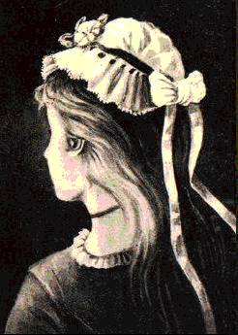
Different Lenses: What Do You See?

Slide 44
Difficult to Establish Common Meanings
Unintentionally ambiguous
Intentionally “strategic ambiguous” when:
  People face multiple and conflicting goals
  Conditions are unpredictable and likely to change
  Relationships are tenuous 脆弱的
  Elite positions are threatened

Slide 45
Interpersonal Communication
Oral Communication
  Advantages: Speed and feedback.
  Disadvantage: Distortion of the message.
Nonverbal Communication
  Spoken words (7%) , voice(38%), facial expressions (55%)
  Advantages: Supports other communications and provides observable expression of emotions and feelings.
  Disadvantage: Misperception of body language or gestures can influence receiver’s interpretation of message.

Slide 46
Written Communication
  Advantages: Tangible and verifiable.
  Disadvantages: Time consuming and lacks feedbacks

Slide 47
Basic Communication Skills Profile
______________________________________________
Communication Order Learned Extent Used Extent Taught
____________________________________________
Listening First First Fourth
Speaking Second Second Third
Reading Third Third Second
Writing Fourth Fourth First

Slide 48
Using Gobbledygook（官方语言）
The use of language characterized by circumlocution迂回表达 and jargon术语, which is usually hard to understand.
Why do administrators engage in gobbledygook?
  Avoid unpleasantness
  Dress up mundane thoughts and make them sound more impressive.

