Slide 1

Public Administration and Management
SUFE SPEA
Instructor: WANG, Feng

Slide 2
Week 14
Implementing

Slide 3
Chapter 7
IMPLEMENTATION
“There is nothing more difficult to take in hand,
more perilous to conduct, or more uncertain in
its success, than to take the lead in the introduction
of a new order of things.”
-Machiavelli 马基雅维利

Slide 4
Traditional Management Functions
Planning –goals & objectives
  Where the organization wants to go and how it is going to get there.
Decision Making- alternative strategies for attaining the objectives.
  Process of identifying problems and opportunities, generating alternatives, and selecting an alternative.
Organizing- structures and roles
  Assignment of tasks (“these are the things we must do”)
  & the grouping of tasks into organizational units (depts, offices)
Leading- motivating and interpersonal skills
  The use of influence to lead and motivate civil servants to achieve program objectives.
Implementing
  Monitoring and adjusting of the agency employees’ activities to ensure that the program remains on track toward its objectives.

Slide 5
Overview
Three views on implementation
Strategic consideration
  Who will run the program?
  How will the program operate?
Tactical considerations

Slide 6
I. Three Perspectives on Implementation
The Complexity of Joint Action
A System of Games
A Process to Be Managed

Slide 7
The Complexity of Joint Action
PA is the realm of uncertainty, chance, differing priorities, conflicting values, confusion, exhaustion, and distrust (Pressman and Wildavsky, 1973).
Government programs -- even when designed to be carried out in a direct and simple matter -- involve multiple participants.
Participants can agree on the ends of a program and still opposed the means for effecting those ends because they have multiple perspectives.
Pessimistic （悲观的）.

Slide 8
Implementation as a System of Games
Eugene Bardach’s metaphor of “games”
Focus on players, their stakes, strategies, resources, rules of play, etc.
Implementation is a process of assembling the elements required to produce a particular programmatic outcome and the playing out of a number of loosely interrelated games whereby these elements are withheld from or delivered to the program.

Slide 9
Implementation as a Process to Be Managed
Implementation is a complex process and involves many participants, perspectives, and games; but in the final analysis, it is a process that can be managed.
Strategic consideration 战略考虑
  1. Who will run the program? (e.g. Which agency? Which level of government?)
  2. How will the program operate? (e.g. Should efficiency or effectiveness be emphasized? Should coercive methods be employed?)
Tactical consideration 战术考虑

Slide 10
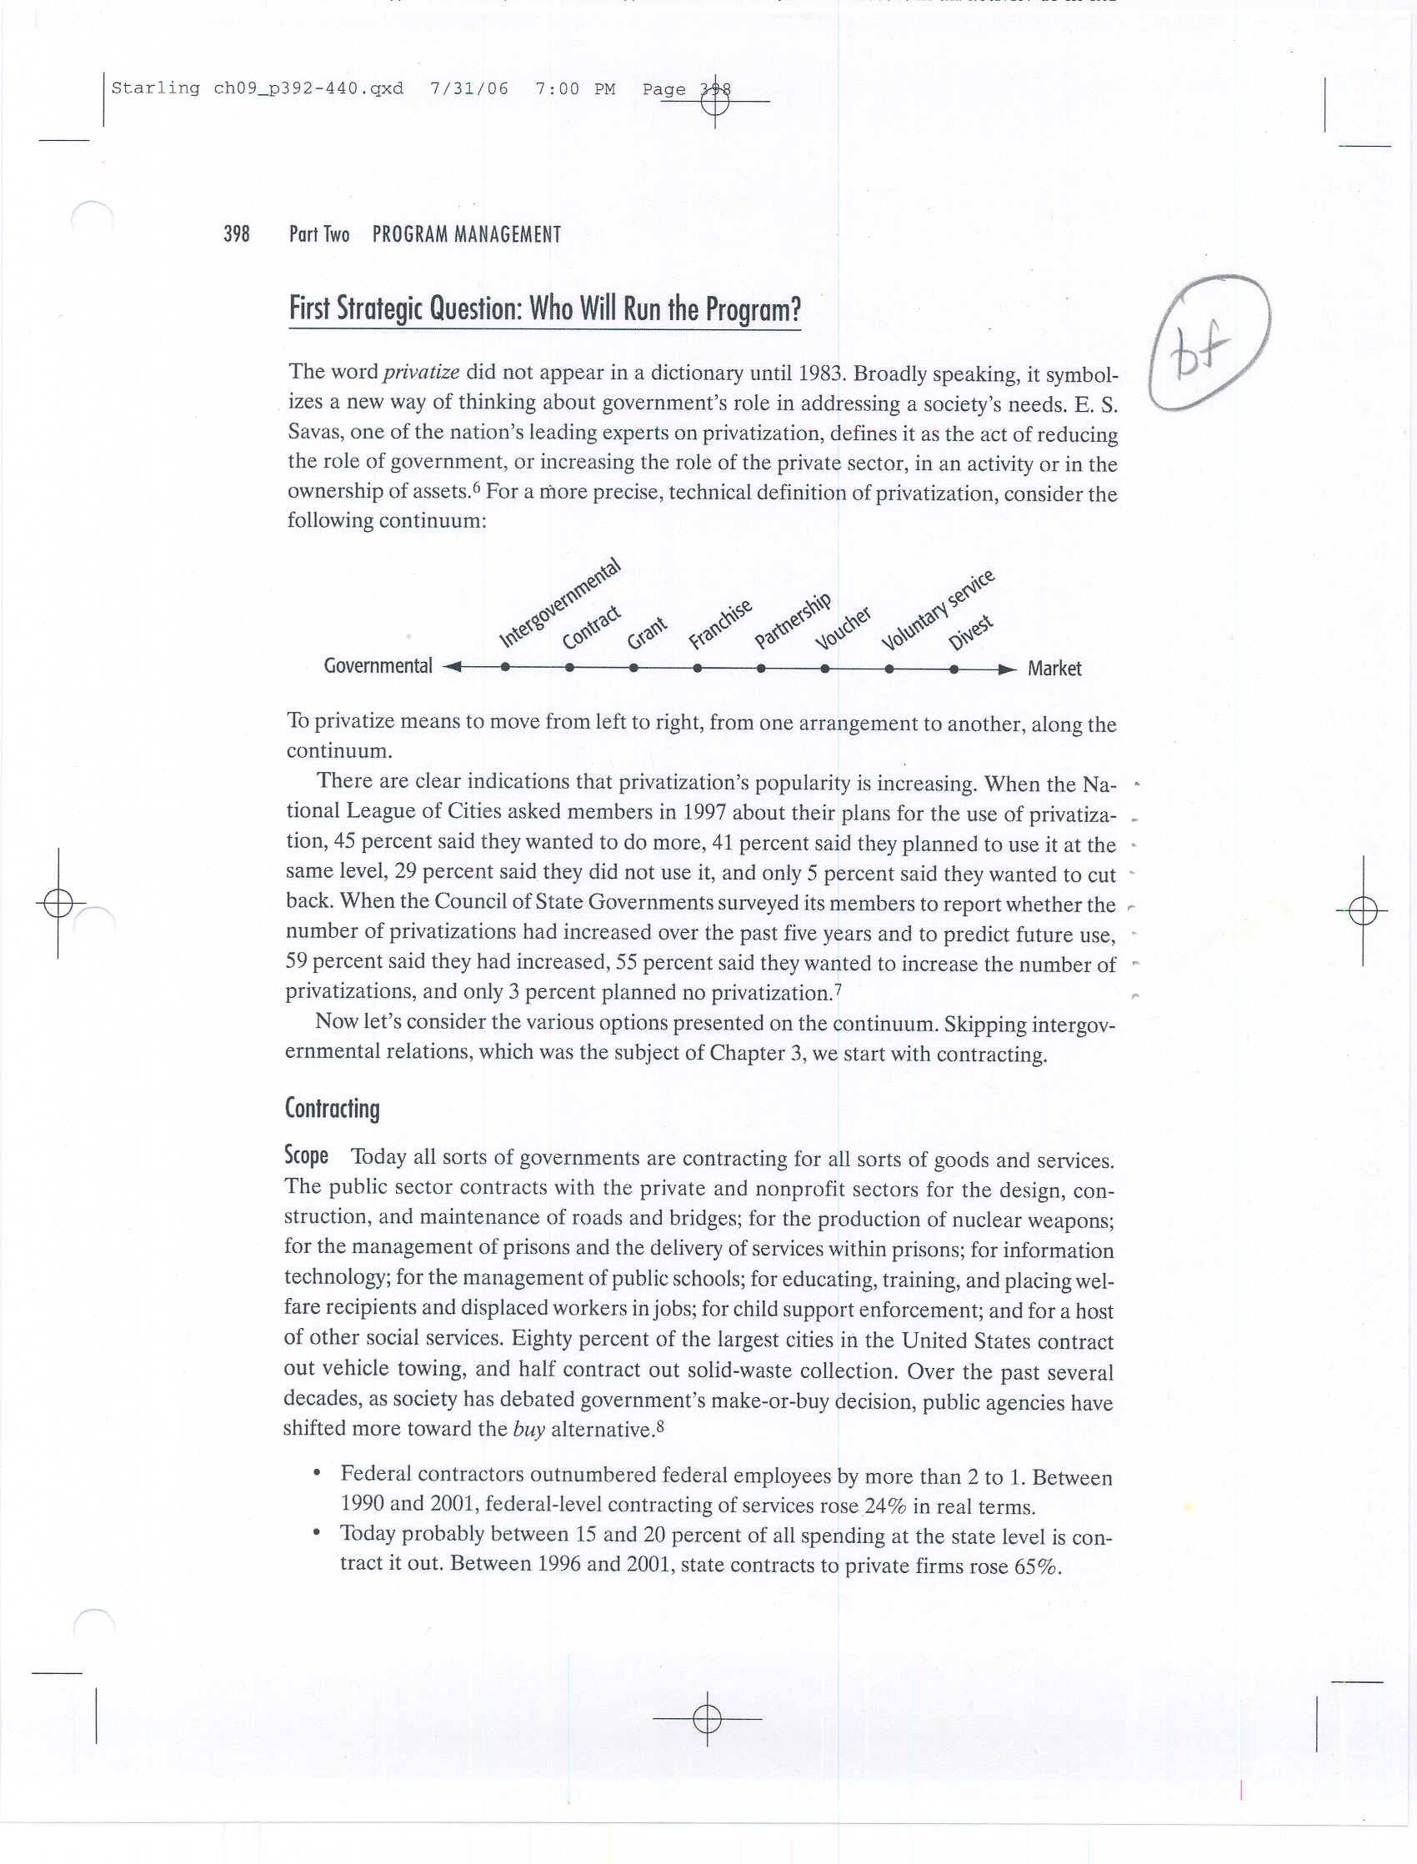
II-1. Who Will Run the Program?

Slide 11
Privatization
Privatize: included in dictionary in 1983.
A new way to consider government’s role in addressing a society’s needs.
Privatization is the act of reducing the role of government, or increasing the role of the private sector, in an activity or in the ownership of assets (E.Savas).

Slide 12
Expanding service provision

Slide 13
Decreasing capacity of government in delivering services (quantitative side)

Slide 14
Common Methods
Contracting 合同外包
Grant 补贴
Franchise 特许经营
Public-private partnership (PPP)
Voucher 凭单
14

Slide 15
Contracting
It dominates in China and the US because it “typically allows much greater involvement in the design and oversight of production by the public agency”.
Advantages
  Greater efficiency (not always the case)
  Free public administration from routine details.
  May increase flexibility.

Slide 16
Contracting
Disadvantages
  Harder to define the role and function of public sector
  Costs may actually rise (monitoring cost)
  The lack of human resources to monitor the contractors, esp. technical staff.
  The shadow of government (the actual size)
  Collusion among bidders (corruption)
  Some activities seem inappropriate for the private sector.

Slide 17
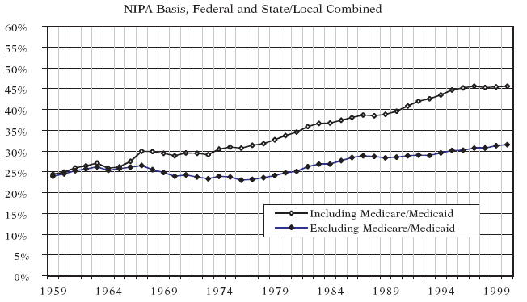
Aggregate Level of Outsourcing in the US (1959-2000)
Minicucci and Donahue (2004)
17

Slide 18
Aggregate Level of Outsourcing in China 2001-2004
Jing (2008)
18

Slide 19
The Process of Contracting
Two laws govern contracting in the U.S. federal government:
  Federal Property and Administrative Services Act of 1949
  Armed Forces Procurement Act of 1947.
Federal Acquisition Regulation (FAR) establishes two basic methods of obtaining “full and open competition”:
  Sealed bidding
  Competitive negotiation

Slide 20
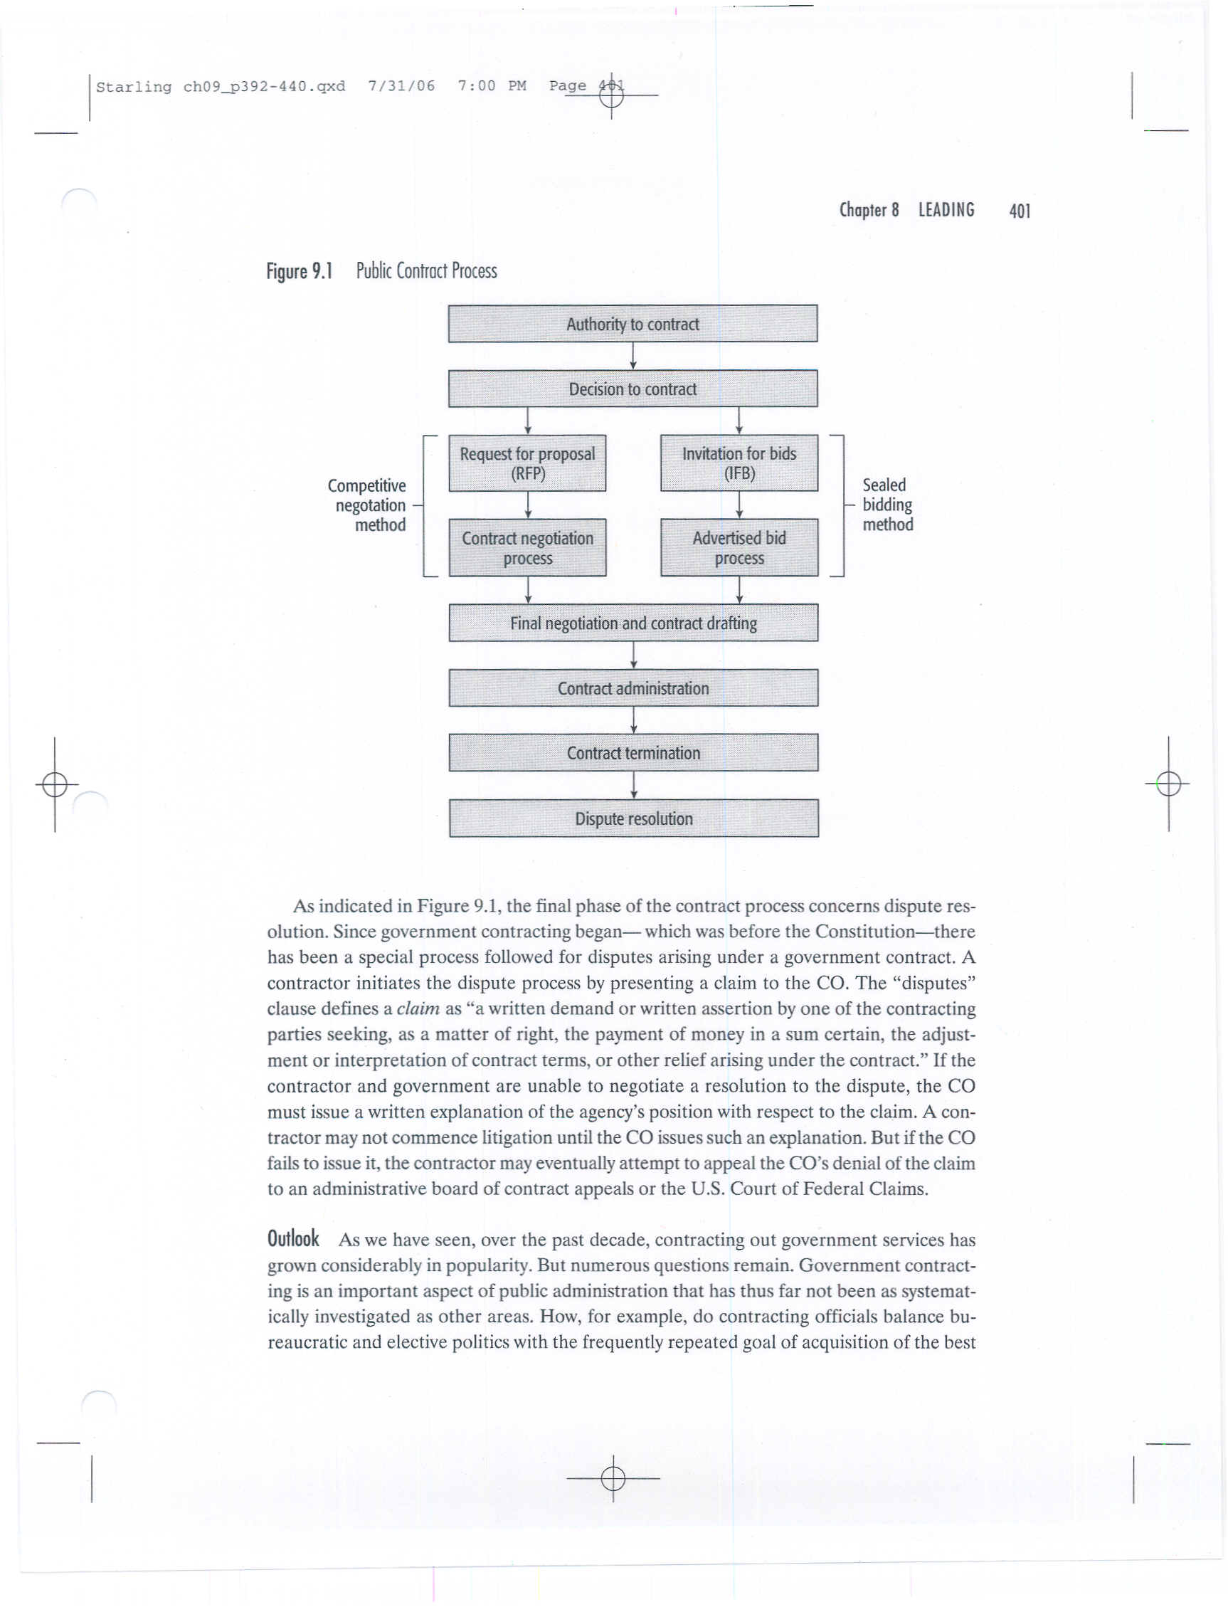
Public Contract Process

Slide 21
Sealed Bidding招标
Characterized by rigid adherence to formal procedures.
Aims to provide all bidders an opportunity to compete for contract on equal footing.
Sealed bids are solicited when four conditions are met:
  1. Time permits.
  2. Award will be made on the basis of price.
  3. No need to discuss with the responding offerors about their bids.
  4. Reasonable expectation of receiving more than one sealed bid.
  Note: If one of these four conditions is missing, the contract officer will award the contract using competitive negotiation.

Slide 22
Competitive Negotiation
Unlike sealed bidding, the contracting officer (CO) may engage in discussions with offerors and, in evaluating proposals, CO may also consider non-cost factors such as managerial experience, technical approach, and past performance.
The negotiating process begins when the CO issues a Request for Proposals (RFP).

Slide 23
Grants（补助）
The grant arrangement involves the gov’t subsidizing firms’ production, creating a profit opportunity by lowering the firms’ costs of production.
Two major examples:
  Wage subsidies to encourage hiring of disadvantaged workers.
  Capital subsidies to encourage plant locations in economically distressed areas.

Slide 24
Franchises（特许经营）
Government designates a private firm as the supplier (but does not pay the producer for it), and consumers purchase the good or service with some price regulation.
Exclusive franchises:
  Utilities (electricity, water, gas), telephone, toll roads, etc.
  Bus transportation
Nonexclusive franchises:
  Taxis

Slide 25
Partnerships
Both sectors share risks and responsibilities in order to meet critical community needs as defined by the partners.
Growing collaboration on econ. development projects, in larger cities.
Attractive because the private sector has three things government needs:
  resources
  knowledge
  public support

Slide 26
Vouchers （凭单）
Government subsidizes customers and permits them to exercise relatively free choice in the marketplace.
E.g. education voucher

Slide 27
Voluntary Service
Voluntary associations perform a host of human services that governments are either unwilling or unable to perform.
New Public Service: A growing number of community groups and block associations work to improve the quality of life in their neighborhoods, plugging gaps in the services of city and country bureaucracy.

Slide 28
Divestiture 政府撤资: Selling Public Assets
Sell the enterprise or asset to a private buyer
Issuing and selling shares to the public
Selling the enterprise to the managers or to employees
Selling the enterprise or assets to its users or its customer
Joint venture（合资）

Slide 29
II-2. How Will the Program Operate?
Case Management
Total Quality Management
Compliance (合规) Management

Slide 30
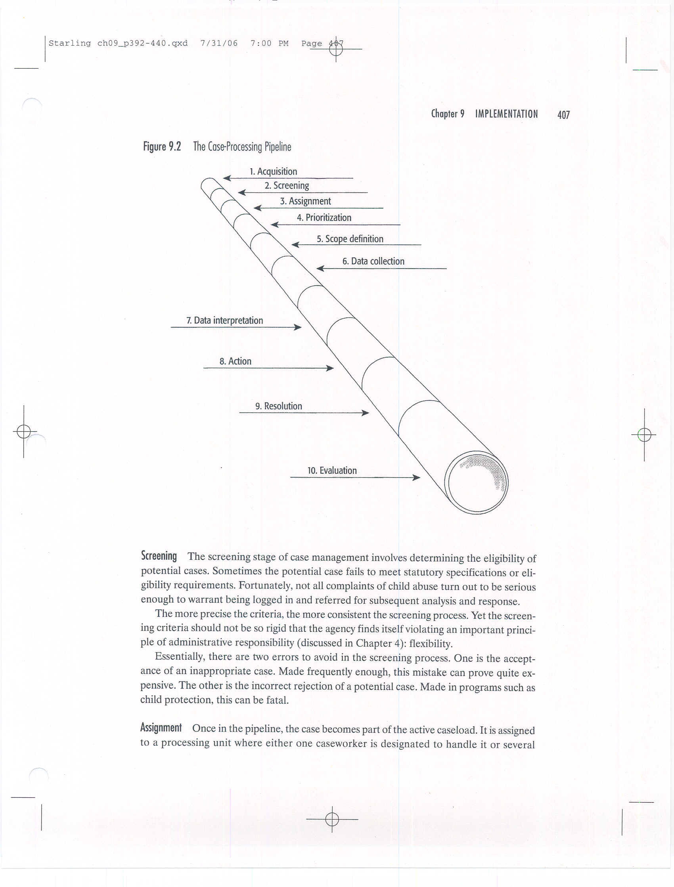
Case Management—
Case Processing Pipeline

Slide 31
Stage 1: Acquisition 获取
Will applicants themselves bring their request to the pipeline or will agency itself seek cases?
Will it involve only agency staff or will it depend on other agencies for referral?

Slide 32
Stage 2: Screening
The screening stage of case management involves determining the eligibility of potential cases.
There are two errors to avoid in the screening process:
  Acceptance of an inappropriate case.
  Incorrect rejection of a potential case.

Slide 33
Stage 3: Assignment
Once in the pipeline, the case becomes part of the active caseload.
It is assigned to a processing unit where either one caseworker is designated to handle it or several caseworkers from a pool may handle parts of it.

Slide 34
Case Management: Stages 4-9
4. Prioritization: Caseworker (investigator, inspector, hearing officer, social worker, attorney, etc) must decide on case’s urgency.
5. Scope definition: For example, in a child protection case, a common question is whether to include the entire family are just the child.
6. Data collection: gather information to help the caseworker decide how to handle the case, such as issue subpoenas (传票）, administer test, conduct interviews, etc
7. Data interpretation: Review and analysis of materials collected in stage 6.
8. Action: In a social services agency, this stage involves a service or treatment plan designed to achieve some benefit for client (clear guidelines is important for caseworkers).
9. Resolution: Case no longer considered active.

Slide 35
Stage 10: Evaluation
Processing time can be measured in at least two way: throughput time (period) and direct handling time (total time).
Management should set appropriate quality standards.
Benchmarking 标杆 involves either making comparisons to similar programs elsewhere or finding the best practices that lead to superior performance in other organizations and using them.

Slide 36
Total Quality Management (TQM)
TQM is a management approach that strives to achieve continuous improvement of quality through organization-wide efforts based on facts and data.
From Japan, private sector: the critical success factor is quality
Out of Crisis (E. Deming):
  Improve quality→ Costs decrease (because of less rework, fewer mistakes, fewer delays and snags, and better use of time and materials) → Productivity improves→ Better quality and lower costs→ Citizen satisfaction

Slide 37
TQM in the Public Sector
How to define the critical factors for a government agency?
–Find the most important aspects of the service from the customer’s view by:
  Informal consultation
  Existing data on complaints
  Customers survey
  Examinations of the critical success factors of similar orgs
  A walk through the system as a customer
Central theme—providers (not inspectors) are responsible for the proof of quality; employees (not managers) are responsible for achieving standards of quality (acceptable level or continuous improvement?)

Slide 38
Core Elements of
Compliance Management
Regulatory function
  A clear focus on results (not output/productivity)
  Adoption of a problem-solving approach
  Investment in collaborative partnerships
Question: how to deal with infant formula problem?

Slide 39
III. Tactical Considerations
Knowing the details vs. micromanagement
Management by walking around
Scheduling models
Other concepts

Slide 40
Distinguishing between Micromanagement and Management by Exception
Micromanagement: Top managers who very closely manage trivial issues, but neglect the overarching organizational goals.
A more effective approach is to manage by exception. These managers concentrate primarily on:
  setting the agenda, tone, and framework;
  laying out principles by which the organization operates;
  delegating much of the process to the staff;
  deciding only issues—whether large or small—that have the potential to affect the mission.

Slide 41
Management by Walking Around (MBWA)
Common problem: Some managers rely too much on formal reporting to tell them “how things are going.”
The solution: Get out of the office and walk around to really see how well their program or employees function.

Slide 42
Scheduling Models
Scheduling models facilitate the coordination of activities of an enterprise and help put resources to better use.
Program Evaluation Review Technique (PERT): Forces careful planning, permits experimentation, encourages participation in the planning process, permits effective control, etc.
  Events
  Activities
  Critical path: the longest possible time span along the system flow plan.

Slide 43
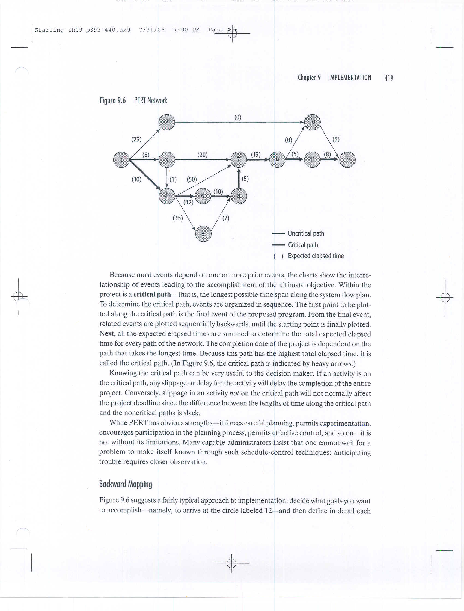
PERT Network

Slide 44
Other Implementation Techniques
Use of an expediter 稽查员: employed to ensure that others have the materials and equipment needed to accomplish their tasks; to coordinate and accelerate the flow of information among the program’s participants.
Follow-up: Administrators must constantly check to see if their orders are being carried out.
Incentive mechanisms: The administrator should strive to build incentives into a program--carrots and sticks.
Participative decision making: organizing a committee of “appropriate people.” People who must participate in the implementation phase have participated in the policymaking phase.

